Slide 1
VO standards supported by the Chinese Astronomical Data Center
Chenzhou Cui, Boliang He
(National Astronomical Observatory of China)
Jian Xiao
(Tianjin University)

Slide 2
Contents
A brief background
Chinese Astronomical Data Center (CAsDC)
  LAMOST pilot sky survey
  The South Galactic Cap U-band Sky Survey (SCUSS)
Conclusion

Slide 3


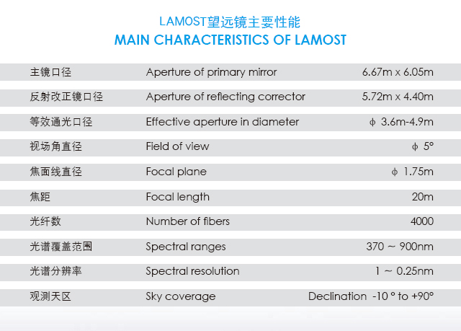
Large Sky Area Multi-Object Fiber Spectroscopy Telescope (LAMOST)
LAMOST was completed in 2008, and is now in the commission period.

Slide 4

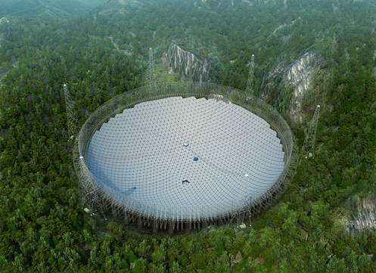
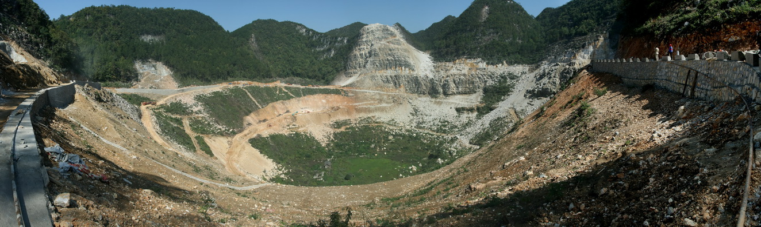
Five-hundred-meter Aperture Spherical Telescope - FAST
Three outstanding aspects
Unique Karst depression as the site
Active main reflector
Cable - parallel robot feed support
FAST sciences
Neutral Hydrogen line (HI) survey
Pulsar research
Joining VLBI network
Molecular lines
Search for Extraterrestrial Intelligence (SETI)

Slide 5
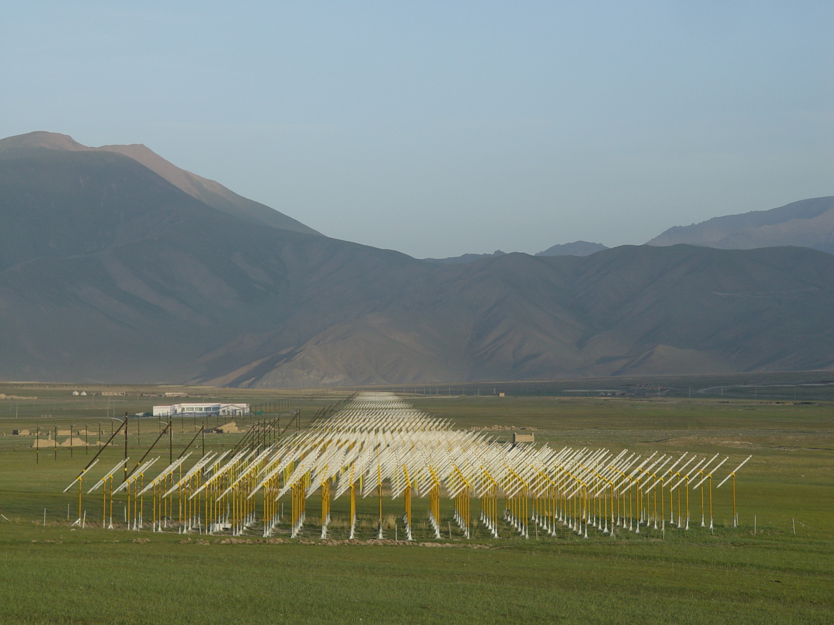
21 Centimeter Array (21CMA)
10287 antennas along two perpendicular arms (6 km + 4 km)
Physical Area: 50544 m²
G o a l : Search for the Lights of First Stars at Epoch of Reionization
Radio Detection of τ Neutrinos

Slide 6
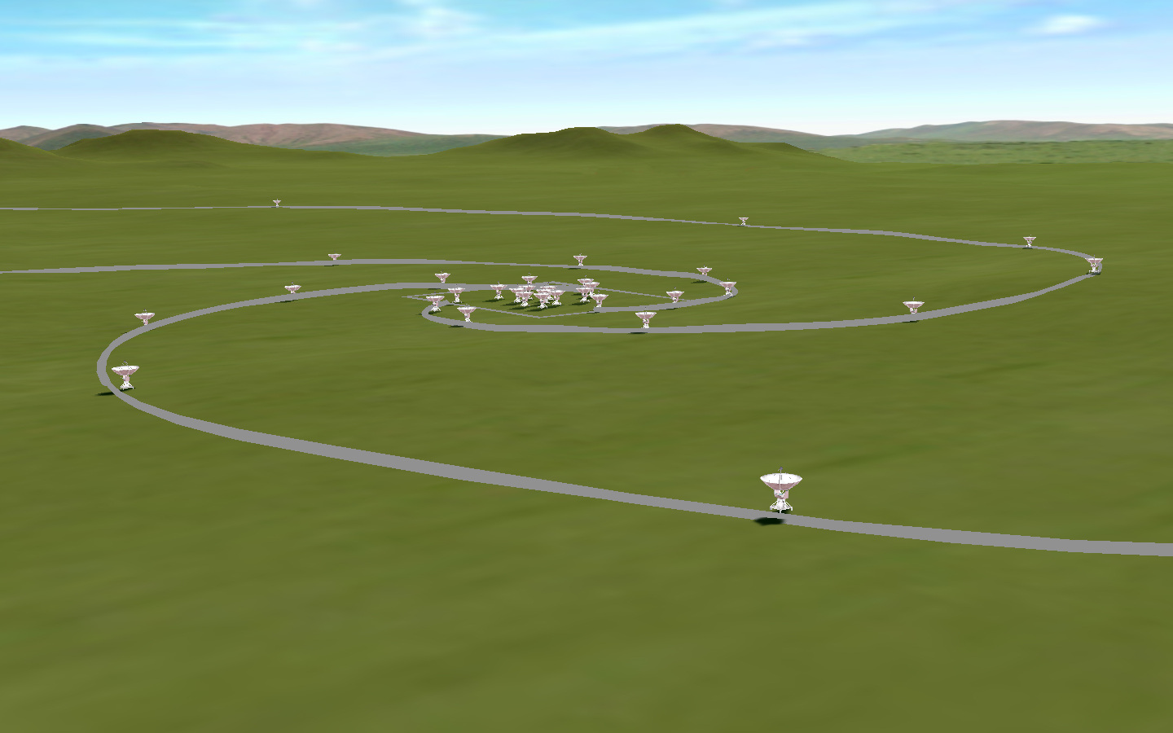
Chinese Spectral Radioheliograph (CSRH) a new instrument capable of true imaging spectroscopy, with high temporal, spatial, and spectral resolution
Specifications
Freq Range 0.4–15 GHz
Spatial Res. 1.3”– 50”
Array 40⋅4.5m＋ 60⋅2m
Max baseline 3 km
Field of view 0.6°– 7°
Site: Inner Mongolia
6

Slide 7
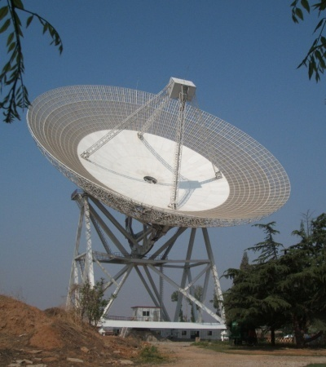
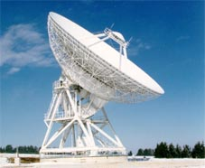
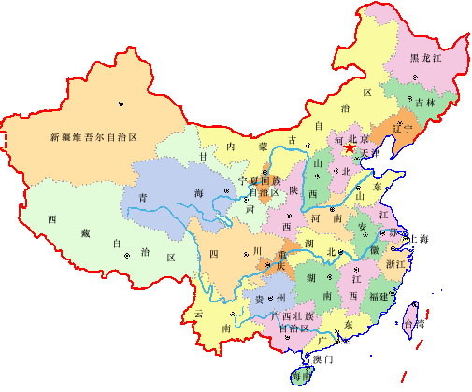
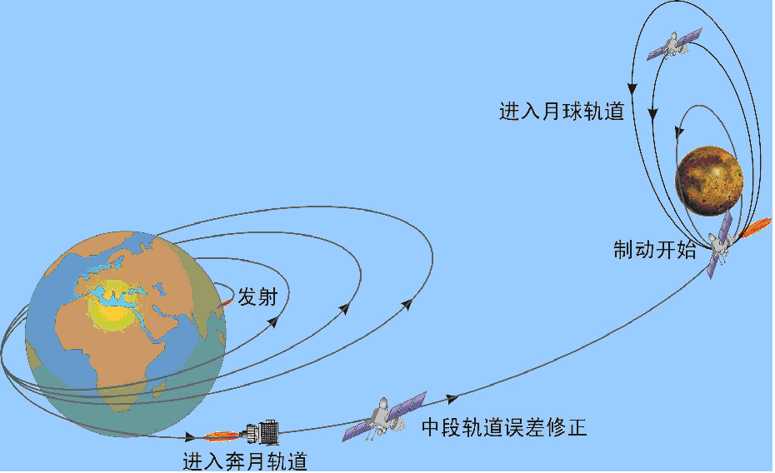
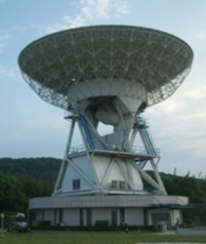
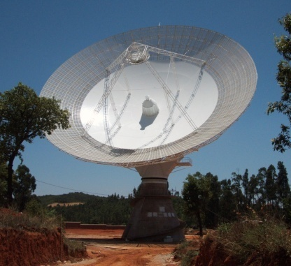

Chinese VLBI Network (CVN) Project
1
VLBI: Navigation of the Chinese Lunar Project ‘Chang E-1’
VLBI测轨系统：完成“嫦娥”1号的测轨任务
50m,Beijing
25m, Urumqi
25m，Shanghai
40m,Kunming
65m，Shanghai

Slide 8
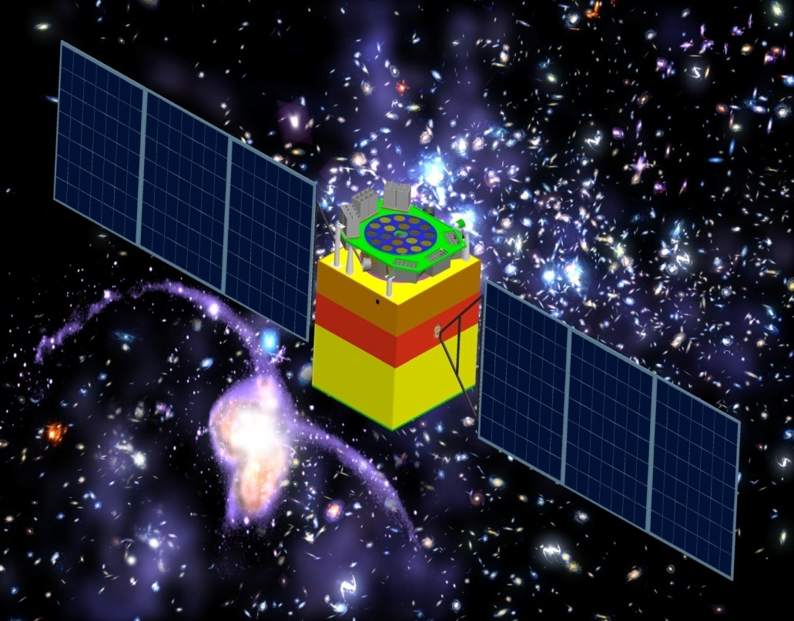
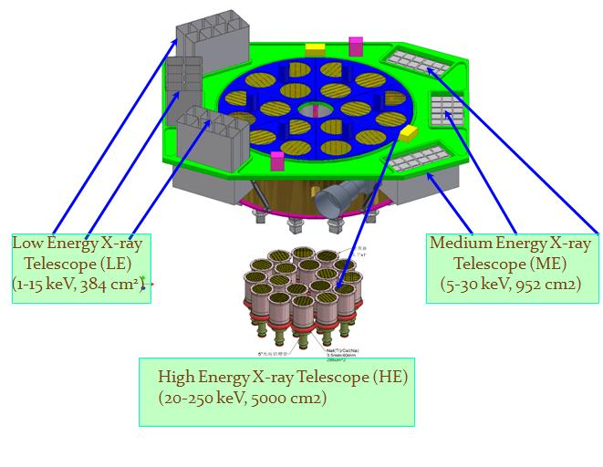
Hard X-ray Modulation Telescope (HXMT)
HXMT will perform a broad band (1-250 keV) X-ray all-sky survey and make pointed observations of X-ray sources to study their spectroscopic and multi-band temporal properties

Slide 9


Space-based multi-band astronomical Variable Object Monitor (SVOM)
Multi-λGRB project
China's contribution to Scientific Payload
GRM: two soft gamma-ray (50keV-5MeV ) spectrophotometers
VT: one 45cm-diameter optical telescope
Designed to detect about 80 GRBs of all known types per year, including those at very high redshifts
a Sino-French space mission scheduled to be launched in 2014

Slide 10
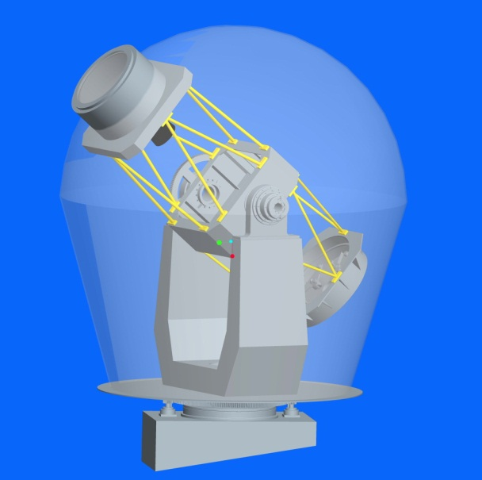
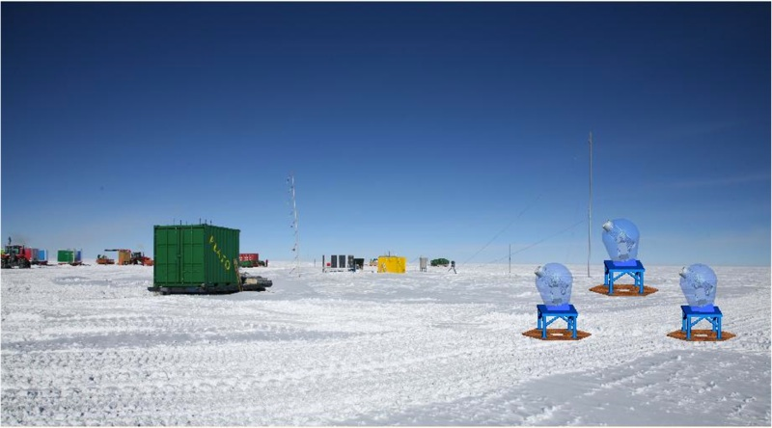
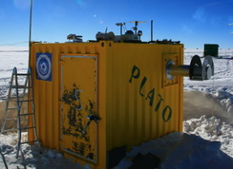
Antactic Survey Telescope x 3 (AST3)
Plan to install one in 2011
Power supplied by PLATO-A (UNSW)
Instruments
Engines

Slide 11


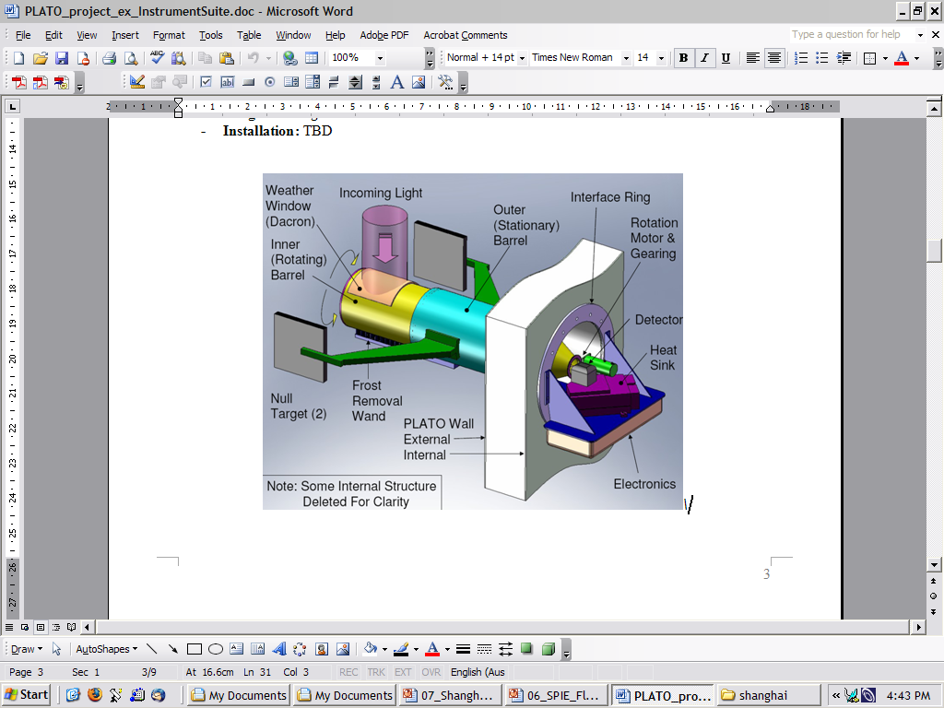
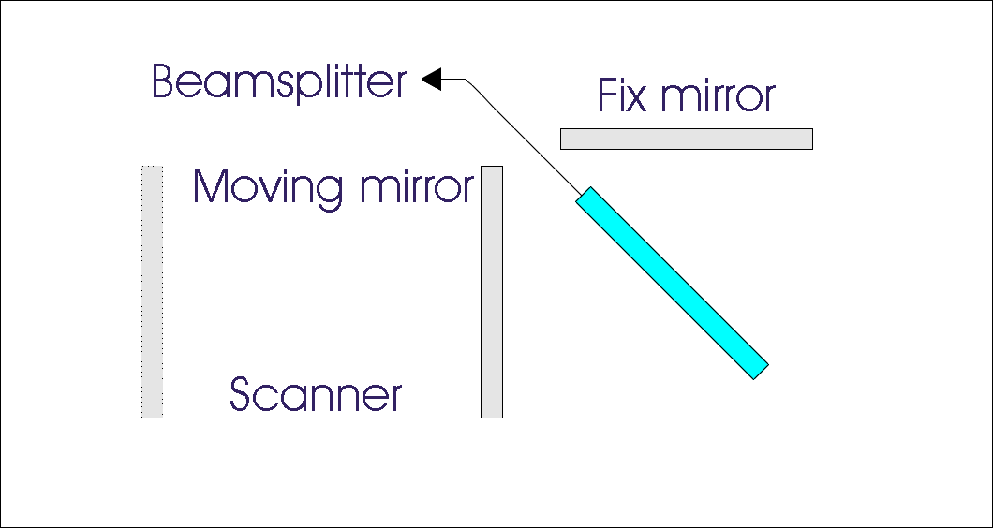

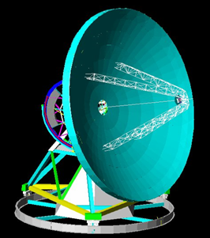
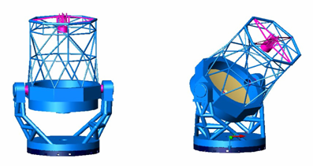
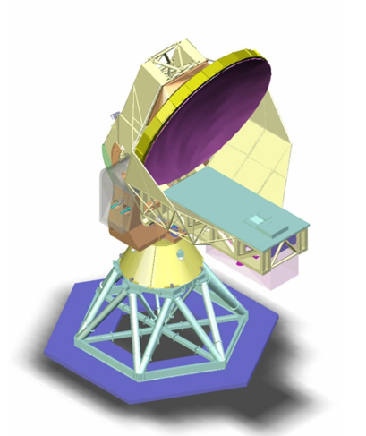
CSTAR
Pre-HEAT
HEAT
PLATO
2009 -
2009
Incident Beam
AST3
FTS
Detector
5m THz Telescope
15m THz Telescope
4m IR/Optical telescope with large FOV
Ultimate
FIR Interferometer!
8-10m IR/Optical Telescope
Notes:
11

Slide 12

World Class Facilities (2)
TMT

Slide 13



Slide 14
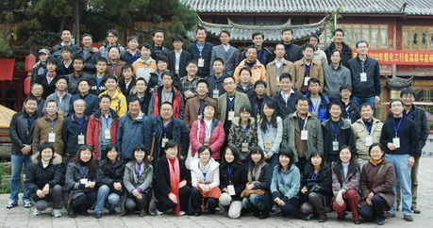
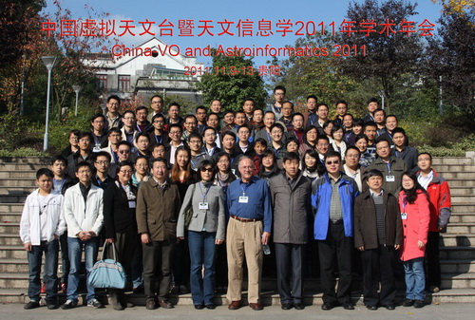
China-VO
Chinese Virtual Observatory (China-VO) is the national VO project in China initiated in 2002 by Chinese astronomical community leading by National Astronomical Observatories, Chinese Academy of Sciences.
China-VO became a member of the IVOA with the recommendation of Dr. Jim Gray
Annual China-VO workshop organized since 2001

Slide 15
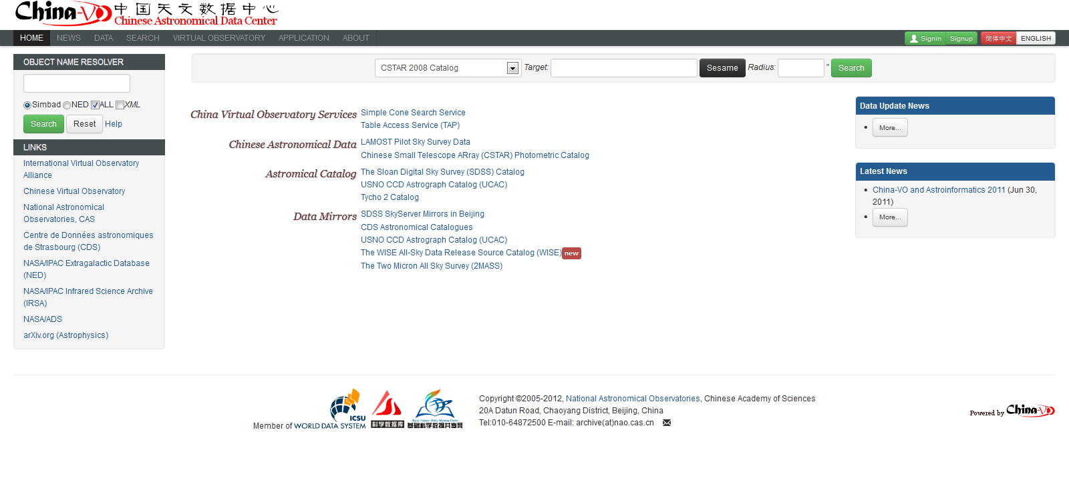
Chinese Astronomical Data Center (CAsDC)

Slide 16
Database Factsheet
Collections
  ~600,000 LAMOST Pilot Spectra
  ~2,000,000,000 CSTAR photometric records
  35,599,543 SCUSS Catalog
  SDSS DR8 (BestDR8)
  Others (UCAC3, WISE, etc)
Database
  PostgreSQL 9.1.x + pgSphere
Web Visualization
  VOTable Search Result -> Aladin Plot
  Image Fits -> Aladin Plot

Slide 17
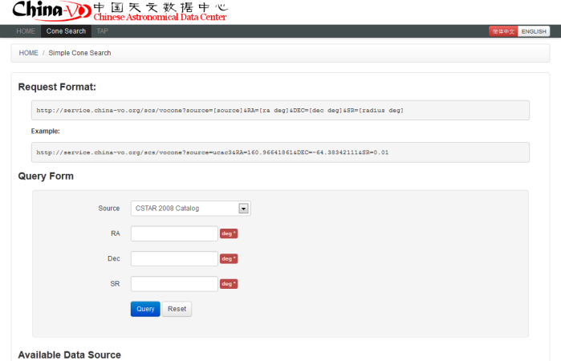
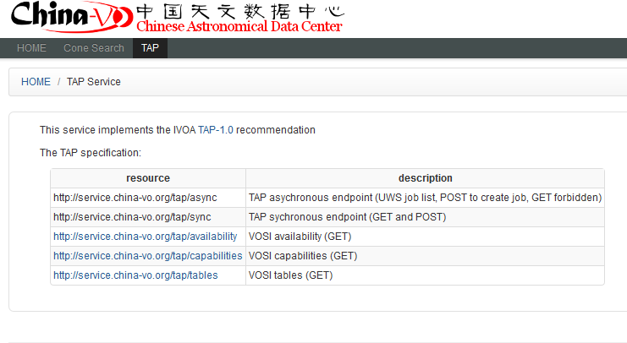
VO Standards supported
VOTable
Simple Cone Search
  http://service.china-vo.org/scs/
TAP Service
  http://service.china-vo.org/tap/
Aladin embedded
Search on lists/SQL
User space

Slide 18
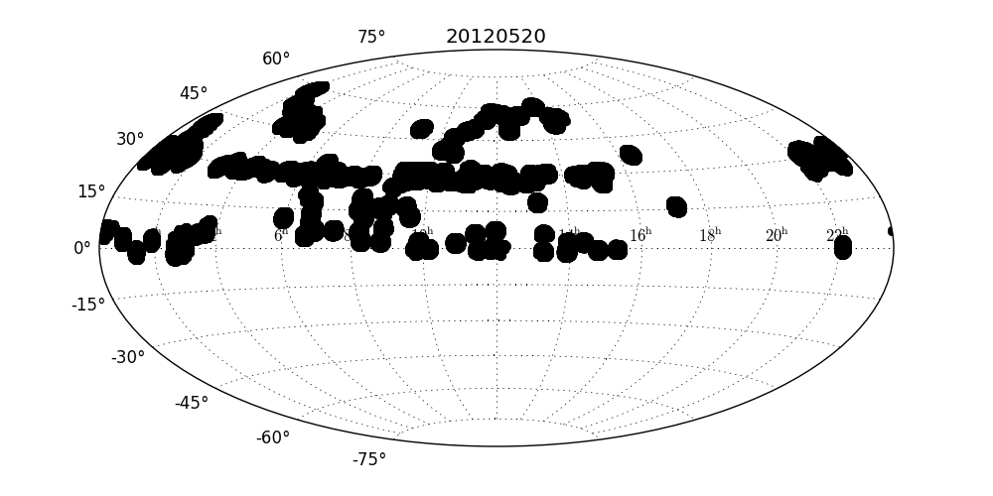
LAMOST Pilot
From 2011-10 to now 2012-4
Plan: 302, Run: 309, archived: 478,699 (+ low SN <160,000)
Spectra Catalog 478,699

Slide 19
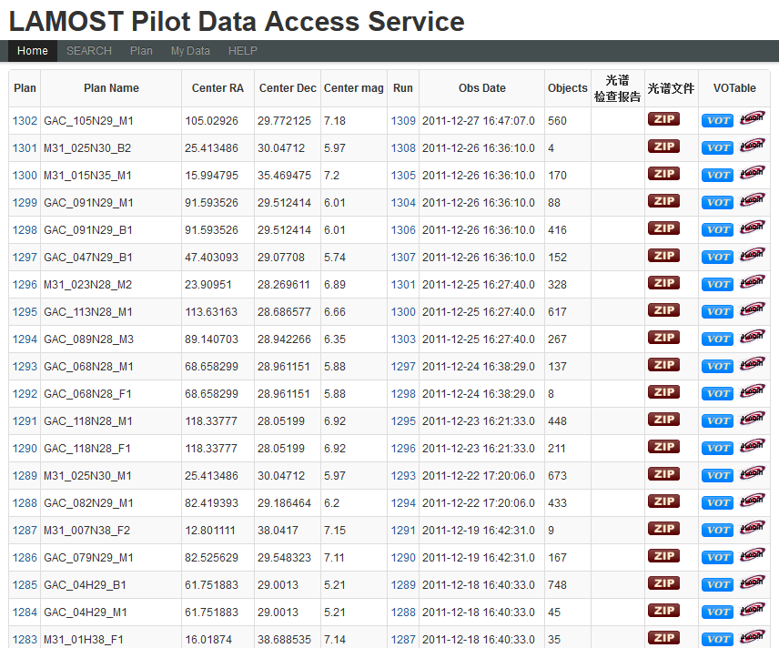
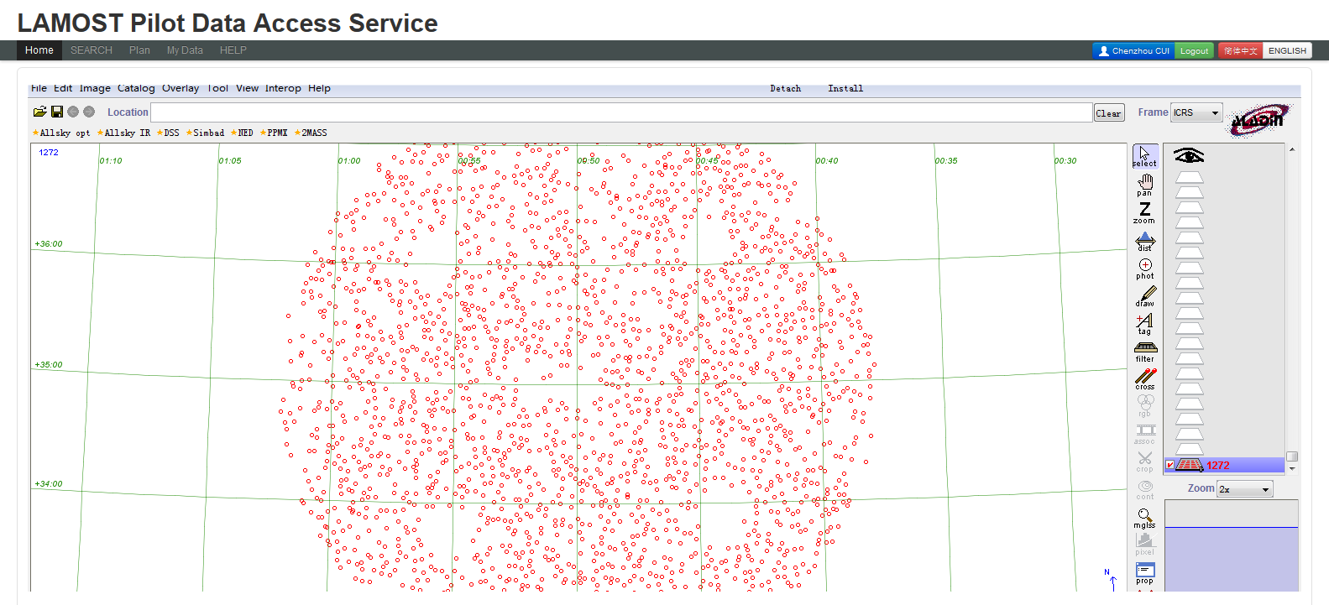

Slide 20
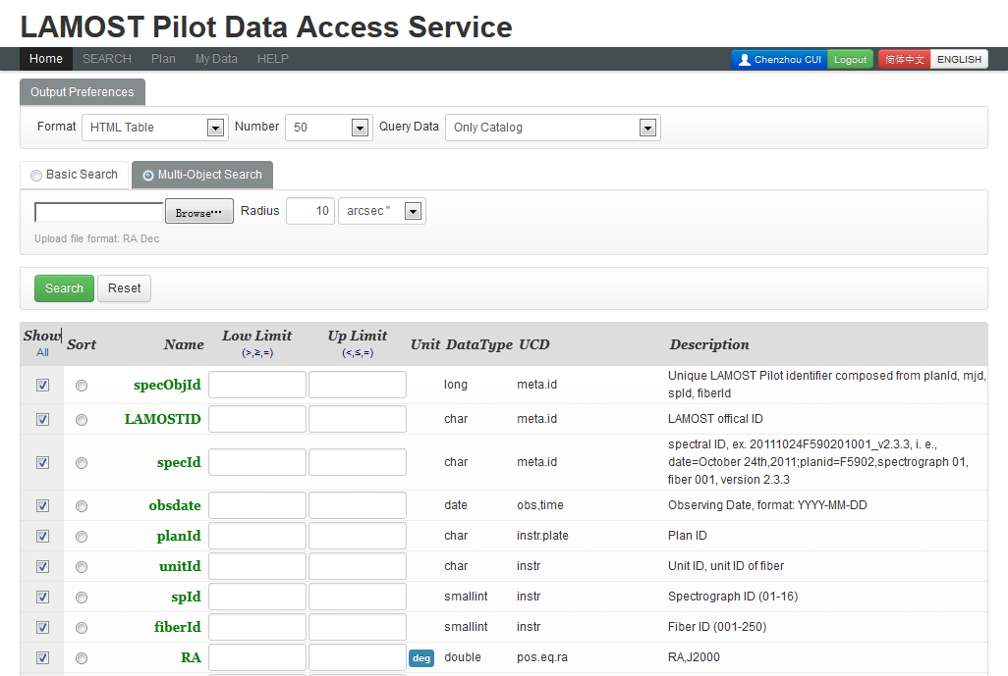
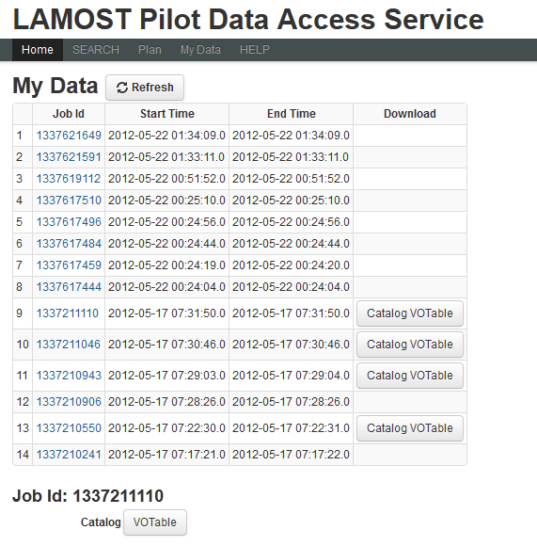

Slide 21
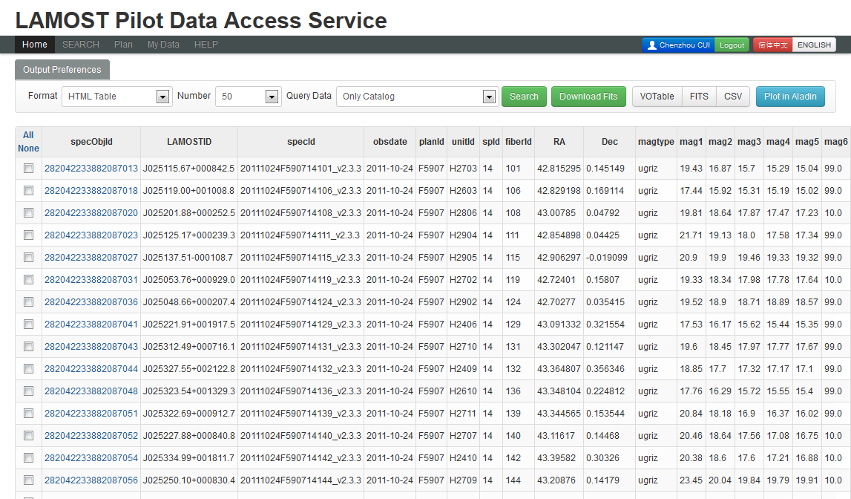
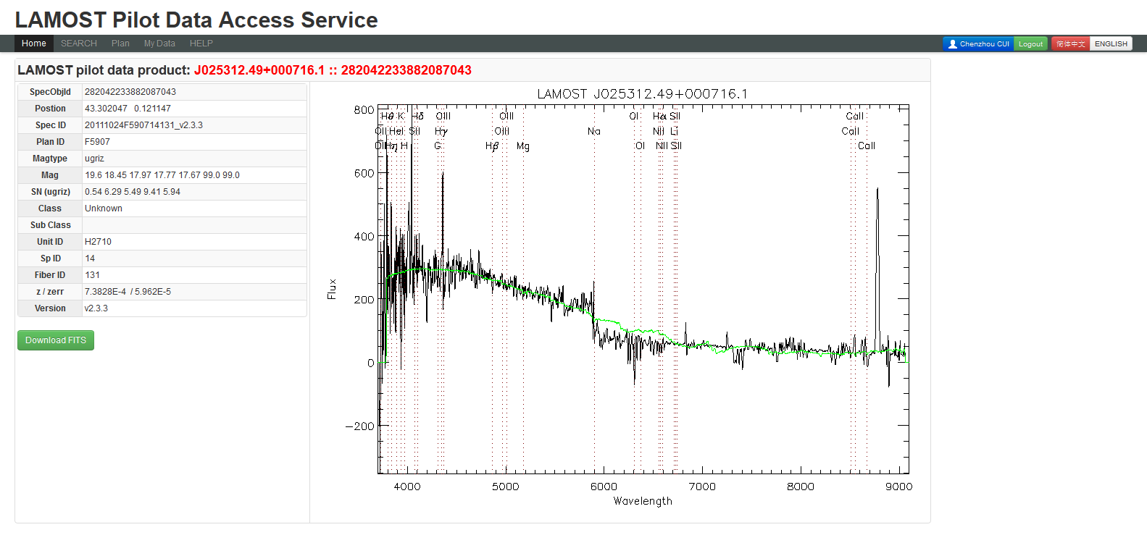

Slide 22
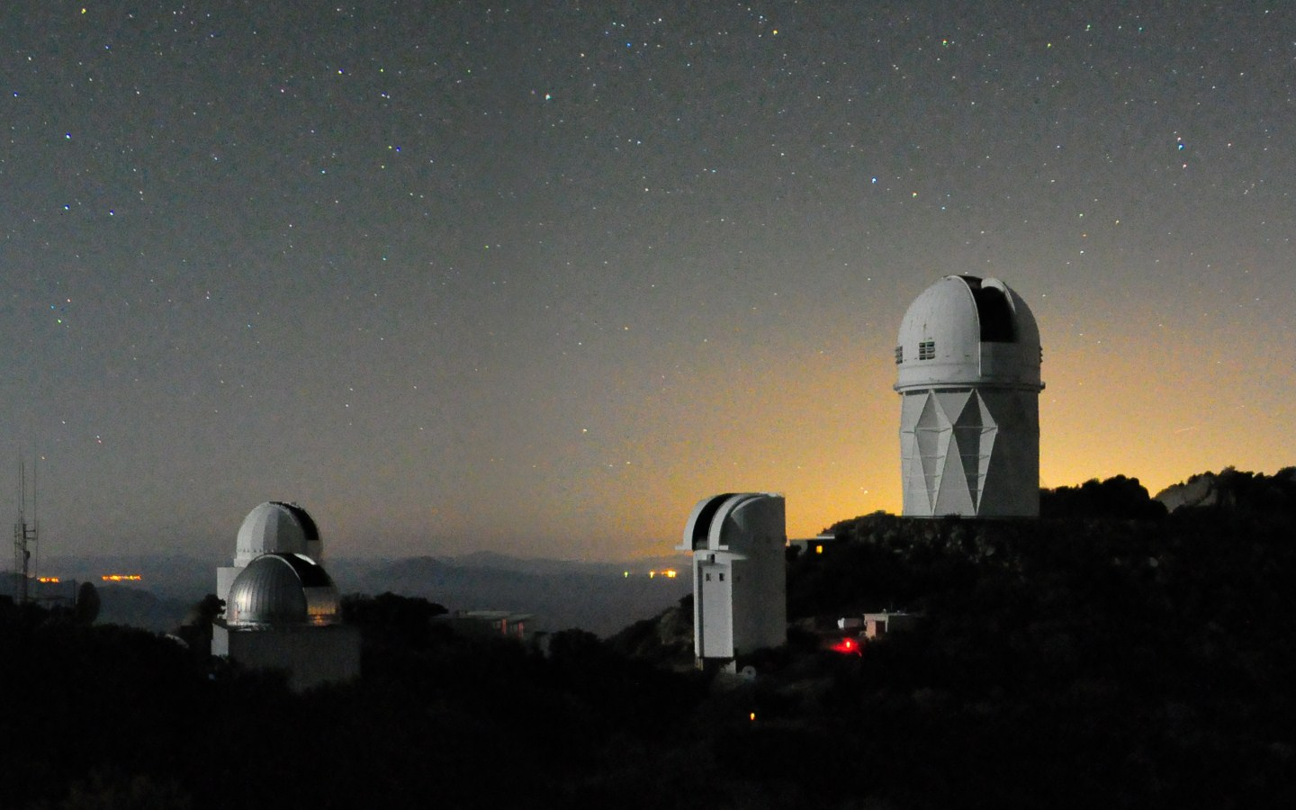

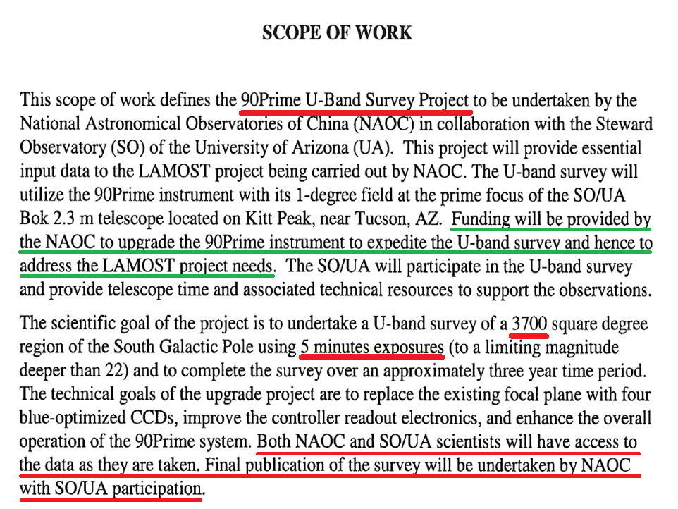
2.3M BOK Telescope of Steward observatory on Kitt Peak

Slide 23
SCUSS Data Release
Field: 1454
Catalog: 35,599,543
Catalog Search
  Web Form Search
  SQL Search
Image Search and Aladin Plot

Slide 24
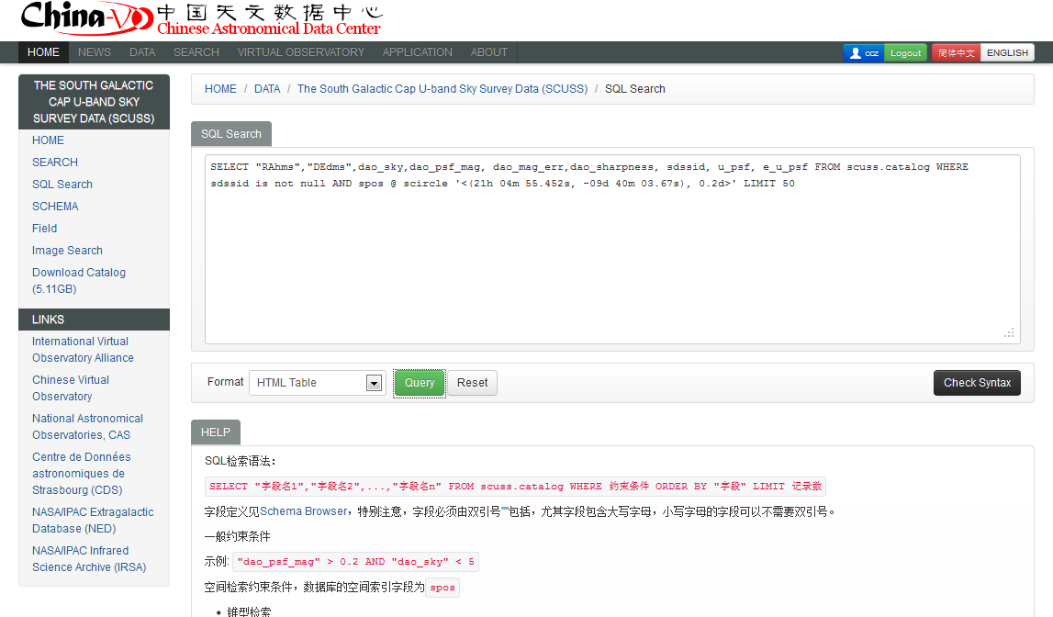
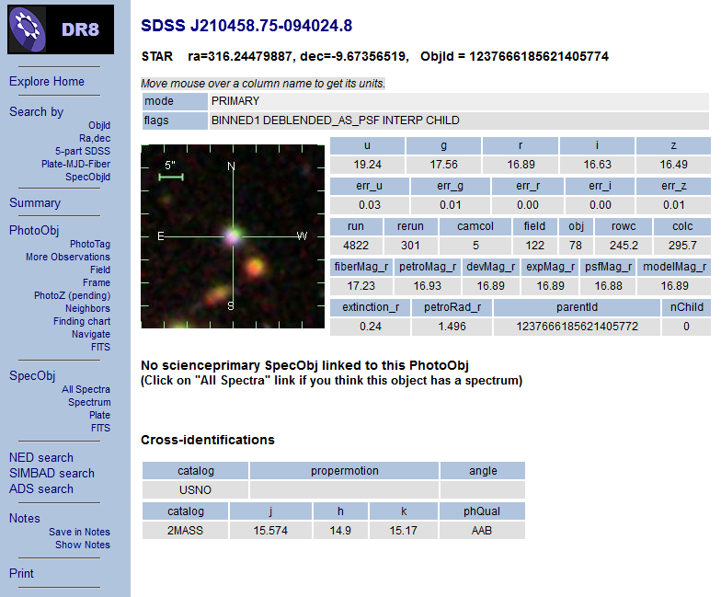
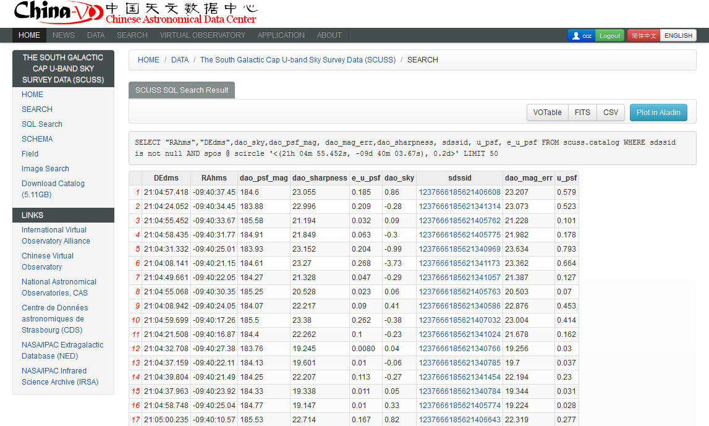

Slide 25
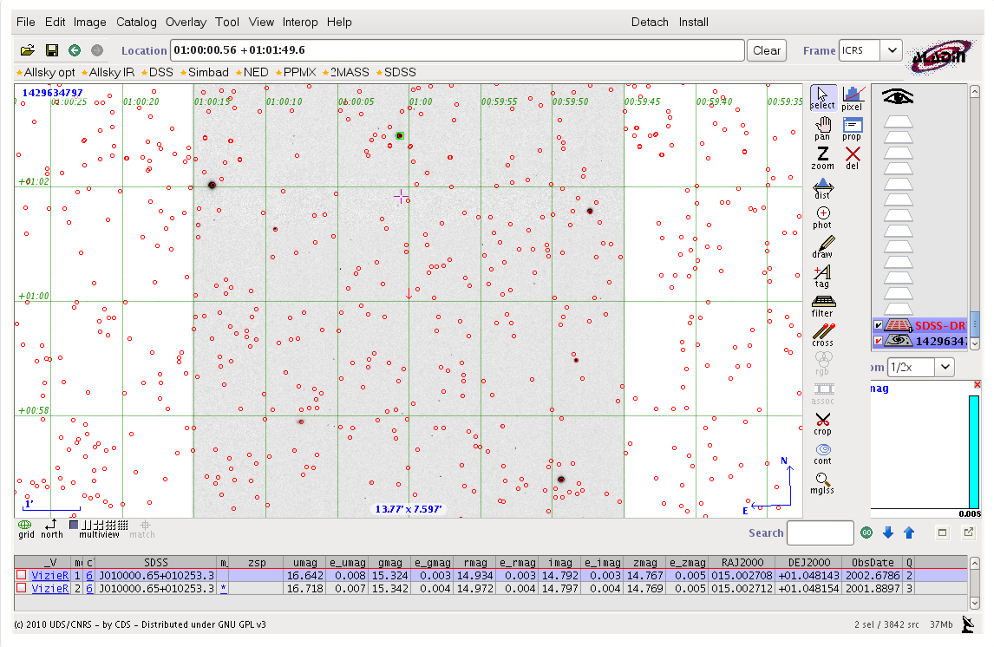
SCUSS Image Visualization In Aladin

Slide 26
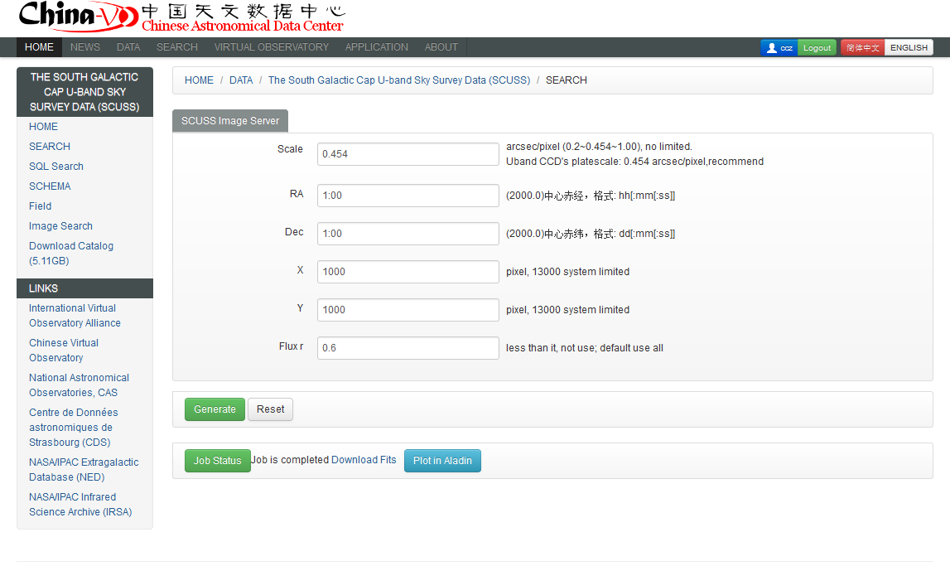
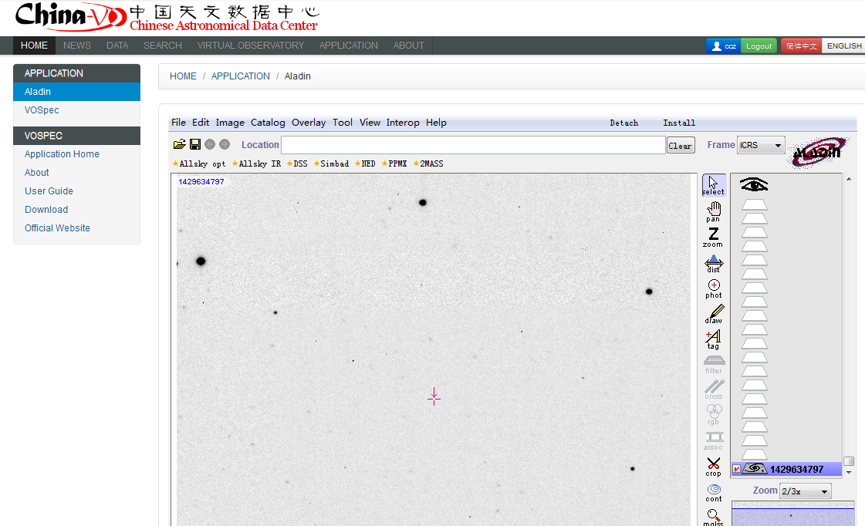

Slide 27
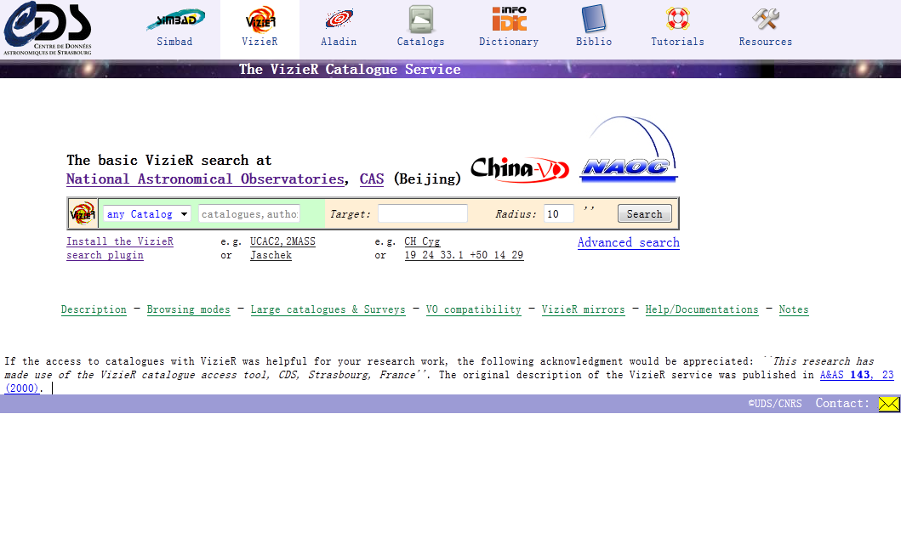
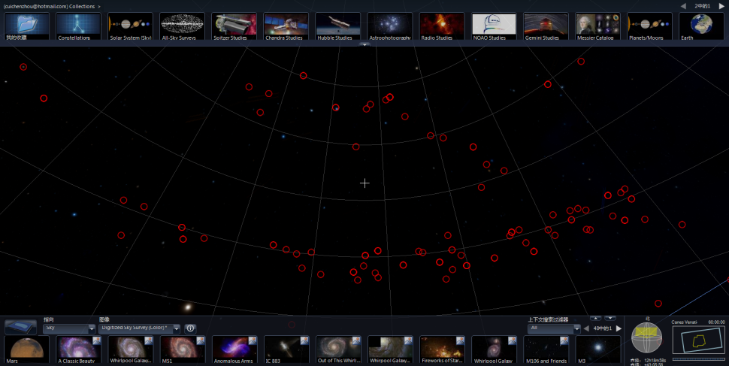
Plans in the near future
Register these services to the IVOA registry
Data federation with Vizier mirror in Beijing
SSA for LAMOST pilot sky survey
SIA for SCUSS/CSTAR images
WWT Interfaces

Slide 28



Active Community Involvement
IVOA
  IVOA and VO are very important for us!
World Data System (WDS)
CODATA
  Data at Risk Task Group
    Chinese astronomical plate digitalization project
Domestic big projects and e-Science community

Slide 29
Thank You

