Slide 1
Visibility Service and Observation Locator: Planning future observations
Jesús Salgado¹ on behalf of Aitor Ibarra¹
Richard Saxton², Jan-Uwe Ness⁴, Erik Kuulkers⁴, Carlos Gabriel⁴, Bruno Merin⁴, Peter Kretschmar⁴,Matthias Ehle⁴, Emilio Salazar³, Celia Sánchez³
^{1 Quasar for ESA}
^{2 TPZ-VEGA for ESA}
^{3 ATG for ESA}
^{4 ESA}

Slide 2
Scientists Require Coordinated Multi-wavelength Observations
Increasing interest to simultaneously observe the same target at different wavelengths. Example use cases:
X-ray binary ToOs
Gaia transients
Optical & radio transients
TDEs, GRBs
GW & neutrino follow-up
Some observatory numbers:
NuSTAR: 30% of the observations are coordinated with other observatories.
XMM-Newton: ~12% coordinated observations (NuSTAR, HST, Chandra, VLT, Swift).
INTEGRAL: ~10% of the observations are coordinated with other observatories.
Chandra has expanded the time available via joint programs.
Middelton et al. 2017

Slide 3
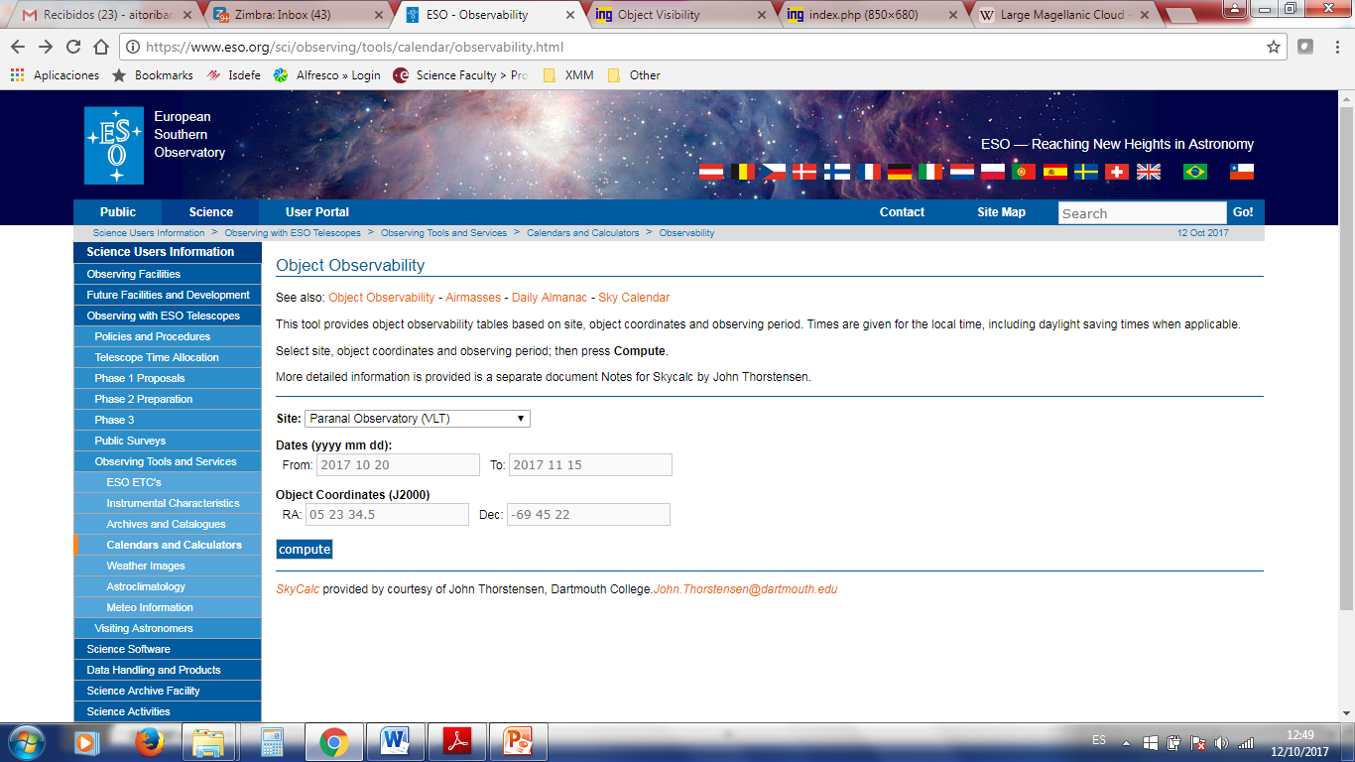
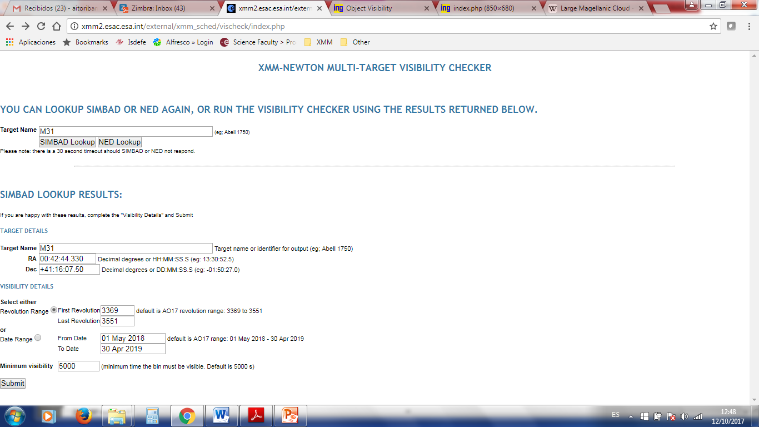
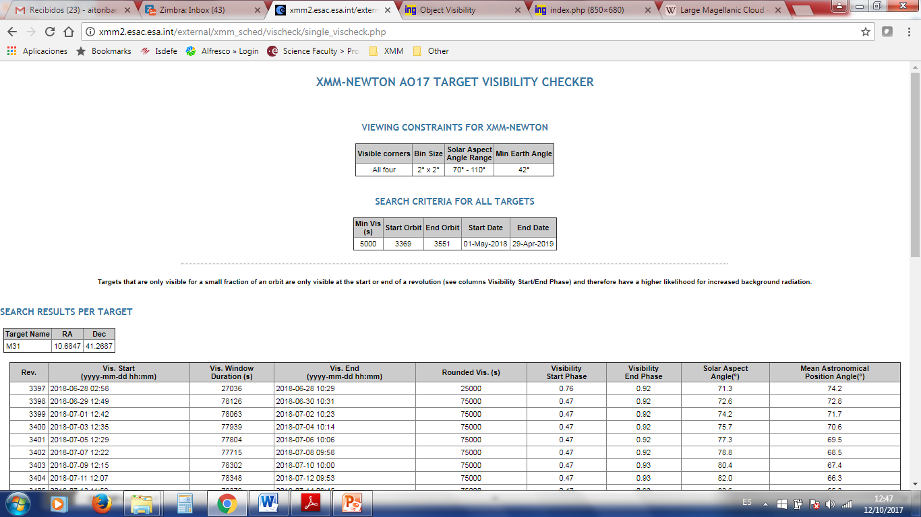
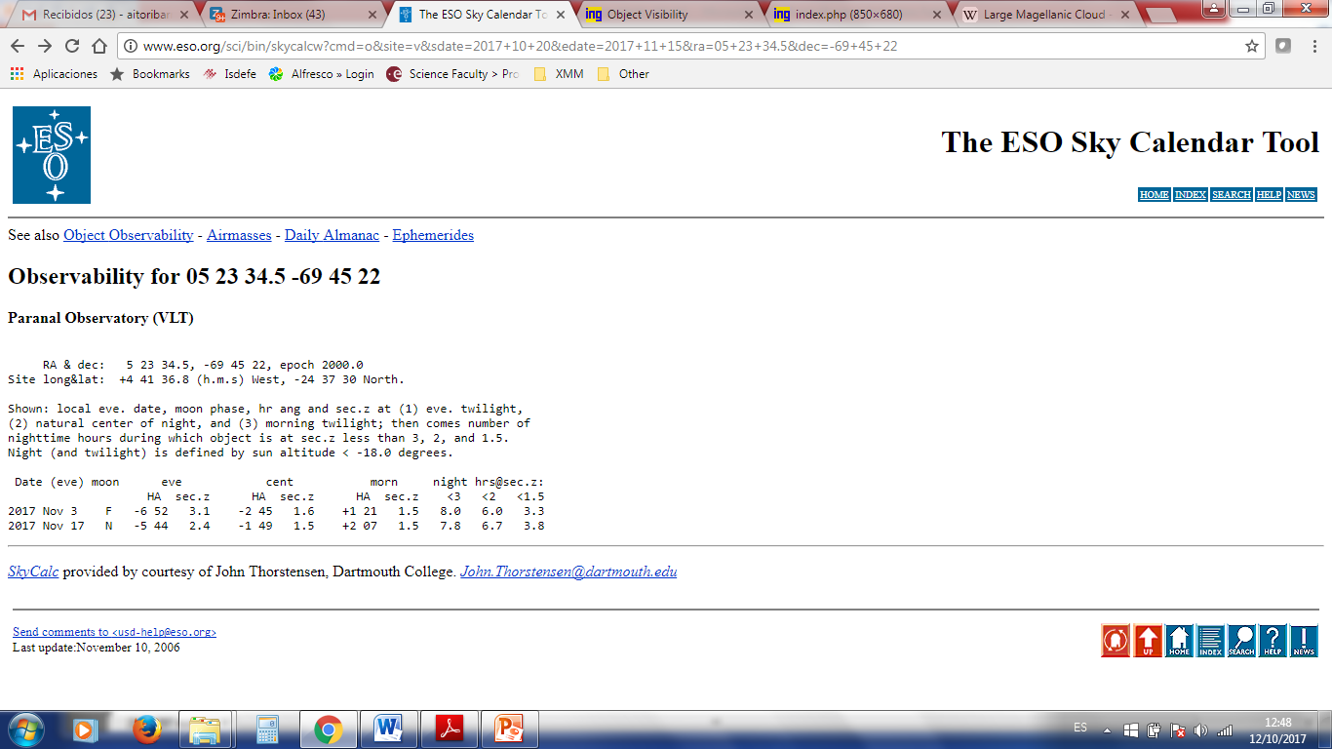
Visibility services

Slide 4
Planned Observations Services

Slide 5
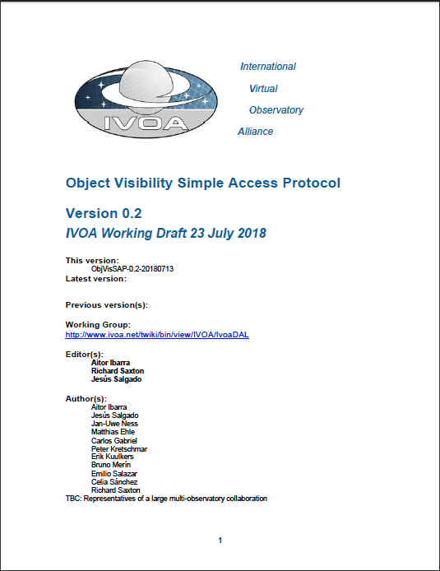
Object Visibility Simple Access Protocol
Initial note modified to create ObjVisSAP v0.2 WD (not big changes)
http://www.ivoa.net/documents/ObjVisSAP/
Properties:
S*AP protocol – different implementation at different observatories (adaptation)
Based on “parameter=value” approach
Basic interface:
Coordinates
Time Range

Slide 6
ObjVisSAP protocol: Input parameters
Compulsory:
RA: Right Ascension - Equatorial J2000
DEC: Declination – Equatorial J2000
START_TIME: Time period start time - UTC Time (IVOA format) or MJD
END_TIME: Time period end time - UTC Time (IVOA format) or MJD
Optional:
MIN_VIS: Minimum visibility check - Double between 0-1 (min/max)
MAX_VIS: Maximum visibility check - Double between 0-1 (min/max)

Slide 7
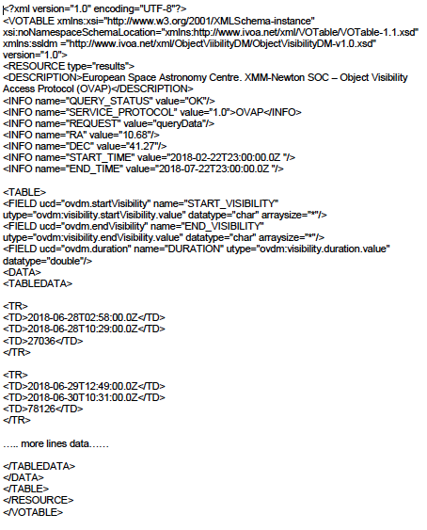
ObjVisSAP protocol: Output
Visibility period start:
UTC Time (IVOA format) or MJD (utype=”ovdm:Visibility.startVisibility.value”)
Visibility period end:
UTC Time (IVOA format) or MJD (utype=”ovdm:Visibility.endVisibility.value”)
Visibility period duration:
seconds (utype=”ovdm:Visibility.duration.value”)

Slide 8
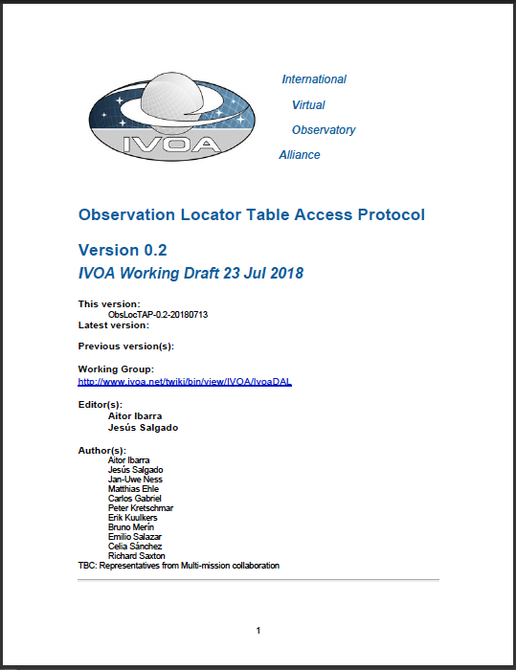
ObsLocTAP: Observation Locator Table Access Protocol
Initial note modified to create ObsLocTAP v0.2 WD
http://www.ivoa.net/documents/ObsLocTAP/
Properties:
TAP protocol – Similar to ObsTAP
Data Model contains:
Observation Characterization
Axes:
Spatial Coverage
Spectral Coverage
Polarization
Observatory provenance

Slide 9
ObsLocTAPUse Case I
Discovery of observations planned for a certain observatory
The observatory receives observatory proposals by the scientists
Proposals are ranked
Proposals are inserted into the observation planning system
Observation planners schedule short-medium plan trying to maximize the relevance of a certain observation period (e.g. per night or orbit revolution) and taking into account the constrains of the observatory (e.g. visibility of the object, geometrical constrains like the Sun or the Earth for space based observatories, etc)
In case of unexpected events like, e.g. targets of opportunity, scheduled plan could be replaced by another one modifying the short or medium plans.

Slide 10
ObsLocTAPUse Case II
Follow-up of Target of Opportunities
Two types of ToOs in astronomy:
Unpredictable ToOs: Astronomical events that require immediate or almost immediate observations and that, generally, require also coordination between different observatories.
Predictable ToOs: These astronomical events are related (not always) to known transient phenomena or due to coordinated observations of targets special interest.
For the first type, short-term plan can be affected in a very short time scale as per triggering of follow-up observations of a certain astronomical event.

Slide 11
ObsLocTAP Main discussions
Main discussion is relation with ObsTAP
Why different protocol?
Different community
Different data model
Somehow different use cases
Data model decoupled from ObsTAP to prevent versioning coupling (ivoa.obsplan)
References to TAP (self-consistent protocol? External relay?)
Pull vs Push approach
Mission dependent language (e.g. priority)

Slide 12
VO protocols for visibility workshop
Workshop organized at ESAC (looking for partners) last September 21st
Large number of collaborators attended
Workshop agenda:
Introduction of the problem
Introduction of the standards drafted
Previous prototypes and operational services
Understanding of requirements
Possible collaboration

Slide 13
Space Missions
Outer Space (Lagrange 2)
Observatories | People | Characteristics | Major constraints
ARIEL | Ralf Kohley | Investigate planetary atmospheres | Sun
Gaia | Uwe Lammers | All-Sky Survey, Astrometry, Spectroscopy | Fixed scanning patterns
eROSITA | Jan Robrade Michael Freyberg Vadim Burwitz | All Sky X-ray Survey | Fixed scanning patterns
PLATO | Larry O’Rouke | Exo-planet search & study, large field of view | Two Long (2-3 years) pointings
Spitzer | Sean Carey | Infrared Observatory Earth-trailing heliocentric orbit | Sun, Anti Sun

Slide 14
Space Missions
Earth Orbit
Observatories | People | Characteristics | Major constraints
XMM-Newton | Peter Kretschmar Aitor Ibarra Richard Saxton Carlos Gabriel Jan-Uwe Ness | X-ray/UV/optical observatory Imaging, Timing, Spectroscopy Long continuous observations, ToO | Sun, Anti-Sun, Moon, Earth, optically bright objects, radiation
INTEGRAL | Matthias Ehle Erik Kuulkers Celia Sanchez Emilio Salazar Jan-Uwe Ness | γ-ray/X-ray/UV/optical Observatory Imaging, Timing, Spectroscopy Long continuous obs., ToO | Sun, Anti-Sun, Moon, Earth, radiation
Chandra | Belinda Wilkes Joshua Wing Raffaele D’Abrusco Janet Evans | X-ray observatory Imaging, Spectroscopy (high-res) | Sun, Moon, Earth, radiation

Slide 15
Space Missions
Low Earth Orbit (LEO)
Observatories | People | Characteristics | Major constraints
Swift | Jamie Kennea Aaron Tohuvavohu | X-ray/UV observatory Fast Slewing Imaging, Timing, Spectroscopy Priority: γ-ray bursts Fill-in, ToO | Sun, Moon, Earth, Pole, radiation (SSA)
NuSTAR | Karl Forster | γ-ray Observatory Imaging, Timing, Spectroscopy | Sun, Moon, Earth, Blockage of Star Tracker
HST | Bill Workman | UV, Optical observatory Imaging, Spectroscopy

Slide 16
Space Missions
Low Earth Orbit (LEO)
Observatories | People | Characteristics | Major constraints
Einstein Probe | Huang Yue Lian Tao | X-ray wide field imager. Transient alerts and follow up | Sun, Moon, Earth
IXPE | Giorgio Matt | X-ray Polarimeter | Sun, Moon, Earth
Astrosat | Dipankar Bhattacharya | Multi-λ(X-ray/UV/vis) pointing telescope | Sun, Moon, Earth

Slide 17
Space Missions
Low Earth Orbit (ISS)
Observatories | People | Characteristics | Major constraints
HXMT | Huang Yue Lian Tao | Hard X-ray observatory | TBD
MAXI | Tatehiro Mihara | X-ray imager mounted to ISS, transient search for followup alerts | Field dictated by ISS orientation
NICER | Keith Gendreau | Neutron Star Explorer | Field dictated by ISS orientation

Slide 18
Space Missions
Flights
Observatories | People | Characteristics | Major constraints
Sofia | Bernhard Schulz | Observations from Air Plane | Flight Schedules
Balloon |  |  | Flight Schedules

Slide 19
Ground-based Facilities
Radio, IR
Observatories | People | Characteristics | Major constraints
ALMA | Maria Diaz Trigo |  | Weather (1-2hrs) => Dynamic Schedule
SKA Australia Square km Array | Minh Huynh
SKA Africa Square km Array | Portuguese group ENGAGE: Domingos Barbosa Valerio Ribeiro
LOFAR | Jason Hessels | Huge radio array, mapping in S/W; can look in several directions at once.
REM Rapid Eye Mount | Emilio Molinari Eliana Palazzi | Near-IR GRB counterparts

Slide 20
Ground-based Facilities
Visible
Observatories | People | Characteristics | Major constraints
Gemini North | Andrew Stephens | Twin Telescope Hawaii | Combined can access full sky
Gemini South | Rene Rutten | Twin Telescope Chile | Combined can access full sky
GTC Gran Telescopios Canarias | Antonio Luis Cabrera
LSST Large Synoptic Survey Telescope | Tim Jenness Tiago Ribeiro | Deep, wide field
TMT Thirty Metre Telescope | Christophe Dumas | La Palma
Subaru | Tae-Soo Pyo | 8.2m optical/IR Mauna Kea

Slide 21
Ground-based Facilities
Arrays
Observatories | People | Characteristics | Major constraints
BlackGEM MeerLICHT (prototype) | Paul Groot Stephen Bloem | GW counterparts
CTA Cherenkov Telescope Array | Emma Ona-Wilhelmi Catherine Boisson Jose Juis Contreras
Las Cumbres Observatory | Martin Dominik | Multi-site small, coordinated, optical telescopes
VLBI Very Long Baseline Interferometry | Arpad Szomoru | Multiple radio telescopes
LIGO-VIRGO | Gravitational Wave observatory | Eric Chassande-Mottin

Slide 22
Organisations
Observatories | People | Characteristics | Major constraints
ESO | Alberto Micol Nando Patat | GW counterparts
NASA | Andrew Ptat Alan Smale
CSIC Consejo Superior de Investigaciones Científicas | Alvaro Gimenez | Spanish governmental council for Sciences

Slide 23
Networks, Activities, Programmes
Initiatives | People | Characteristics | Objectives for meeting
ASTERICS Cleopatra | Rob van der Meer Marjan Timmer Pep Colome Catherine Boisson | EC funded project Astronomy+Astroparticle communities Facilitate multi-messenger science | Find common grounds for multi-messenger observations
Daryl Haggard | GW followup distribution list
SmartNet | Matt Middleton Phil Charles
OPTICON | Martin Dominik | Multi-observatory proposal platform
ePESSTO | Maria Teresa Botticella | ESO Spectroscopy Survey

Slide 24
Networks, Activities, Programmes
Initiatives | People | Characteristics | Objectives for meeting
HEASARC | Edward Sabol | High-energy multi-mission visibility tool
ISDC (International Science Data Centre) | Enrico Bozzo
VO | Catherine Boisson | Suport with VO policies and procedures

Slide 25
Workshop Summary - ObsVisSAP
Request for more use cases within spec
Implementation of the standard is not difficult if server side already present (similar service)
For some projects visibility on a given day can be predicted long ahead, but not the precise time intervals (e.g. HST, due to complex operations, the actual visibility intervals cannot easily be given ahead of detailed planning)
t_min and t_max should be required
Some ”filter parameters”, e.g. moon separation, should be optional output parameters
Time reference to be specified in the spec

Slide 26
Workshop Summary - ObsLocTAP
Coordinated observations are quite usual for many observations
Exact t_min and t_max for planned observations could be not exact. Two proposals:
Remove NOT_NULL for these fields
Set a best guess time (option preferred)
Category and priority need to be specified more in detail as these fields have totally different definitions as per project
Link to ObsCore data model and why not to use it was also discussed
Implementation of TAP is not trivial for newcomers. Toolkits required

Slide 27
Conclusions and future steps
Comments received on the specs will be tackled
Quite relevant interest from this community (Science Operations Centres)
Many use cases are already in people minds. It is important to reflect them into the specs
IVOA could support offering technical assistance and frameworks (in particular for TAP implementations)
Difficulties to find resources for reference implementations
Next steps:
New minor version of the specs including comments
Some server prototypes proposed (Integral, XMM-Newton). Some other non-ESA missions also discussed
For visibility SALT could implement a client (many TAP clients)
ESASky already have support for future observations

Slide 28
Thanks!

