Slide 1
SciServer
See demo booth
http://www.sciserver.org
https://apps.sciserver.org

Slide 2
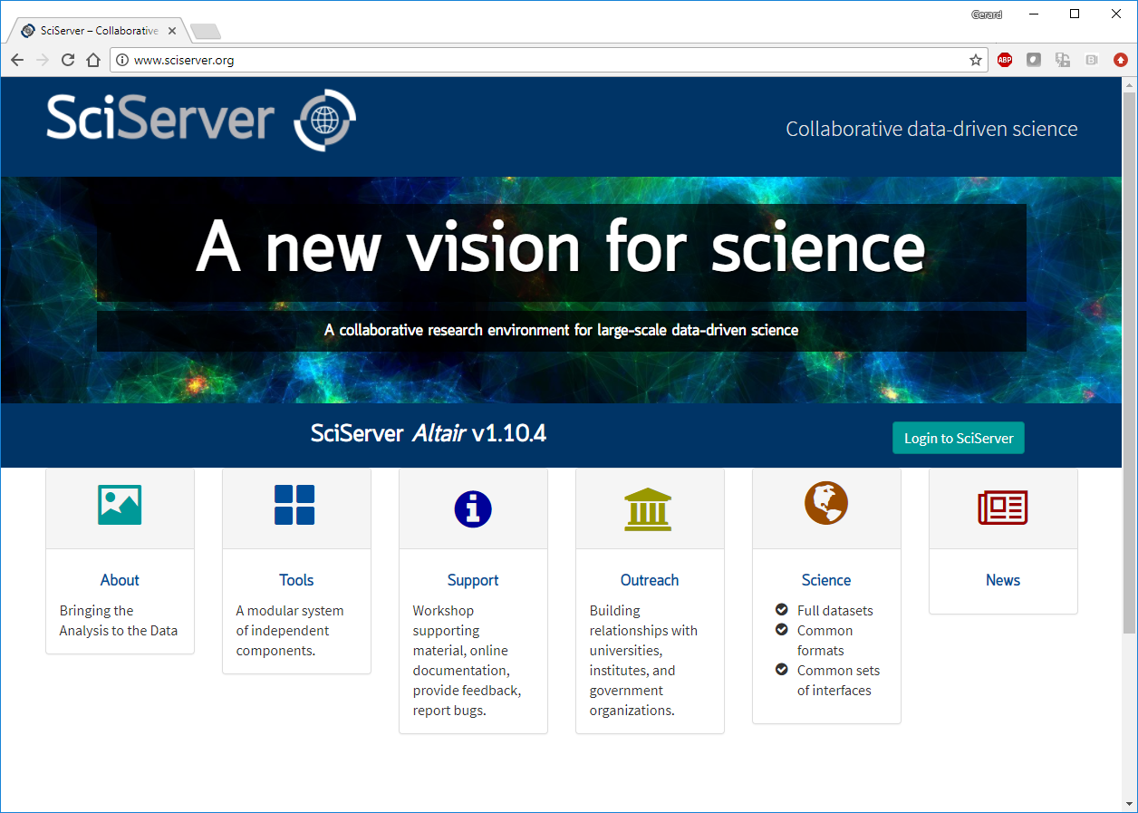
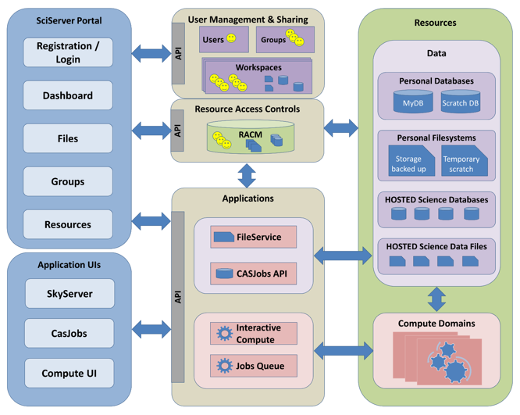
SciServer
& Architecture
Graphical
User Interfaces
Resource Access Control with Groups
Storage: databases and files
Programming Interfaces
Compute in python and R

Slide 3
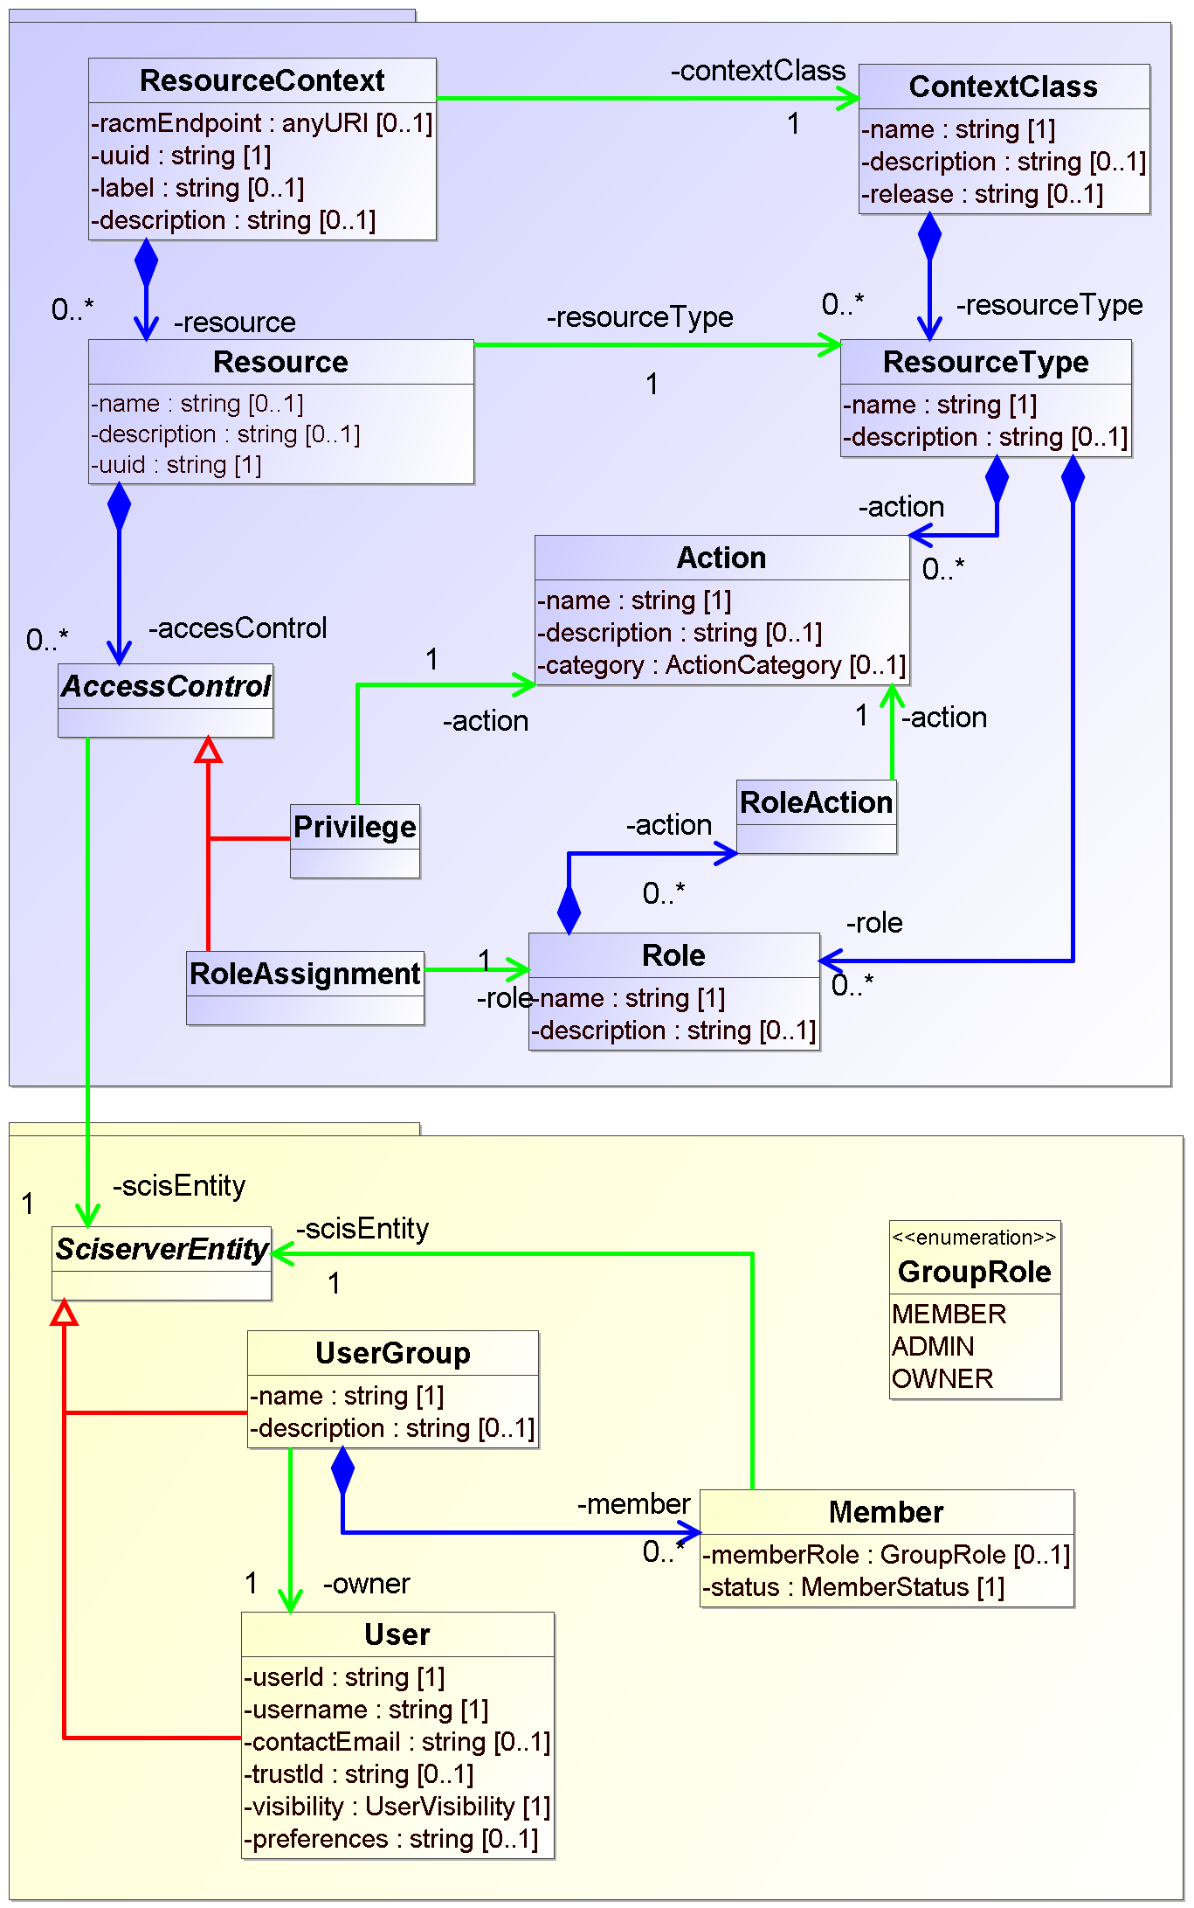
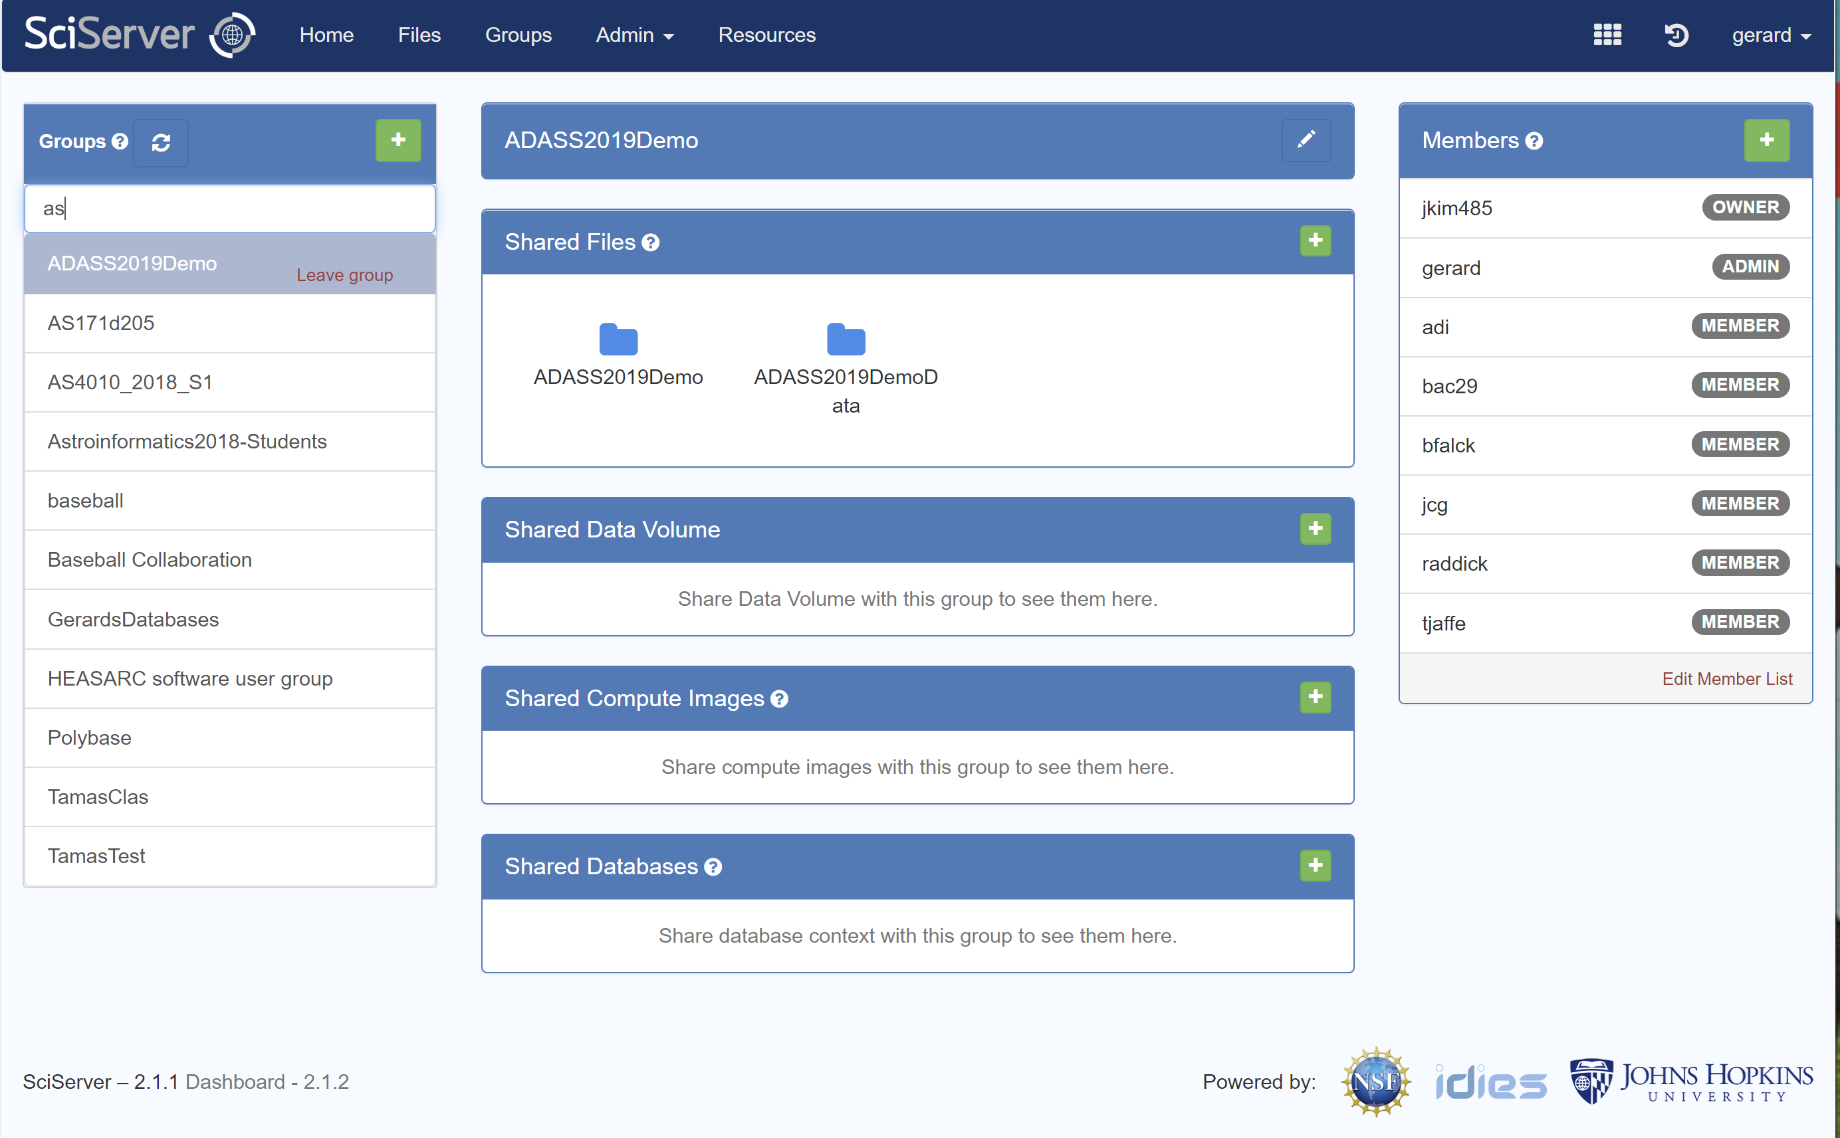
Resource Sharing

Slide 4
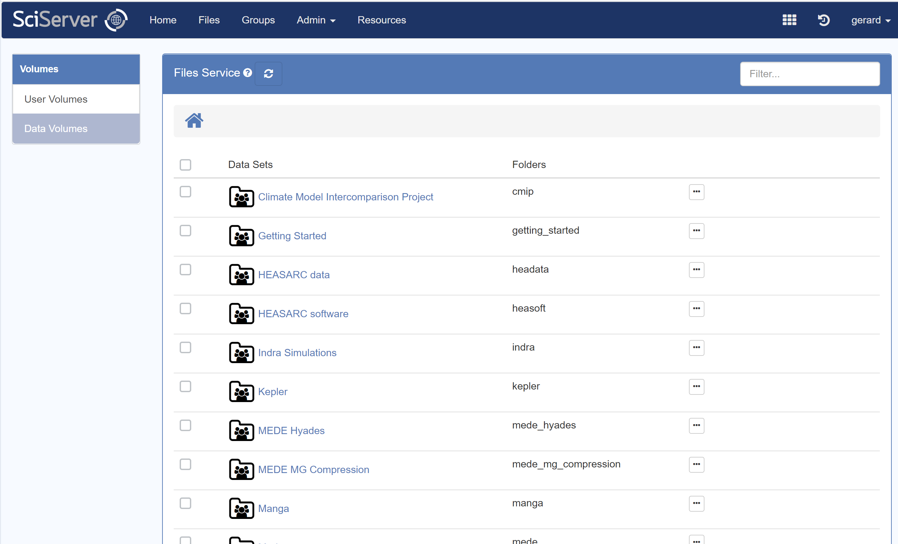
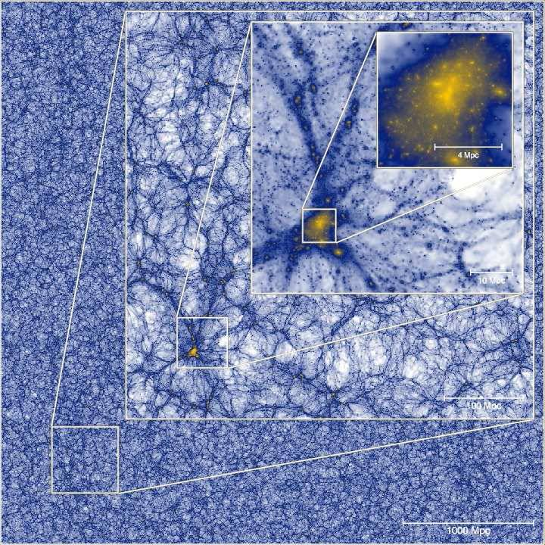
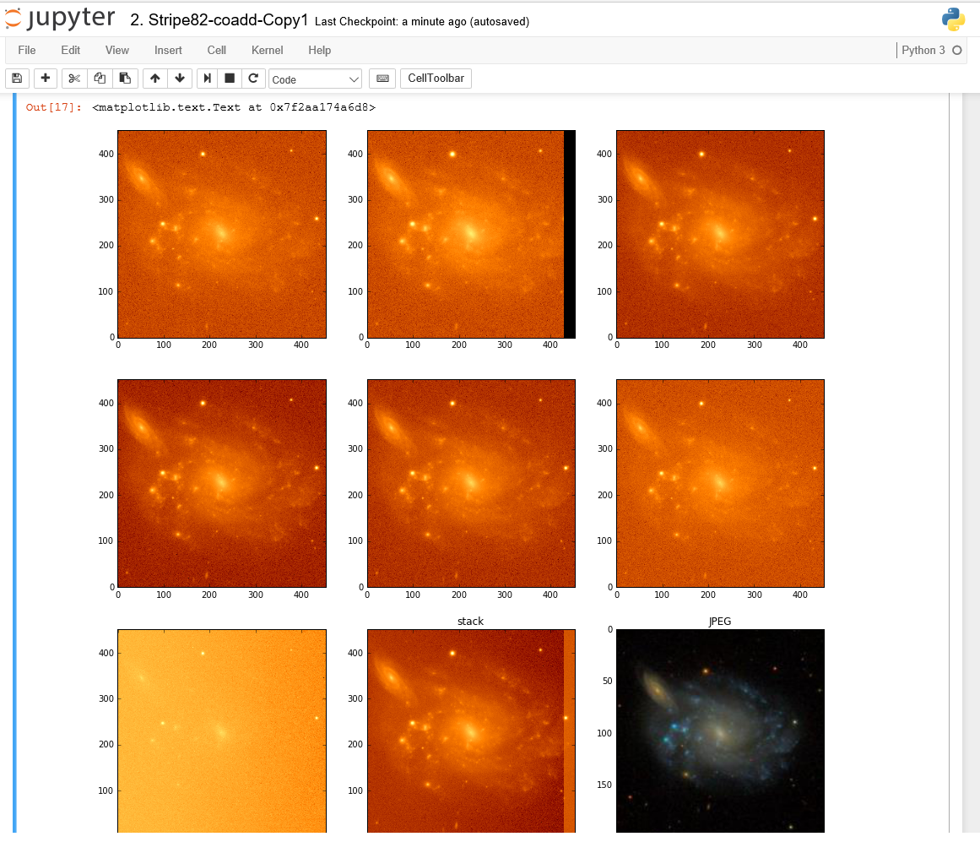
Storage: file systems

Slide 5
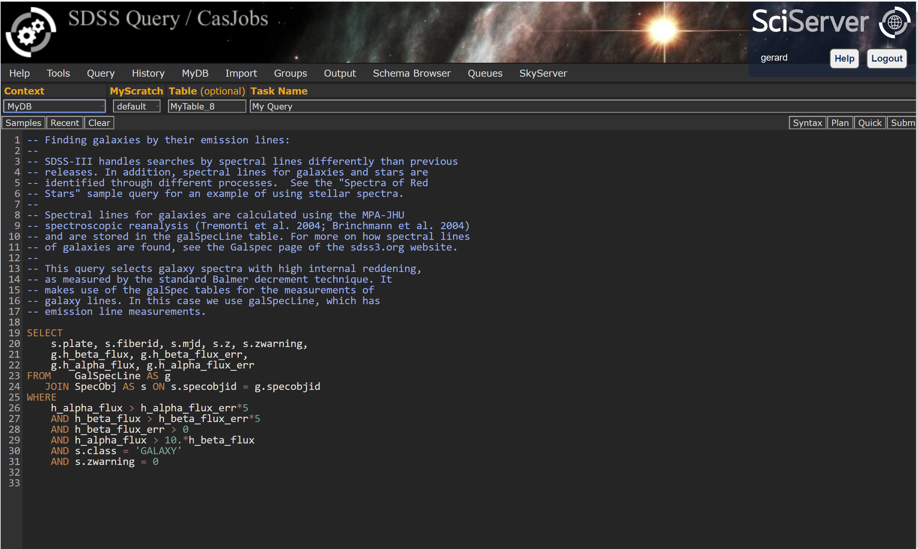
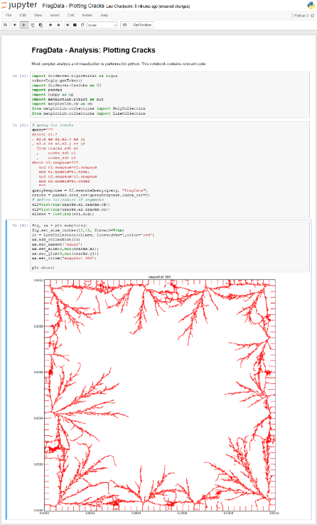
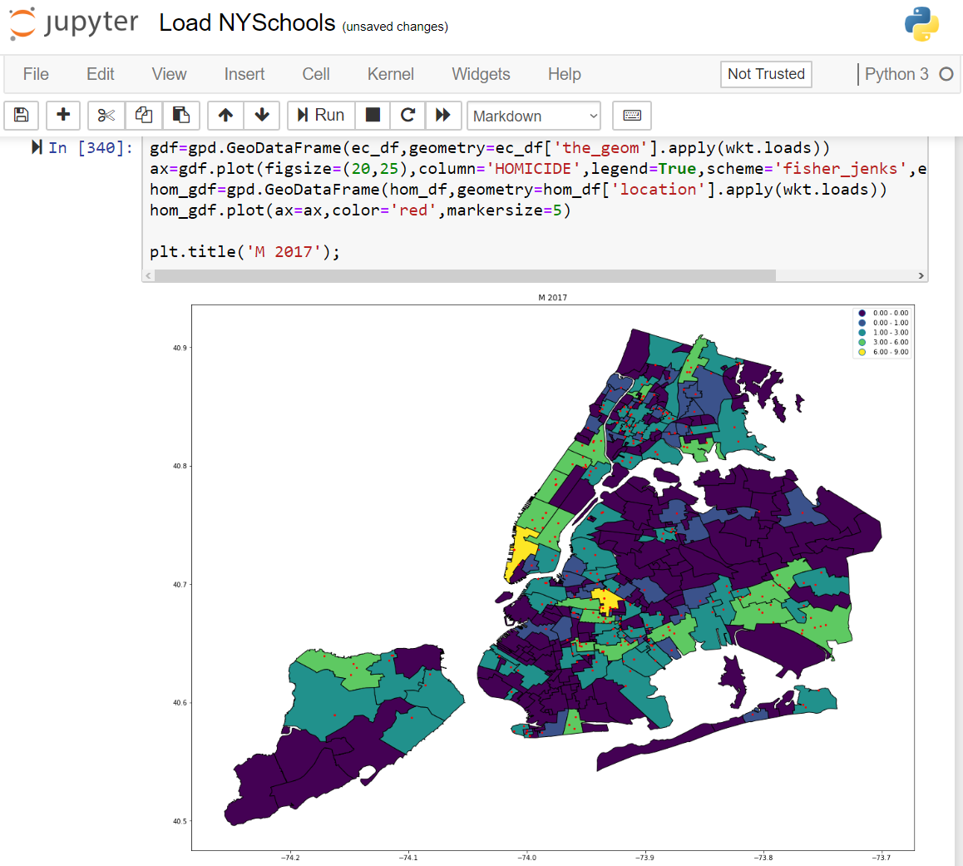
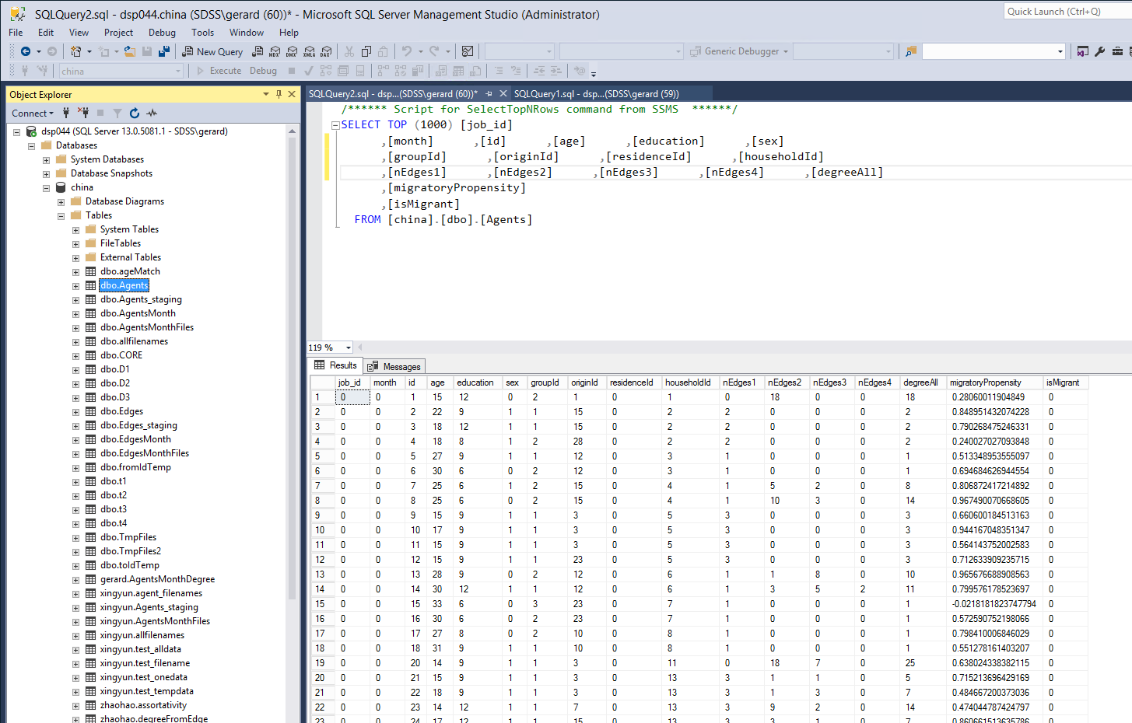
Storage: databases

Slide 6
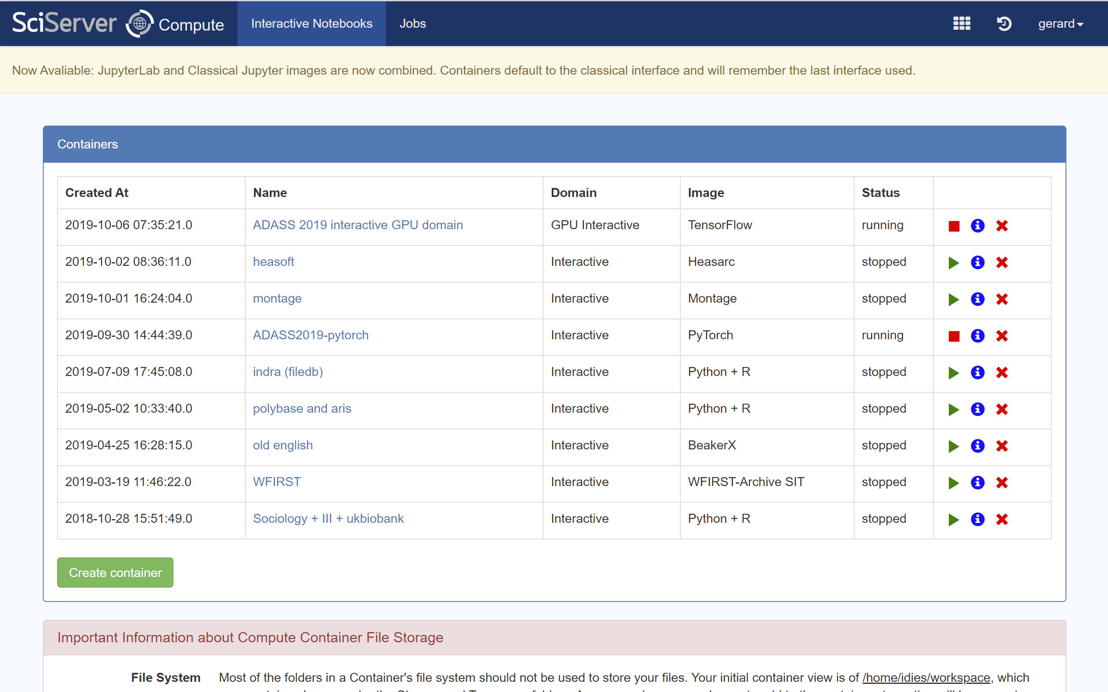
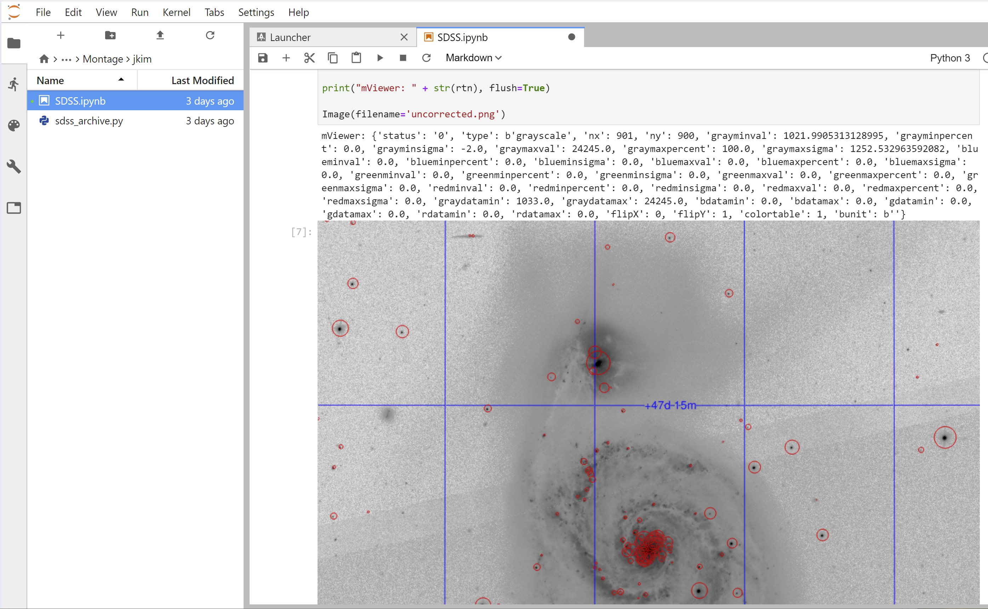
Compute

Slide 7
Since last year
Since last year
SciServer can (almost completely) be installed with K8S+HELM
So happy to install sciserver on the LSST K8S cluster!
CasJobs query engine still requires Windows IIS. Port to Java in progress.
Compute still talks to Docker API iso K8S. In progress.
Can query postgres, MySQL
Directly as Jobs (soon SciQuery)
Joined to MSSQL through Polybase
Exploring more advanced backends
GPU domains (batch only)
DASK
SQL Server 2019 Big Data Studio (T-SQL on Spark/HDFS)
Overflow of compute to the commercial clouds

Slide 8
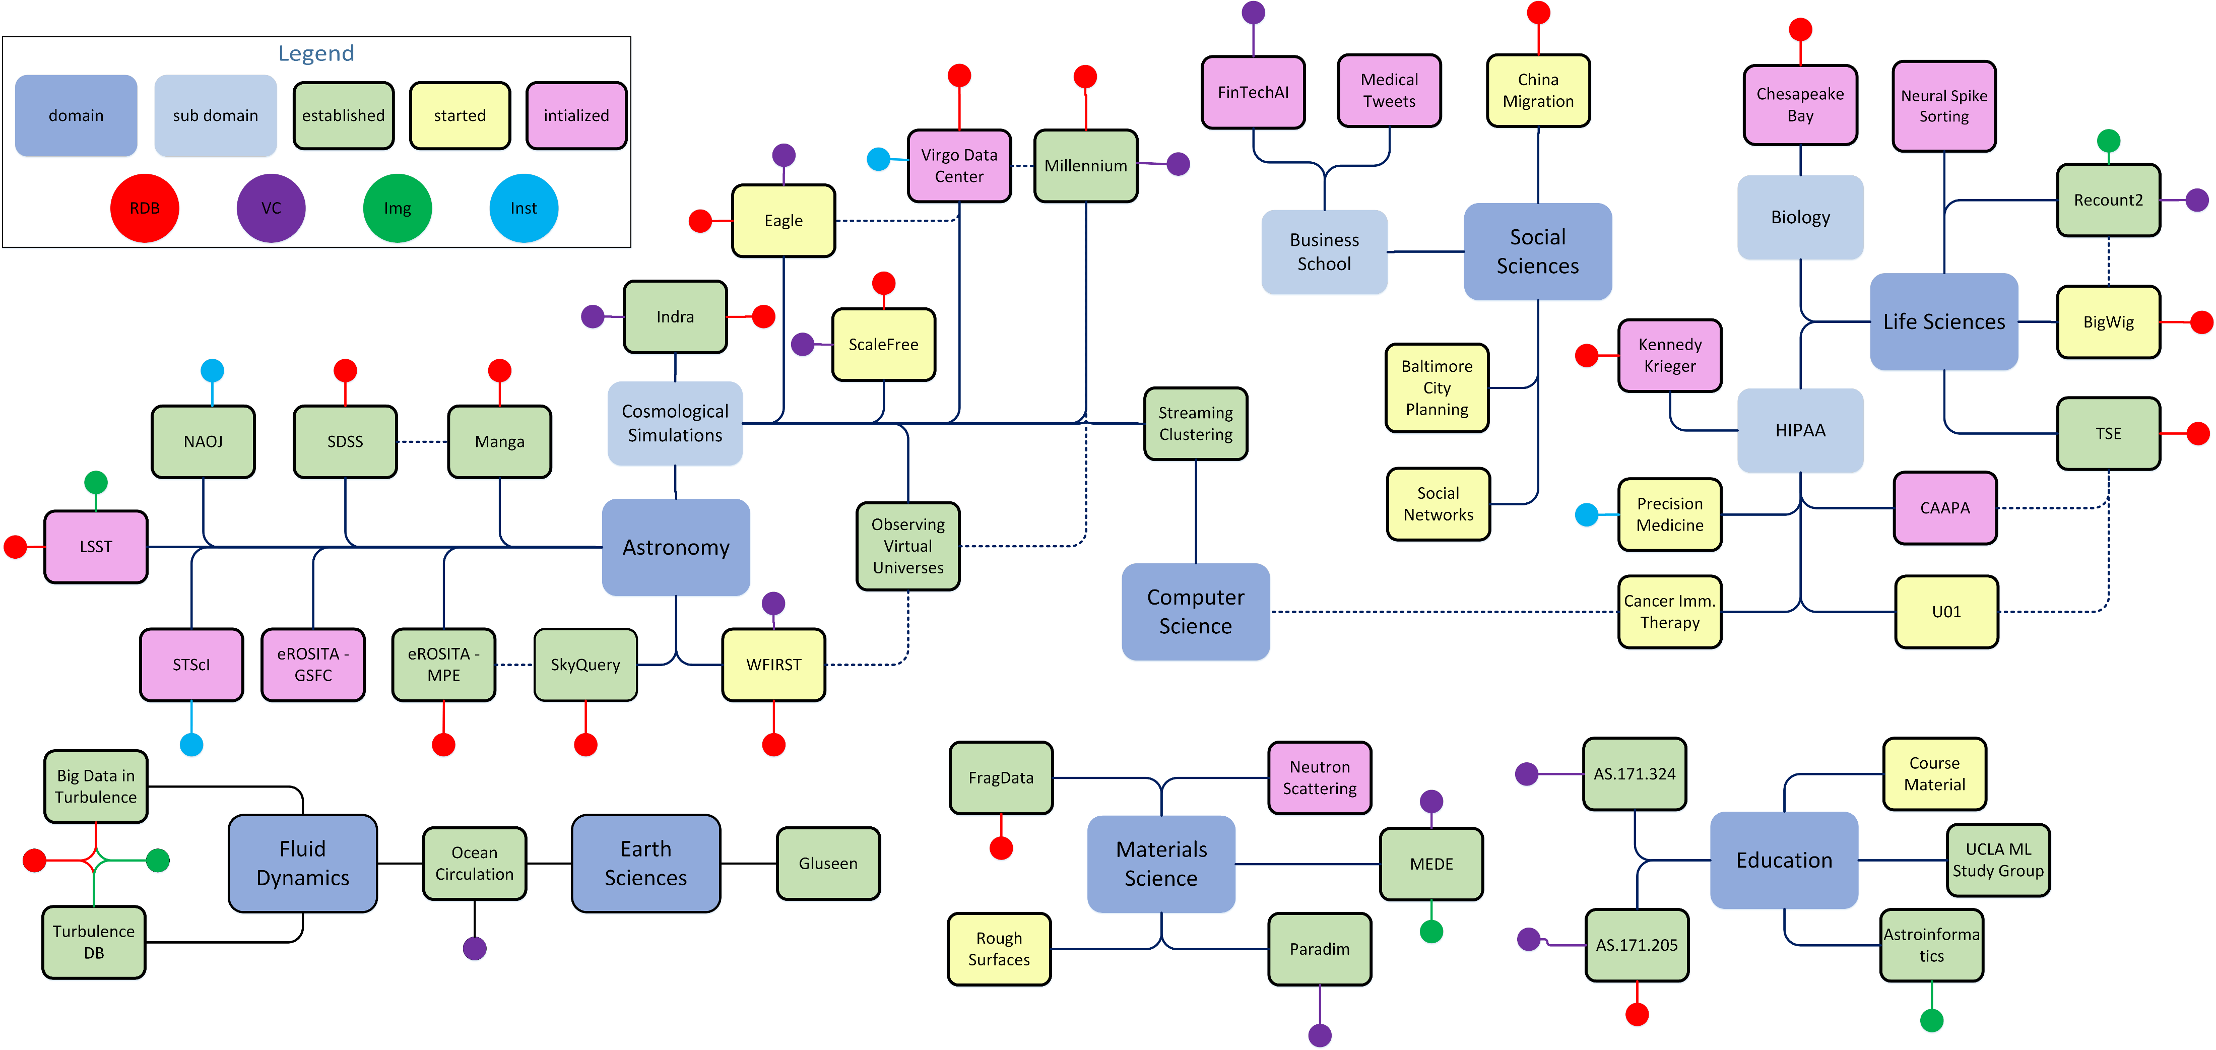
External usage
External usage
JHU Precision Medicine: HIPAA compliant SciServer in Azure
eROSITA+HETDEX @ MPE: SciServer on K8S
Soon (we hope): HEASARC data on SciServer @ JHU

Slide 9
Common
Interoperability?
“Run container based on my image on you SP”
Requirements on image?
Image inherits from standard image with standard functions implemented by science platform provider
Access patterns to LOCAL data
getHomePath(), listDataSets(): return datasetid+metadata
…
Interactive vs batch: jobs submission?
Docker file or image: TRUST!
Common Authentication?
Common Resource access control?
Run my platform on your k8s cluster?

