Slide 1
Exploring and Mapping Vocabularies
IVOA InterOp Semantics Session
Trieste Italy, May 2008
Alasdair J. G. Gray

Slide 2
Outline
Vocabulary Exploration
Vocabulary Mappings
  Why do we need them?
  How should we express them?
  A GUI Editor
Open Issues

Slide 3
Vocabulary Explorer
Web application
http://explicator.dcs.gla.ac.uk/WebVocabularyExplorer
Uses official vocabularies
Allows text search for vocabulary concepts
  Displays available concept information
  Exploration of Broader, Narrower and Related links
Demonstrate why we need
  Multiple vocabularies (screenshots)
  Mappings

Slide 4
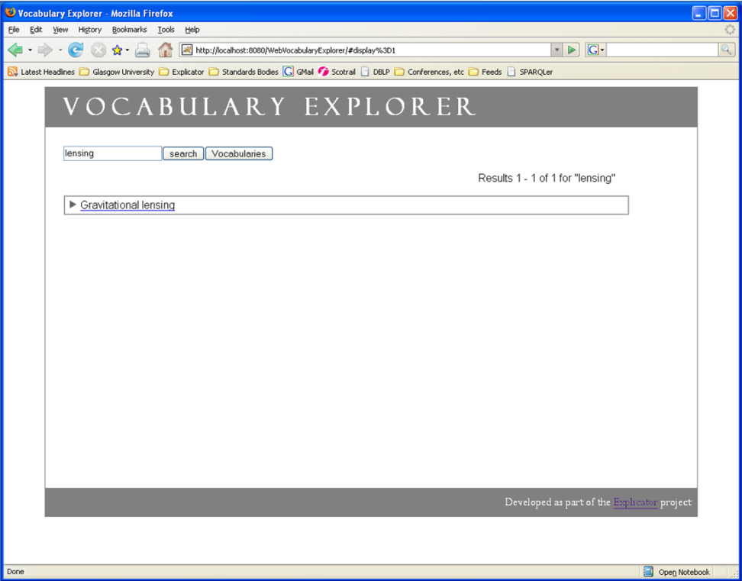
Exploring a Vocabulary
Notes:
Has a search box
Show small number of results for searching for lensing within the A&A keywords
Click on concept name for more information

Slide 5
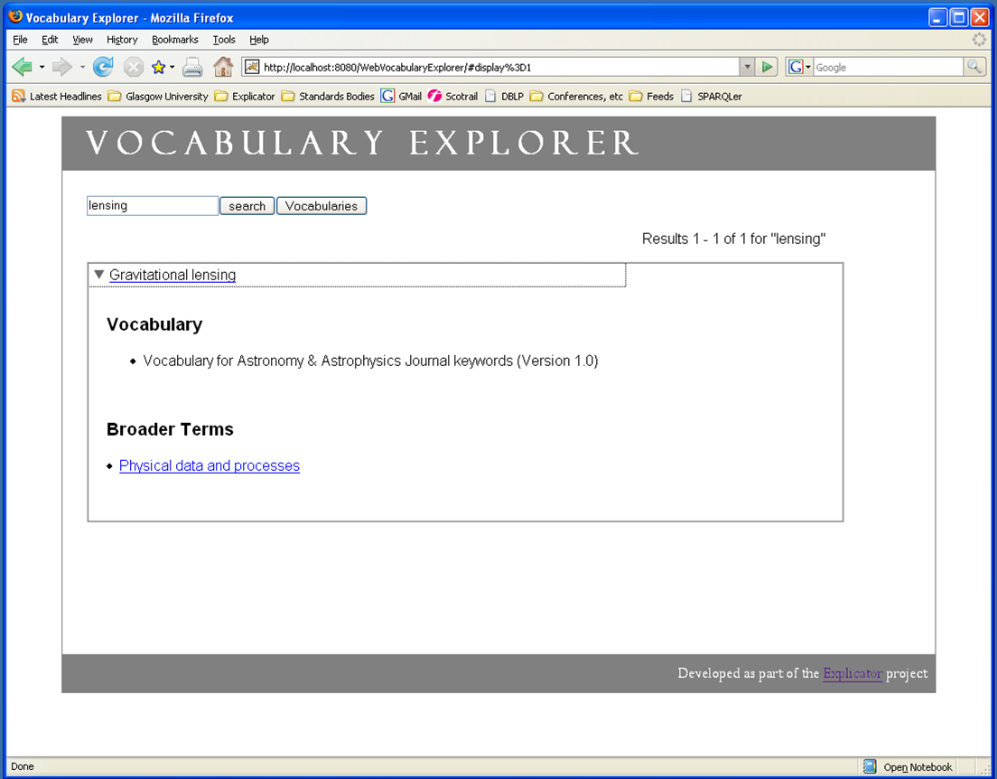
Exploring a Vocabulary
Notes:
Shows available information
Follow broader link and we can explore further options for exploring

Slide 6
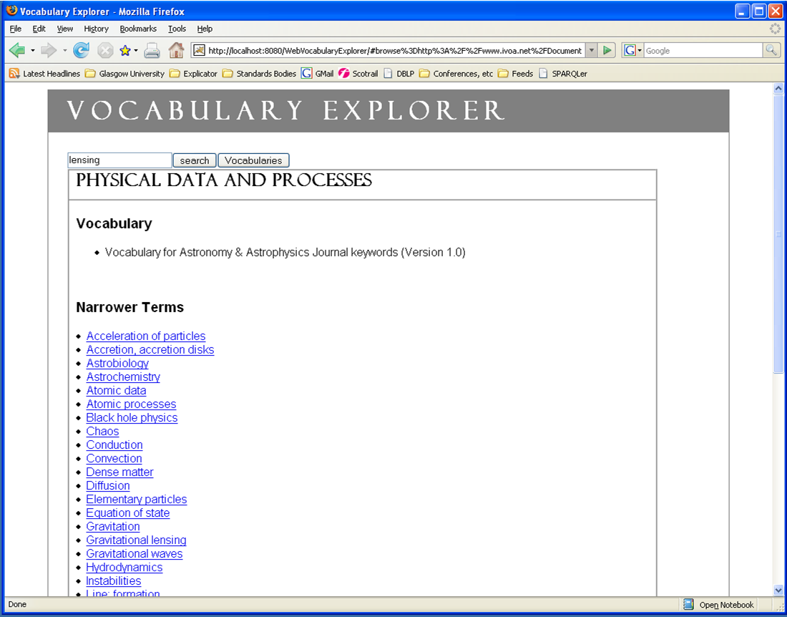
Exploring a Vocabulary
Notes:
Problems using a single vocabulary
Small number of results
Not necessarily informative

Slide 7
Exploring a Vocabulary
Small number of results
  Could be none
  Can lead to frustration
What if we explore all the vocabularies?
(Screenshots)

Slide 8
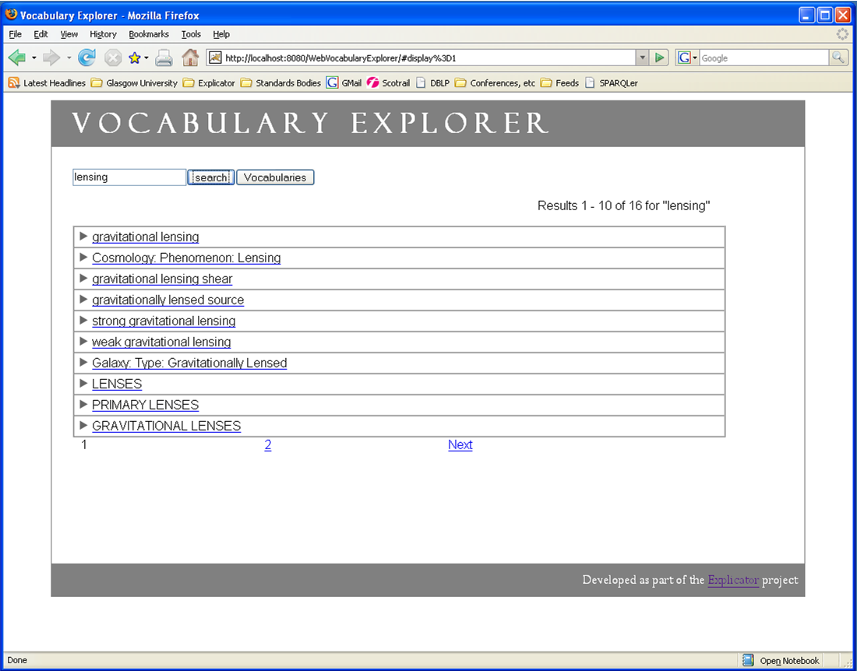
Exploring Vocabularies
Notes:
Shows a larger number of results if we allow all the vocabularies to be explored

Slide 9
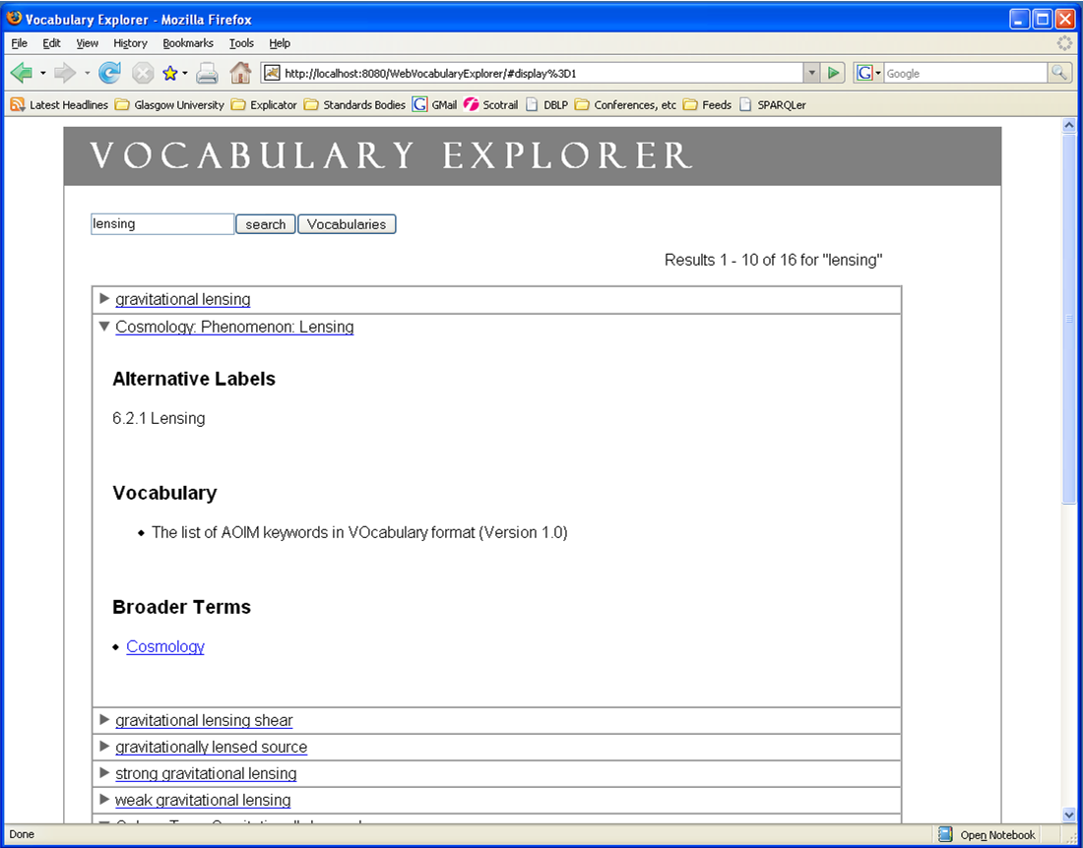
Exploring Vocabularies

Slide 10
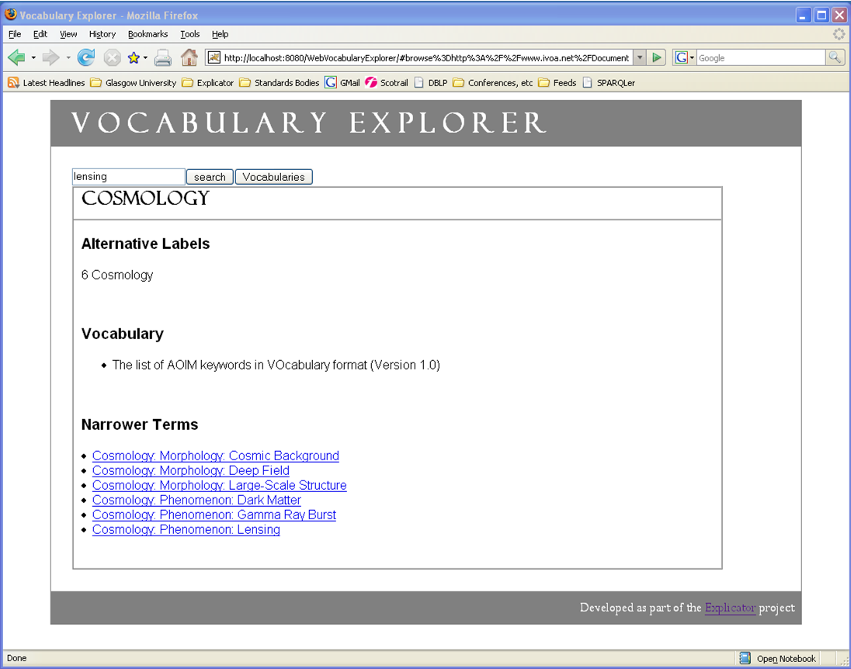
Exploring Vocabularies

Slide 11
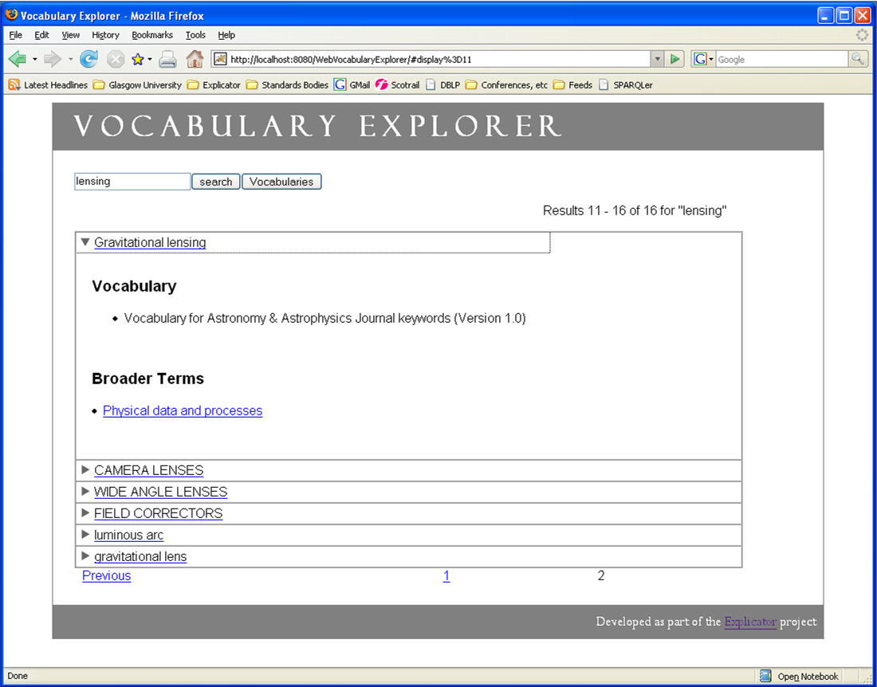
Exploring Vocabularies

Slide 12
Exploring Vocabularies
Get more search results
  Results from different vocabularies
Exploration “locks” you into a vocabulary
  No additional links to concepts in other vocabularies
What if we have mappings?
  What is a mapping?
  How can they be expressed?

Slide 13
What is a Mapping?
“A relationship from a concept in one vocabulary to a concept in another vocabulary.”
Types of mapping:
  The same concept
  A more general/broader concept
  A more specific/narrower concept
  A related concept
  Others? Similar, synonym, …

Slide 14
Using broader/narrower/related
Conceptual mismatch
  Leads to inconsistencies
No “these things are the same” relationship
aaKeys:sunspot
a skos:concept ;
…
skos:narrower aaKeys:sun ;
skos:narrower aoim:starspot ;
…
aoim:starspot
a skos:concept ;
…
skos:narrower aoim:star ;
ex:sameAs aaKeys:sunspot ;
…

Slide 15
Separate Mapping Terms
Currently four mapping relationships:
  skos:exactMatch
  skos:broader
  skos:narrower
  skos:related
Inverse mappings
Declared in separate file
  Good practice
  Use vocabulary independently of mappings
  Declare in one direction

Slide 16
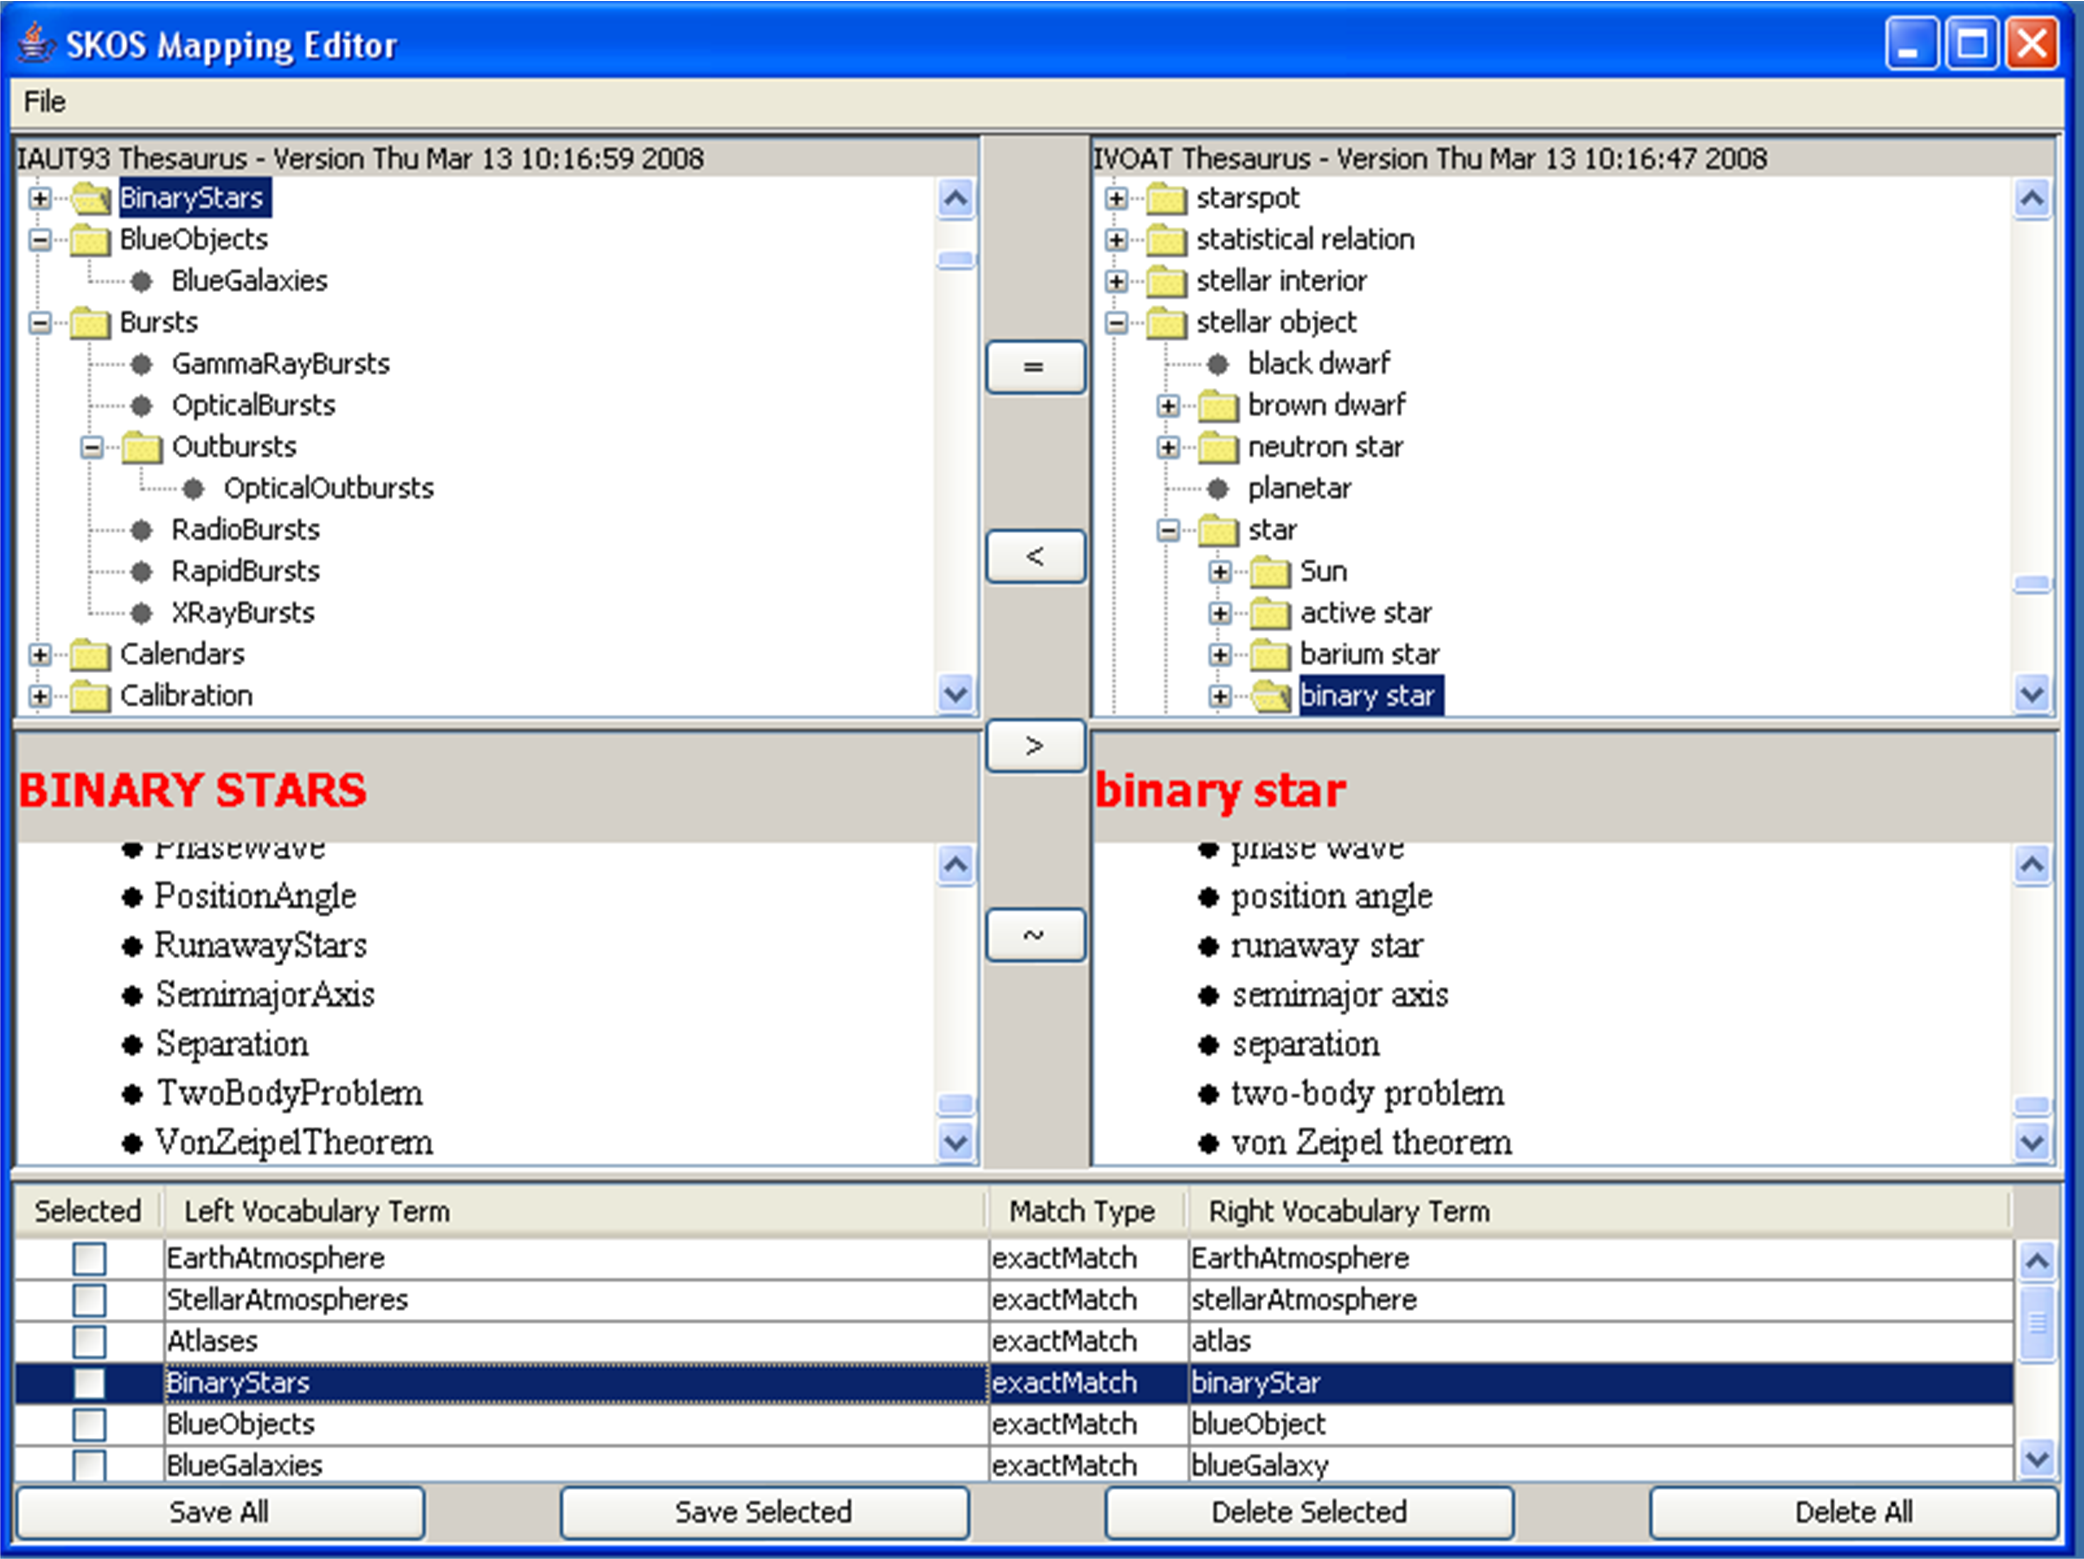
Generating Mappings
Choose 2 vocabularies
Choose concepts
Click type of mapping
Save mappings to file
Notes:
Show the mapping editor

Slide 17
Mapping File
[Appropriate prefix declarations]
<>
dc:creator "Alasdair J G Gray"@en;
dc:created "2008-02-07”;
dc:title "Mappings from Astronomy & Astrophysics Journal keywords to the AOIM taxonomy"@en .
aaKeys:AccretionAccretionDisks skos:exactMatch aoim:StarCircumstellarMaterialDiskAccretion .
aaKeys:BlackHolePhysics skos:relatedMatch aoim:StarEvolutionaryStageBlackHole , aoim:GalaxyComponentCentralBlackHole .
aaKeys:GravitationalLensing skos:exactMatch aoim:GalaxyTypeGravitationallyLensed ;
skos:relatedMatch aoim:CosmologyPhenomenonLensing .
Require metadata
  dc terms
  Our own
What do we require?
  Creator
  Vocabularies
  Versions
  Date
  ?
Notes:
Talk about metadata at top of file and simplicity of mappings

Slide 18
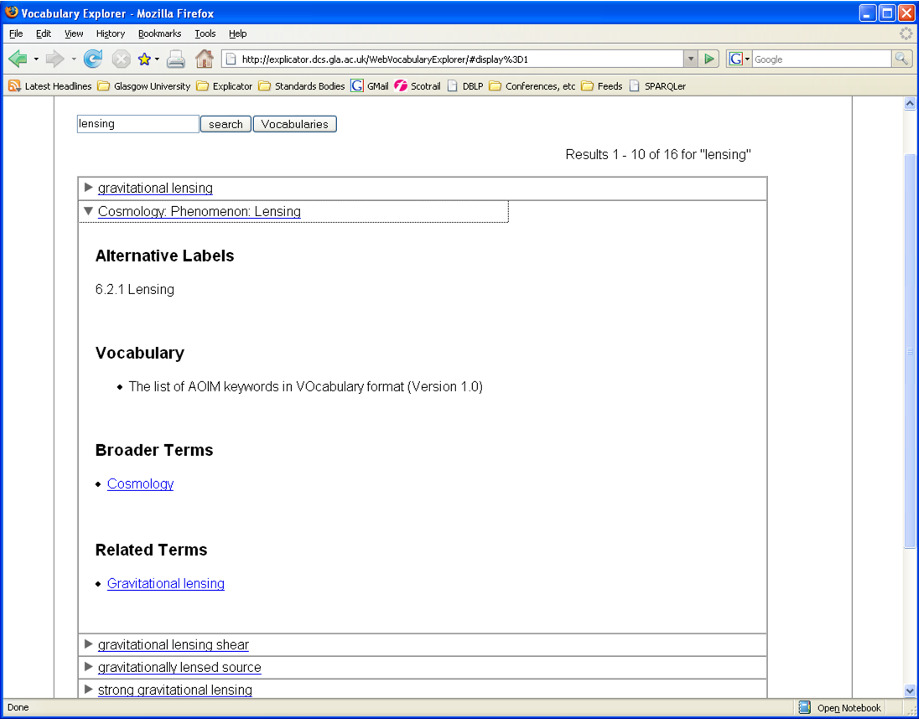
Exploring Using Mappings
Notes:
Show exploration leaping around vocabularies by using embedded mappings

Slide 19
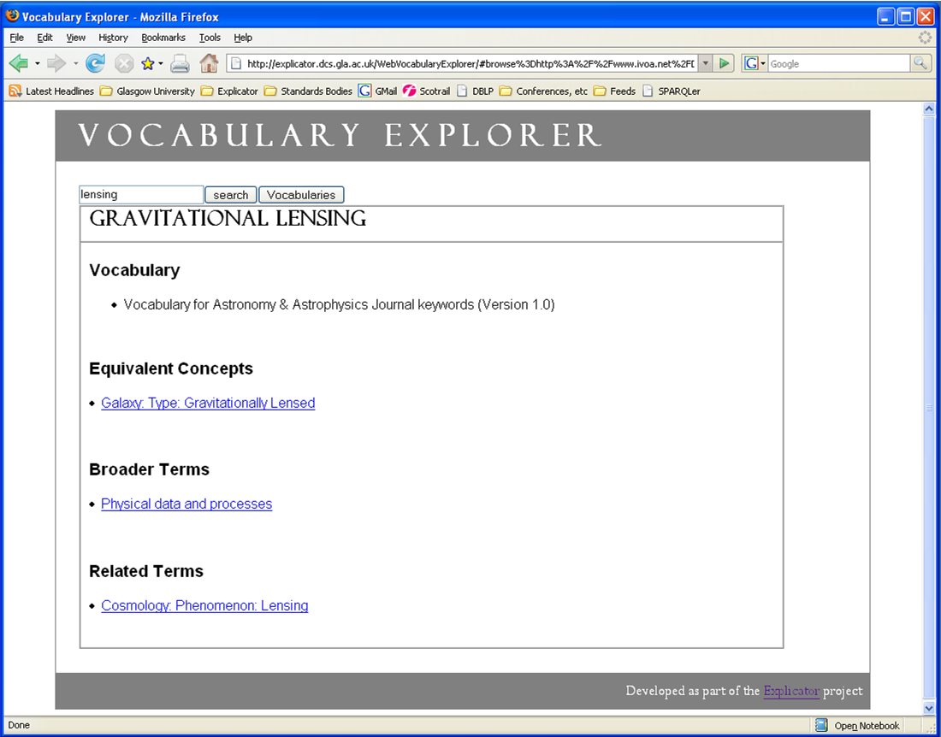
Exploring Using Mappings

Slide 20
Exploring Using Mappings
(Screenshots)
Many search results
  Require better ranking (try star)
Discover inter vocabulary relationships
  Jump to concepts in other vocabularies
Require more mapping files
  Need to be generated using domain knowledge
  Laborious process
  Done once used often

Slide 21
Conclusions
Mappings are useful
Mappings are different from relationships
  Are current mappings sufficient for our needs?
  What metadata do we require?
Need tools to help us
  Basic mapping editor
  Vocabulary Explorer
Need improved search ranking

