Slide 1
VOView
Rendering VOTables using XSLT and JavaScript
Dean Hinshaw
HEASARC GSFC/NASA

Slide 2
Overview
View large tables within a Web browser
  Goal 1000 to 100,000 rows
  Javascript not efficient enough to handle large tables
  XSLT 1.0 processing built in to all major browsers
    Needed for operations that handle the entire table, e.g. sorting
Promotes/Exploits VO Table standard

Slide 3
Status
Original version written by Rick White for Hubble Legacy Archive
Code picked up and modified by several groups:
  HLA version still working
  HEASARC: Sview, Simple Query, Datascope (new)
  NVO Directory
  European HST/HLA Archive (new)

Slide 4
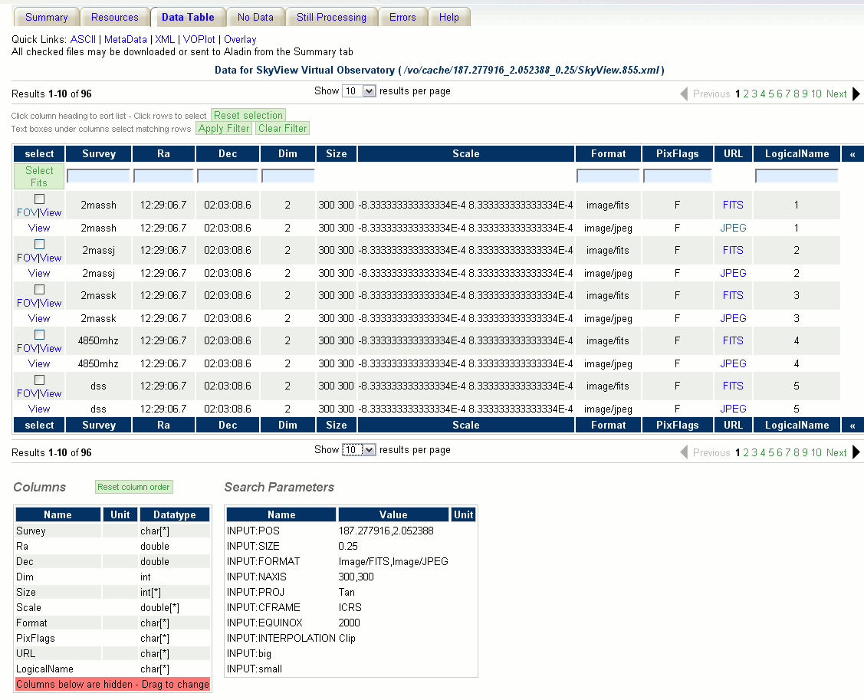
Datascope
Notes:
Show in browser if possible – Tom demoed VOView at previous interop

Slide 5
Goals
Bring development together into one project
  Google Project: voview
  Combine all functionality into one code base
Make VOView into a package (a la jquery)
  Simple installation
  Well defined external interfaces
  Documentation
Design
  Redesign with well-define OO structure and interfaces
    Modular design allows for developer customization
Notes:
Talk about Google Project at the end

Slide 6
Design
Displayed Table (HTML)
Filter
Full VOTABLE (XML)
Filtered VOTABLE (XML)
Renderer

Slide 7
Filter Class
Takes full table as input and returns the rows of the table to be displayed
Encapsulates functionality requiring the entire table
  Sorting
  Column Filtering
  Paging
Requires use of XSLT for efficiency
Could be implemented server-side

Slide 8
Renderer Class
Transforms XML into HTML to be displayed
Input is modest sized XML table
  XSLT not required, more implementation options
    XSLT could be used, but limited functionality
    Jquery
    Other
Most customization likely to be here

Slide 9
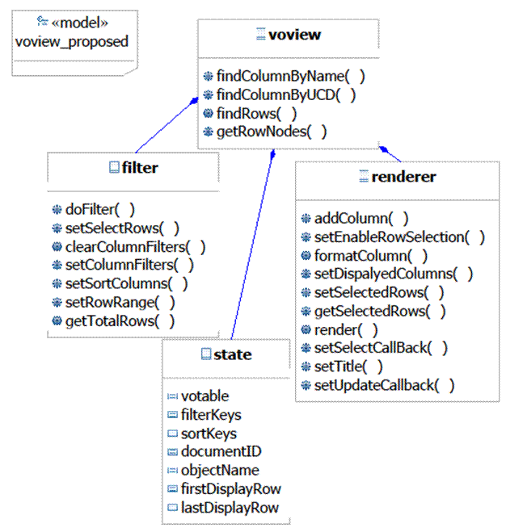
Class Diagram

Slide 10
Interface Definition
Detailed interface definition being developed using Jsdoc
  Jsdoc is a javadoc-like documentation system for javascript
  Inline comments generate html documentation
index.html
Notes:
Link to jsdoc only works on my PC

Slide 11
Google Project
Design and Interface still very much at proposal/discussion phase
Google Project voview
  svn repository
  Wiki
  Issue tracker
  Discussion group
http://code.google.com/p/voview/
voview@googlegroups.com

