Slide 1
A review of the VO standards process
Cape Town
2016-05-09
Matthew Graham

Slide 2
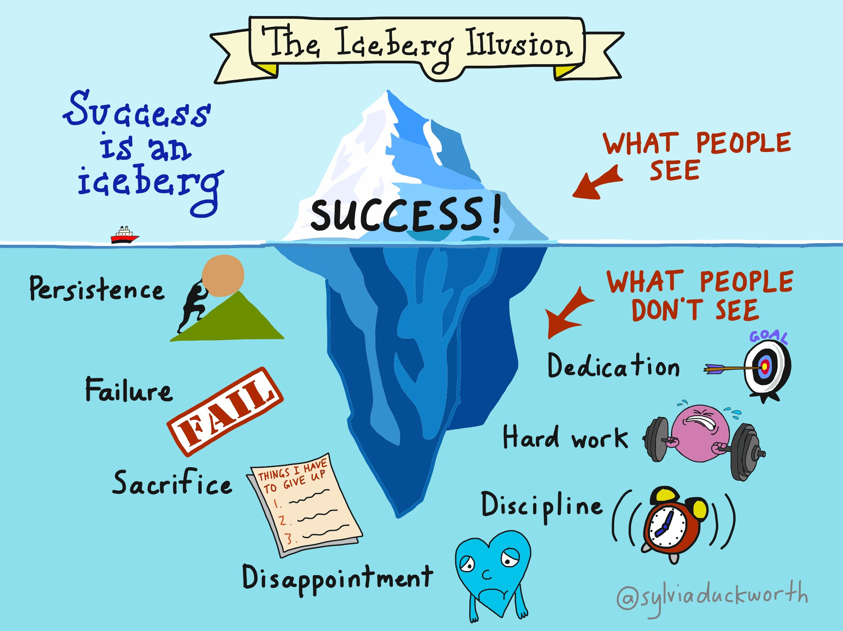
Overview

Slide 3
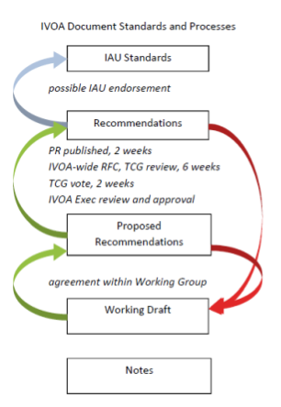
The standards process: a reminder
The role of Working Groups is to build consensus and broker agreement on technical work
The role of Interest Groups is to act as points of contact between the community and the Working Groups and vice versa

Slide 4
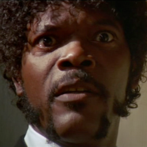
The path of standards development
“The path of the standards developer is beset on all sides by the inequities of the selfish and the tyranny of evil projects. Blessed are they who, in the name of interoperability, shepherd the spec through the valley of darkness. For they are truly their protocol’s keeper and the finder of lost issues.”

Slide 5
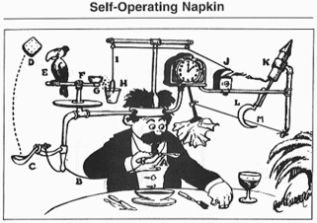
Case Study A: The one that failed

Slide 6
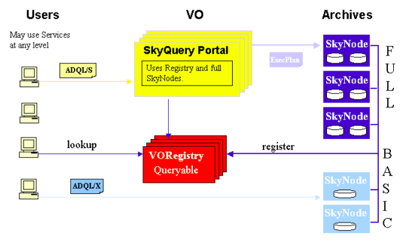
Case study A: SkyNode - I
“SkyQuery is a successful implementation of a distributed astronomical query system … using some proprietary Microsoft Technology [and] SOAP Services. Currently to be a SkyNode one has to implement a set of web interfaces some of which would require .NET technology. Now it is time to bring this in line with VO efforts and to make it properly platform independent.”

Slide 7
Case study A: SkyNode - II
The concept was sound: a common interface accepting ADQL and supporting distributed queries
BUT
No clear use cases or minimal requirements
Too much informed by implementation details:
Choice of language (proprietary)
Choice of supporting infrastructure (web framework, db)
Choice of web technology (doc/literal vs. rpc/encoding)

Slide 8
Case study A: SkyNode - III
The solution was presented as a fait accompli by an influential project
Overly ambitious and complicated:
1.0 already defined a Full SkyNode which shall implement a distributed query plan and crossmatching and should accept complex shape queries and a footprint service
Two flavors of query language: ADQL/s and ADQL/x
Out of step with other current IVOA efforts: SCS, SIA
No significant uptake outside the proposing project by other projects or users despite supporting material
Unclear whether it addressed current community needs

Slide 9
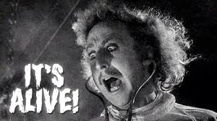
Case Study B: The one that worked

Slide 10
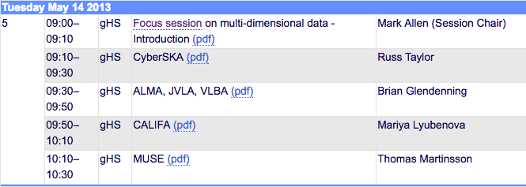
Case study B: Multi-d data - I
In 2012/3 the CSP identified multi-dimensional data as a scientifically relevant priority in the community
At the 2013 Spring Interop an initial focus session was held with invited large projects (stakeholders):

Slide 11
Case study B: Multi-d data - II
A set of use cases for multi-d data was defined, drawn from:
radio astronomy
integral field spectroscopy
simulation data
These defined a common set of operations:
Finding data based on spatial, spectral, polarization and temporal axes
Combine and compare (IFS) data sets with other image, spectral and cube data

Slide 12
Case study B: Multi-d data - III
This led to a set of minimal requirements:
A service shall be able to receive queries regarding its data collection containing constraints on position, frequent/wavelength, polarization, spatial size, angular resolution, integration time, and time of observation (Data Discovery)
The service shall return to the client a list of observations meeting the user-imposed constraints (Data Discovery)
The user can download the complete science data for each selected observation or simple cutouts thereof (Data Access)
For a simple cutout, the user-specified cutout is restricted to be a contiguous interval within each dimension of the multi-dimensional science data (Simple Cutout)

Slide 13
Case study B: Multi-d data - IV
The Exec’s endorsement of these meant:
The preparation of the standards cannot be held up by discussion of “features” that are not necessary to meet the minimum standards
The WGs should be thinking in an agile sense where subsequent versions of a given standard with more “features” come rapidly after the first version
And a clear vision of what was required in terms of initial (and subsequent) standards development:
SIAv2 (query capability only)
DataLink
AccessData (for simple cutouts only)

Slide 14
Case study B: Multi-d data - IV
The Exec’s endorsement of these meant:
The preparation of the standards cannot be held up by discussion of “features” that are not necessary to meet the minimum standards
The WGs should be thinking in an agile sense where subsequent versions of a given standard with more “features” come rapidly after the first version
And a clear vision of what was required in terms of initial (and subsequent) standards development:
SIAv2 (query capability only)
DataLink
AccessData (for simple cutouts only)

Slide 15
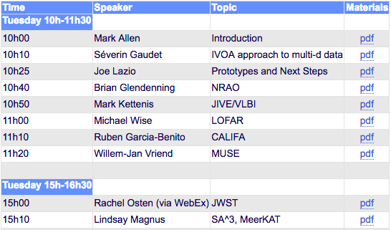
Case Study B: Multi-d data - V
Follow-up engagement with the community in 2014 for:
Summary of the progress towards the protocols and prototype implementations
Identification of the next steps in the widespread adoption of the IVOA services and standards
Description of the additional functionality or enhancements likely to be needed

Slide 16
Case Study B: Multi-d data - VI
Current status (2016):
SIA v2.0:
ObsCore 1.0: Recommendation
Datalink 1.0: Recommendation
SIA 2.0: Recommendation
SODA (AccessData) 1.0: In PR
SIA v2.1:
Obscore 1.1: In RFC
ImageDM 1.0: Refactored into DatasetDM and CubeDM, both in WD.
SIAv2.1: to follow ImageDM and/or ObsCore

Slide 17
Summary
Community engagement from the outset
Participatory stakeholders
Identified commonalities across (siloed) projects
Minimal requirements for initial utility
Clear incremental development path for further and enhanced capabilities
Community accountability

