Slide 1
IVOA interop closing remarks Victoria, Canada 27 May – 1 June 2018
Pepi Fabbiano
Harvard-Smithsonian Center for Astrophysics
Chair of the IVOA Executive Committee
IVOA Interoperability Meeting Opening Session
Victoria, Canada, 1/June//2018

Slide 2
Meeting Highlights

Slide 3
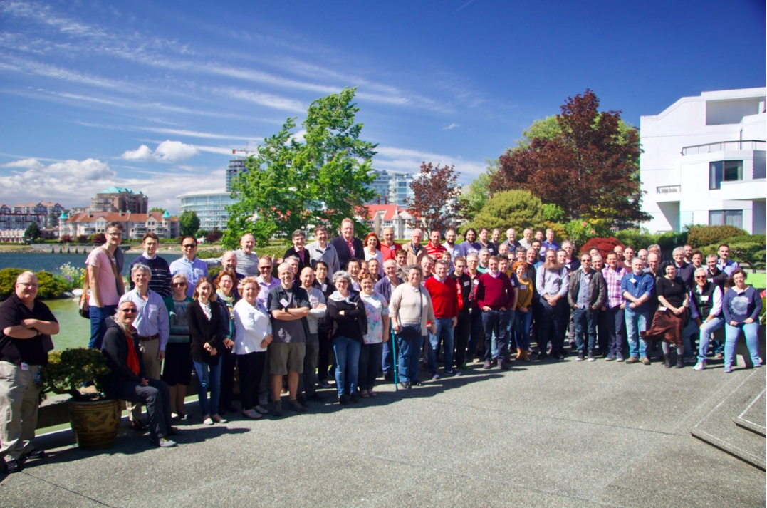
Victoria Interop 2018

Slide 4
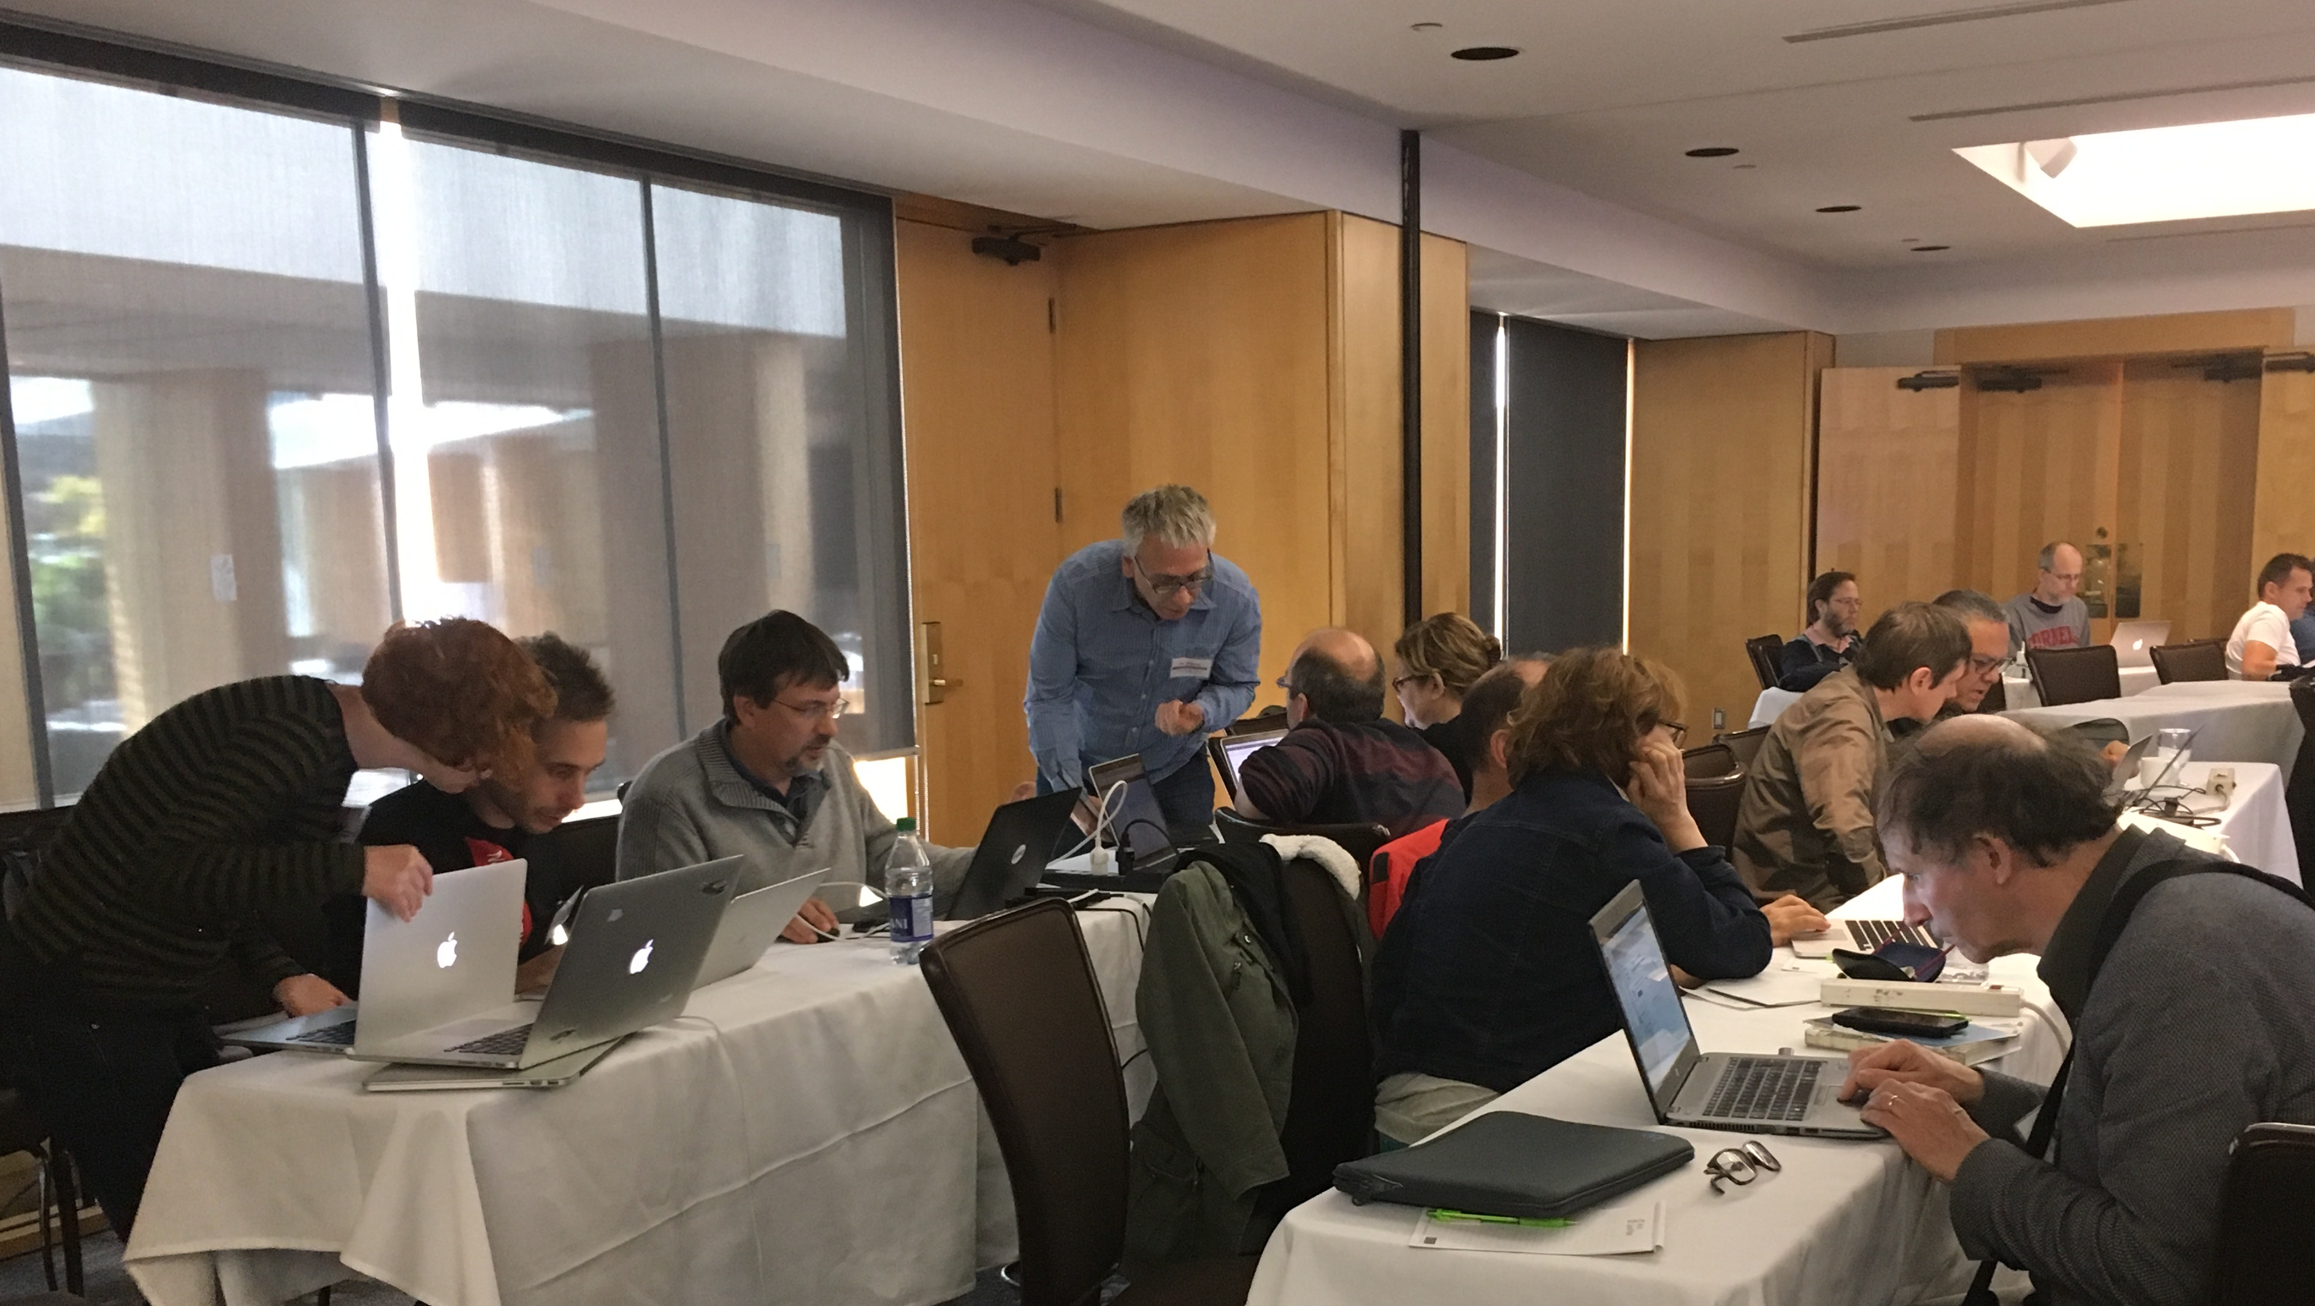
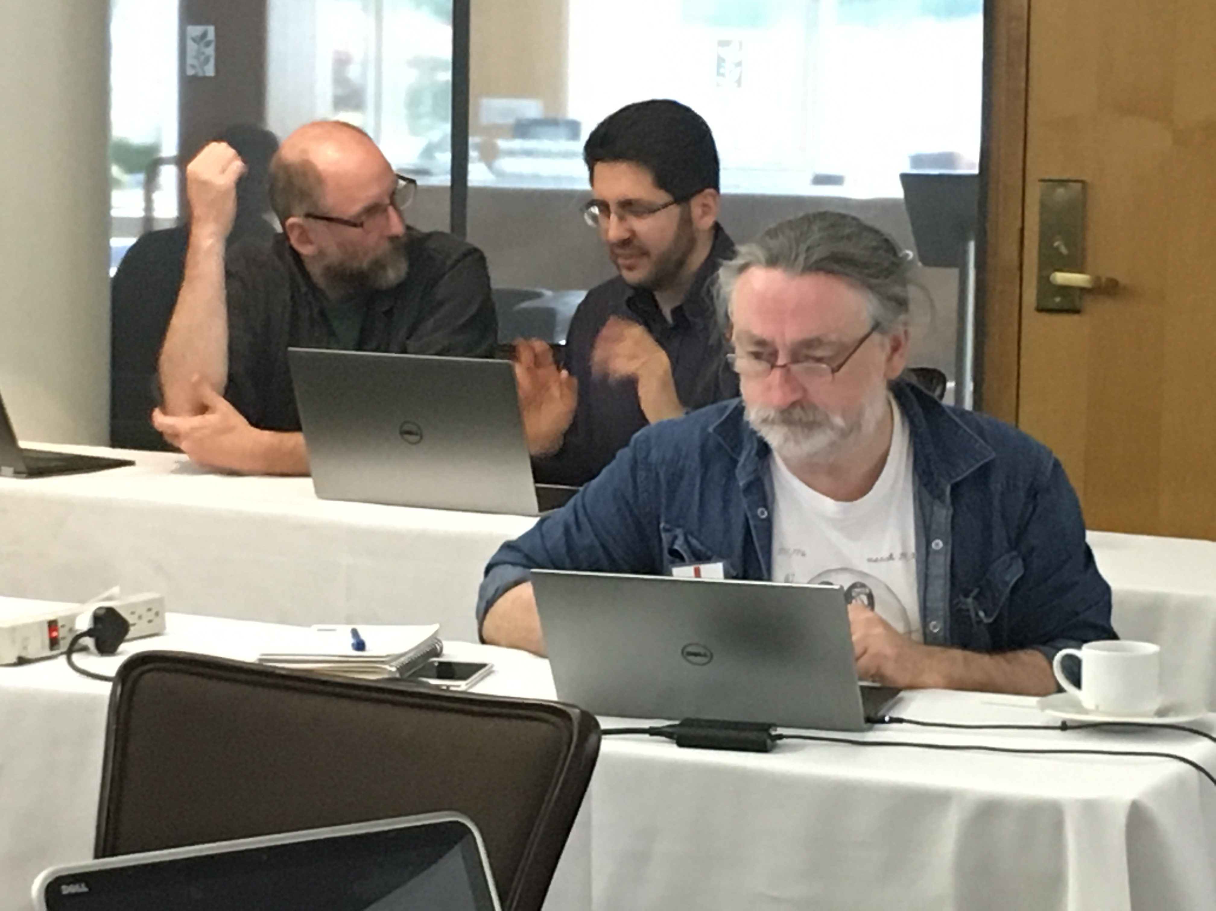
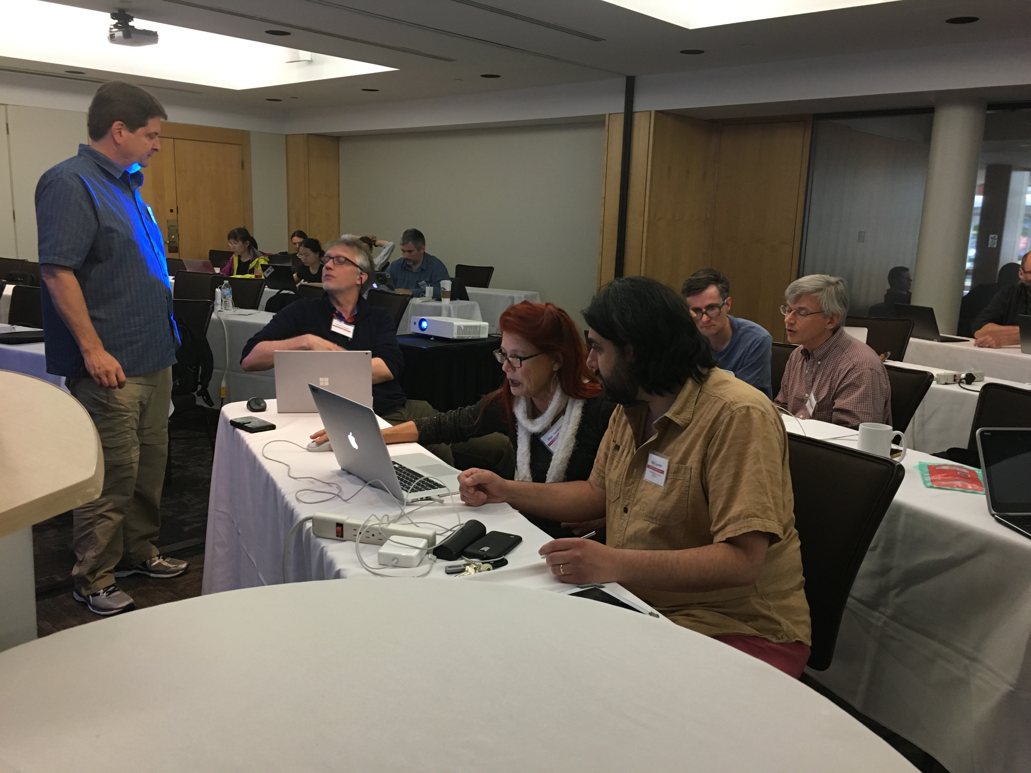
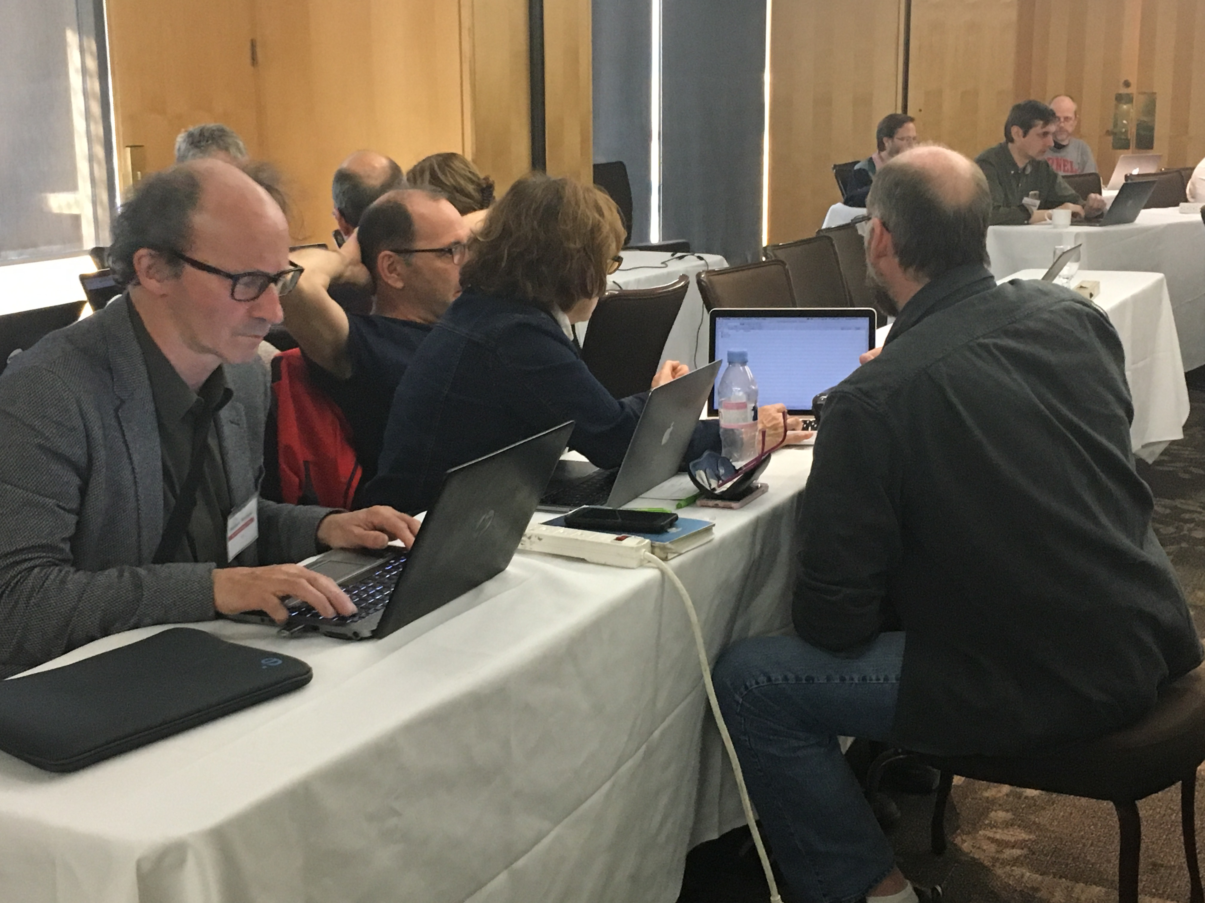
The First IVOA Hackathon

Slide 5
Special CSP session with Astropy
How can the IVOA be more visible to the Astropy community?
IVOA in GITHub for standards discussion?
Python s/w based on IVOA standards

Slide 6
IVOA Media Group Summary
Social Media: Hashtag for Interop meetings: #ivoa<year><country code> : #ivoa18ca Twitter account & Facebook group: @IVOAastro and the Chinese counterparts Weibo and WeChat.
Outreach: Booth at IAU IVOA handouts have been designed and IVOA corporate visual document in draft.
Web Pages: Media Group working on a redesign of the web pages http://ivoa.net. Currently focusing on the home page.
IVOA Newsletter: Articles please for #19! Deadline: 15 June 2018
Media Group Charter: Update has been sent to the Exec.
Contact us: media@ivoa.net New members welcome!!

Slide 7
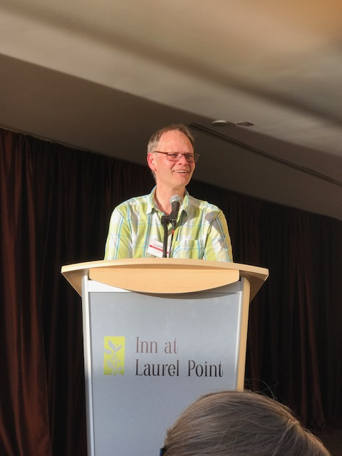
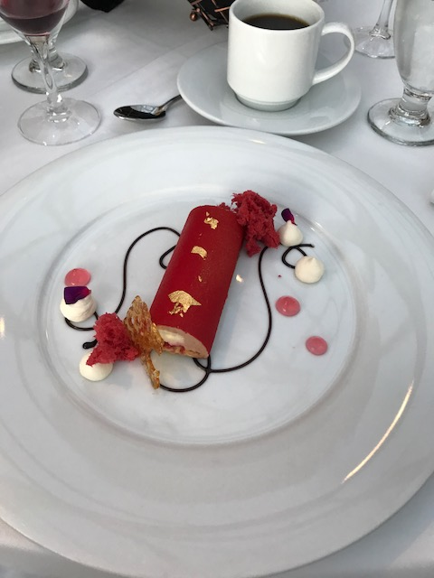
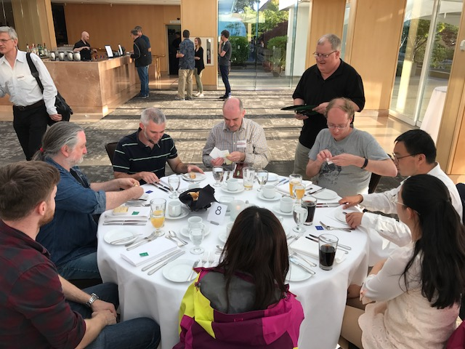
The Banquet

Slide 8
New Chairs and Vice-Chairs

Slide 9
WG Chairs and Vice-Chairs
App.: Pierre Fernique - Ch, Tom Donaldson - V Ch New: Tom Donaldson Raffaele D’Abrusco
DAL: Francois Bonnarel - Ch, Marco Molinaro - V Ch Marco Molinaro James Dampsey
Registry: Markus Demleitner - Ch, Theresa Dower – V Ch Theresa Dower Pierre Lesidaneur
DM: Mark Cresitello-Dittmar* - Ch, Laurent Michel* - V Ch
GWS: Brian Major* - Ch, Giuliano Taffoni* - V Ch
* 1 yr extension

Slide 10
WG Chairs and Vice-Chairs
Semantics: Mireille Louys - Ch, Alberto Accomazzi - V Ch Mireille Louys* Open **
* 1 yr extension
** To Be Discussed by Exec in July – nominations are open (please e-mail Mark Allen)

Slide 11
IG Chairs and Vice-Chairs
DCP: Francoise Genova – Ch Andre’ Schaaff – Ch Tim Jenness –V Ch
KDD: Kai Polterer – Ch V Ch Open**
Ops: Tom McGlynn* - Ch, Mark Taylor* - V Ch
SS: Baptiste Cecconi – Ch, Steve Joy – V Ch
*1 yr extension ** ** To Be Discussed by Exec in July – nominations are open (please e-mail Mark Allen)

Slide 12
TCG, CSP and Exec
TCG: Matthew Graham - Ch, Patrick Dowler - V Ch
Patrick Dowler Janet Evans
CSP New Members: Raffaele D’Abrusco and Gregory Dubois-Felsmann
Exec: Pepi Fabbiano - Ch, Mark Allen - V Ch Mark Allen Chenzhou Cui
The position of Exec Secretary is open for nominations
To Be Discussed by Exec in July (please e-mail Mark Allen)

Slide 13
Next Interop
08-10 Nov | Interoperability Meeting | USVOA | College Park, Maryland, USA | before ADASS

