Slide 1
PaperData Updates : Integrated VOSpace, Registry and DOI services
Yihan Tao, Changhua Li, Boliang He, Chenzhou Cui
China-VO, NAOC
IVOA InterOp Meeting, Paris, May 2019

Slide 2
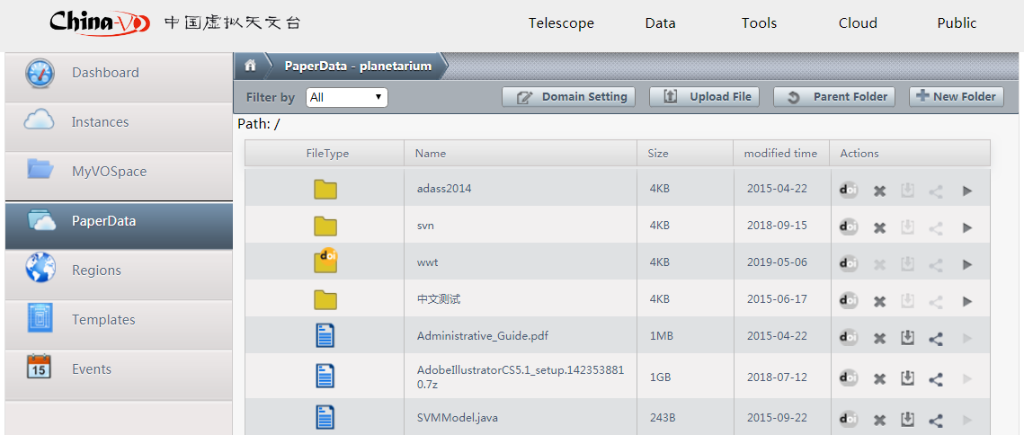
PaperData V2.0 - A Persistent Data Repository for Journal Papers
Adding DOI services in PaperData V2.0
Notes:
Other new features for PaperData V2.0?
In Compliant with VOSpace, VORegistry

Slide 3
Digital Objects and PIDs
Digital Objects | IVOID | DOI | Notes
Registry | ✓ |  | VO Registry
Organisation | ✓ |  | Institutions, Observatories, Data Centers
Equipment | ✓ |  | Telescopes
Datasets | ✓ | ✓ | Astronomical datasets, Data releases
Data Service | ✓ |  | VO data access service
Paper data | ✓ | ✓ | Paper related data
Documents |  | ✓ | Documents, papers
Images |  | ✓ | Images
Audio & Video |  | ✓ | Audio & Video
Software |  | ✓ | Software
Course |  | ✓ | Open Course
Other digital resources |  | ✓
Notes:
China-VO now provides journal authors DOIs to create unique and permanent links to datasets in PaperData
Query？

Slide 4

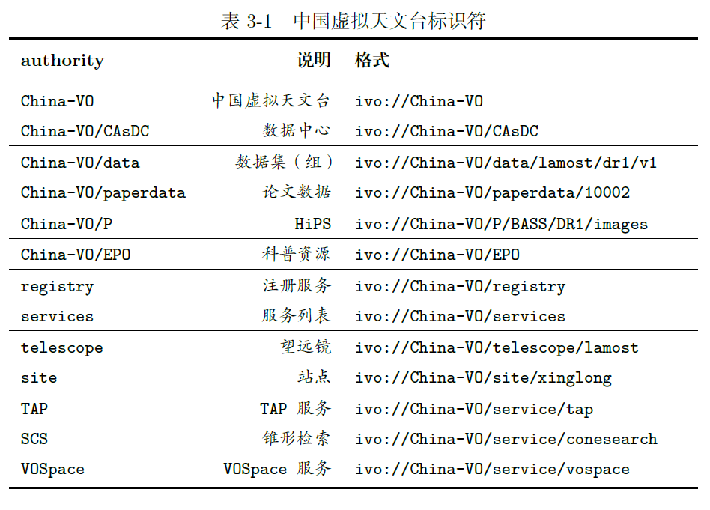
PIDs Syntax by China-VO
DOI
Syntax¬：doi://10.12149/10000
• 10.12149：DOI of Chinese Astronomical Data Center (CAsDC)
• 10000：Serial number, start from 10000
PaperData ID
http://paperdata.china-vo.org/LastName.FirstName/Year/Journal/PaperTitle/filename
IVOID
Prefix
Suffix
Notes:
Prefix Suffix

Slide 5
To get a DOI / IVOID
1.Upload Data Objects to PaperData
2. Apply for DOI from PaperData
3.Fill in Metadata
4. Quaility Audit by CAsDC
5. If Approved, Assign a DOI / IVOID
If Rejected

Slide 6
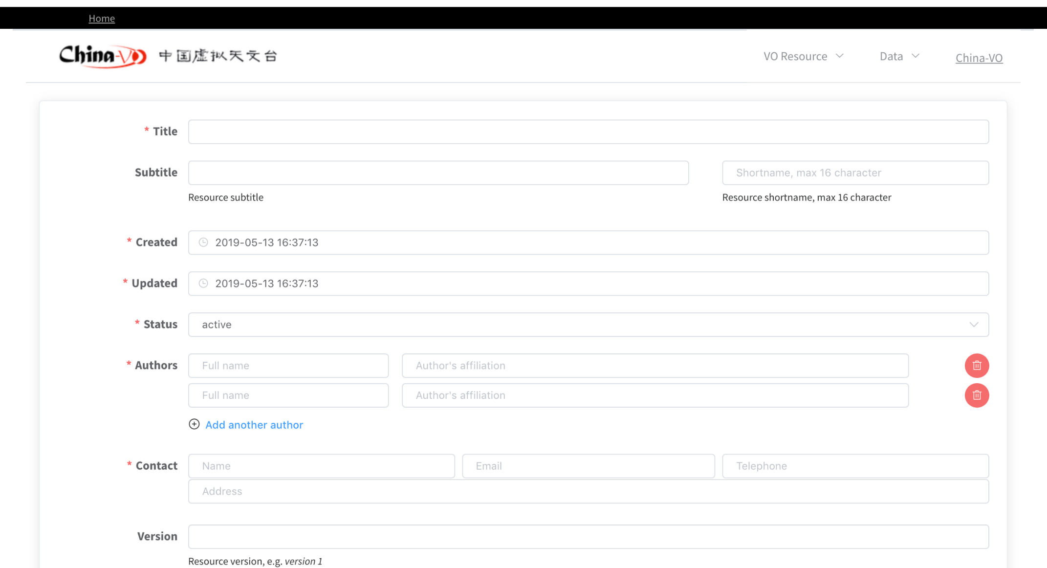
Metadata
Based on DataCite metadata schema and VOResource schema
Notes:
Mandatory + recommended：
Optional:version

Slide 7
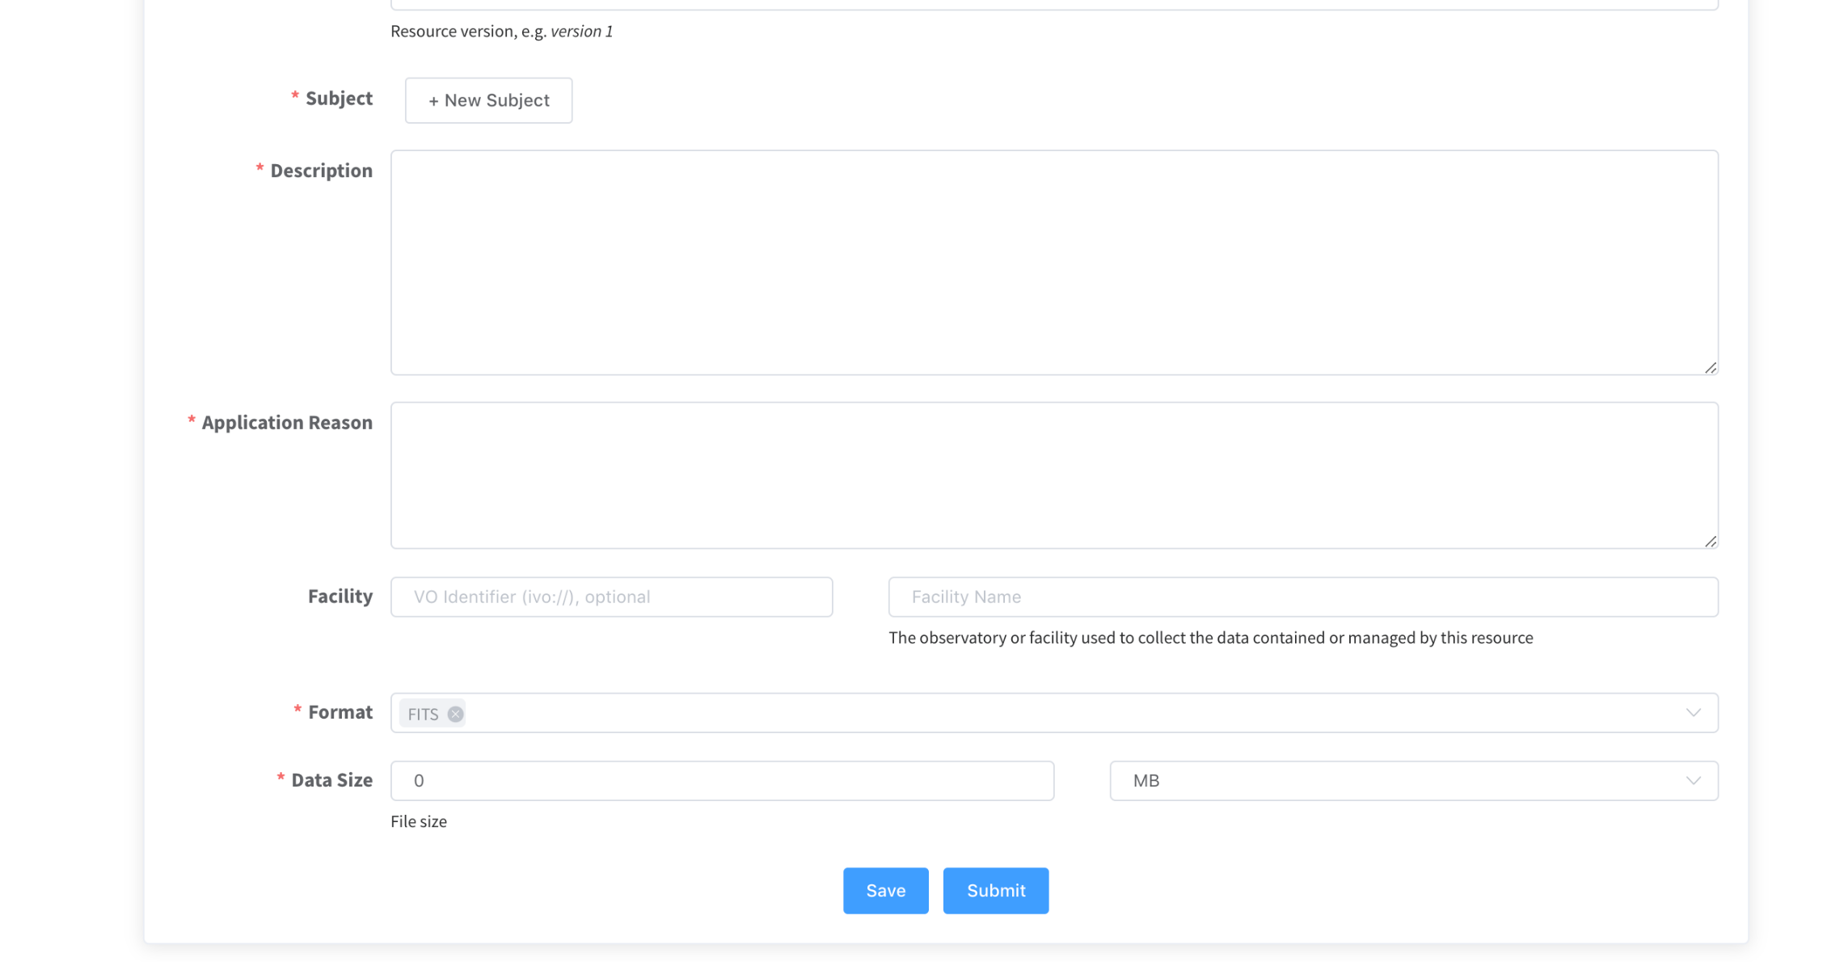
Metadata

Slide 8
Quality Audit
Requirements
  Paper has been accepted
  Metadata is complete and true
  …
Check by CAsDC administrators

Slide 9
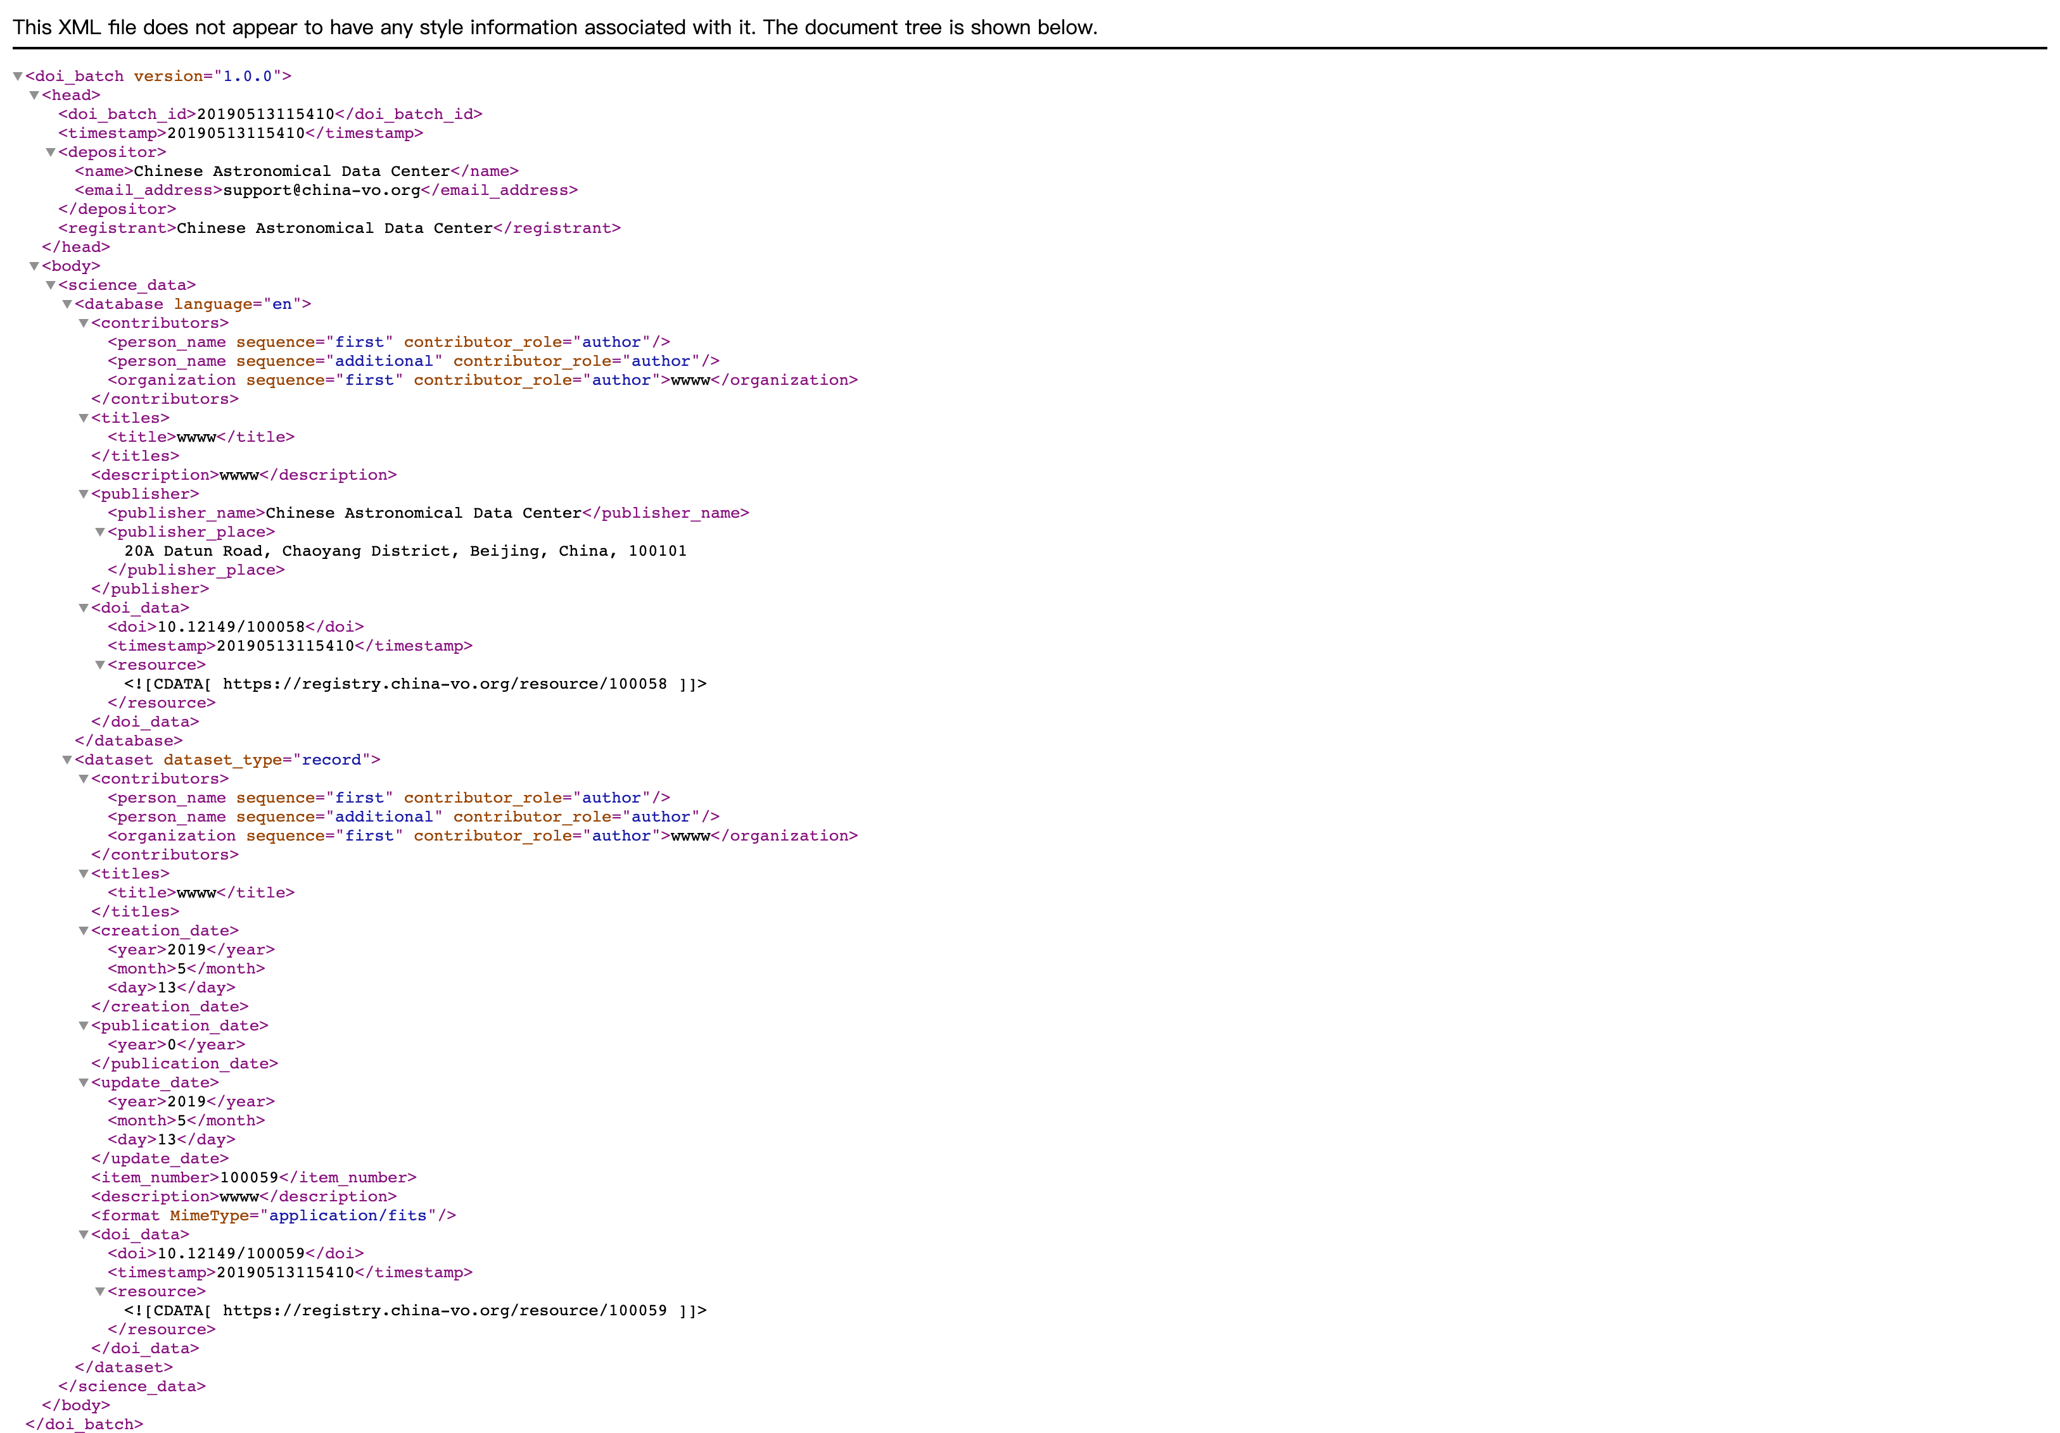
Automatically generated XML

Slide 10
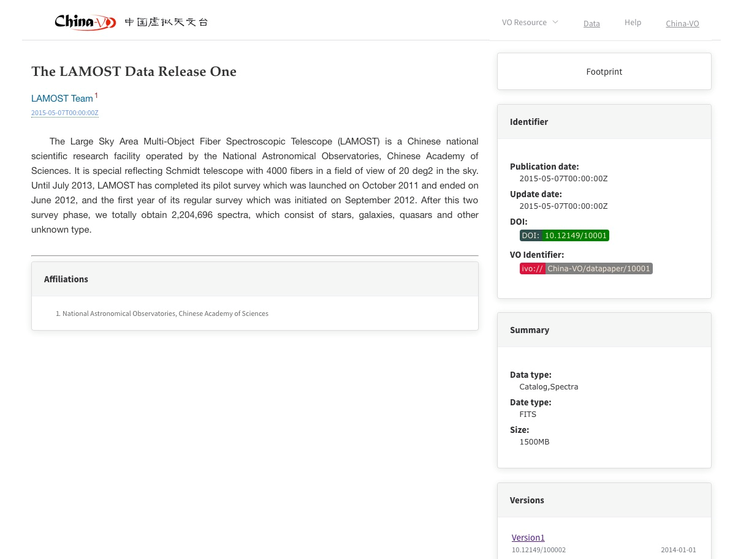
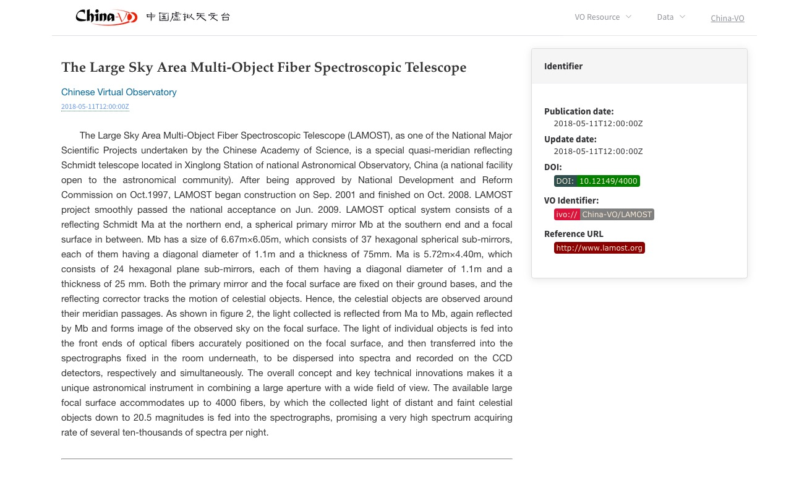
DOI Landing Page
Notes:
View list of data objects registered with DOIs and detailed description

Slide 11
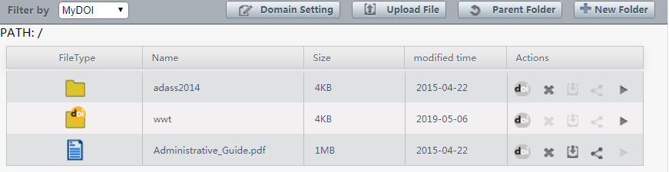
Data Security
Once a DOI is issued, no change of content/deletion allowed
Notes:
不同版本的截图

Slide 12
Versioning
Different DOI for each version of a data object, also a DOI for all versions

Slide 13
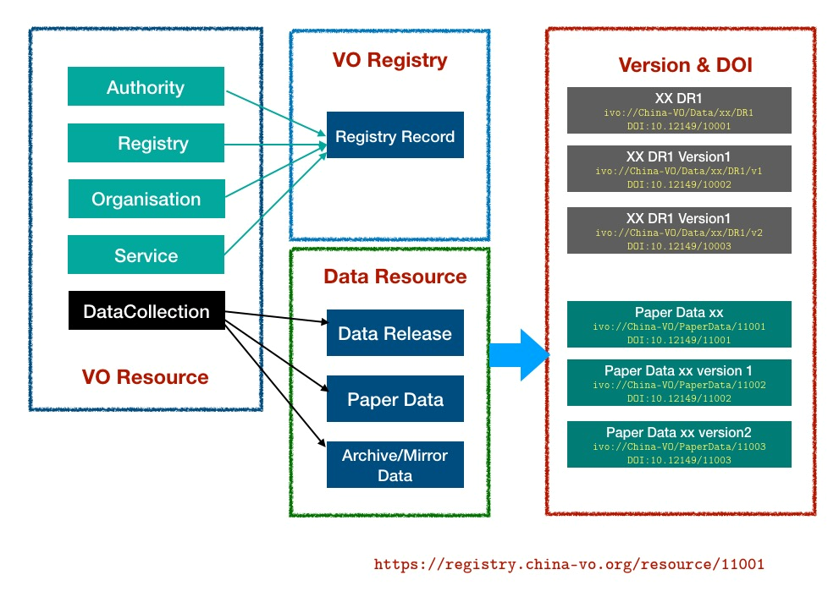
VOResource and DOI

Slide 14
Persistent Repositories for AAS Journals
China-VO Paper Data Repository
http://paperdata.china-vo.org/
In comply with the basic requirement and can serve as one of the Persistent Repositories for AAS Journals
https://github.com/AASJournals/Tutorials/blob/master/Repositories/UsingRepositories.md

