Slide 1
ObsLocTAP status report
Jesús Salgado¹,
Aitor Ibarra¹, Karl Foster⁵, Richard Saxton², Jan-Uwe Ness⁴, Erik Kuulkers⁴,
Carlos Gabriel⁴, Bruno Merín⁴, Peter Kretschmar⁴,Emilio Salazar³, Celia Sánchez³
1 Quasar for ESA - 2 TPZ-VEGA for ESA - 3 ATG for ESA - 4 ESA 5 NuSTAR

Slide 2
Observations Life cycle
Planned
Scheduled
Performed
Archived
Aborted

Slide 3
Planned Observations Services

Slide 4
ObsLocTAP RFC Status
TCG revision of PR 1.0
2020-10-19 - now
https://wiki.ivoa.net/twiki/bin/view/IVOA/ObsLocTAP10RFC
Minor revisions including comments from TCG
Server reference implementations:
Integral Science Archive
https://ila.esac.esa.int/tap/tap/
(compliant)
Chandra CFA
https://cda.cfa.harvard.edu/cxctap/
(compliant)
Docker implementation
(ongoing work)

Slide 5
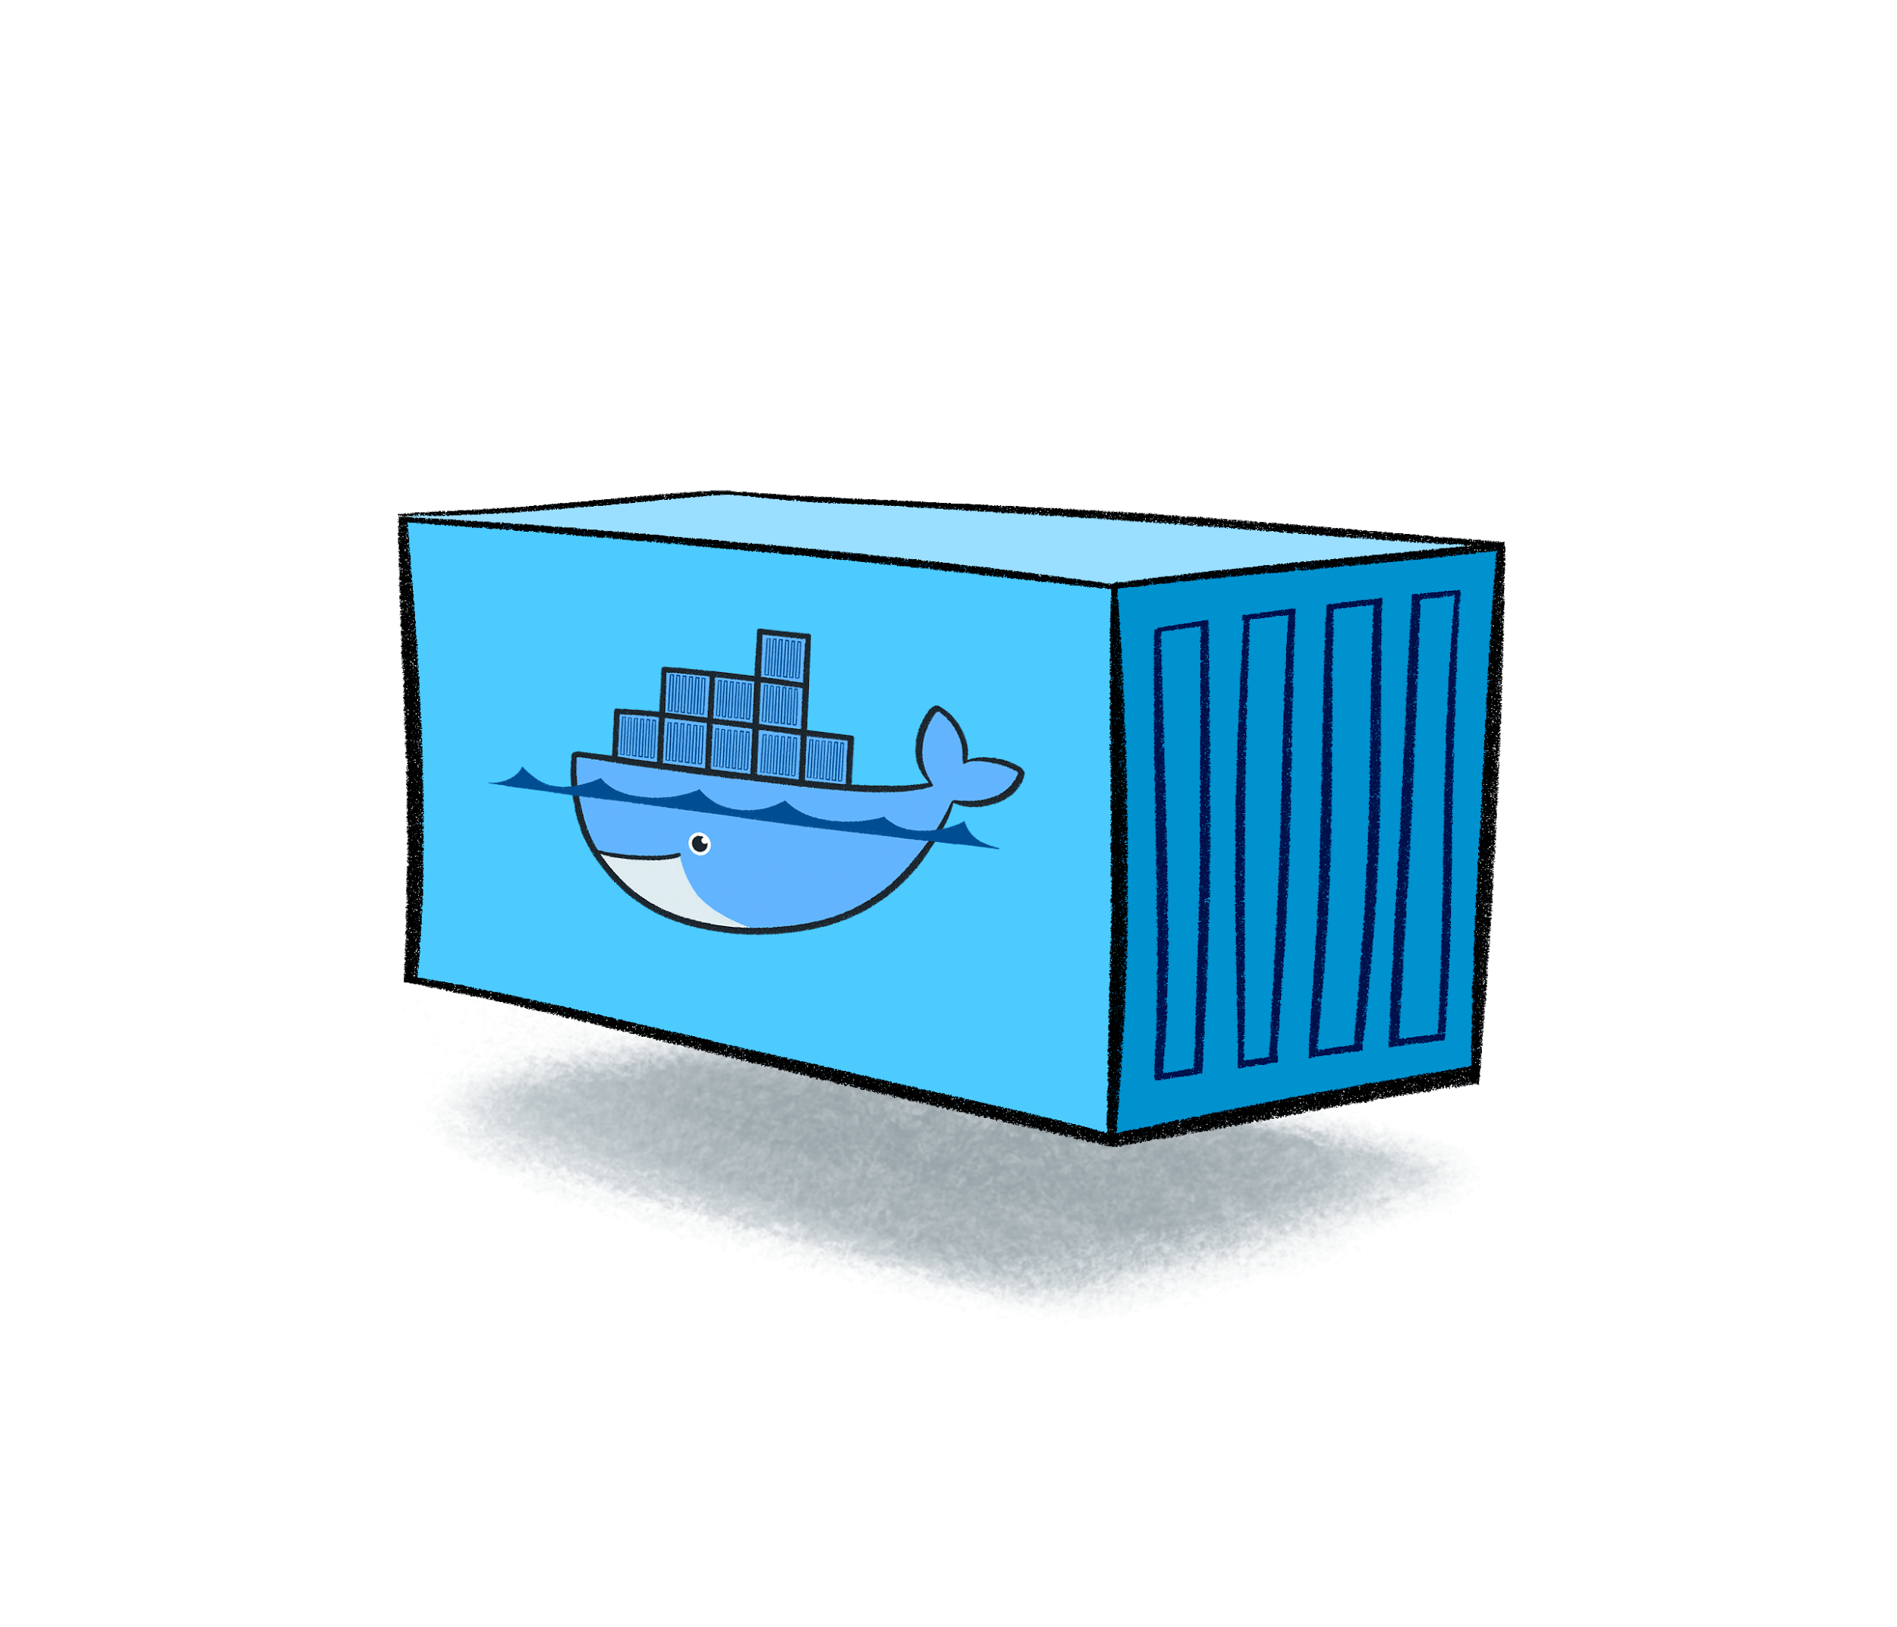
ObsLocTAP by Docker start-up
network bridge
postgreSQL - pgsphere-obsplan
tapserver (taptuto)
Database
Port 5432
Tomcat
Port 8080
docker pull jsalgadodocker/pgsphere-obsplan:latest
docker pull jsalgadodocker/tapserver:latest
docker network create --driver=bridge db-network
docker run -p 8080:8080 --net=db-network --name tap jsalgadodocker/tapserver:latest
docker run -p 5432:5432 --net=db-network --name db jsalgadodocker/pgsphere-obsplan:latest

Slide 6
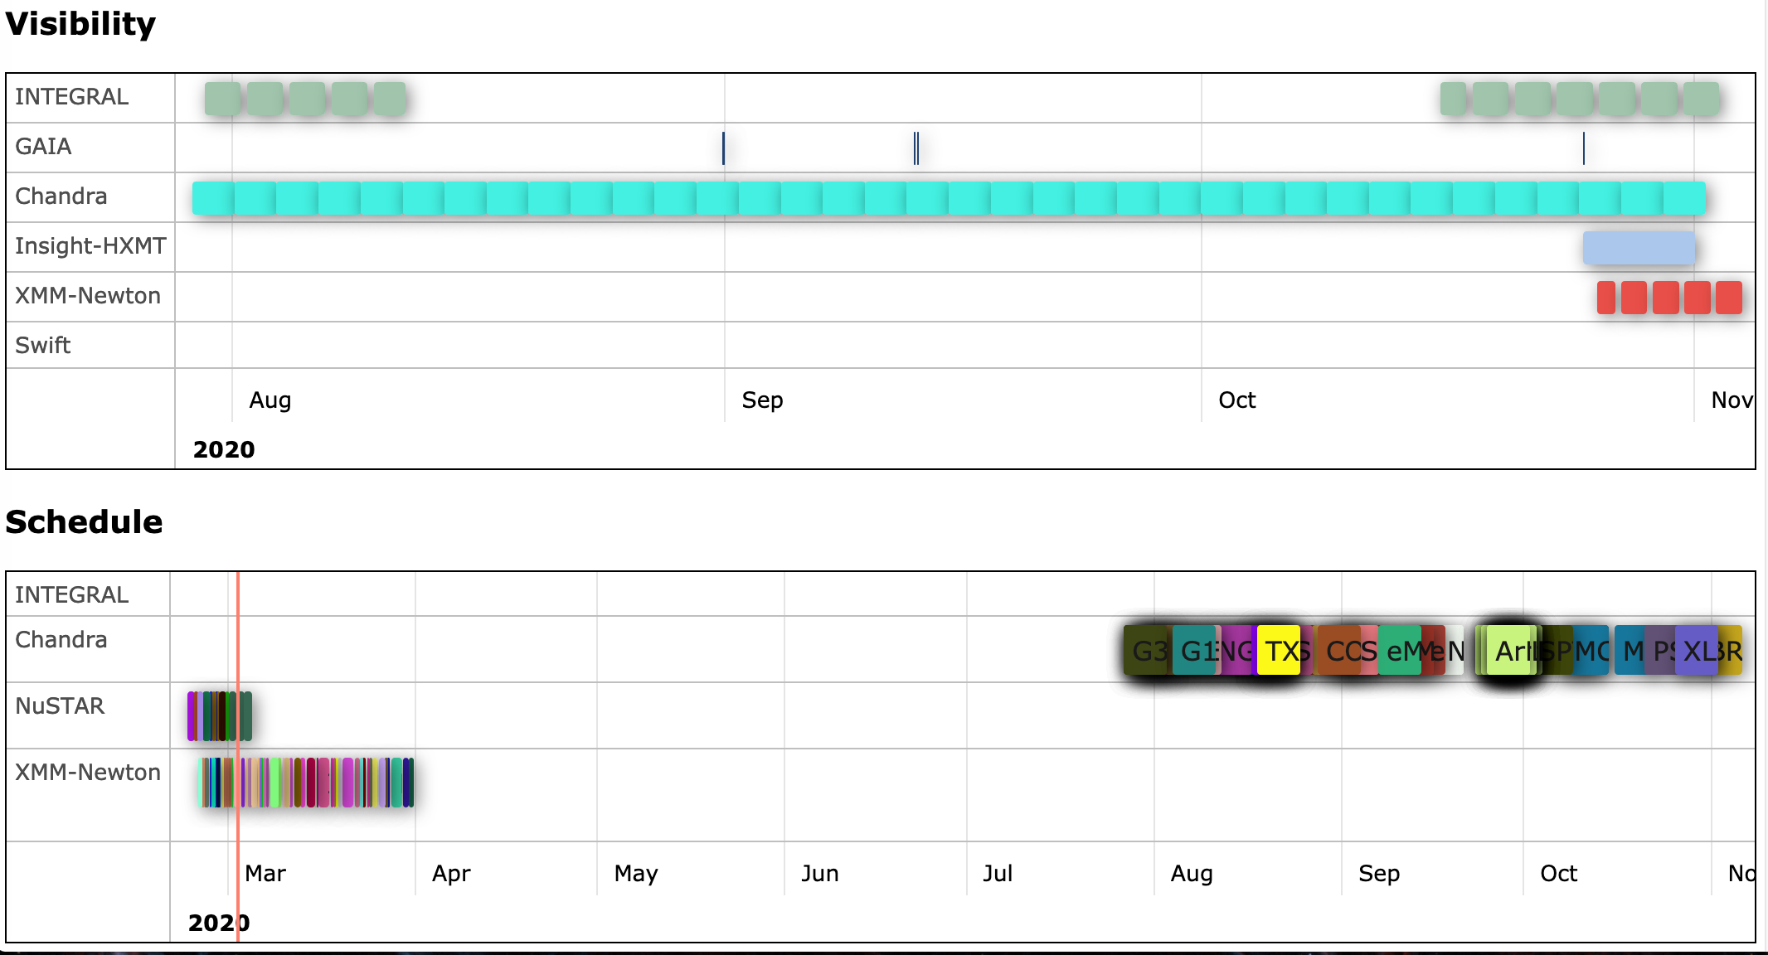
Reference implementation client
TOBY, reference client implementation (E. Salazar)
http://integral.esa.int/toby/
Other clients expected: MySpaceCal (calendar for many missions), ESASky, etc

Slide 7
Validator
Taplint prerelease version
ftp://andromeda.star.bris.ac.uk/pub/star/stilts/pre/stilts.jar
with ObsLocTAP validation
Thanks to Mark Taylor!
Validator has been quite useful to evaluate the implementations but, also to correct specification from ambiguities or errors
Integral server is now fully compliant and it is consumed by prototype implementation

Slide 8
Registration
Example of registration included into the spec
Thanks to Markus Demleitner!
Identifier: ivo://esavo/isla/obsloctap
SELECT ivoid, res_title, access_url
FROM rr.resource
NATURAL JOIN rr.capability
NATURAL JOIN rr.interface
NATURAL JOIN rr.res_table
WHERE
table_utype='ivo://ivoa.net/std/obsloctap#table-1.0'
AND standard_id LIKE 'ivoa.net/std/tap%'
AND intf_role='std'
AND authenticated_only=0

Slide 9
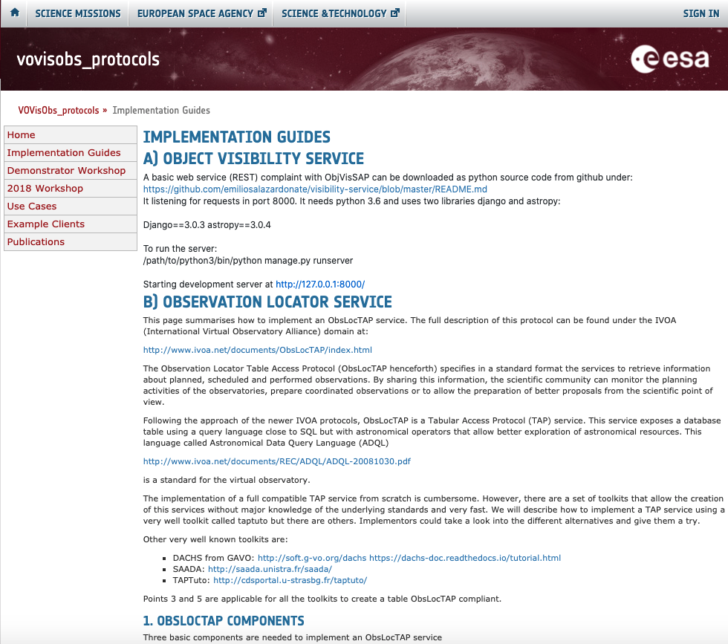
Tricks for implementors
https://www.cosmos.esa.int/web/vovisobs_protocols/implementation-guides

Slide 10
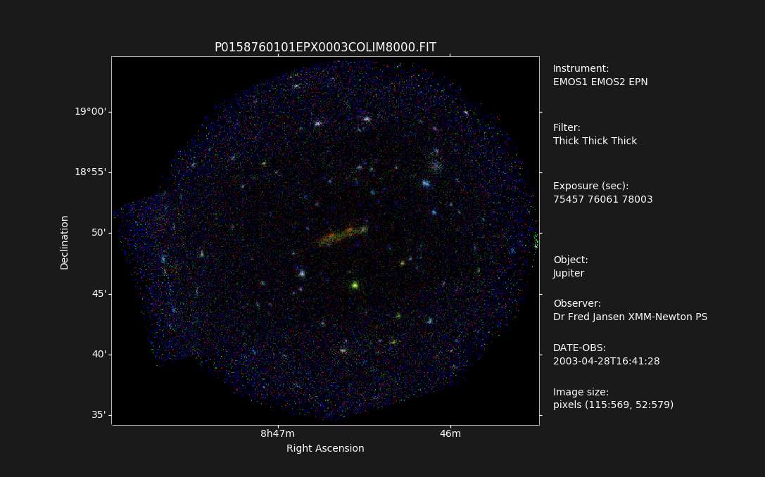
Other RFC comments from TCG
Comments received by all WGs and all answered
Current version a lot more stable and improved due to review (thanks!)
Only open issue, if protocol could be used for moving target (Solar system objects)
"tracking_type" parameter:
RA/Dec (default)
solar-system object tracking
transit mode
Under discussion within authors
Specification almost ready for recommendation
Votes pending:
TCG Chair (changes requested answered this week)

Slide 11
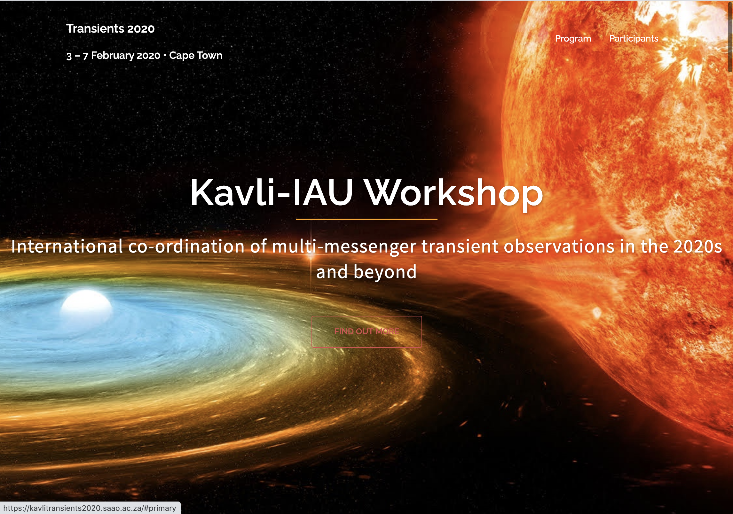
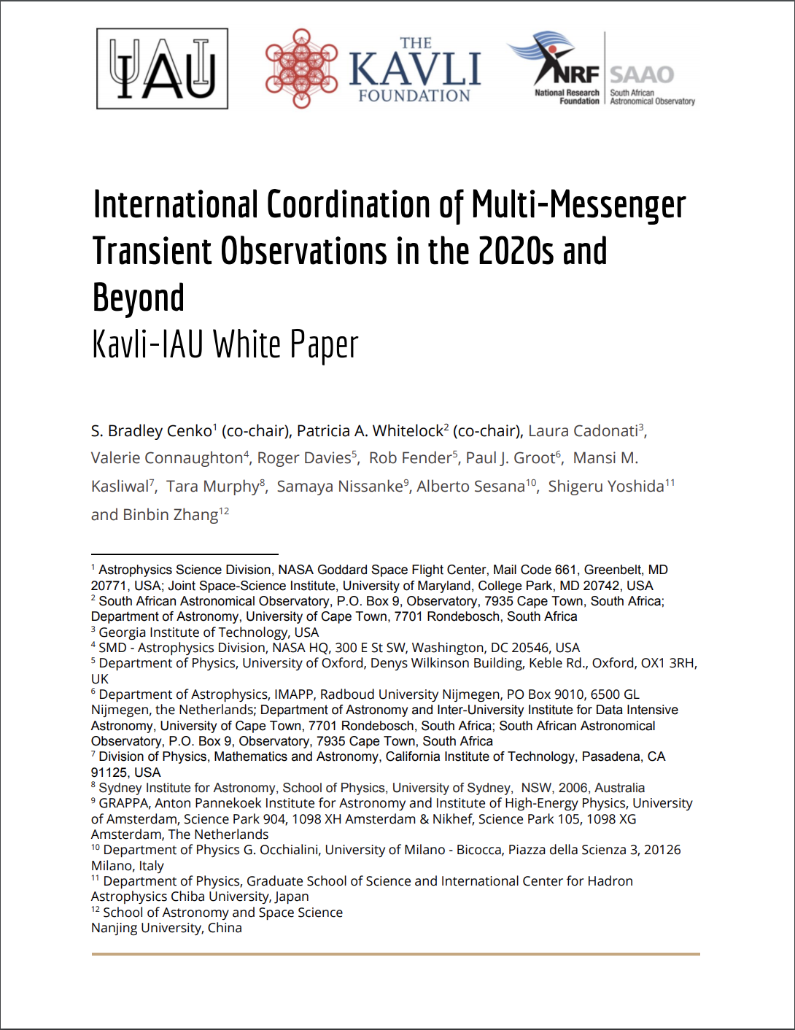
ObsLocTAP IAU endorsement proposal
Multi-messenger and Transient Astronomy White Paper
(Thanks to Ada Nebot for representing IVOA on this forum!)
https://arxiv.org/abs/2007.05546
“Telescope Coordination Recommendation 1: We recommend the IAU endorse a common format for all observatories to report previous and planned observations, namely the standard developed by the IVOA (ObsLocTAP).”
Proposal to endorse this white paper recommendations by IAU during next XXXI IAU General Assembly (Busan, South Korea, August 2021)

Slide 12
ObsLocTAP architecture
INGEST
ivoa.obsplan

Slide 13
ObsLocTAP implementation problems
Technical background
Not all the observatories have the resources or expertise to implement a TAP server
Answer: Toolkits, Dockers, support (IVOA members could help)
Not good knowledge of future observations
Answer: Even a short term knowledge is quite relevant for the community for, e.g. ToO follow-up
Proprietary metadata
Answer: Even to know that one time slot is reserved (or not) and to know if this is a must-done observations or something that could be done is quite relevant for multi-messenger astronomy
Summary
Question: Why this has not been done before?

Slide 14
Thanks!

