Slide 1
GWS Working Group
Opening
Jesús Salgado & Sara Bertocco

Slide 2
GWS WG - “The unique and only palindrome WG in the IVOA” - G. Taffoni
What did we do?
Define the use of Grid technologies and web services within the VO context and to investigate, specify, and implement required standards in this area.
What do we do?
Relation between software and resources (Computing, Storage)
Authentication, Authorisation
Clouds, Orchestrators, Containers
Science Platforms
WG name changing to Distributed Services and Protocols (DPS)

Slide 3
DAL/GWS Protocol Transitioning Tiger team (P3T)
Upgrade technologies of IVOA protocols
Use of OpenAPI
  Machine readable interfaces
  Clearer Specifications
  Faster Development
  Community Involvement
  Automated Documentation
  Potential for Validation, Testing, Version Control

Slide 4
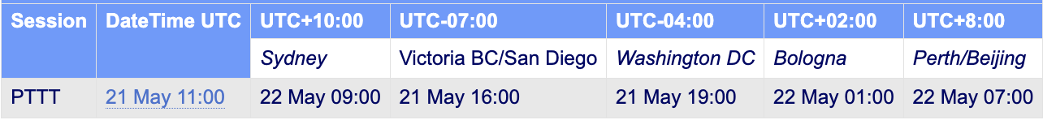
DAL/GWS Protocol Transitioning Tiger team (P3T) (II)
Execution Broker WG designed using new paradigm (D. Morris)
UWS one of the first candidate of existing standards to be upgraded

Slide 5

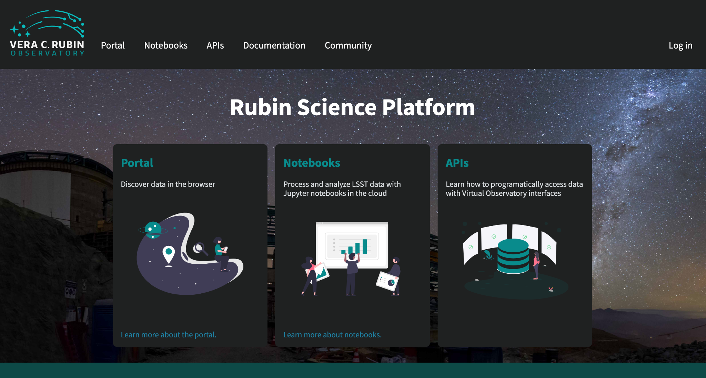



Science Platforms

Slide 6
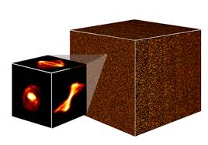

Connecting platforms
S. Bertocco
V. Navarro + C. Arviset
AAI
AAI
Science Platform 1
Science Platform 2
SSO
App1
App2
Execution
Broker
Y. Grange
P. Le Sidaner +
A. Shih
D. Morris
P. Dowler
VOSpace

Slide 7
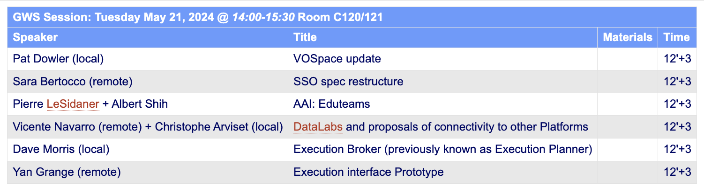
GWS WG Session -
GWS Session: Tuesday May 21, 2024 @ 14:00-15:30 Room C120/121

Slide 8
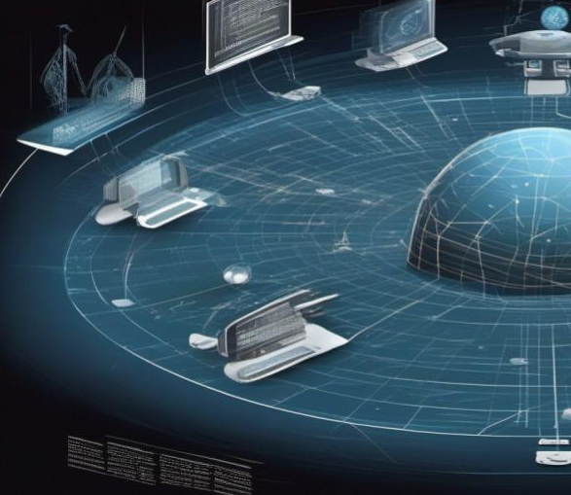
Thanks!
Contact us:
grid@ivoa.net

