Slide 1

Unifying Access Control across the All-Sky Virtual Observatory
Dr Simon O’Toole – AAO-Macquarie

Slide 2
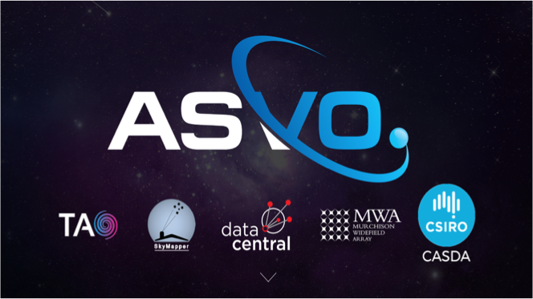
asvo nodes

Slide 3
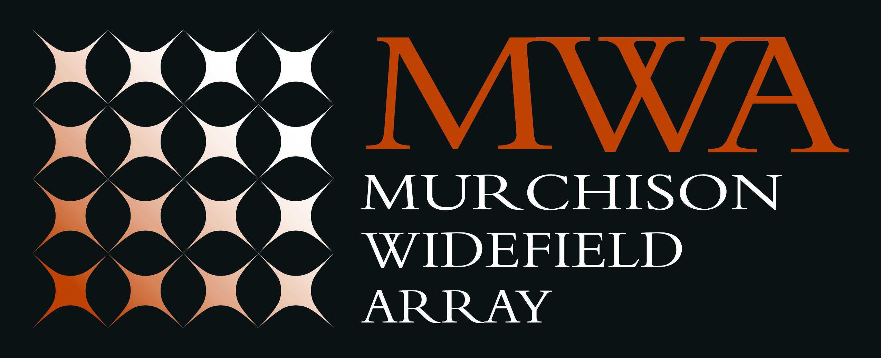
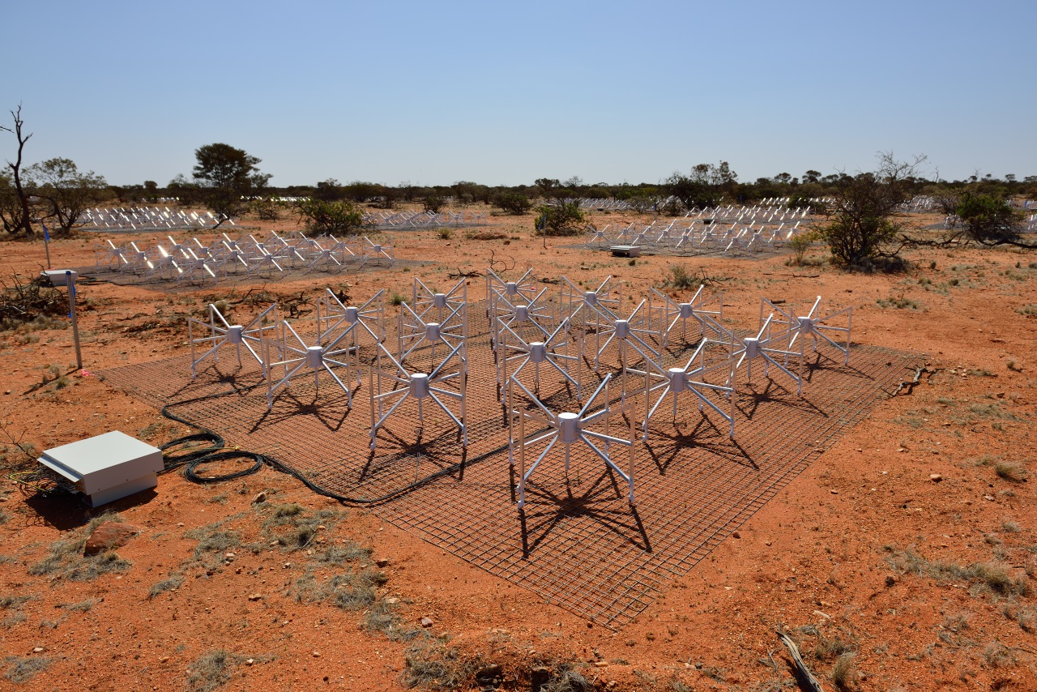
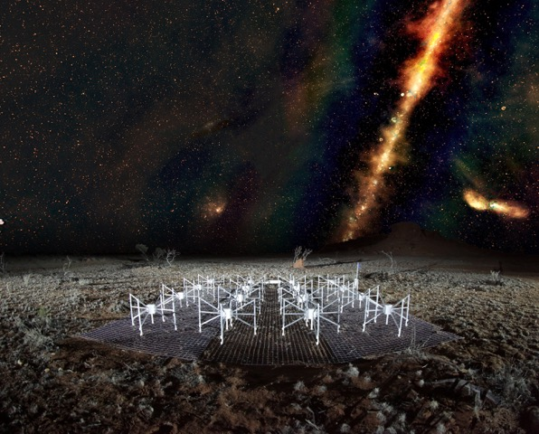
MWA Node
asvo: mwa
Summary:
  International Consortium led by Curtin University
  Low frequency radio telescope (80-300 MHz)
  Operations began mid-2013
  Provides pre-processed uncalibrated data
  One of the 4 SKA precursor telescopes
  28Pb publicly available data
  Each observation 10-100 Gb’s in size
  MWA ASVO averages data into smaller volumes
  MWA ASVO reduce barriers for astronomer not directly involved in the project by making manageable data

Slide 4

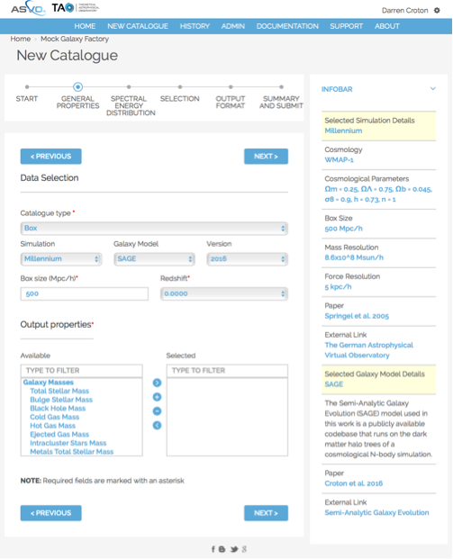
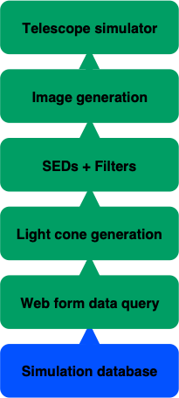
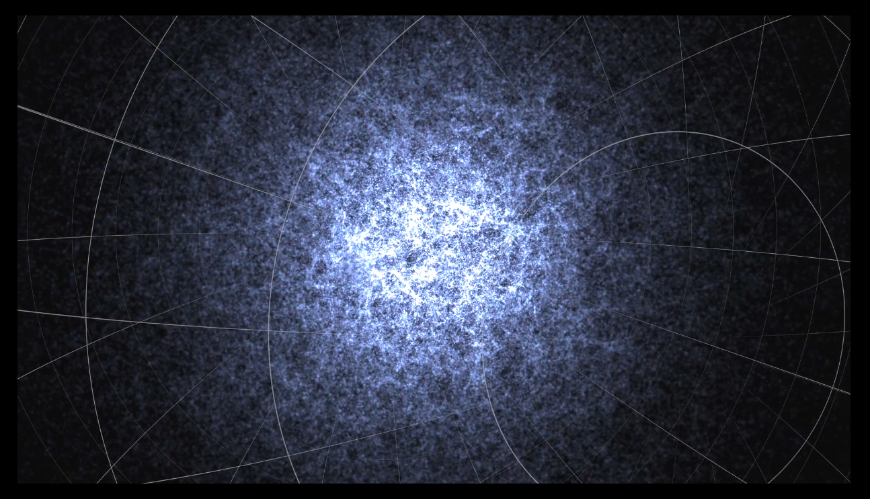
TAO Node
asvo: tao
Summary:
  Led by Swinburne University
  Cosmological and galaxy formation simulations for astronomers
  Launched March 2014
  Over 1000 virtual universes built

Slide 5

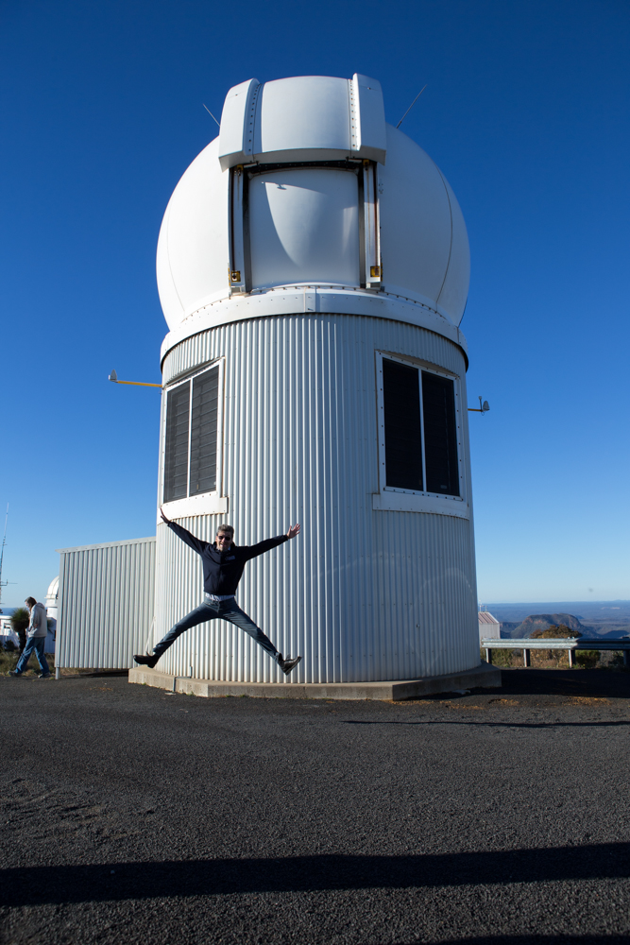
SkyMapper Node
asvo: skymapper
Summary:
  Consortium led by Australian National University
  Specially built 1.3m telescope at SSO
  SkyMapper Southern Sky Survey
  Digital record of the entire southern sky
  Multi-epoch, multi-colour processed and calibrated data made available
  Total survey 1 Pb data
  First data release 2016

Slide 6
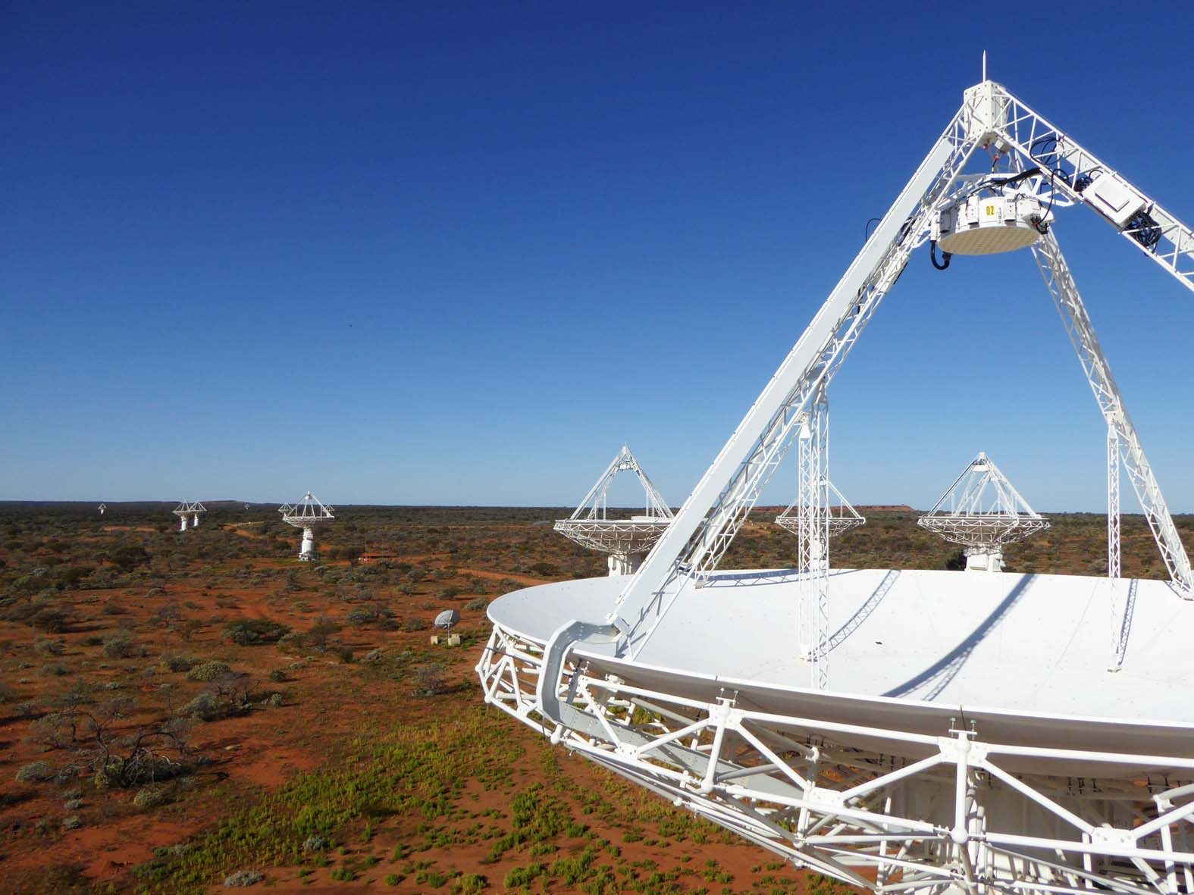

CASDA Node
asvo: casda
Summary:
  Collaboration - CASS, CSIRO IM & T, Pawsey
  CSIRO ASKAP Science Data Archive
  Data archive Australia SKA Pathfinder
  Science ready data products
  5 Pb data per year (full operational mode)
  First data release late 2015
  36 antenna radio telescope

Slide 7
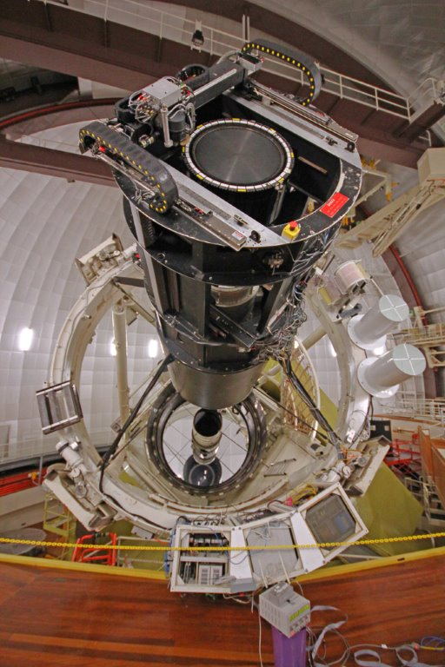
Data Central Node
asvo: data central
Summary:
  AAO-MQ (previously AAO)
  Virtual Observatory
  Launched 2017
  0.5Pb, 2020 1Pb
  AAT legacy data archive, 40 years
  Survey data (optical and other wavelengths)
  UI and API access

Slide 8

The problem
asvo: the problem
Five nodes acting as one
Each node has different infrastructure, requirements, politics
Each node has different user management
Require “seamless” integration — from review of ASVO

Slide 9
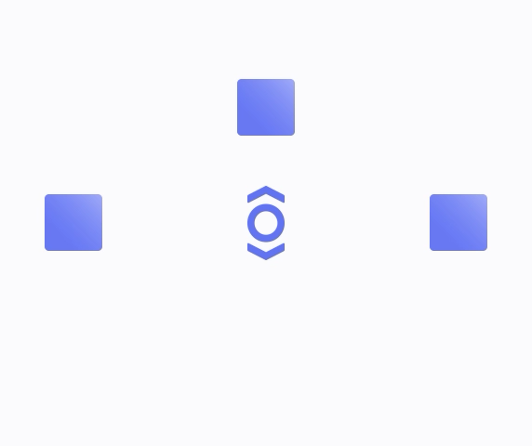
A Solution
asvo: solution
Single Sign-On using OAuth 2.0 & Open ID Connect
Identified ORY/Hydra as lightweight Identity Provider system (https://www.ory.sh)
Allows straightforward integration with your existing local IDP
Runs in Docker

Slide 10
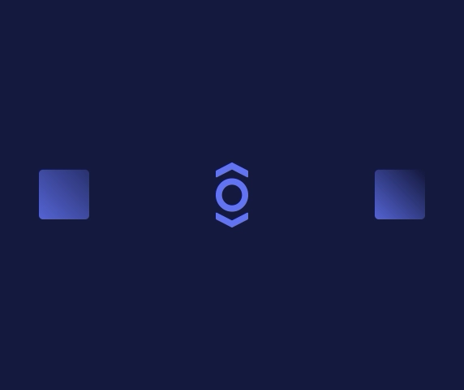
Workflow
asvo: workflow
Register client
  Generates client specific endpoints to server
User accesses endpoint
  Client redirects to login provider
  User logs in
  Login provider redirects to consent endpoint
  Client redirects to consent provider
  User gives consent (or not)
  Consent provider redirects to client application

Slide 11
Status
asvo: status
Data Central pilot with SkyMapper
SkyMapper already uses OAuth2.0 with Github, Facebook, Google
Currently implementing Hydra workflow
Next steps: testing then implement at other ASVO nodes

Slide 12


Welcome back.
Sign in to access your personalised data portal, collaborate with other researchers and manage your data
Sign in with Data Central
Sign in with SkyMapper
Sign in with TAO
Sign in with MWA
Sign in with CASDA
No account? Create one.
Click “Sign in” above to accept our Terms of Service & Privacy Policy
Milky Way over the Pinnacles in Australia - Michael Goh

Slide 13
OAuth2.0 & IVOA
asvo: oauth2 & ivoa
OAuth2.0 services must use TLS encryption
OAuth2.0 clients are recommended to use TLS
OAuth2.0 uses revocable tokens, so the user can revoke consent
These might be issues for some VO services and clients
ORY offers Oathkeeper to translate other tokens (e.g. JWT) in OAuth2.0

