Slide 1
Object Visibility Observability SAP Status
Aitor Ibarra
IVOA 2023 Tucson - 10/11/2023

Slide 2
Overview
Brief Object Visibility Observability SAP Introduction
Main goal
Current Status
  Visibility Concept Revision
Next steps

Slide 3
Brief Object Visibility Observability SAP Introduction
Demand for coordinated observations is increasing…
Some observatory numbers:
    NuSTAR: ~30% of the observations are coordinated with other observatories.
    XMM-Newton: ~15% coordinated observations (NuSTAR, HST, Chandra, VLT, Swift).
    INTEGRAL: ~10% of the observations are coordinated with other observatories.

Slide 4
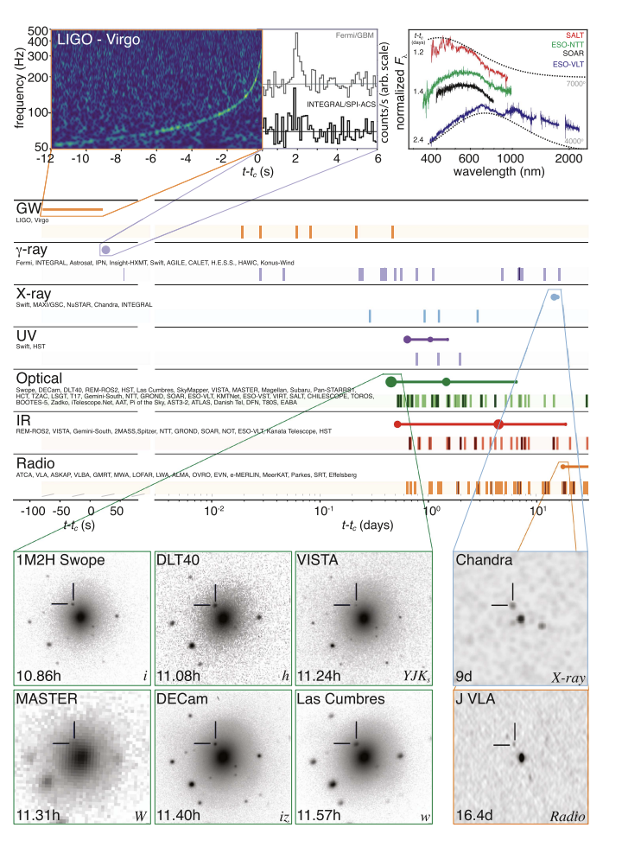
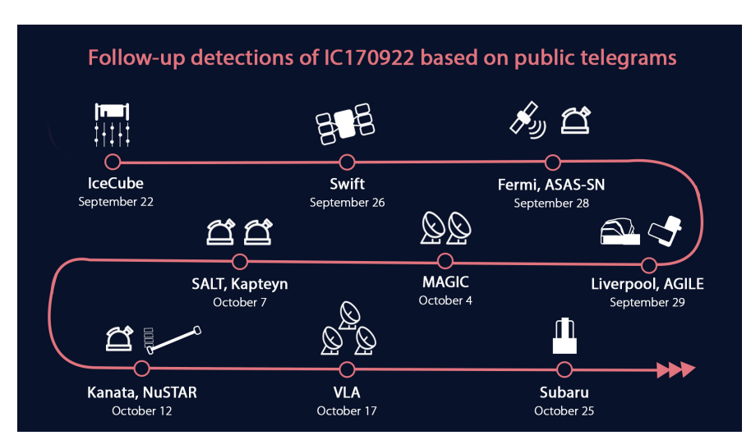
Brief Object Visibility Observability SAP Introduction
The NASA Multi-Messenger Astrophysics Science Support Center (MOSSAIC)*
Sambruna et al. (April 2022)

Slide 5
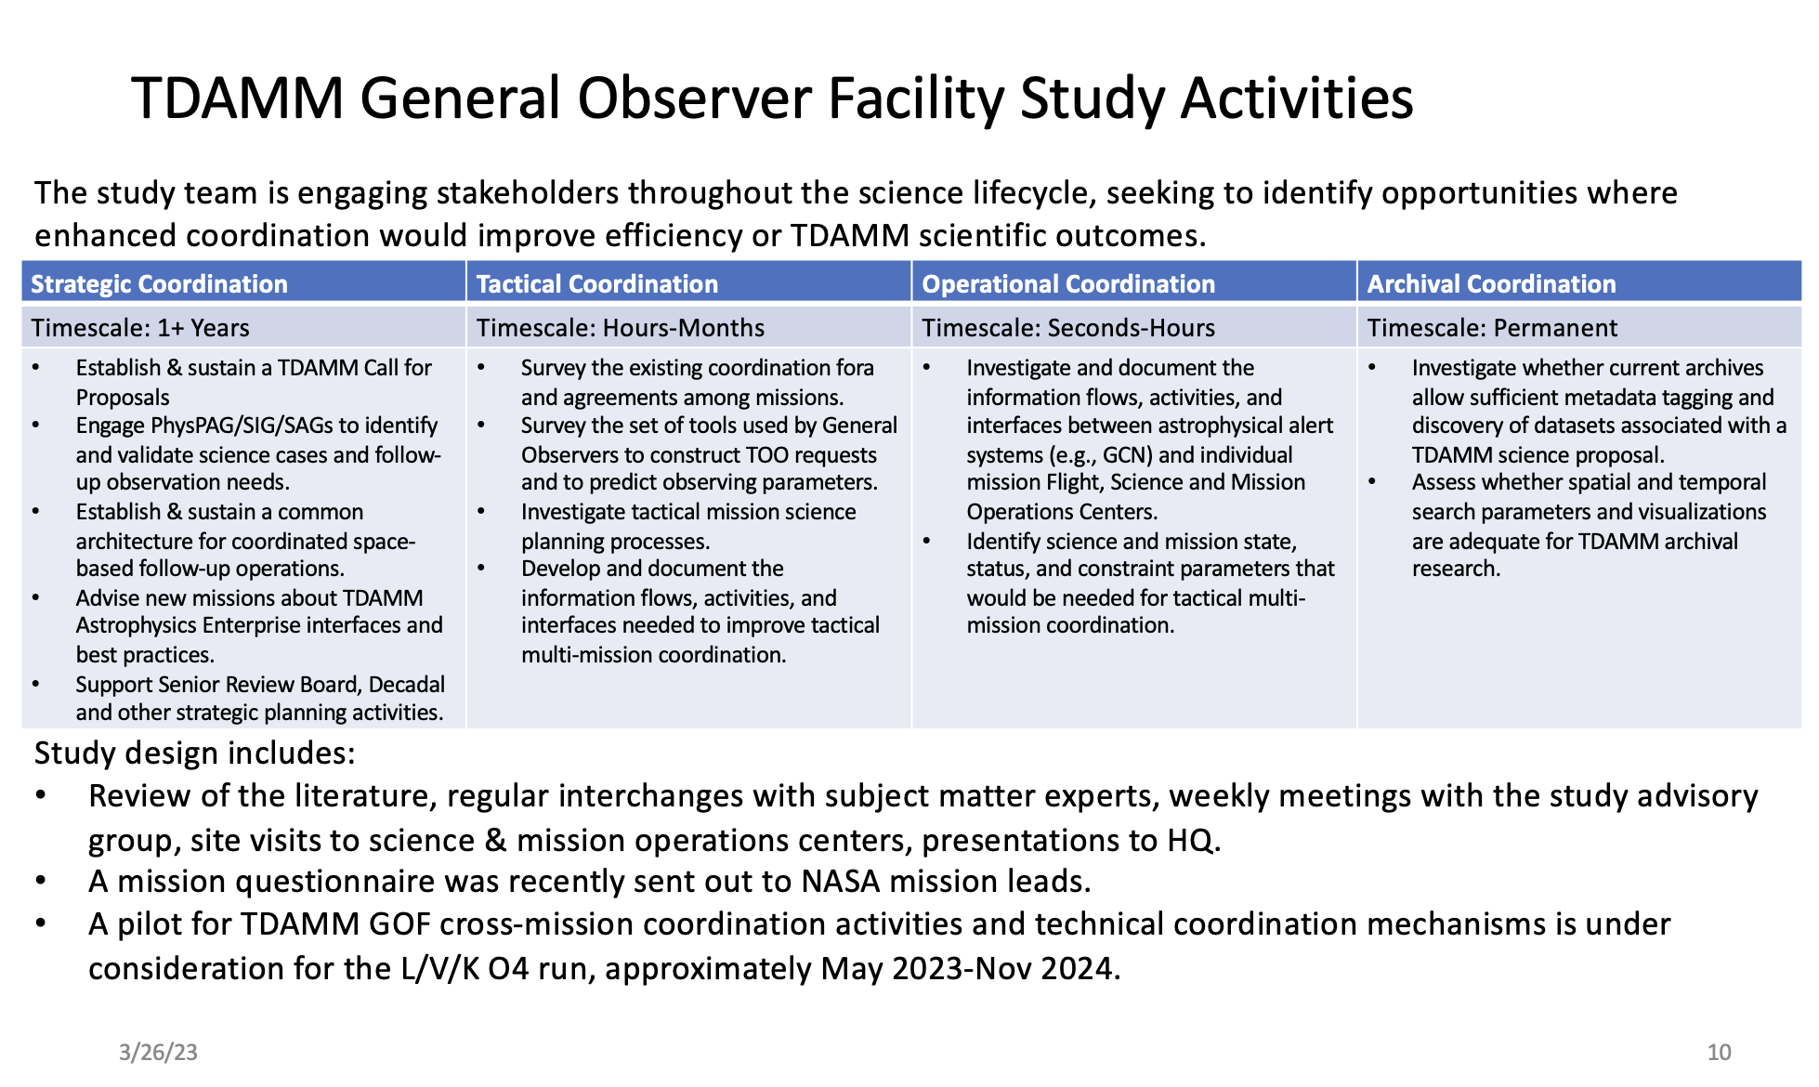
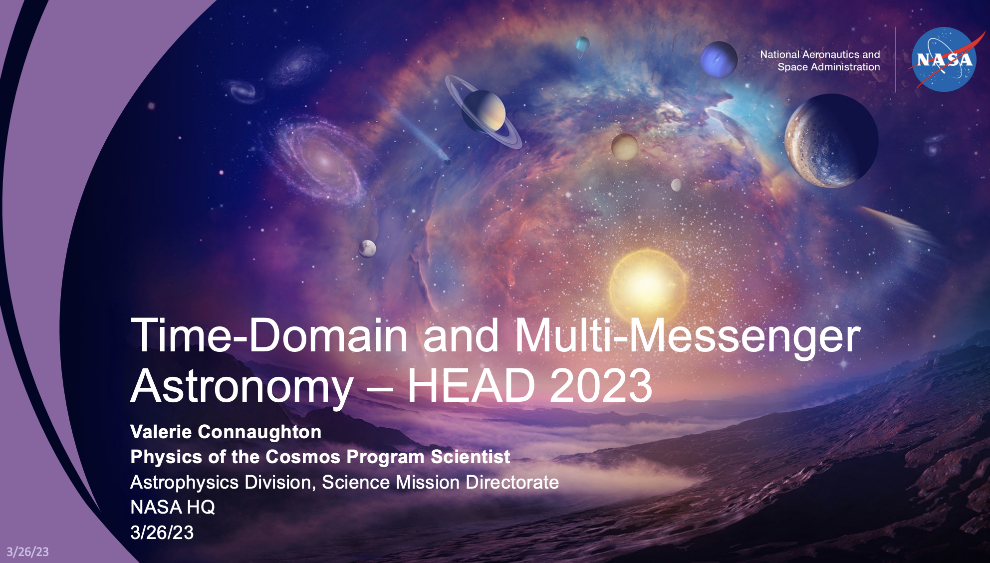
Brief Object Visibility Observability SAP Introduction
Time-Domain and Multi-Messenger Astronomy – HEAD 2023

Slide 6

Brief Object Visibility Observability SAP Introduction
Brian Humensky | NASA’s Astrophysics Cross-Observatory Science Support (ACROSS) Initiative
Michael Coughlin | A technical ecosystem to enable multi-messenger astrophysics
Shreya Anand | MMA observing campaigns with the Zwicky Transient Facility: challenges and lessons learned
Gautham Narayan | SCIMMA: Real-time Orchestration of Multi-Messenger Astrophysical Observations
Rachel Street | Tools for Time-Domain Observers: New features and development plans for the TOM Toolkit and more.
Monika Soraisam | GOATS: an end-to-end time-domain and multi-messenger astronomy platform
Griffin Hosseinzadeh | Infrastructure for Searches After Gravitational-waves Using ARizona Observatories
Sarah Antier | A french example of coordination of space and ground facilities for the multi-messenger effort
Nicholas White | Process barriers to new multi-messenger astrophysics space observatories

Slide 7
Main goal
To standaridize the retrieval of the well-known observability or contraint-free periods of astronomical targets that all facilities have
Follow-up observations
Alerts
Automated coordination
Easier communication
Help to plan observations
…

Slide 8
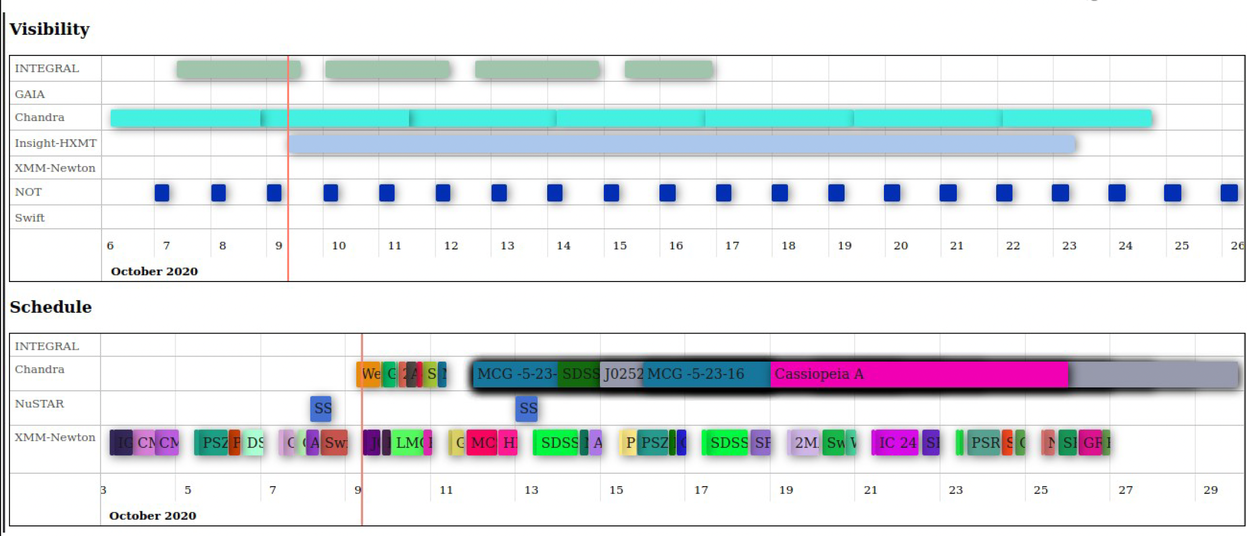
Current Status
Demo workshop organized by ESAC in September 2020
Object Visibility Simple Access Protocol already under discussion in the IVOA DAL panel.
Prototype implementation already in place for some facilities.

Slide 9
Current Status
Target constraint-free time periods concept in optical, high-energy and radio astronomy is the same, but the term visibility is not shared by all disciplines.
Visibility in radio astronomy
The visibility function is the result of the Fourier Transform of the celestial brightness distribution in the sky.
It is a measure of how well the signals from a celestial source are correlated between the antennas.

Slide 10
Current Status
SCHED is a program for planning and scheduling Very Long Baseline Array (VLBA)
THE SCHED USER MANUAL Version 11.8, Released April 2023 (nrao.edu)
"This tries to compensate for edge stations that have no mutual visibility with the rest of the array for sources at low elevation in certain directions. The input scan to use is then selected based on the adjusted weights."
VLBI scheduling software sked
https://core.ac.uk/download/pdf/42753936.pdf
" Sked calculates the source visibility table (a table which indicates which stations can see each source). This is used to generate the universe of possible scans."

Slide 11
Current Status
TOM toolkit
Plugins — TOM Toolkit 1.1.0 documentation (tom-toolkit.readthedocs.io)
"tom-nonsidereal-airmass. This module provides a templatetag supporting visibility plots for non-sidereal.”
SPICE from JPL
SPICE Geometry Calculator (nasa.gov)
Concepts like:
  "target in field of view”
  "target in view”
Astroplan (python)
astroplan v0.9.2.dev1+g5e4ac2c
"Determining observability of sets of targets given an arbitrary set of constraints (i.e., altitude, airmass, moon separation/illumination, etc.)."

Slide 12
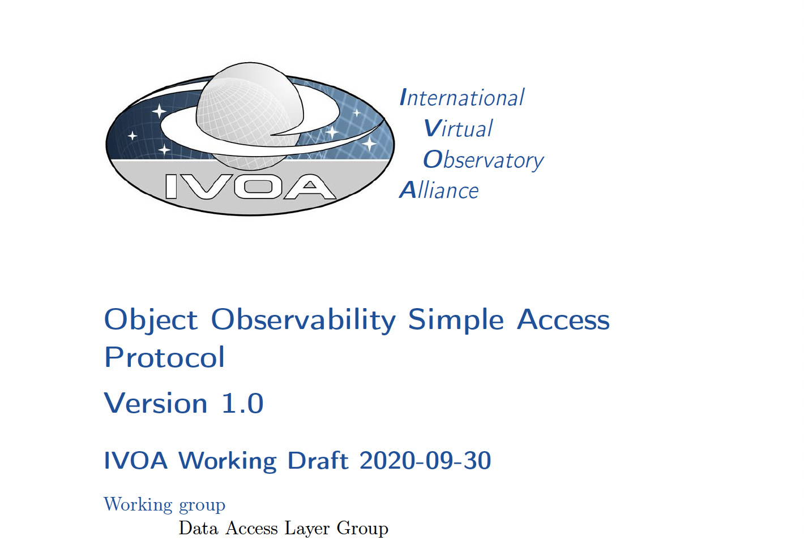
Next Steps
We propose to change “Object Visibility” by “Object Observability” and replace in the current protocol documentation the term “visibility” by “constraint-free” or “observability”
Target Observability Simple
Access
Protocol
TarObsSAP
1.1?

