Slide 1
Connecting Science Platforms
Jesús Salgado
IVOA GWS chair and
SKA Regional Centres Network Architect

Slide 2
Open Science and AI
Harmonisation
Transparent Data Access
Combined Computing Resources
Science Enabling Applications
Astropy and Astroquery
Notebooks
Users environments
Discovery And Access Services
InterOperability and
Federation
Cone Search
SSAP, SIAP
TAP
Federated Authentication
and Distributed Processing
Platforms interconnected
Data Lakes
Notes:
© Copyright PresentationGO.com – The free PowerPoint and Google Slides template library

Slide 4
SKA Regional Centre Capabilities Blueprint
Science Enabling Applications
Distributed Data Processing
Analysis Tools, Notebooks,
Workflows execution
Machine Learning, etc
Computing capabilities provided by the SRCNet to allow data processing
Data Discovery
Visualization
Discovery of SKA data from the SRCNet, local or remote, transparently to the user
Advanced visualizers for SKA data and data from other observatories
Interoperability
Support to Science Community
Heterogeneous SKA data from different SRCs and other observatories
Support community on SKA data use, SRC services use, Training, Project Impact Dissemination
Data Management
Dissemination of Data to SRCs and Distributed Data Storage

Slide 5
SRC Network global capabilities
SRCNet

Slide 6
Science platforms
Authentication
Interactive Analysis
Big Terminal
Batch
Authorisation
SW Repository
Orchestrators
Metadata
Data
Computing

Slide 7
Science Platforms Interoperability
Federated Authentication
Authentication
Authentication
API
API
Interactive Analysis
Big Terminal
Batch
Interactive Analysis
Big Terminal
Batch
Authorisation
Authorisation
Orchestrators
SW Repository
SW Repository
Orchestrators
Interoperable/federated SW Repositories
Metadata
Data
Computing
Metadata
Data
Computing
Service
Service
Federated Data Lake

Slide 8
Federated Execution

Slide 9
Visualisation API
Vis Tool 1
Client
Locate
Data
Operations
SRCn
Vis Tool 1
Server
Vis Tool 1
Server
Vis Tool 2
Server
IVOA SODA
Service
Command Line API
Data Operations API
SKA Data Parser Library
Data
Management
Resolver
Data
Management
SRC1
SRCn

Slide 10
Remote “Data Parsing” Operation
Remote
Invocation
Software
Repository
Data Management
REST Service
Authorisation
Remote Data Stream From URL
Local Data Reader
Local Data Parser Service
Orchestrator

Slide 11
Some possible data mesh services
Data Type | Operation | Input | Output
Any Type | Get Stream | ID | Input Stream
Data Cube | Cut-out | ra, dec, size, resolution | Data Cube
Data Cube | Get Spectra | ra, dec, size | Spectrum
Data Cube | Get Time Series | ra, dec, size | Time Series
Data Cube | Get Slice | wavelength | Image
Image | Change Resolution | ra, dec, size, resolution | Image (FITS to HiPS)
Image | Source Extraction | ID, algorithm params | Source Catalogue
Spectrum native | Convert to VO | ID | Spectrum VO
Source Catalogue | Similar Source | Source ID | Source Catalogue

Slide 12
Container
Repository
import astroquery.ska.formats as skaformat
for obsid in list
cube = skaformat.getCube(obsid)
layer = cube.slicePerFrequency(150)
img = tf.keras.utils.load_img(
layer, target_size=(img_height, img_width)
)
img_array = tf.keras.utils.img_to_array(img)
img_array = tf.expand_dims(img_array, 0)
predictions = agnModel.predict(img_array)
score = tf.nn.softmax(predictions[0])
Local SRC
ML enabled
environment
Layer
Layer
Layer
Create Layer
Remote SRC

Slide 13
Remote Approach Use Cases
Mosaicking
Local
Stacking
Cut-outs
Operations
Source finding
Image Convolution
Distributed
Visualisation
Source Classification

Slide 14
Execution Planner
Science
Platform I
Science
Platform III
Science
Platform II
Execution
Planner
Science
Platform IV

Slide 15
Solving the Topology
Information
System
Execution
Planner

Slide 16
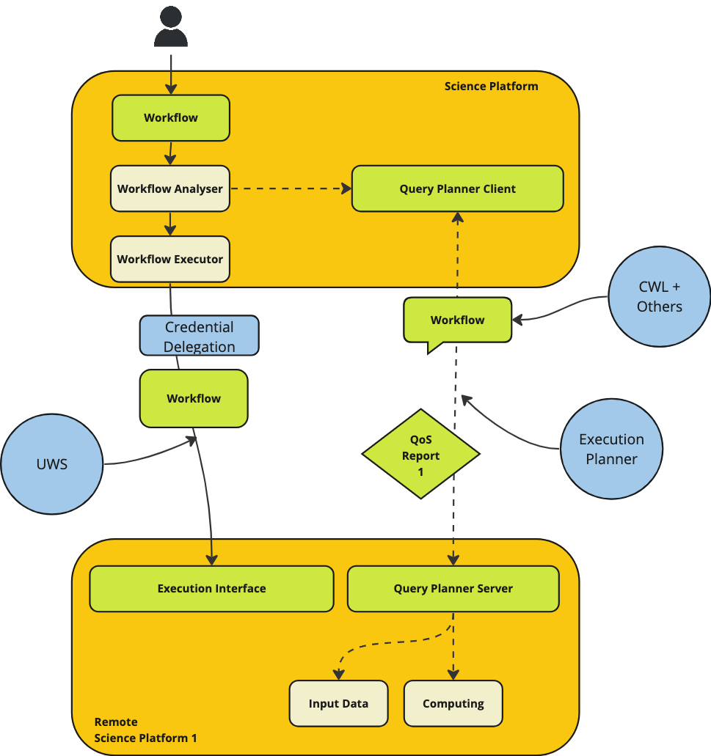

Slide 17
Summary
Possible “interoperable science platform” new phase with:
Federated Authentication Protocols
Improved data access
Remote operations
(Simplified) federated execution
Execution planner
Topologies
Software characterisation
Workflows
Today objectives
Agree on roadmap
Identification of interested parties
PROMOTE/ENDORSE
NEW? NEEDED?
EXTEND?
NOTE TO STANDARD
DM INSIDE EXEC.PLAN.?
NEW? NEEDED?

Slide 18
Thanks for your attention

