Slide 1
Standing Committee for Science Priorities (CSP) status
Francesca Civano
NASA - GSFC
(Chief Scientist - Physics of the Cosmos Program)
Chair of the IVOA Committee for the Science Priorities

Slide 2
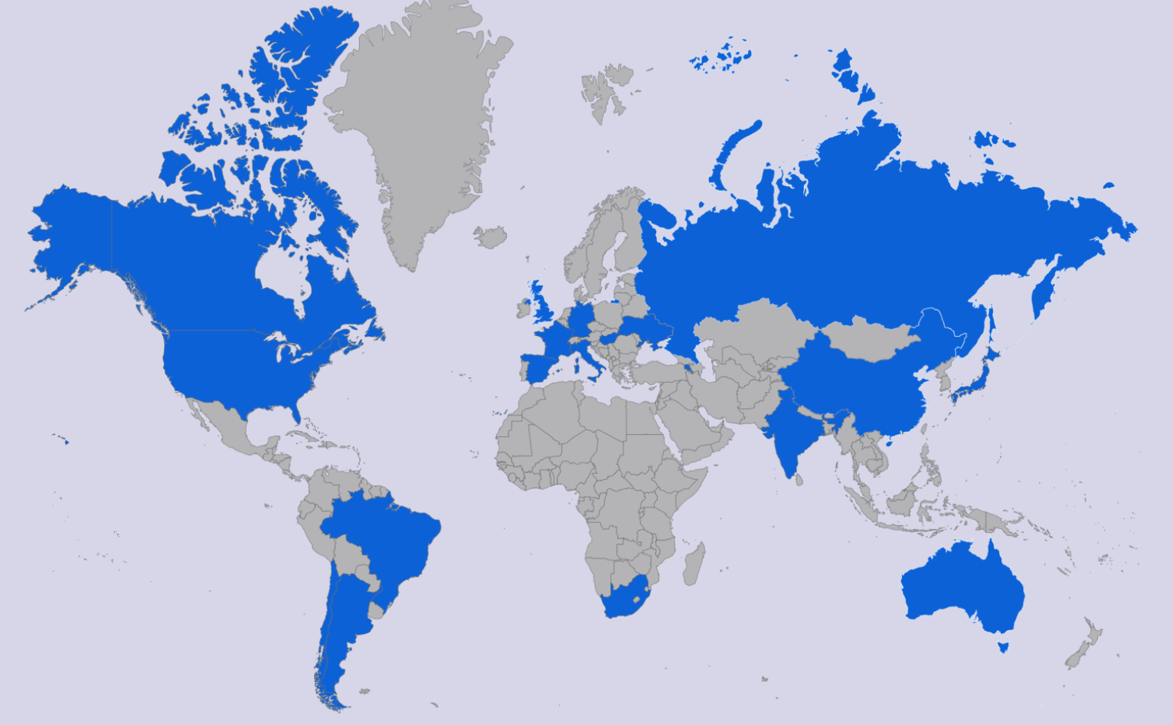
The CSP of the IVOA
Who is in the CSP?
Members of the science community and active astronomy projects.
Members
Members: Mark Allen, Chenzhou Cui, Raffaele D’Abrusco, Gregory Dubois-Felsmann, Janet Evans, Pepi Fabbiano, Minh Huynh, Mark Lacy, Marco Molinaro, Ada Nebot, Kai Lars Polsterer, Judy Racusin, Enrique Solano, Rachana Bhatawdekar and Rosie Bolton
Chairs: Francesca Civano (chair), Vandana Desai (vice-chair)
http://ivoa.net/twiki/bin/view/IVOA/IvoaSciencePriorities
CSP status - Interop Malta 2024
Notes:
The CSP is formed by members of the community actively involved in astrophysics projects. We have at this time 17 members, listed there,

Slide 3
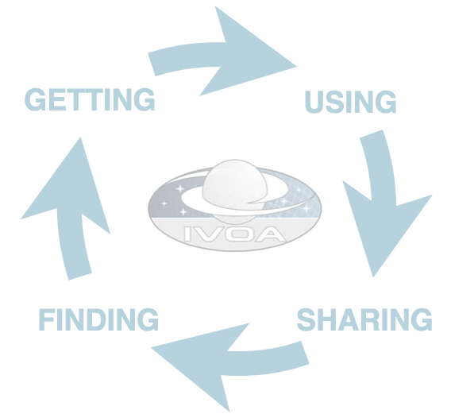
Goal of the CSP
What is the goal of the CSP?
Sustain the scientific impact of the VO as an interoperable ecosystem to support science
Ensure continuous engagement of the international astronomical community
Astronomy community
The astronomy community comprises missions that are active or under development, operating observatories, astronomical archives, and teams of astronomers performing research and disseminating data products to the community.
CSP status - Interop Malta 2024
Notes:
The goal of the csp is to be the liason between the astronomy community and the VO to first of all sustain the scientific impact of the VO as an interoperable ecosystem to support science which can be achieved only with the continue engagement with the community

Slide 4
Activities of the CSP
Recommend scientific priorities and scientific requirements
Driven by scientific use cases that are developed in cooperation with the scientific community.
Will influence the development of new protocols which will be developed by the IVOA and coordinated by the TCG
Scientific community
IVOA Committee Scientific Priorities
IVOA Technical Coordination Group
Ensure community engagement
Encourage engagement, adoption and feedback of implementations by the international astronomical community
Support VO members in developing tutorials, technical and scientific workshops and scientific training materials.
CSP status - Interop Malta 2024
Notes:
By being in touch with the community, The CSP contributes to identify scientific priorities and bring the requirements to the TCG, which then coordinate the development of new standards and protocols and works on what the community needs.
The CSP should then report back to the community and solicit the community to implement the stabdarsd and get their feedback.

Slide 5
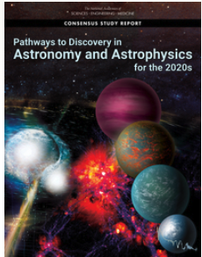
Science Priority Areas
Pathways to Habitable Worlds
JWST, DKIST
Ground-based ELTs equipped with high-resolution spectroscopy, high-performance AO, high-contrast imaging
Future: Habitable World Observatory
New Windows on the Dynamic Universe
Rubin, Euclid and Roman ... ELT
next gen radio observatories
updates to current ground-based GW facilities and LISA
high energy neutrino observatories
Unveiling the drivers of galaxy growth
JWST, Rubin, Roman, Euclid
progress in numerical simulations
ELT
CSP status - Interop Malta 2024
Notes:
When we talk about science prioiorities needs, we should look at the international astronomical community, look at the reports, one example being Astro 2020, and identify the priorities and the projects.

Slide 6
Important considerations
Identify the current main science cases in the community
Engage with large and small projects
Ensure IVOA is building standards, tools and services responding to these science cases
Ensure right balance for these standards
Not too generic, not too specific
Implementable standards, while not too simplistic
Need for new standards, or updating existing standards
Addressing new data types, new areas in astronomy
CSP status - Interop Malta 2024

Slide 7
Activities after the last Interop
Plenary Session in Sydney on “Handling a deluge of big data”; The Big Data problem: Transport, Process, Store, Distribute
CSP meeting on September 5th, 2024
10 attendees
Discussion on next priorities including large data volume and access of large data in the cloud and continue the discussion after the Sydney plenary;
HEIG: support the group by organizing a plenary session including also the time domain and alert aspect.
What’s next: increase conversation with IG and WG to focus on priorities
CSP status - Interop Malta 2024

Slide 8
High Energy and Time Domain Plenary session
The goal of the session is to hear from high-energy projects about their involvement in IVOA and their use of standards.
Discoverability: How does your project make their data discoverable? Are data from your project in the IVOA registry? Are there problems in the IVOA Obscore definition preventing or limiting it?
Interoperability: What data products are used in your data analysis and are they interoperable with data from other projects? Do you use a data model?
Alert: What do you use for an alert system? Do you use VOevent, and if not, can you address the issues you see?
Follow-up: How do you coordinate rapid follow up observations currently? Are the Observing plan of your project/mission available externally and is there coordination of your project/mission among the HE projects? Are you familiar with the IVOA ObsLocTAP protocol and ObjObsSAP working draft of the IVOA?
CSP status - Interop Malta 2024

Slide 9
High Energy and Time Domain Plenary session
Jamie Kennea (Penn State - NASA Swift) | Swift, ACROSS and VO
Yunfei Xu (China-VO) | Einstein Probe Time Domain Astronomical Information Center: Enhancing Data Discovery, Transient Identification, and Rapid Follow-up Coordination
Karl Kosack (CTA/HESS) | IVOA and High-Energy Gamma Rays: Ground-based IACTs
Jutta Schnabel (ECAP / KM3NeT) | High-Energy Neutrino Data for the VO: Status and Prospects
Judy Racusin (NASA GCN) | General Coordinates Network (GCN): NASA’s Time-Domain and Multimessenger Astronomy Alert System
Roberto de Pietri (Universita di Parma) | The LVK Alert System and the use of IVOA standard
Janet Evans (CXC) | HEIG overview

