Slide 1
IVOA Interoperability Meeting 2024
Einstein Probe TDAIC: Enhancing Data Discovery, Transient Identification, and Rapid Follow-up Coordination
Yunfei Xu on behalf of the China-VO team
2024-11-15
Notes:
Good morning, everyone. My name is Yunfei Xu. I am from the National Astronomical Data Center of China, and I am also a member of the China-VO team. It is my pleasure to share our work on behalf of the China-VO team.
Today, my talk is on the Time Domain Astronomical Information Center of the Einstein Probe Satellite, focusing on how the system enhances data discovery, transient identification, and rapid follow-up coordination.

Slide 2
Context
Overview of Einstein Probe (EP) TDAIC
Data Discovery and Access
Transient Identification
Follow-up Observation Coordination
Summary
Notes:
My talk is structured into five parts.

Slide 3
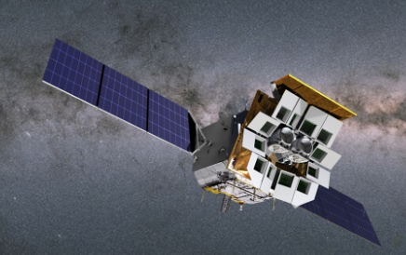
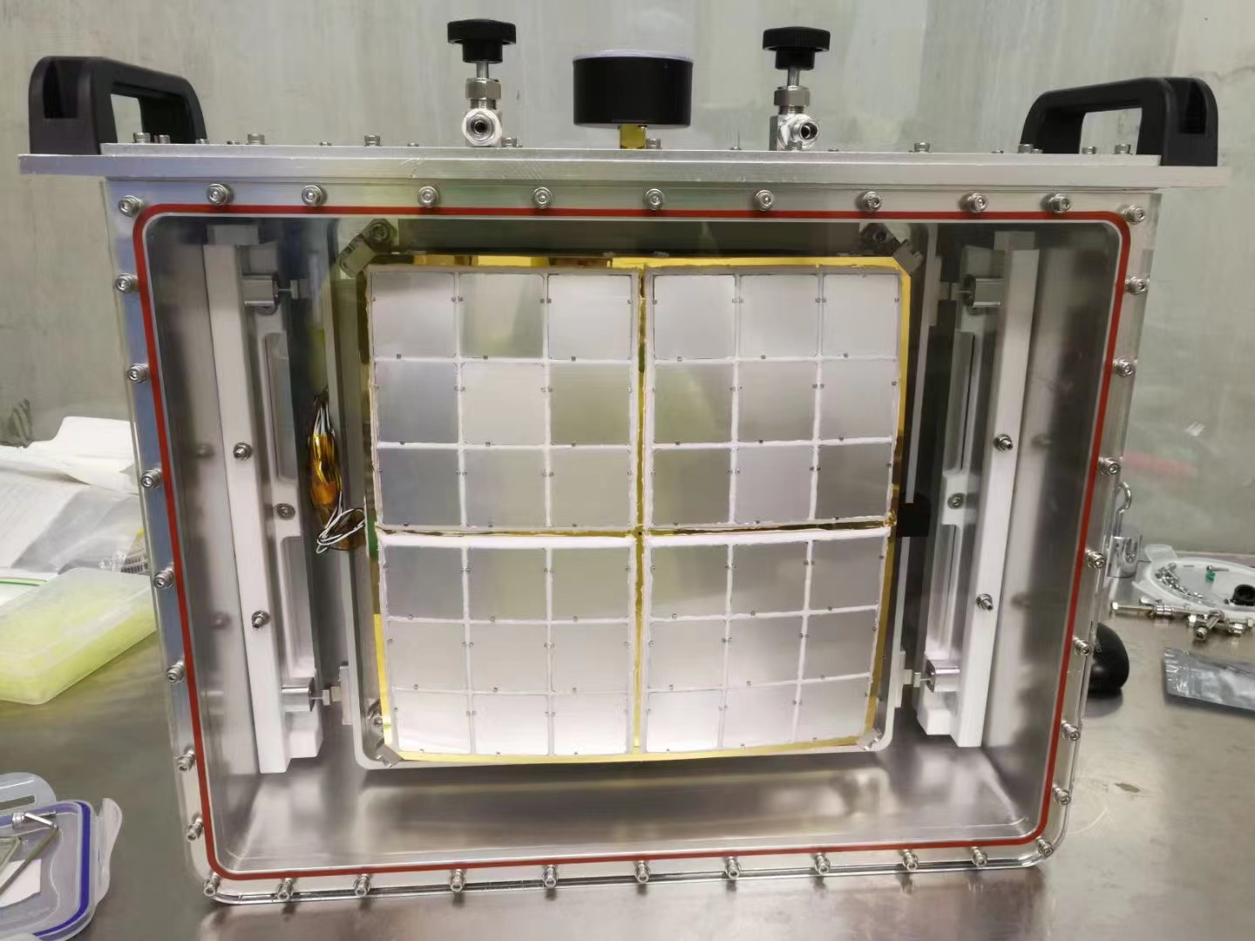
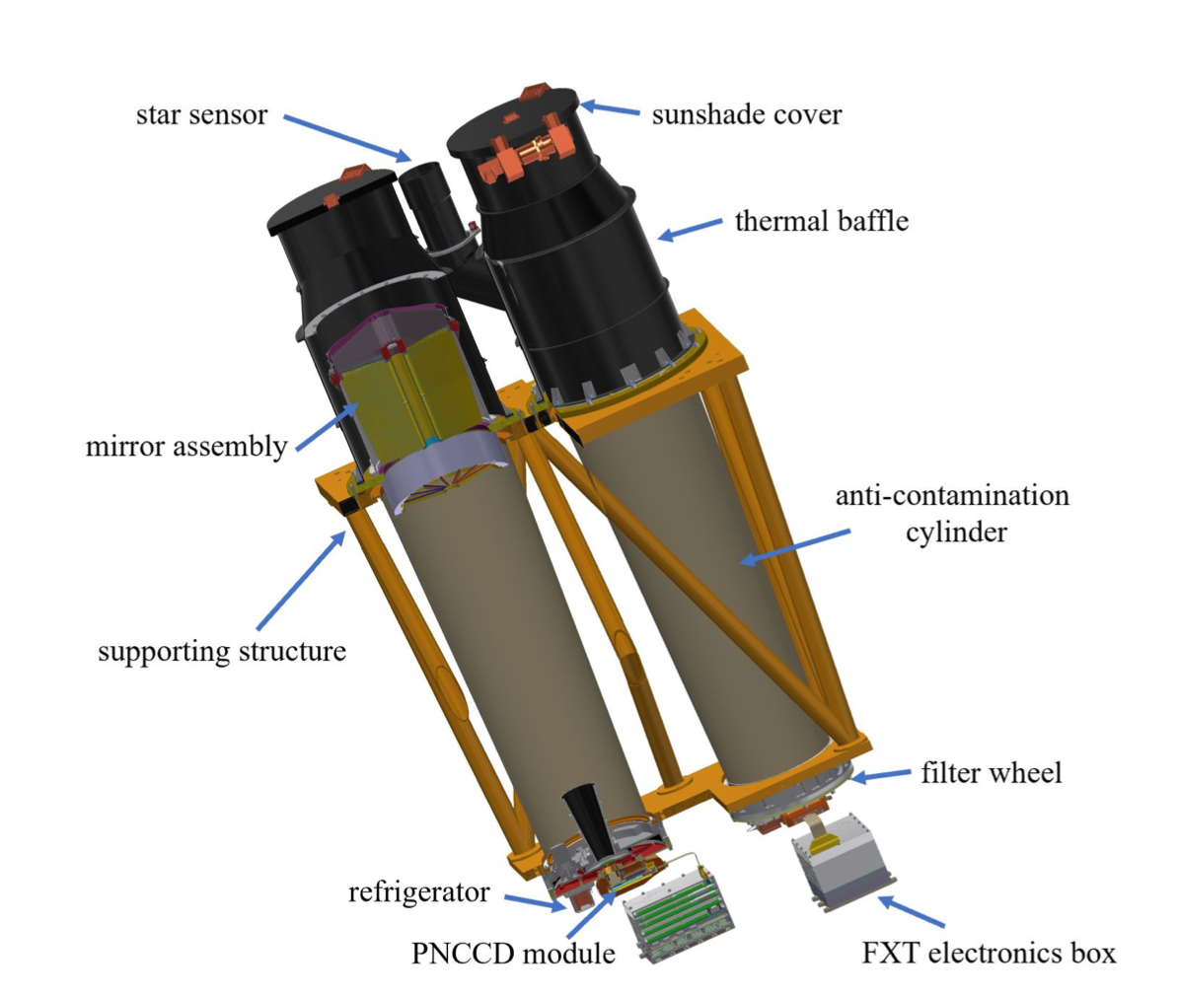
Einstein Probe
WXT (Wide-field X-ray Telescope)
48 Lobster eyes CMOS units
FOV：3600 squaredgrees，localization ~1arcmin
0.2-4keV
FXT (Follow-up X-ray Telescope)
FOV 1°X1°
localization 5-15 arcsec
0.5-10 keV
Launched on January 9th 2024
Notes:
First, I will provide a brief overview of the Einstein Probe Satellite and the TDAIC system.
The Einstein Probe (EP) satellite is a collaborative project developed by the CAS,ESA, MPE, and CNES.
It is equipped with two types of payloads: the Wide Field X-ray Telescope, or simply WXT, and the Follow-up X-ray Telescope, or simply FXT. The WXT, which contains 48 CMOS units and features a lobster-eye structure, provides a very large field of view of up to 3,600 square degrees. The WXT’s localization ability is about 1 arcminute, whereas the FXT offers superior localization capabilities, ranging from 5 to 15 arcseconds. Both payloads operate in the soft X-ray band. The WXT surveys the sky to detect transient signals, and the FXT then conducts rapid follow-up observations to acquire more precise data. The EP satellite was launched on January 9th, 2024.

Slide 4
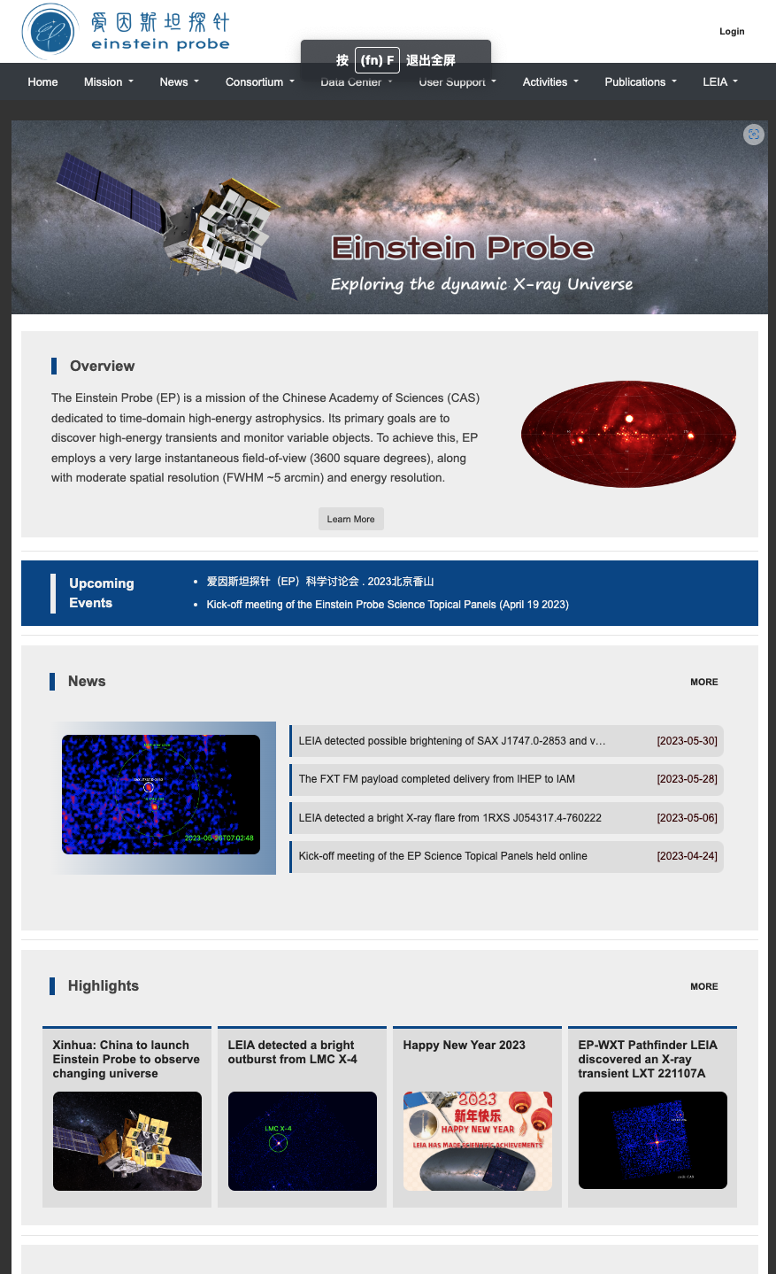
Overview of the EP TDAIC
EP Time Domain Astronomical Information Center
Data Discovery and Access
Transient Identification
Follow-up Observation Coordination
https://nadc.china-vo.org/ep
Notes:
The China-VO team has developed the Time Domain Astronomical Information Center for the EP satellite. This comprehensive system integrates a suite of services and tools, making it easy for scientific users to access and analyze EP data.
It is an online system accessible via the link provided below.

Slide 5
Overview of the EP TDAIC
EP Data Pipeline
Level0
WXT Data Generator
Level1
WXT Data Analysis Software
Level2/3
WXT Metadata Extractor
Level 0
FXT Data Generator
FXT Data Analysis Software
FXT Metadata Extractor
Data Product
Image
Catalog Spectrum
Light Curve
Metadata
Event files
Orbit file
Attitude file
Archive Database
Metadata DB
Data Query,Access,
ToO Observation Proposal
User Interface
Data Discovery and Access
EP Scientific User
Transient Identification
Role and Authorization Management
Data Distribution
Observing Proposal Tools
EP TDAIC
Notes:
In this slide, we present the architecture of the TDAIC. All EP data originates from the Data Pipeline. The raw Level 0 data we receive from the satellite is initially processed by the Data Generator for each payload, transforming it into Level 1 data. This level includes event files,orbit and attitude files. Subsequently, the Level 1 data is further processed into Levels 2 and 3 by the Data Analysis Software, which produces image, catalog, spectra and light curves. Metadata for each data level is stored in the Metadata Database within TDAIC, while the corresponding data files are archived in the Archive Database, which is based on an object file system.
The TDAIC system comprises three main modules: data discovery and access, transient identification, and observing proposal tools. These modules interact with both the metadata and archive databases to manipulate the data, providing services to EP scientific users through a web-based user interface.

Slide 6
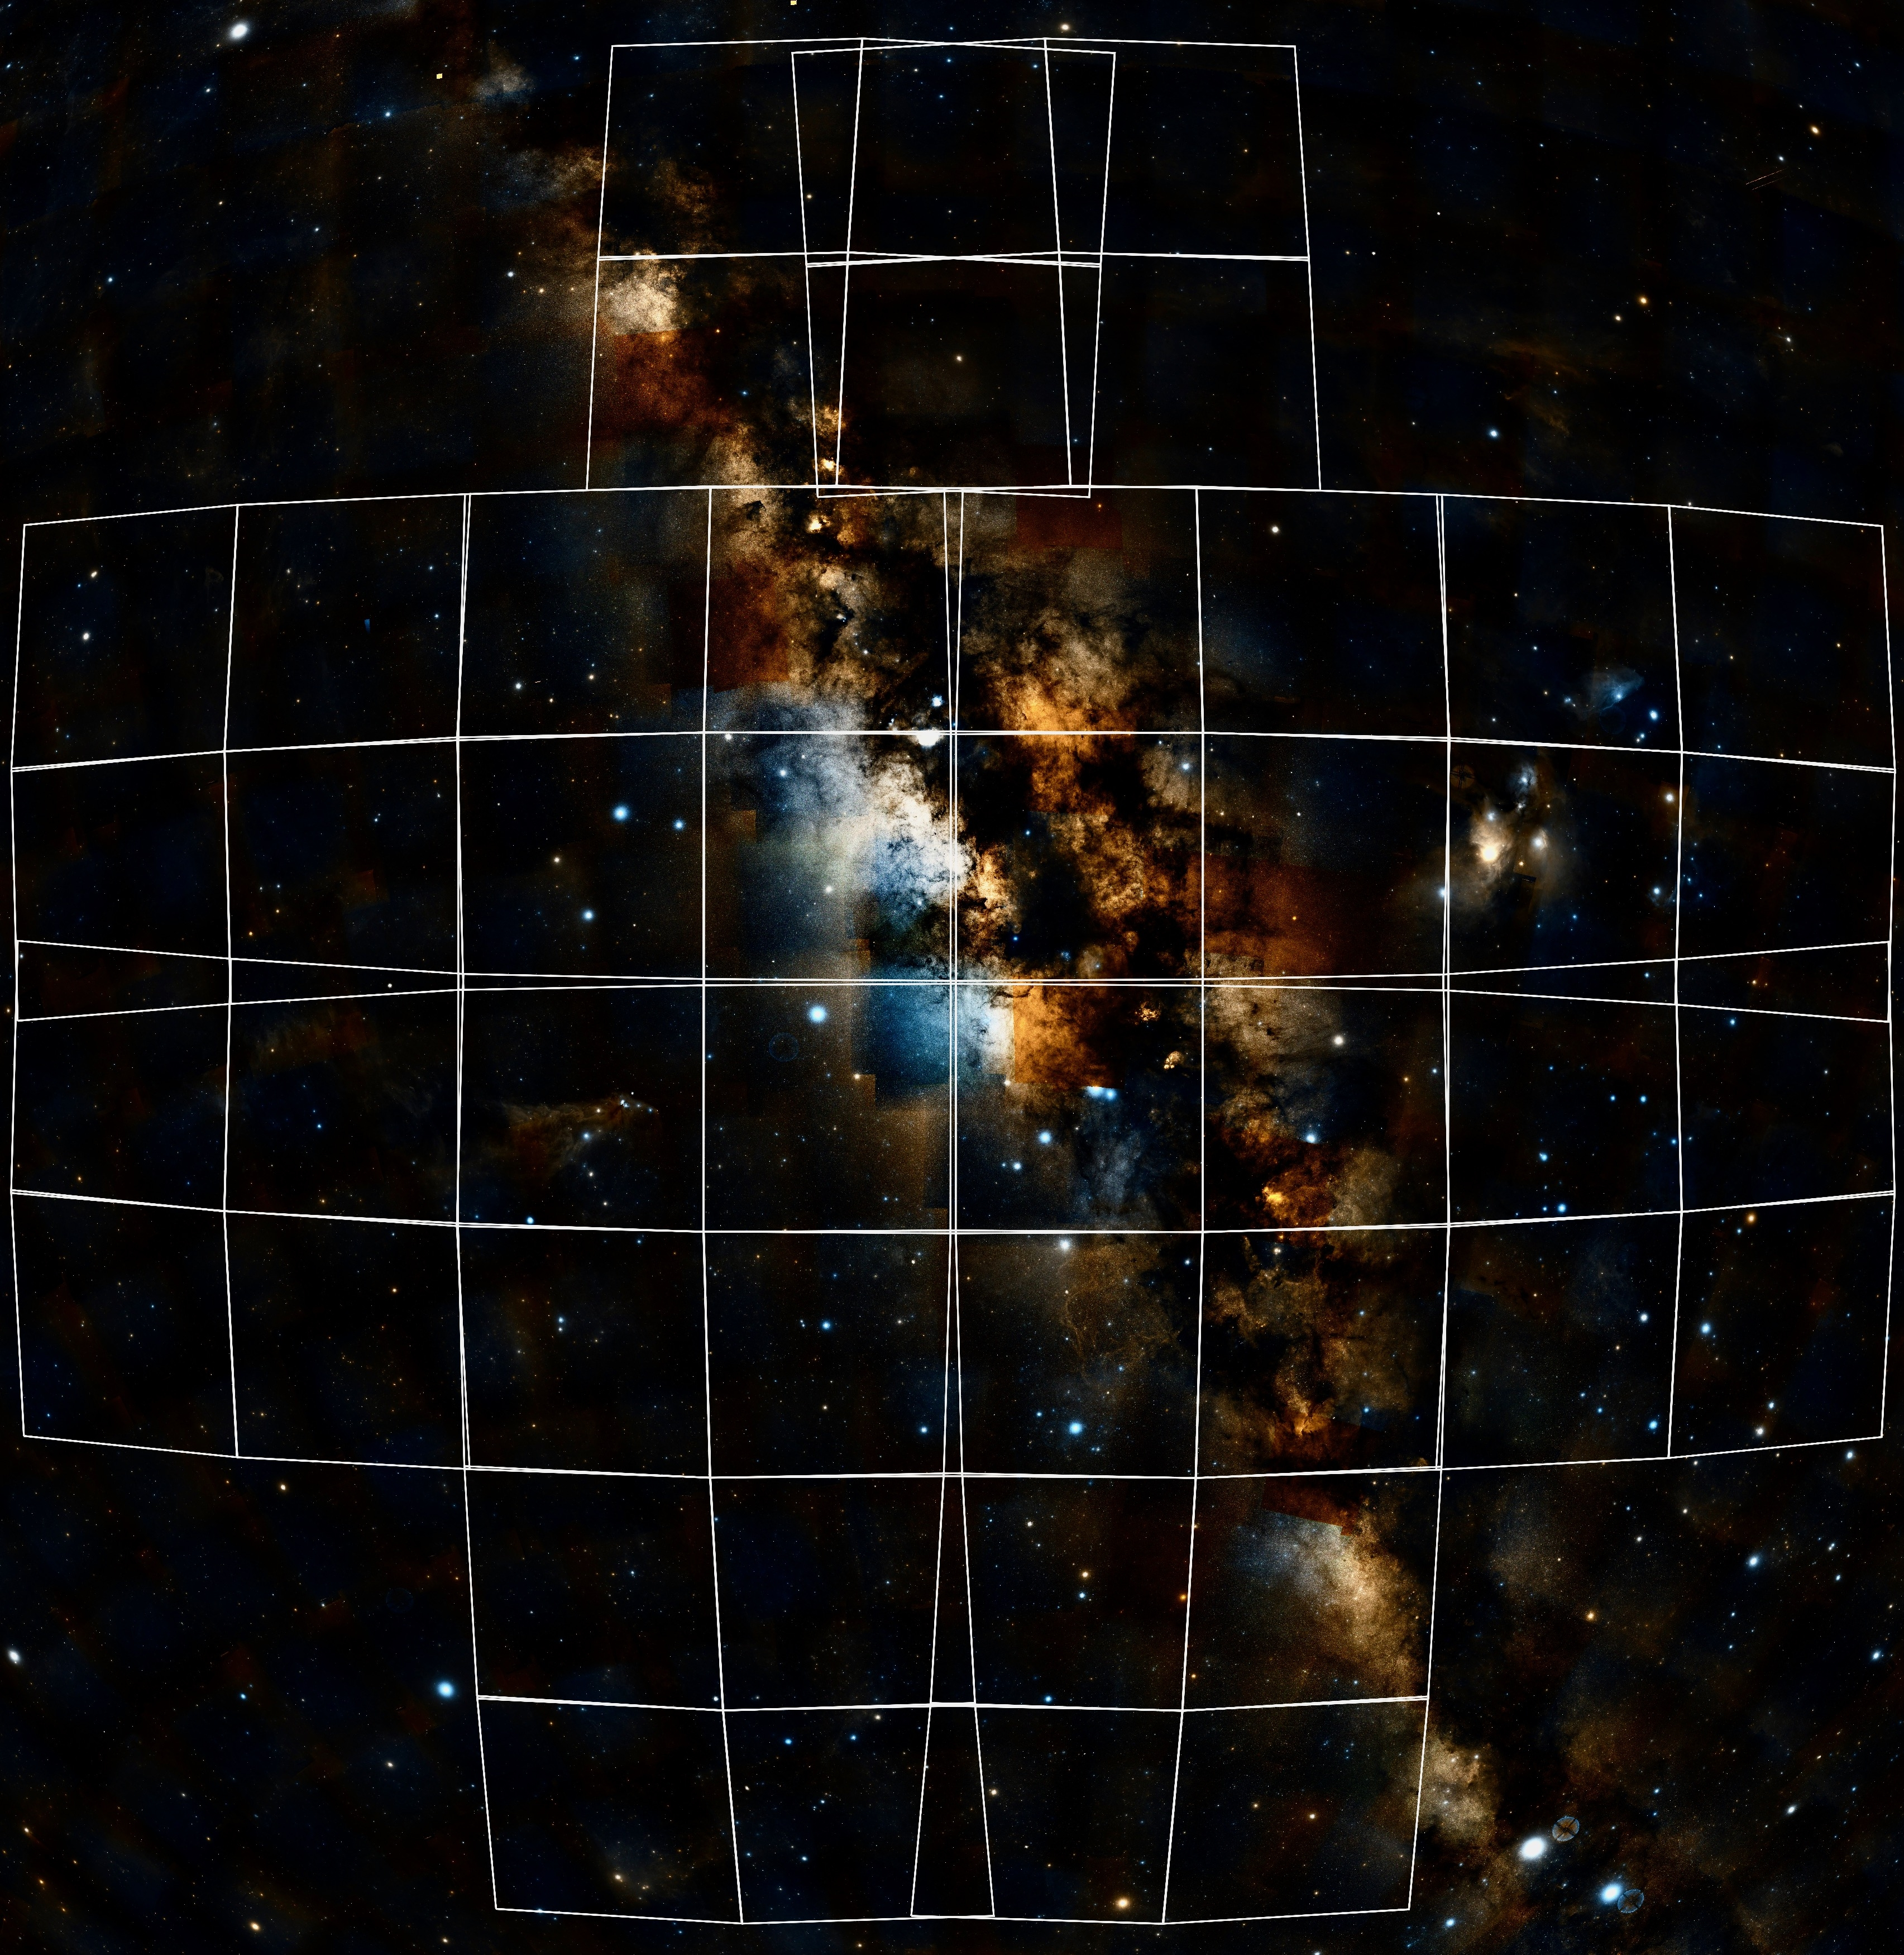
Data Model of TDAIC
Observation data of one CMOS
dataproduct_type | Event | Image | Catalog | Spectrum | Light Curve
calib_level | 1 | 2 | 3 | 3 | 3
obs_id
instrument_name
target_name
target_class
obs_collection
obs_publisher_did
s_ra
s_dec
s_fov
s_region
s_resolution
s_xel1
s_xel2
access_url
access_format
access_estsize
t_xel
t_min
t_max
t_exptime
t_resolution
em_xel
em_min
em_max
em_res_power
o_ucd
pol_xel
obs_creation_date
proposal_id
obs_release_date
status
trigger
trigger_time
data_version
ObsCore Model
Notes:
Now, I would like to introduce the data model we use in TDAIC. Both WXT and FXT are identical in terms of data structure, so I will take WXT as an example. As mentioned earlier, there are 48 CMOS units in WXT, and the observation data is organized by each CMOS unit. The data model follows the IVOA ObsCore data model standard, with all mandatory fields implemented. As you can see in the slide, the two columns on the left represent the mandatory fields of the ObsCore data model. Additionally, we have included four supplementary fields to capture the status, trigger, and version of the observation.
Each observation includes five types of data: the event list, image, catalog, spectrum, and light curve of each source. Each type of data exists at different calibration levels, and these two elements are represented by the "dataproduct_type" and "calib_level" fields, respectively.

Slide 7
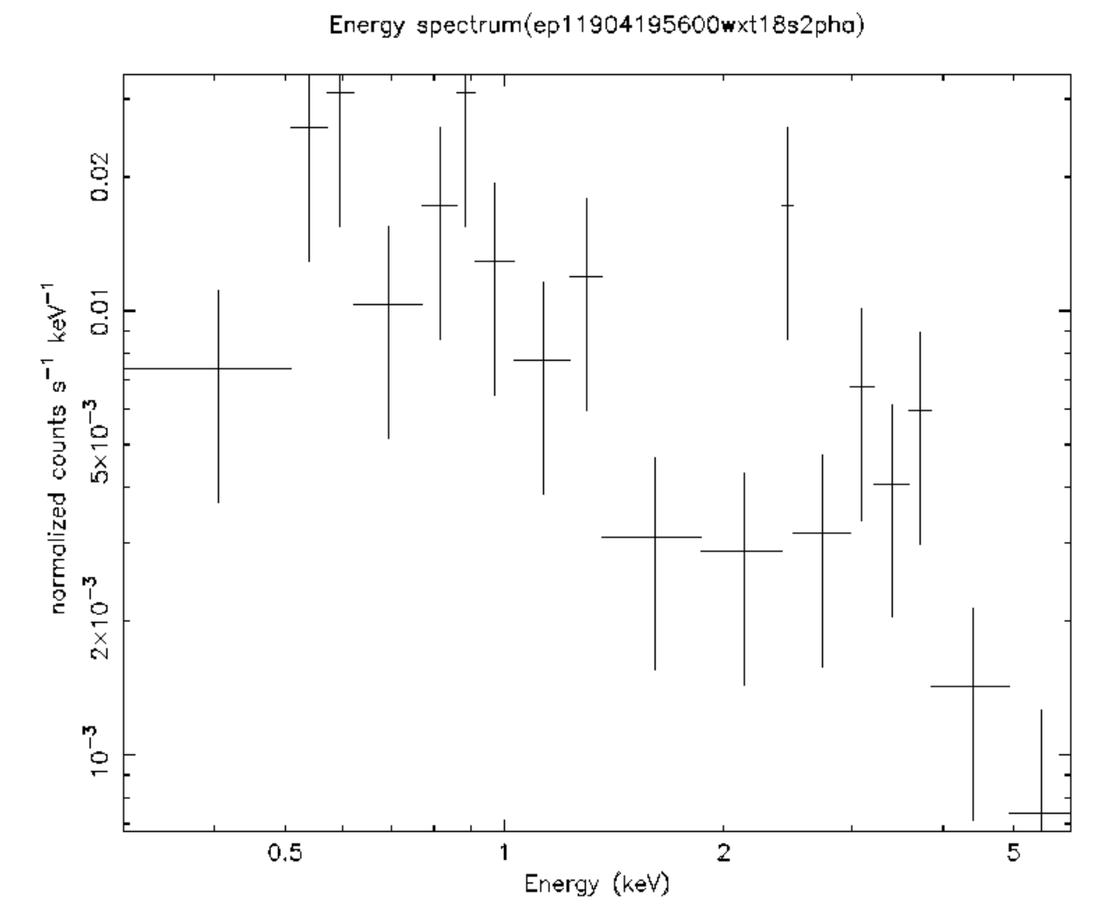
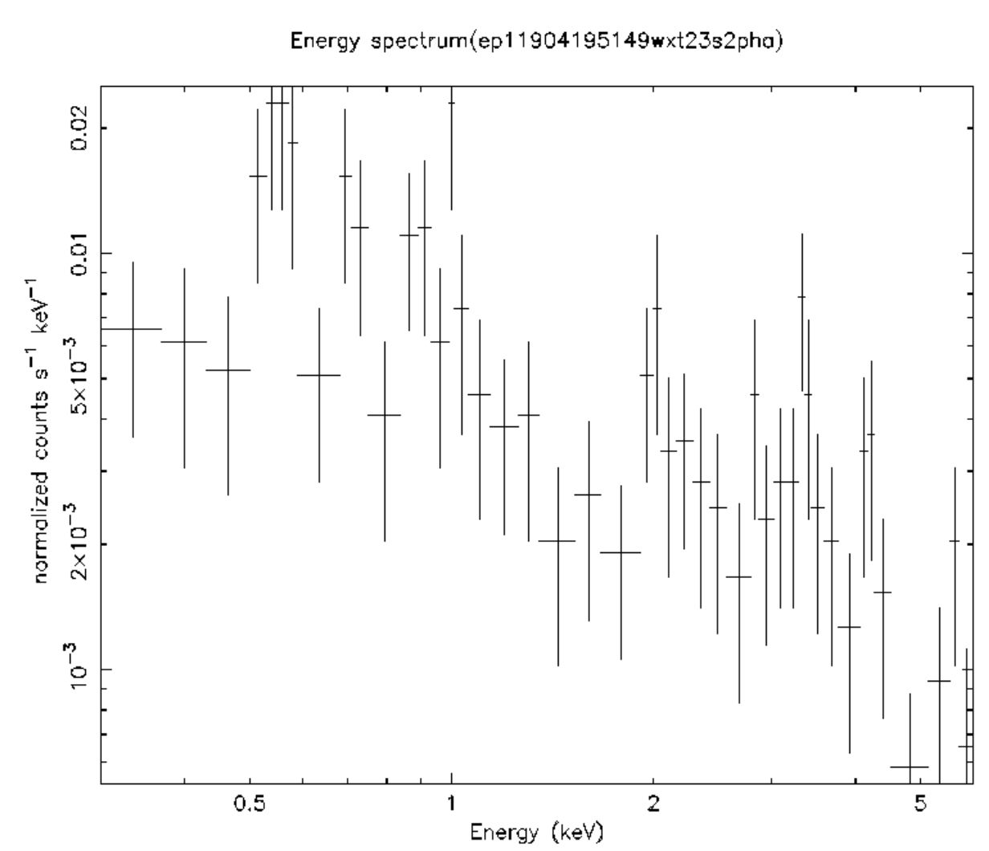
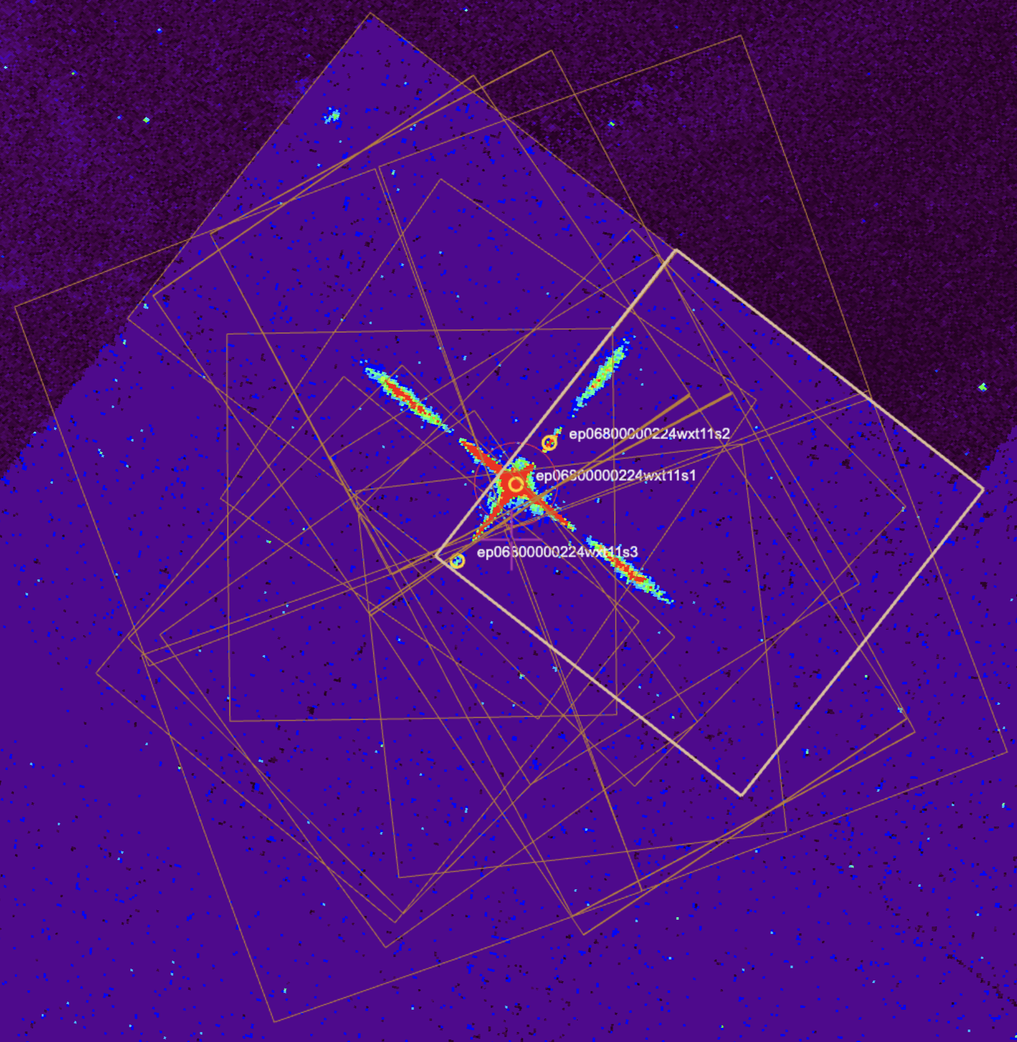
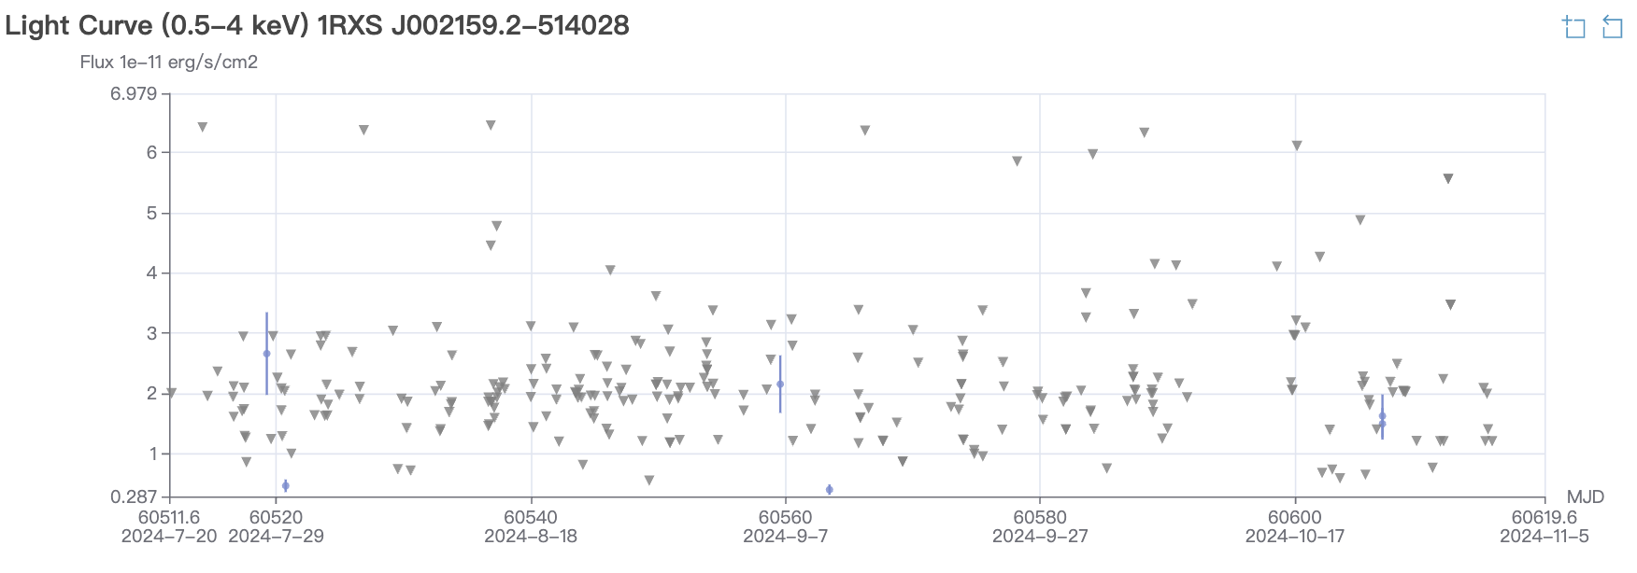
Data Model of TDAIC
Event List
Spectrum
Image
X-Ray Source
Light Curve
All data are organized by source logically
Notes:
The EP data is also logically organized by each X-ray source. EP maintains a catalog of known X-ray sources, which is compiled from catalogs such as XMM-Newton, Chandra, MAXI, and Swift. Every X-ray source extracted from EP observations is matched by position with this known source catalog. Once matched, all related event lists, images, spectra, and fluxes are logically connected to the known source. This allows us to easily obtain long-term light curves and stacked images for specific sources.

Slide 8
Data Discovery and Access
According to the EP data policy, all EP data is subject to a one-year protection period. After this period, the data will be made publicly available. Currently, only members of the EP Science Topical Panel (STP) can access the data upon request.
We are actively working on making EP data available in the VO registry. Since we have implemented the ObsCore data model, the EP data is nearly TAP-ready. The next step is to implement the TAP interface to complete the process.
Currently, the TDAIC web user interface is the only way to discover and access EP data.
Notes:
How to discover and access EP data? According to the EP data policy, all EP data is subject to a one-year protection period. After this period, the data will be made publicly available. Currently, only members of the EP Science Topical Panel (STP) can access the data upon request.We are actively working on making EP data available in the VO registry. Since we have implemented the ObsCore data model, the EP data is nearly TAP-ready. The next step is to implement the TAP interface to complete the process. Currently, the TDAIC web user interface is the only way to discover and access EP data.

Slide 9
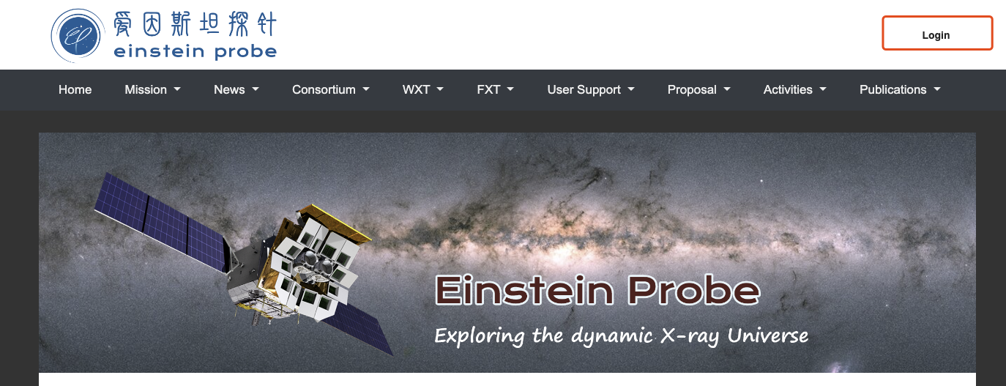
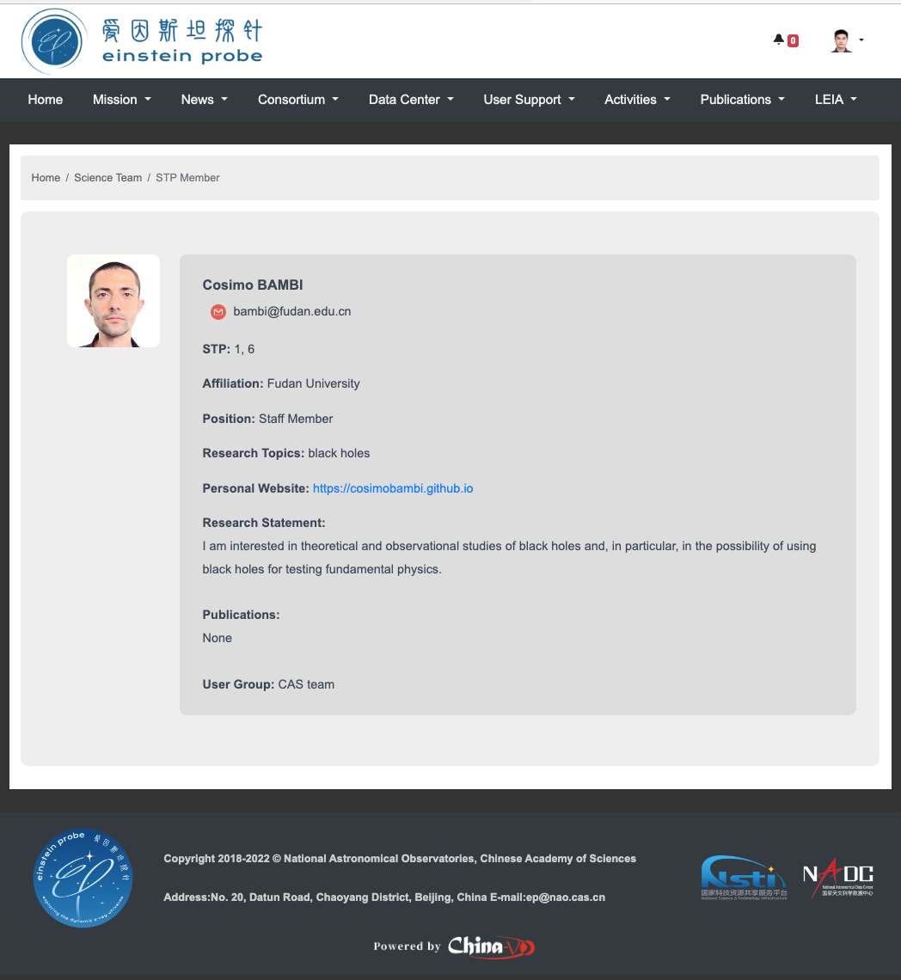
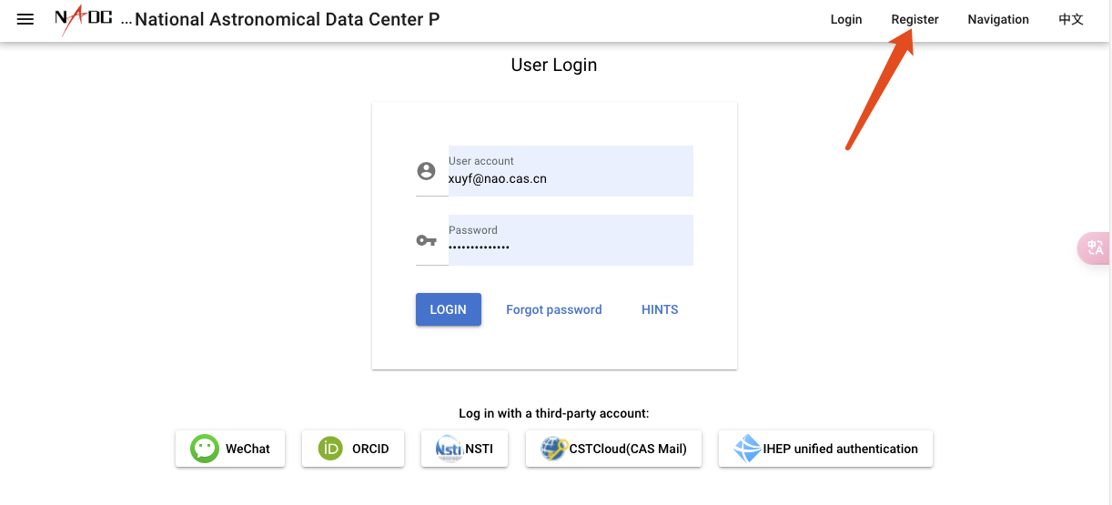
User Roles and Permissions
Each registered member will receive appropriate permissions depend on user roles：
Science Management Committee
STP member
Associate STP member
Duty Scientist
Transient Advocate
Guest
Notes:
To access the data and services in TDAIC, you will need to create an account on the website.
Once you're set up, a role will be designated to your account by the TDAIC administrator.
The role assigned to you will define your access privileges on the website.

Slide 10
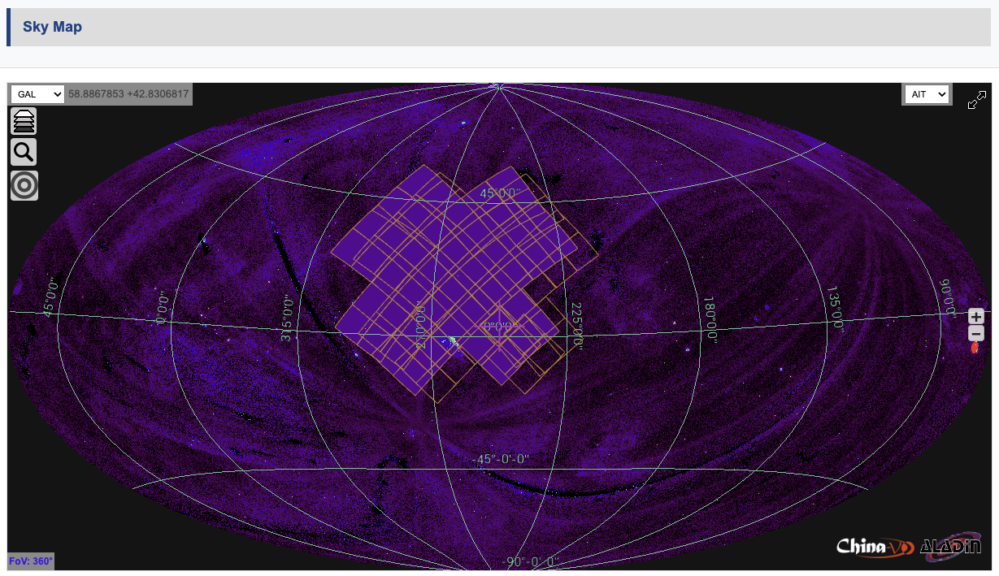
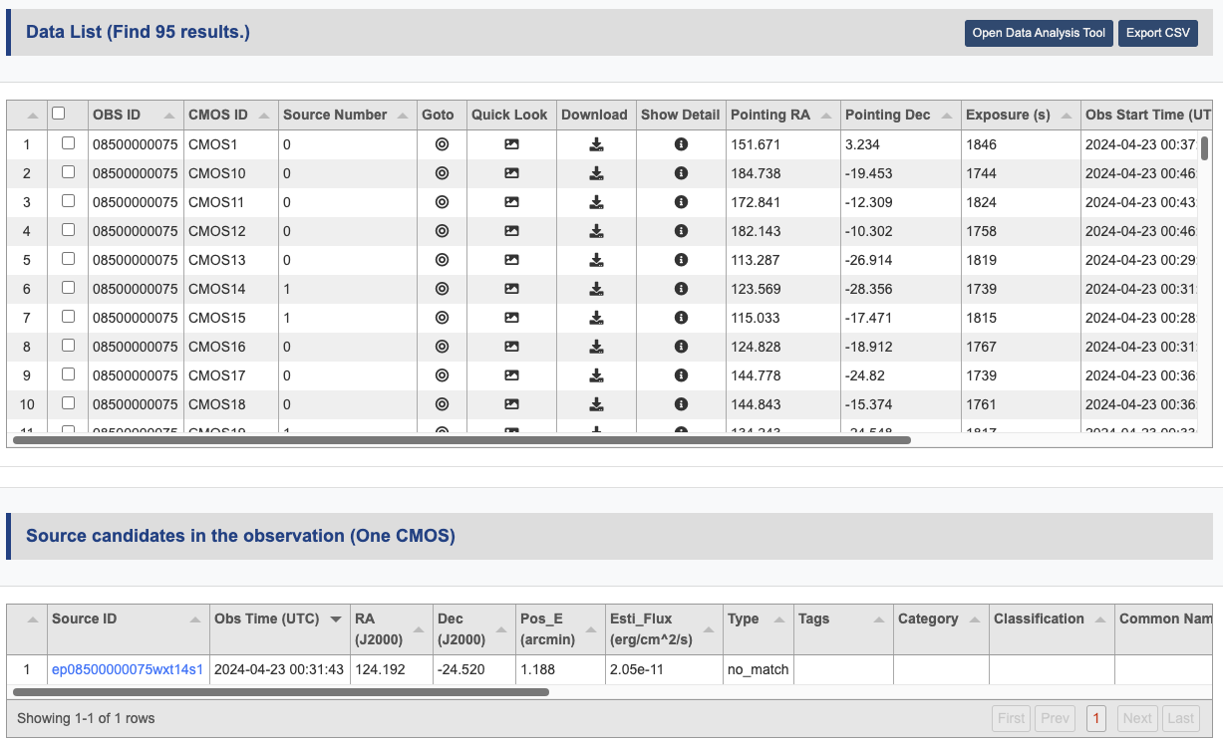
Observation Data Access
Data query
Object name
locaiton
time range
Obs ID
Data visualizaiton
(Aladin lite and HiPS)
Data quicklook & download
Online data analysis
Notes:
The website‘s search tools are intuitive – you can look up data by object name, location, time range, or a specific observation ID if available.
The query results are organized in a tabular format and visualized on the Aladin lite.
And if you‘re authorized to download data, you can easily do so directly from this table.

Slide 11
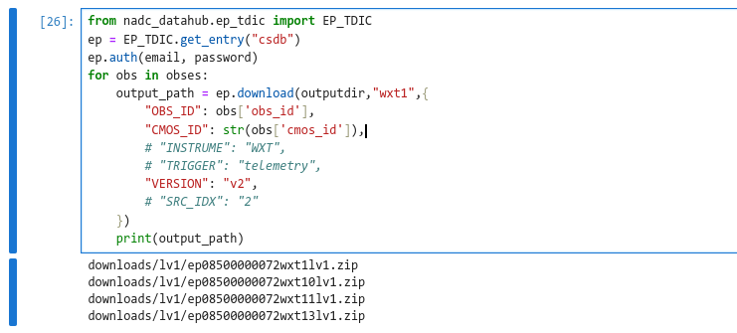
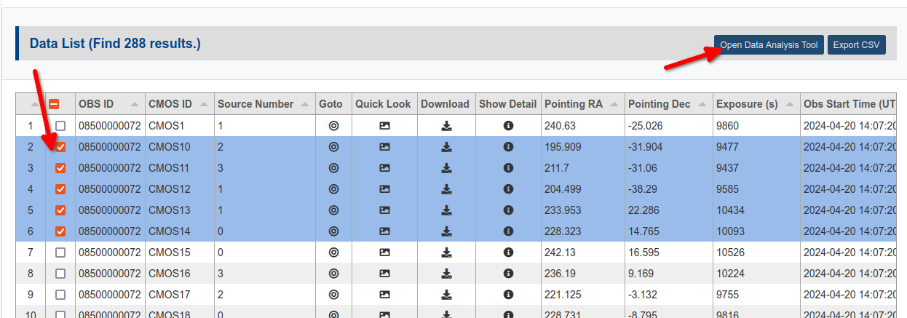
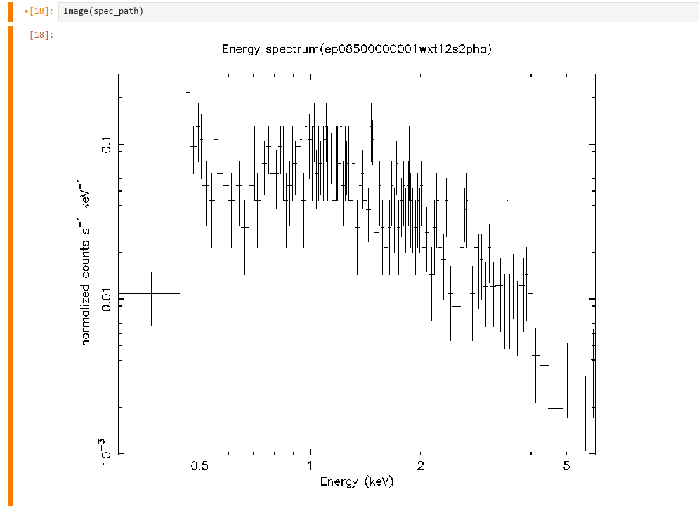
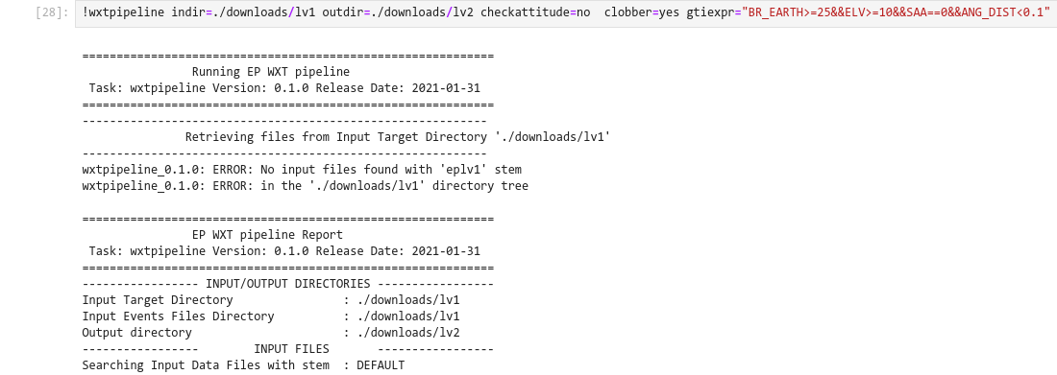
Analyzing EP Data Online
Main objective: Providing an online environment for data analysis.
Find
TDAIC Data Query Page
Access
Python API
Analysis
Visualization
Jupyter
EP Data Analysis Software
Notes:
Furthermore, China-VO team has developed an online data analysis platform which allows users to conduct data analysis online without the need to download datasets to their local devices.
The platform offers a Jupyter Hub user interface, where you can run your Python code and access EP data directly on the platform. This includes data permission checks to ensure secure and appropriate use.
With the Jupyter Hub interface, you can utilize functions from the EP data analysis software that has been already integrated into the platform for your analysis work.
Additionally, you can create publication-quality images from your analysis results using matplotlib directly on the platform.

Slide 12
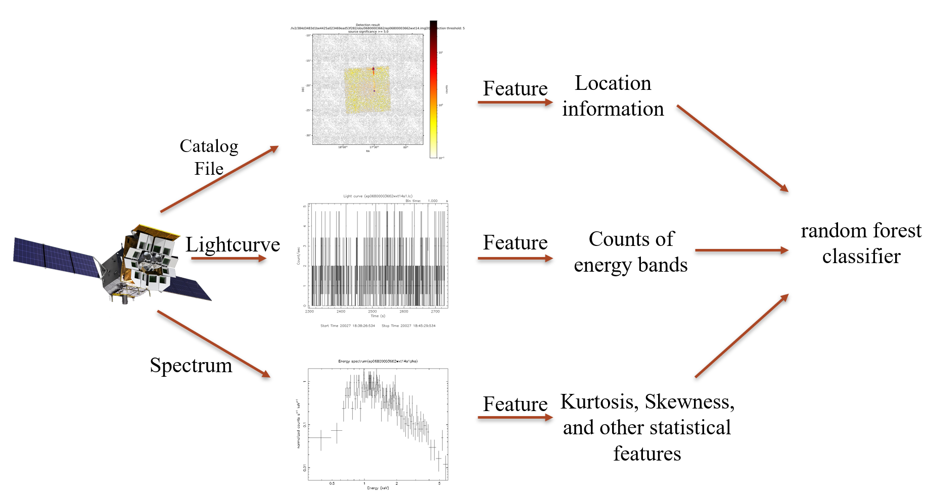
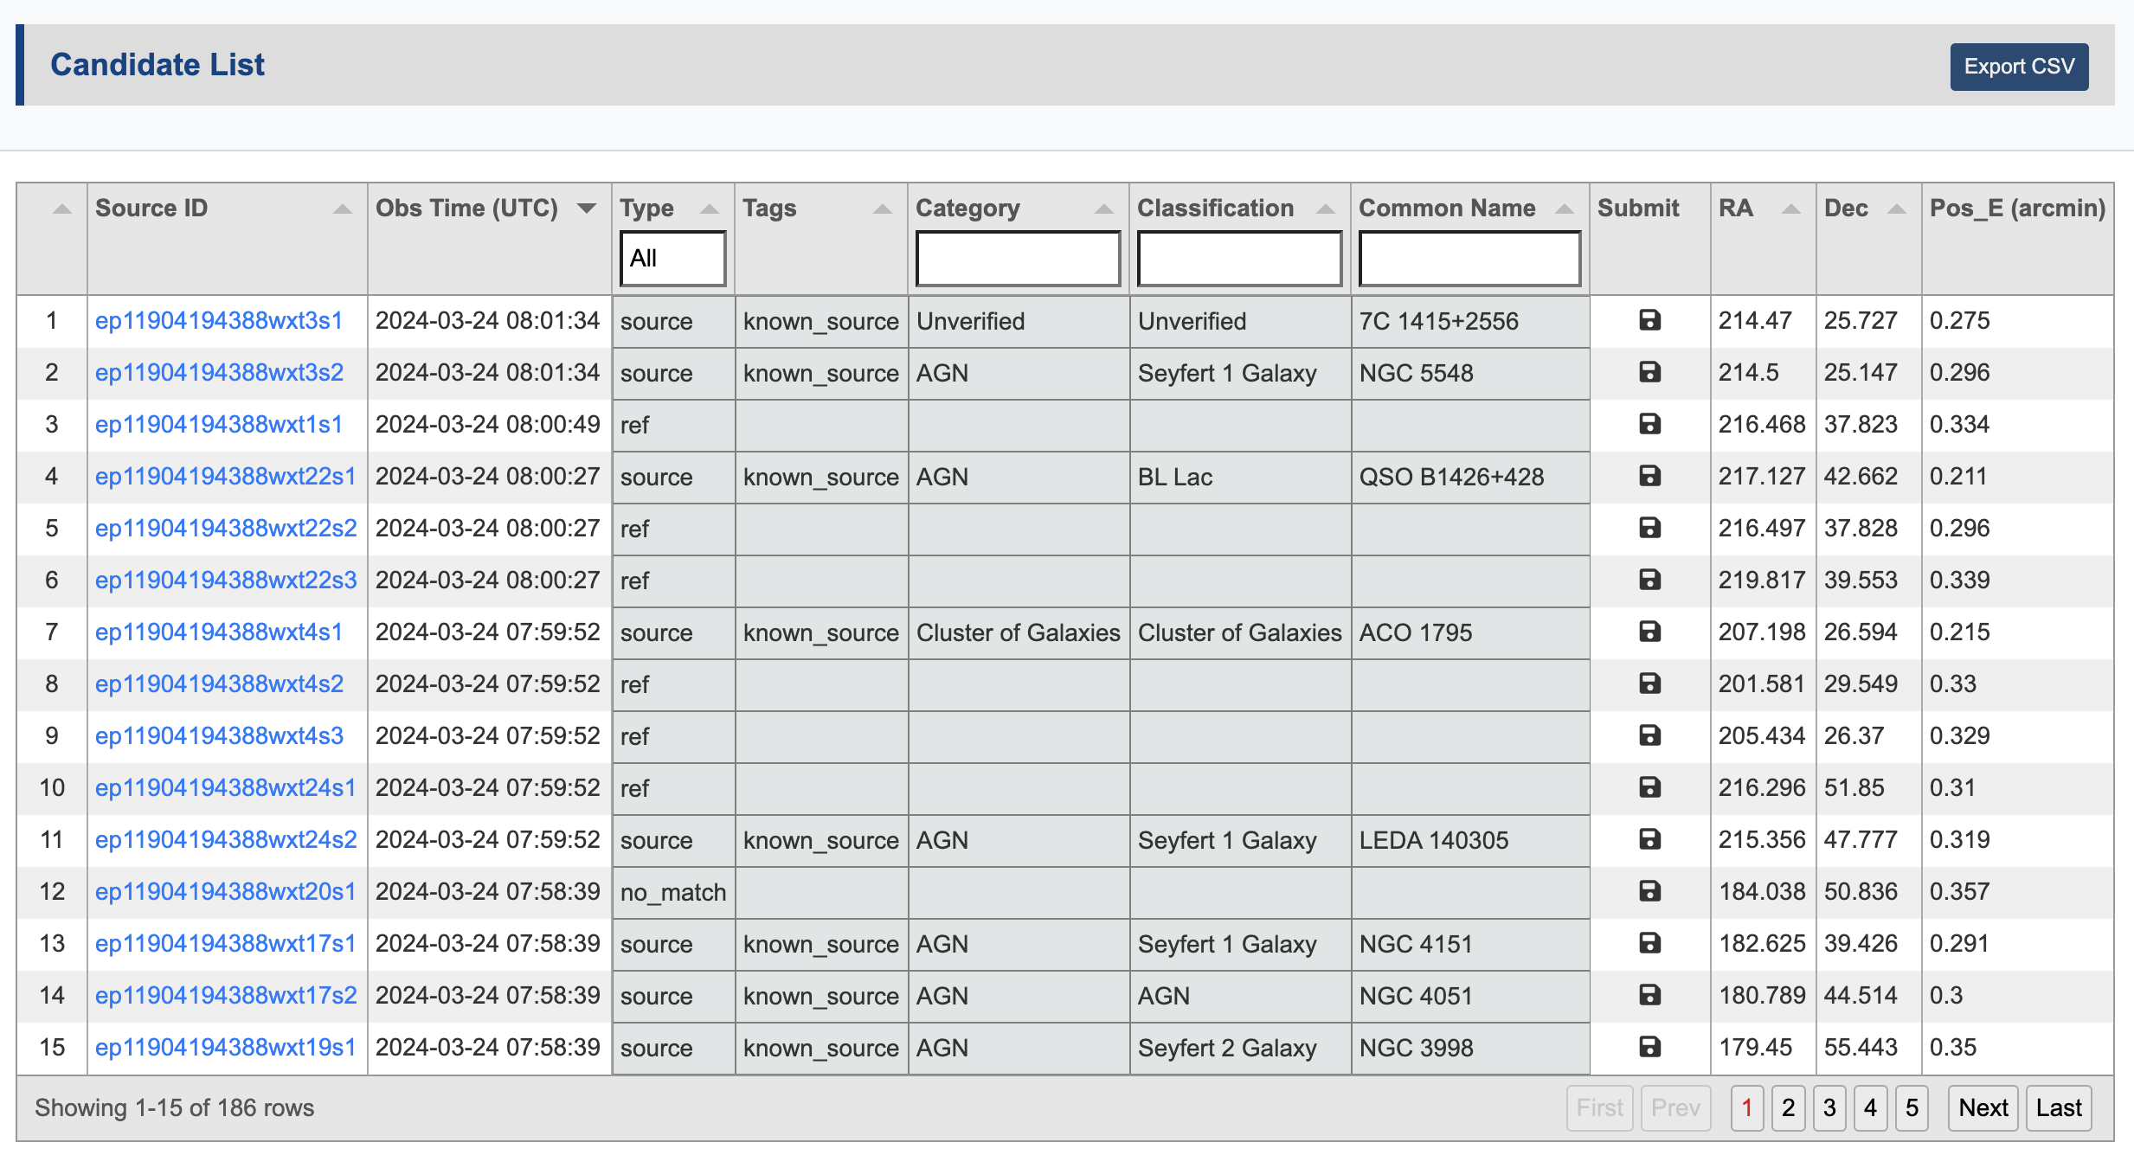
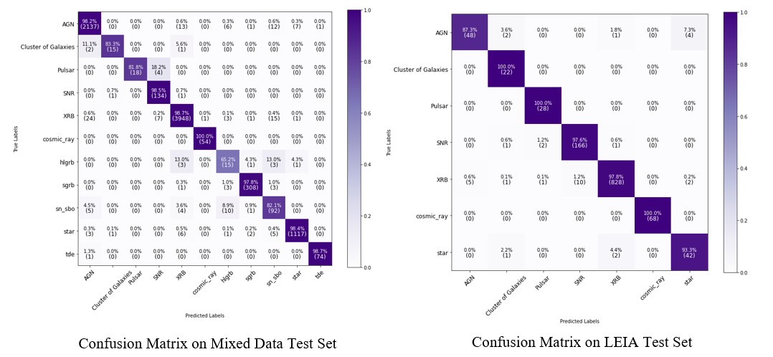
X-Ray Transient Identification
Automatic Classification
In the EP scientific data pipeline, an automatic determination is made as to whether each detected X-ray source is known, and a preliminary classification is provided through AI algorithms
Accuracy 98% Accuracy 97.3%
Automatic Classification Results of X-ray Sources (Known Source, Burst, No Match, Cosmic Ray）
AI Algorithm-Based X-ray Source Classification Process and Results
Notes:
Now, let's discuss X-ray transient identification. In the EP data pipeline, an automatic process determines whether each detected X-ray source is already known. As previously mentioned, a reference catalog is used to match against each detected source to determine if it is already known.
Sources that are unknown undergo further examination to determine if they are fake sources or cosmic rays. For the remaining transient candidates, a random forest algorithm is employed to provide a preliminary classification.

Slide 13
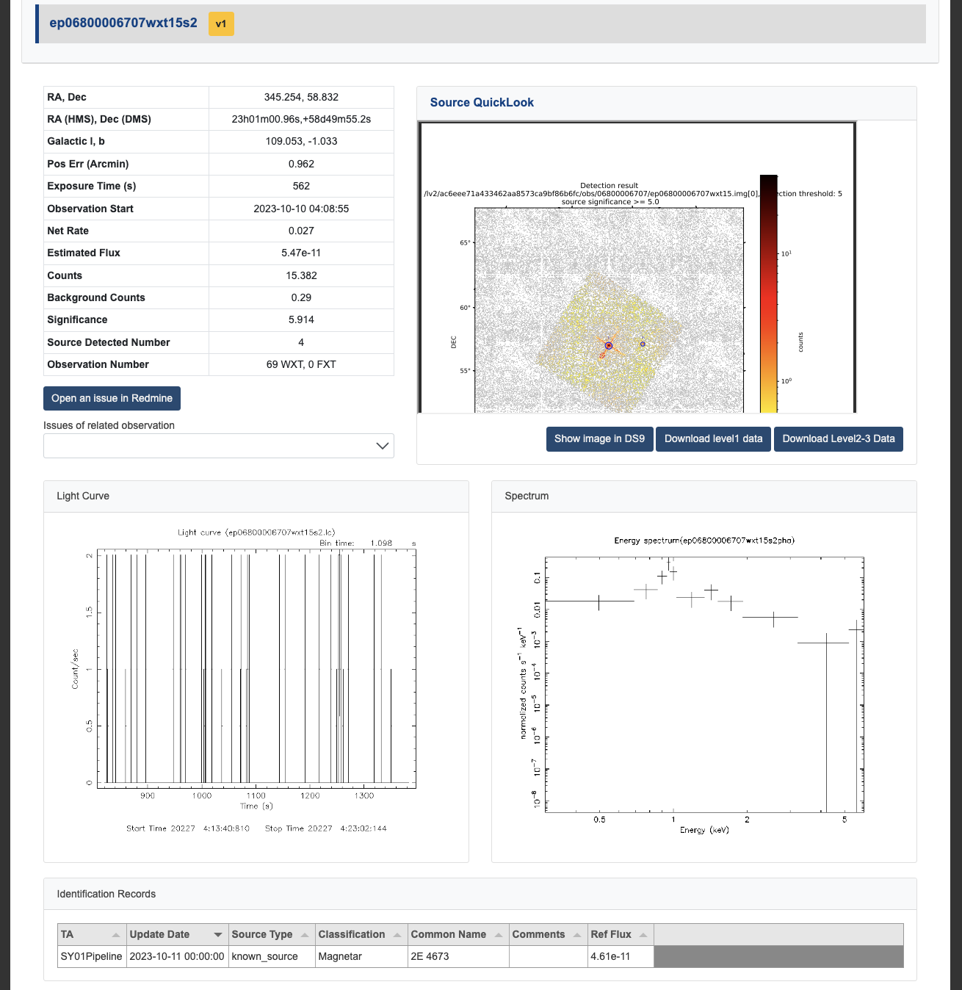
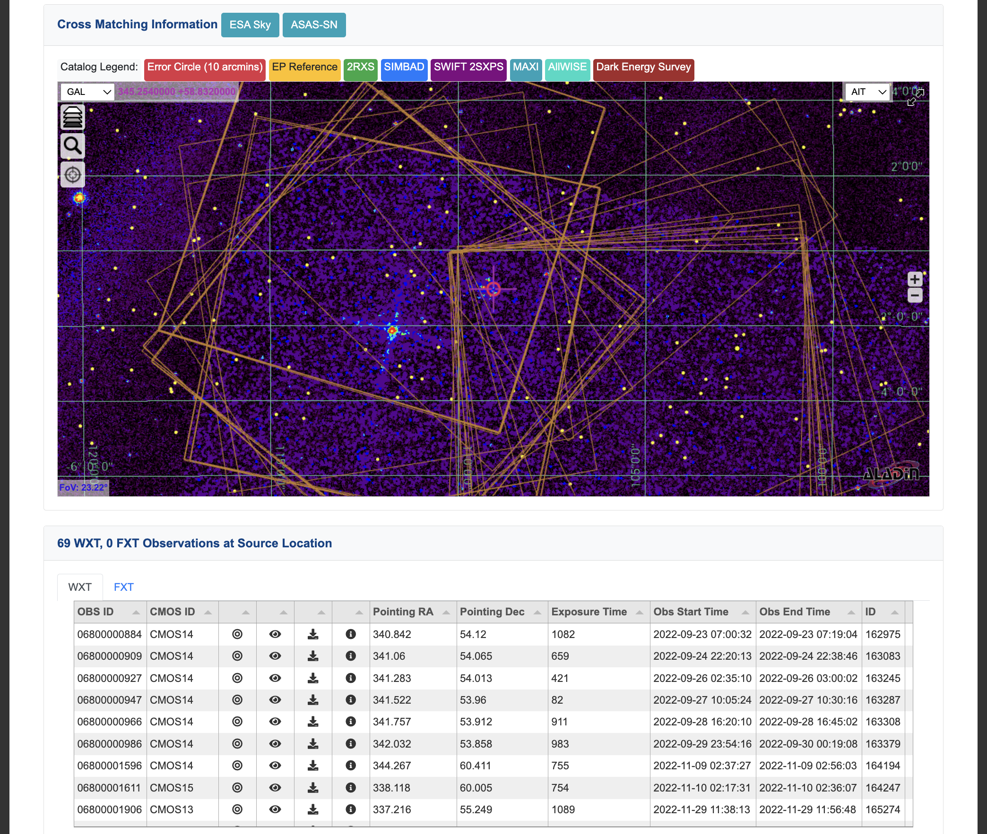
X-Ray Transient Identification
Multi-wavelength Data Assisted Transient Identification
EP Image、LC、Spectrum
DSS, ROSAT, ALLWISE Skymap
MAXI、Swift 2SXPS、4XMM Catalog
Link to Simbad、NED、ASAS-SN
ATel、GCN、TNS Alert
The identification results and the personnel involved in the operation will be recorded, making the identification results traceable.
As of Nov 15th, 2024, over 5000 known sources, 80 transients, and 400 stellar flares have been identified.
Transient Candidate information Portal
Notes:
All transient candidates will be further examined by the transient advocatet. TDAIC provides them with various tools and services to streamline the identification process.
There is a dedicated page that displays all details about each candidate, including its location, image, spectrum, light curve, and so on. In addition,TDAIC integrates DSS, ROSAT, AllWISE sky maps, and catalogs from MAXI, Swift, and XMM-Newton as references, utilizing Aladin Lite for visualization to offer the transient advocate an intuitive user experience. It also links to SIMBAD, NED, and ASAS-SN based on the candidate’s location. Related time-domain astronomical alerts such as GCN Notices, circulars, and ATels are also listed for reference.
All identification results, as well as the personnel involved in the process, will be recorded to ensure traceability of the findings.
As of November 15th, 2024, over 5,000 known sources, 80 transients, and 400 stellar flares have been identified.

Slide 14
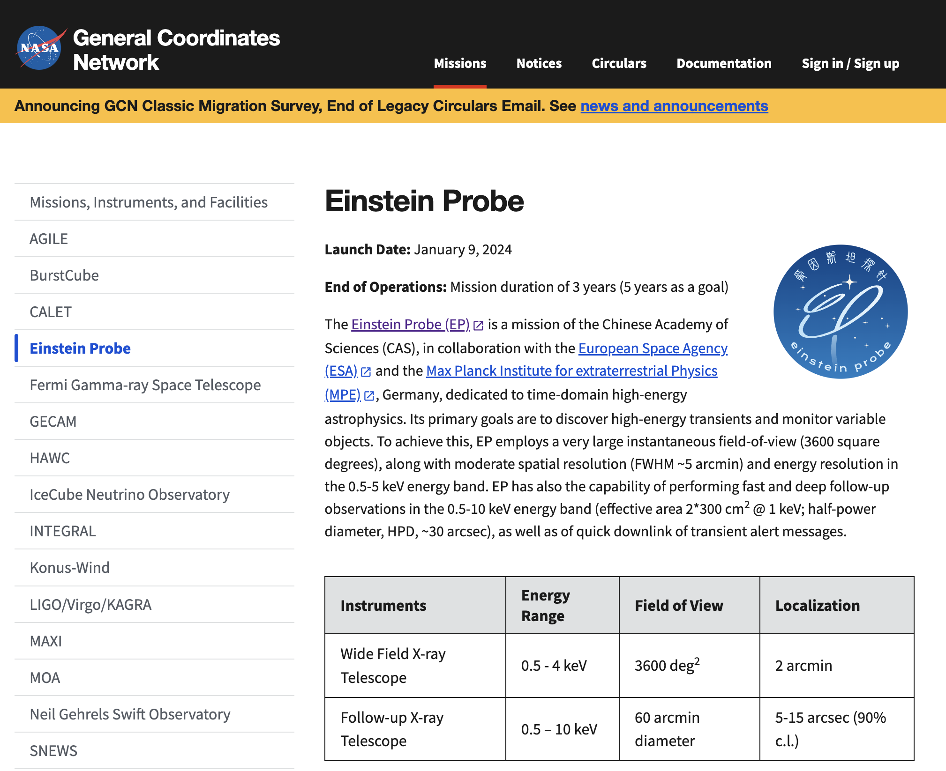
Coordinating Follow-up observations
Implemented end-to-end observation plan push from EP to subsequent telescopes
GCN Notice will be issued via Kafka in JSON format
Cadidate Name
RA, Dec
Type
Err Circle
B_mag
Redshift
Parallax
Obs Type
ToO Urgency
Telescope1
Telescope2
MQTT
EP Transient Candidate
Follow-up
Obs Plan
Telescope3
GCN Notice
ATel
……
GCN Circular
Telescope N
GCN Kafka topic： gcn.notices.einstein_probe.wxt.alert
Notes:
If a transient is confidently identified, follow-up observations will be initiated as soon as possible. TDAIC will directly send the follow-up observation plan to cooperating telescopes using the MQTT protocol. Additionally, GCN notices or circulars and ATels will be issued as appropriate for different situations.
The follow-up observation plan and alert content are organized in JSON format, and GCN notices are sent via Kafka.

Slide 15
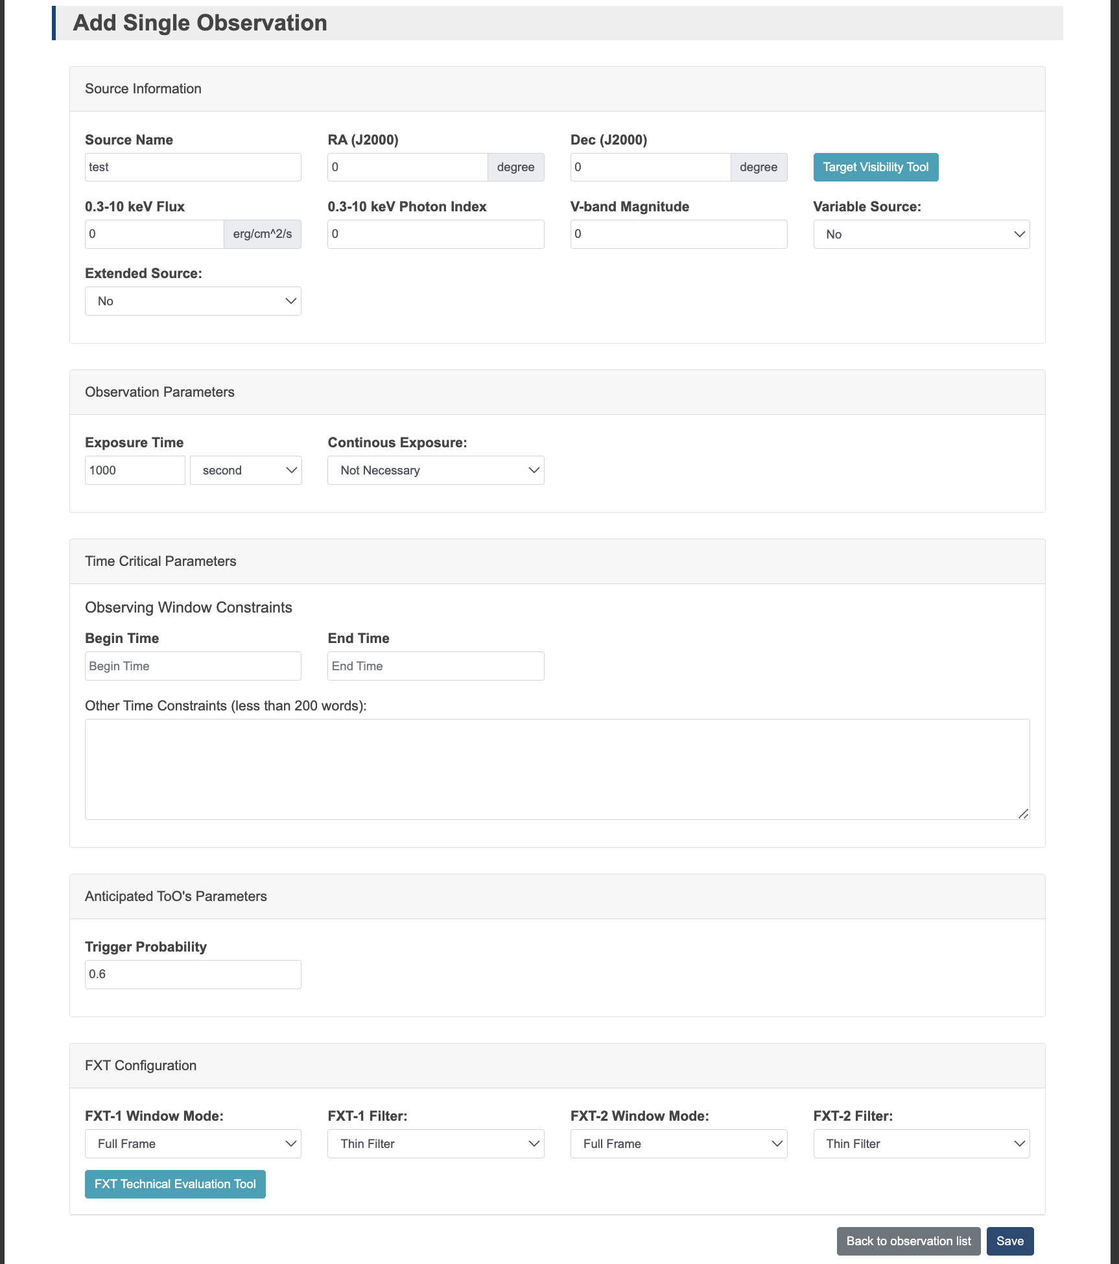
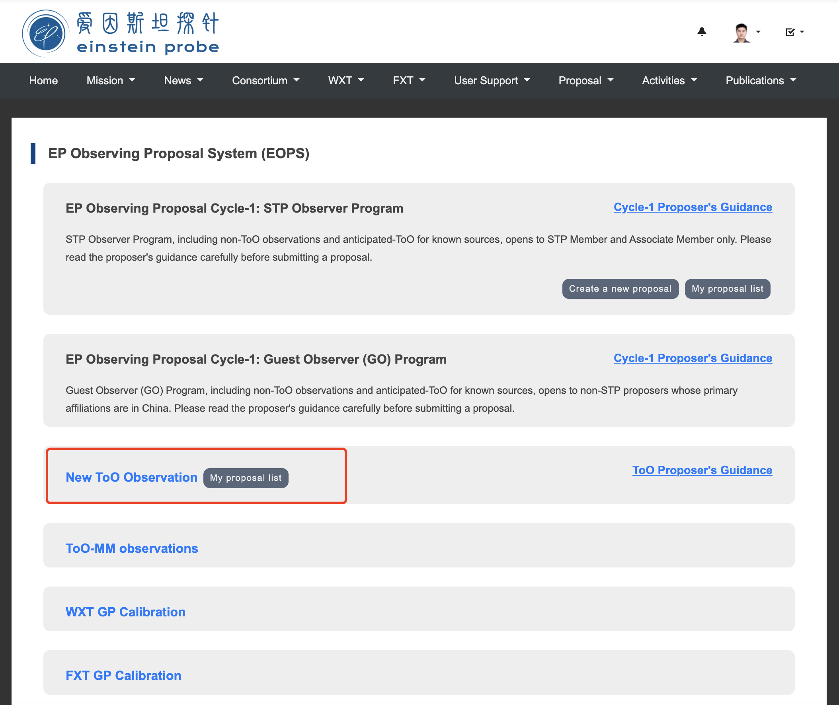
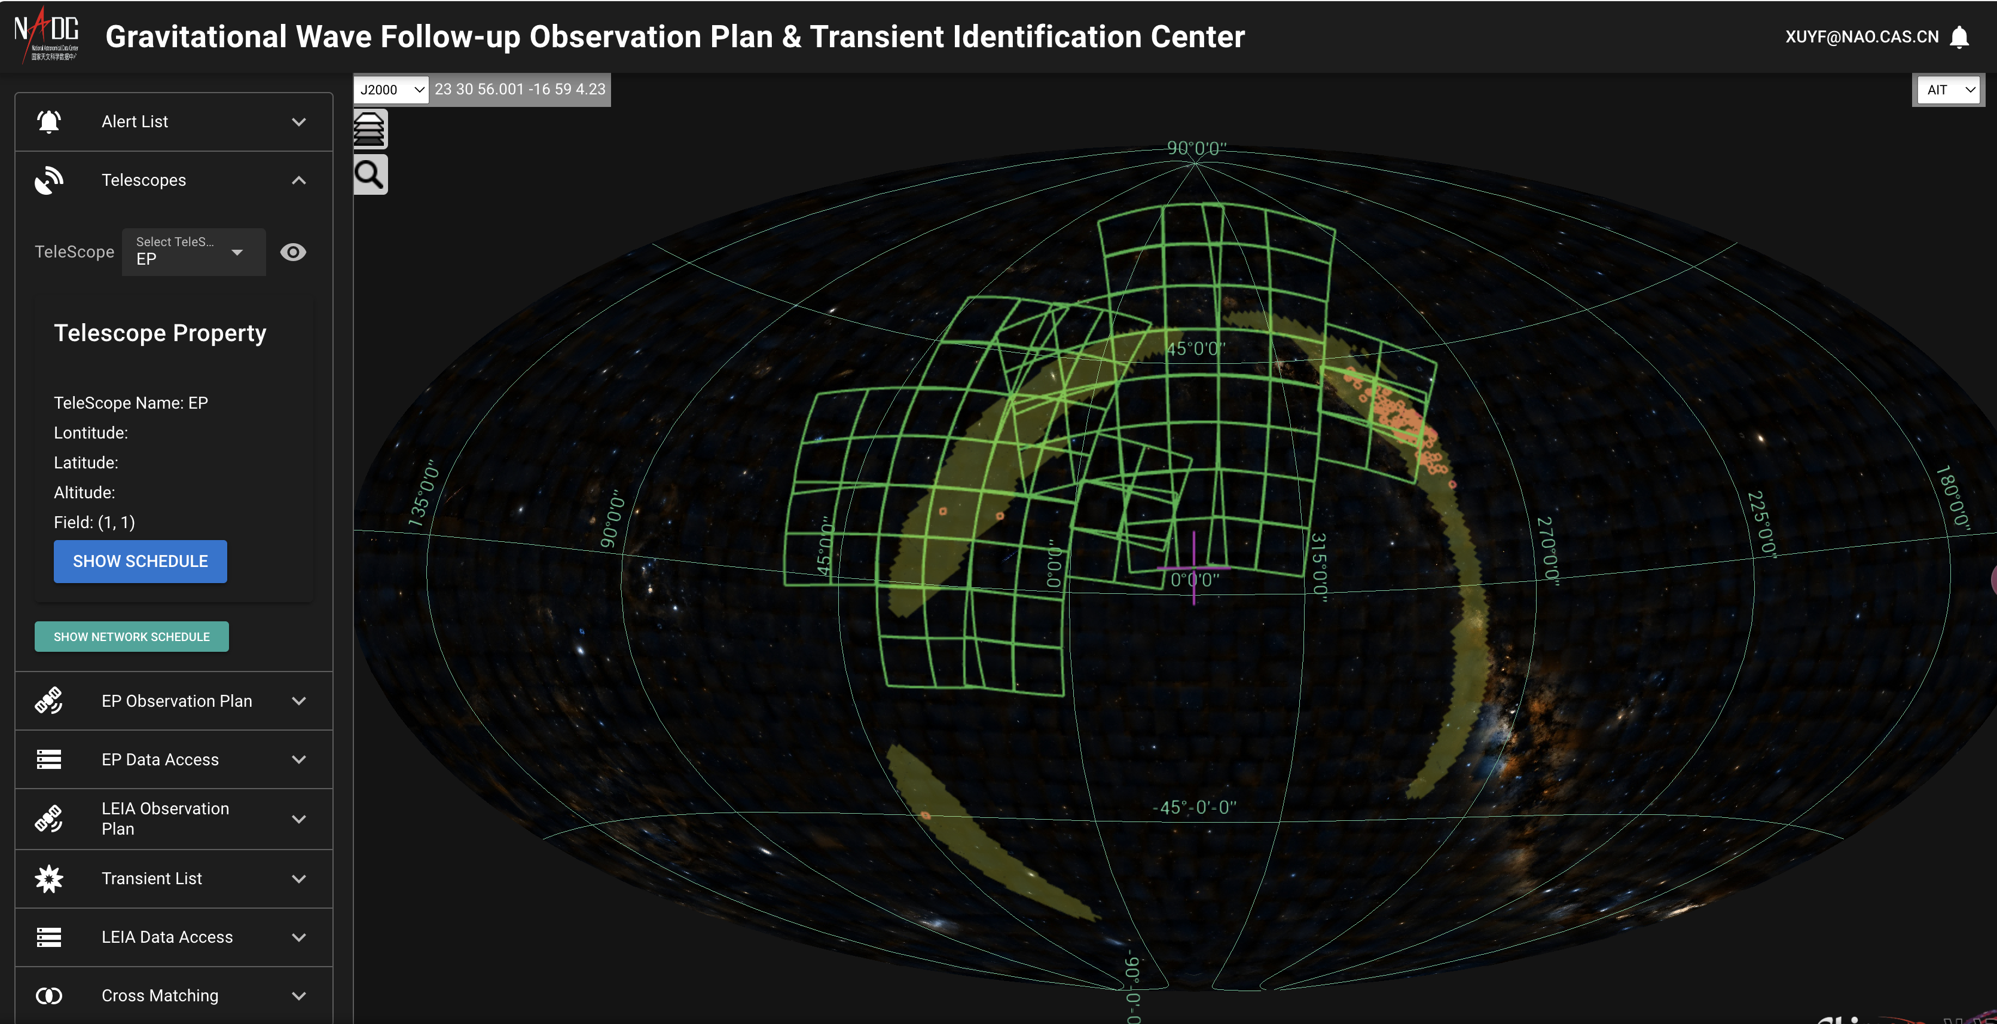
Coordinating Follow-up observations
Follow up observation alerts from other projects: SVOM, LIGO
Rapid ToO (Target of Opportunity) upload capability: Beidou Link, X/S-band link
ToO Observing Proposal Tool
Notes:
There are also methods to respond to follow-up observation requests from other facilities, such as those triggered by gravitational wave events. We have a separate system that generates EP WXT observation plans for each GW event, as shown in the snapshot on the left. These observation plans are then uploaded to the satellite using TDAIC’s ToO observing proposal tool.
There are two types of uplinks available for uploading EP’s ToO observation plans: the X-band link and the Beidou link. The X/S-band link requires several hours to upload data to the satellite, whereas the Beidou link completes the upload in just a few minutes.

Slide 16
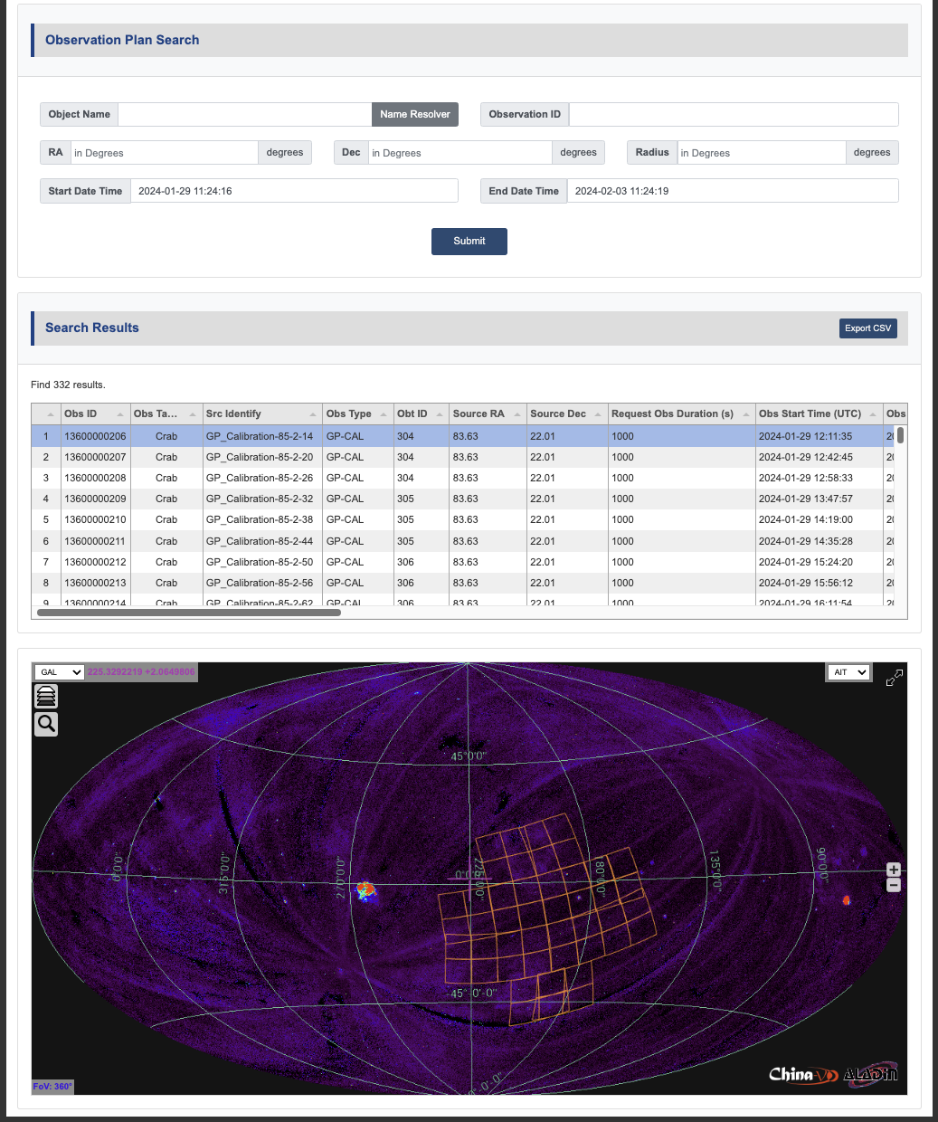
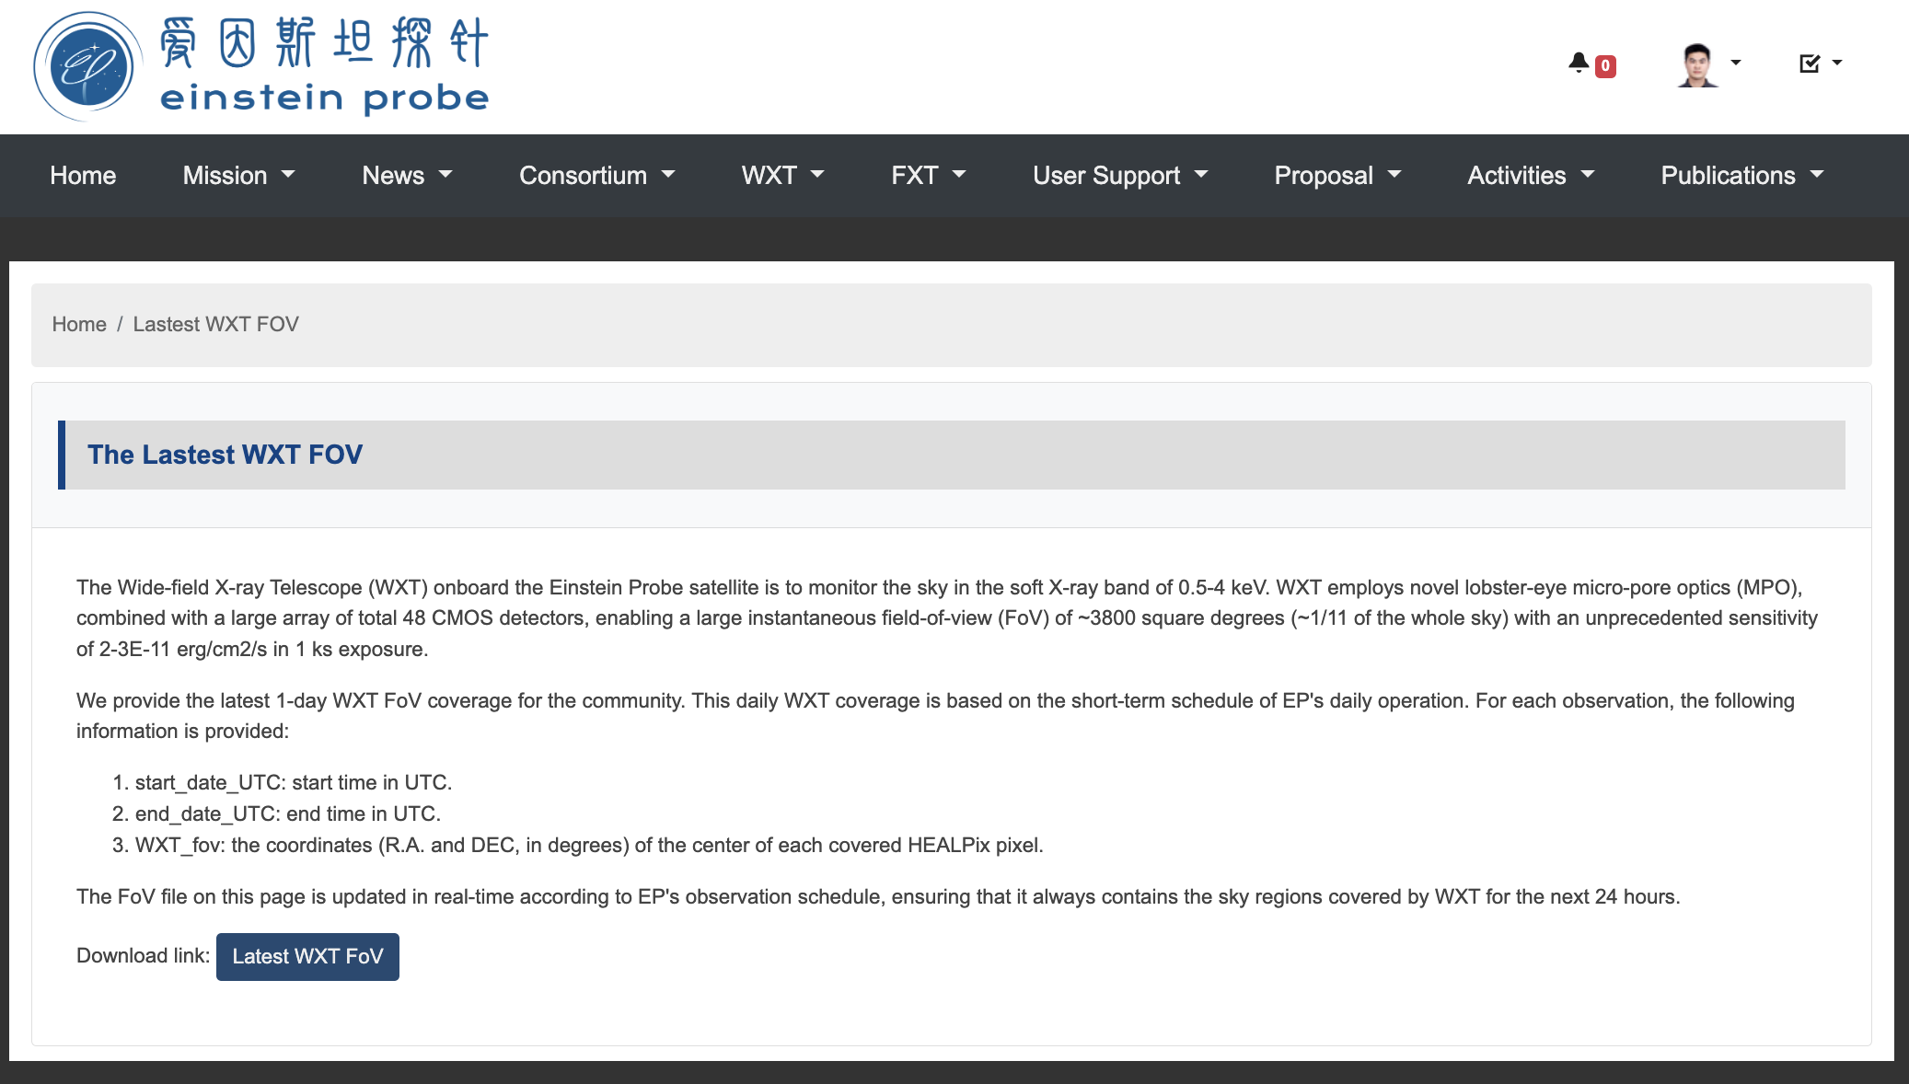
Coordinating Follow-up observations
Coordinate observation with other facilities
Observation Plan Query UI & API
ObsLocTAP implementation in progress
Notes:
For coordinated observations between EP and other facilities, TDAIC offers several ways to access EP's observation plans. Through the TDAIC's user interface, users can query observation plans by location, time span, or observation ID. Additionally, TDAIC provides an API for retrieving the latest WXT field of view, making it convenient for automated programs.
We are actively working on improving coordinated observations, and the IVOA ObsLocTAP protocol will be implemented in the near furture.

Slide 17
Summary
TDAIC provides a web UI that allows EP scientific users to discover and access EP data. The use of the ObsCore data model to organize the EP data makes it nearly TAP-ready; the next step is to implement the TAP interface.
In the process of transient identification within TDAIC, multi-wavelength data is interoperated with EP data to assist in identification task.
The alert system of TDAIC is built on protocols such as MQTT and Kafka, utilizing JSON-formatted messages to issue alerts and follow-up observation plans.
EP can swiftly upload ToO target using the Beidou link and the X/S-band link, often completing the process in just a few minutes.
EP's observation plans are publicly released through the TDAIC website. We are working on implementing the ObsLocTAP standard to make these plans discoverable within the VO framework.
Notes:
Finally, I will conclude with a summary and try to answers the questions from the chair.

Slide 18
Thank you！
Notes:
And that‘s everything I have for you today. I hope you found this overview helpful. Thank you for your time.

