Slide 1
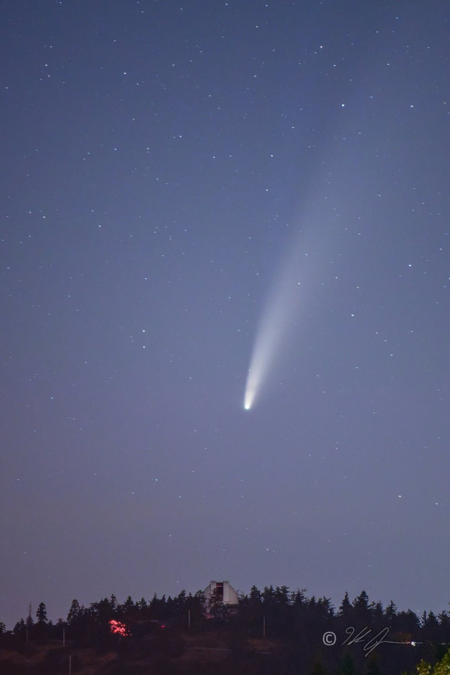

State of the IVOA
14-16 Nov 2025
Southern Spring Interoperability Meeting
Görlitz, Germany
JJ Kavelaars
IVOA Chair

Slide 2
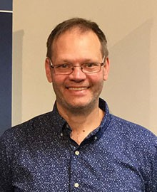
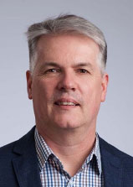
IVOA Executive Chair/Vice-Chair
JJ Kavelaars – Chair
June-2025 to Nov-2026
Mark Allan – Vice Chair
June-2025 to Nov-2026

Slide 3

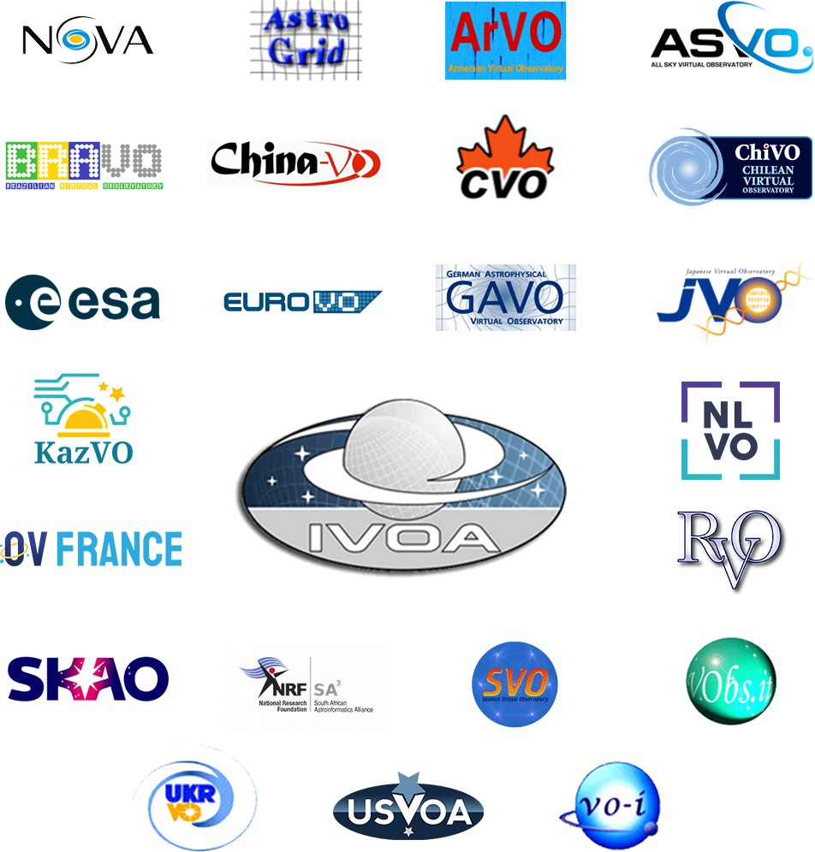
What is the IVOA?
IVOA founded in 2002.
23 Member Organizations/Projects
A group of people that agrees on standards on which to build applications that interoperate across data providers
Two interoperability meetings per year:
“Northern Spring”
“Southern Spring” (typically after ADASS)
ivoa.net

Slide 4



Vision of the IVOA
Develop a FAIR data management framework for astronomy
Interoperability standards (VO framework) amongst astronomical (ground and space based) archives
Publishing tools for data centres
Enable new science through the VO
Multi wavelength science, combining datasets from multiple sources
Data discovery and data access tools
Data analysis and visualization tools
World wide collaboration amongst astronomical VO projects
No formal funding, nationally funded projects
Diversity makes IVOA’s richness
ivoa.net

Slide 5

IVOA Organisation
IVOA-IAU
Liaison Group
Executive Committee
Committee on Science Priorities
Media Group
Technical Coordination Group
Standards & Processes Committee
Working Groups
Interest Groups
Applications
Data Access Layer
Data Models
Data Curation & Preservation
Operations
Theory
Distributed Services & Protocols
Registry
Semantics
Radio Astronomy
Solar System
Time Domain
Knowledge Discovery
Education
High Energy
ivoa.net

Slide 6
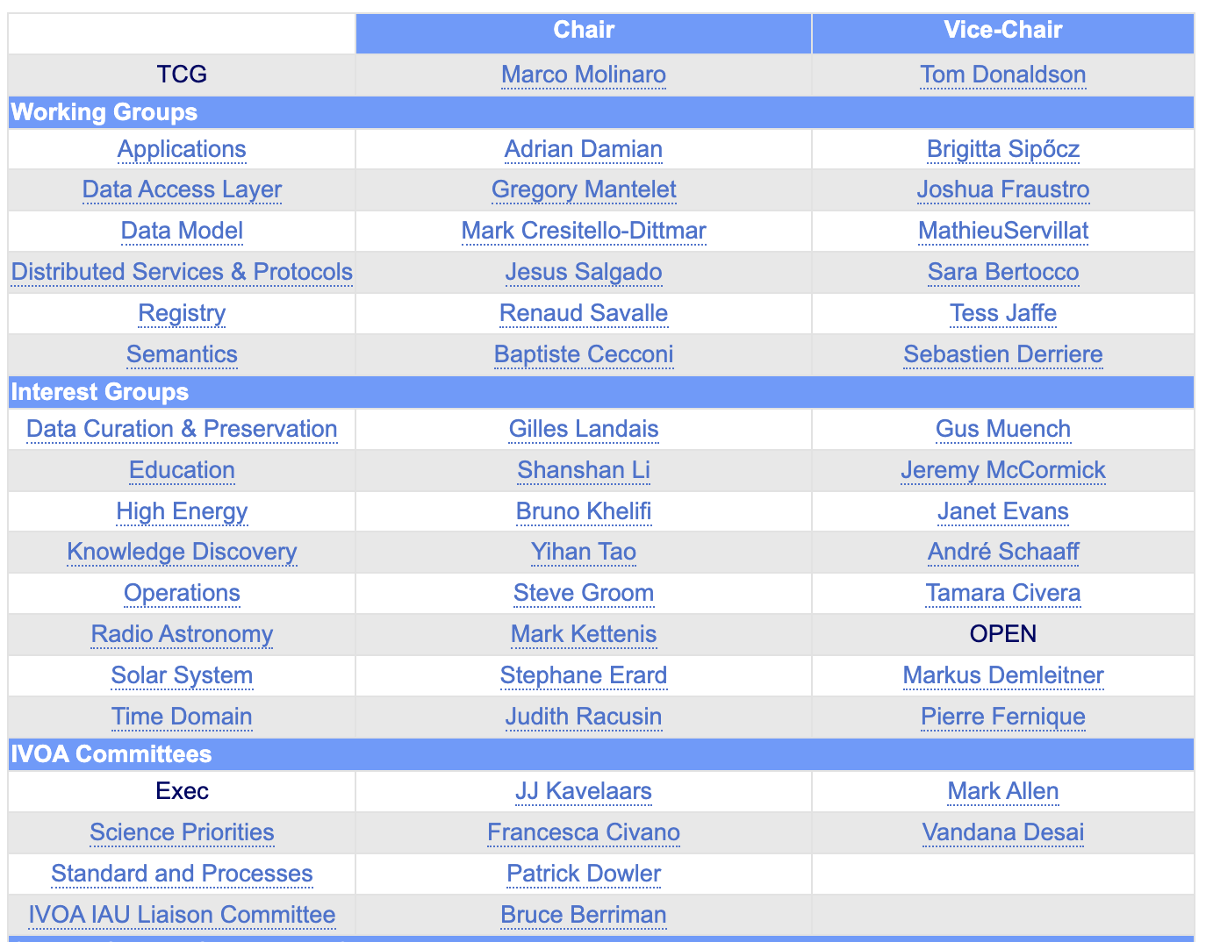
Working and Interest Groups
WG/IG chairs and vice-chairs are 3- year terms, with one year extension possible
There are currently one open position:
Radio Astronomy IG vice chair
Note: Theory IG is currently on hiatus
ivoa.net

Slide 7
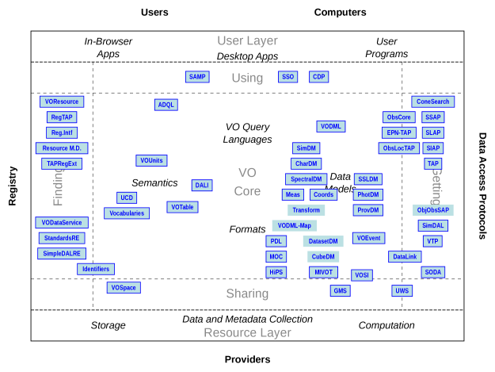
IVOA Architecture – All the Standards
IVOA Architecture 2024-10-25 draft
IVOA is an open community – if a standard is close but doesn’t fit – implement an extension & provide feedback to influence change to the standard
Example – Radio extension to the ObsCore Data Model
ivoa.net

Slide 8
IVOA Website and Newsletter
New web site that is more dynamically maintained will be released VERY soon (today?)
A new addition of the IVOA Newsletter planned for January and then we hope annually after each Northern Spring InterOp.
Newsletter intended to be inward AND outward facing: tell the IVOA and the world about the cool new projects you’re working on!
Email articles to ivoa-news-editors@ivoa.net
ivoa.net

Slide 9
VO Project Updates

Slide 10

Armenian VO 20th Anniversary meetings
Astronomical Surveys and Big Data 3 (ASBD-3), 15-19 Sep 2025, Byurakan, Armenia; https://www.bao.am/meetings/meetings/ASBD3/
4th Regional Astronomical Summer School (4RASS) "Astronomy and Data Science", 8-12 Sep 2025, Byurakan, Armenia; https://www.bao.am/meetings/meetings/4RASS/
Armenian VO collaborations
Observatoire Virtuel France (OV-France)
German Astrophysical Virtual Observatory (GAVO)
Chinese Virtual Observatory (China-VO)

Slide 11

All-Sky Virtual Observatory
Submitted $19M funding application for Data Central and CASDA
Integration of platforms via VO services
Enhanced storage and compute capabilities
Improved links between data team and researchers
New data engineering program for service monitoring and data contracts
Cybersecurity uplift

Slide 12
All-Sky Virtual Observatory
Data Central
Published DEVILS Data Release 1 (Multiwavelength imaging, AAT optical spectra and catalogues)
Developed TAP authentication capability
Test ingestions for mock catalogue and ASKAP datasets
Data Central
Published DEVILS Data Release 1 (Multiwavelength imaging, AAT optical spectra and catalogues)
Developed TAP authentication capability
Test ingestions for mock catalogue and ASKAP datasets

Slide 13

Canadian Virtual Observatory
Contributing to and proposing Working Drafts:
WD-CAOM-2.5 proposed as a rich observation metadata model suitable for all astronomy missions
WD-VOSI-next support for user-managed tables via the VOSI-tables API (with OpenAPI spec)
WD-DALI-1.2 adds a variety of new xtypes to describe values in VOTable
WD-TAP-1.2 will add user-managed table support and an OpenAPI specifications
IVOA in the SKA Regional Center
Designing a software metadata architecture to support discovery of containers holding software of interest.
Execution brokering in the CANFAR science platform
AAI federation for LSST and SRC to inform AuthVO
Contributing to IVOA Web site updates:
Introduced foundational styling tools to support a clean and consistent design.
Optimizing for mobile.
Unifying the visual identity.
Aligning the user interface.
Styling updates applied throughout.
Cleanup and infrastructure updates.
Node tooling added.
Development of PyVO and astroquery.cadc and other VO driven CLIs (e.g. cadc-data, cadc-tap)
Added BINARY/BINARY2 VOTable and parquet/VOParquet support to TAP libraries, release coming soon
CAOM2 Python and Java implementations available
Notes:
Change picture to list of archives
New storage is IVOA

Slide 14
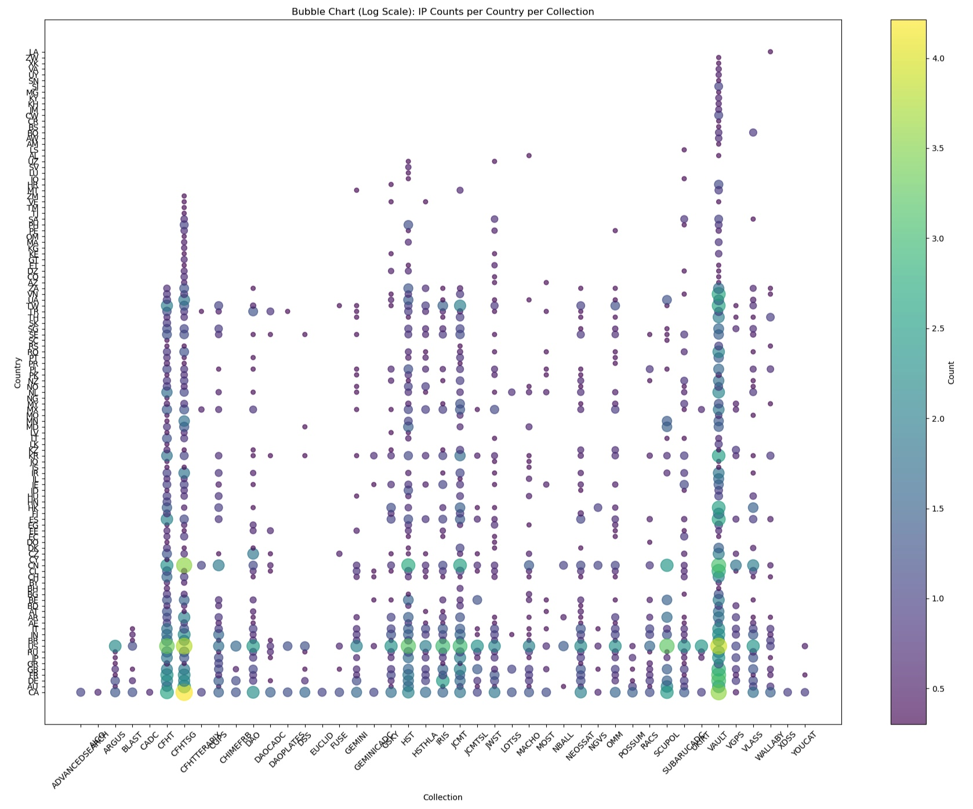

Slide 15
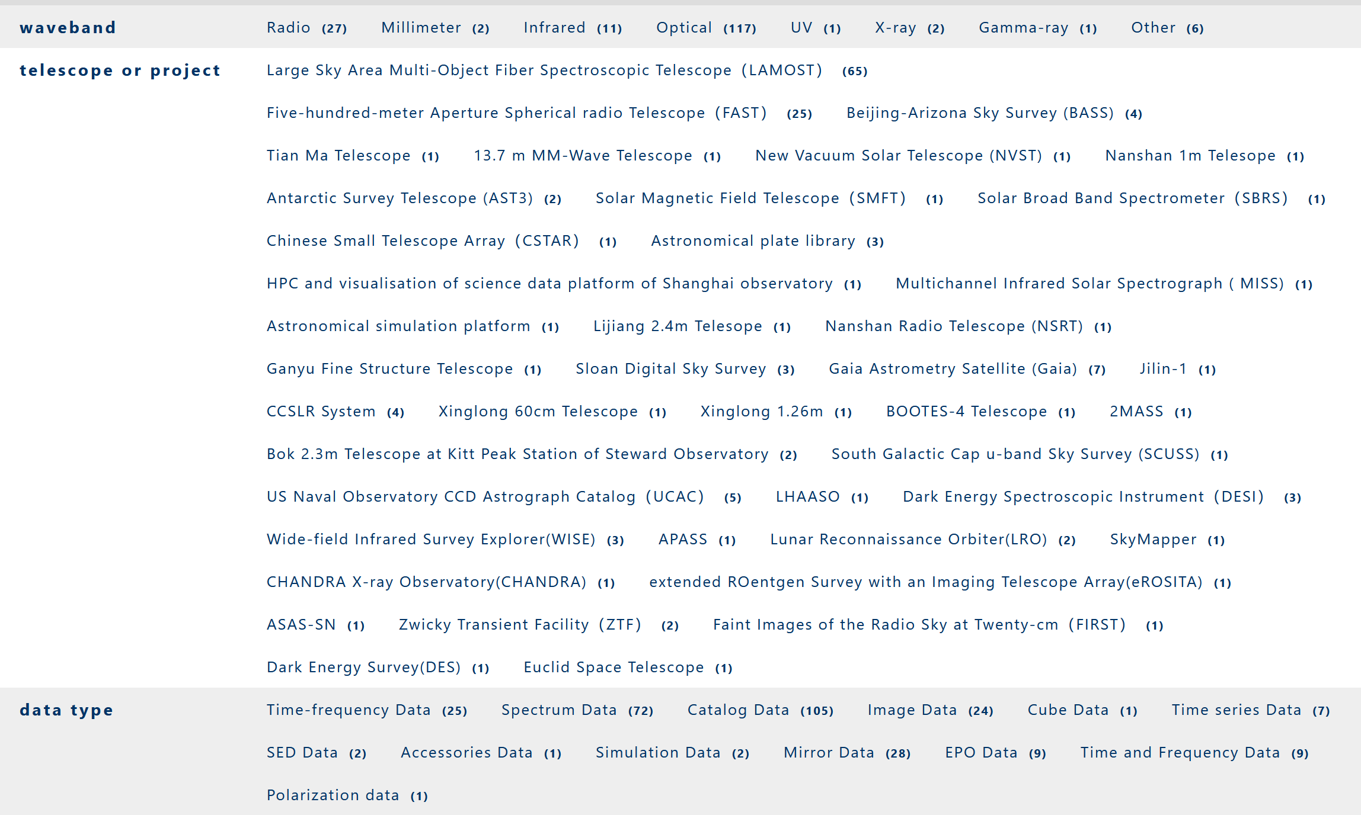
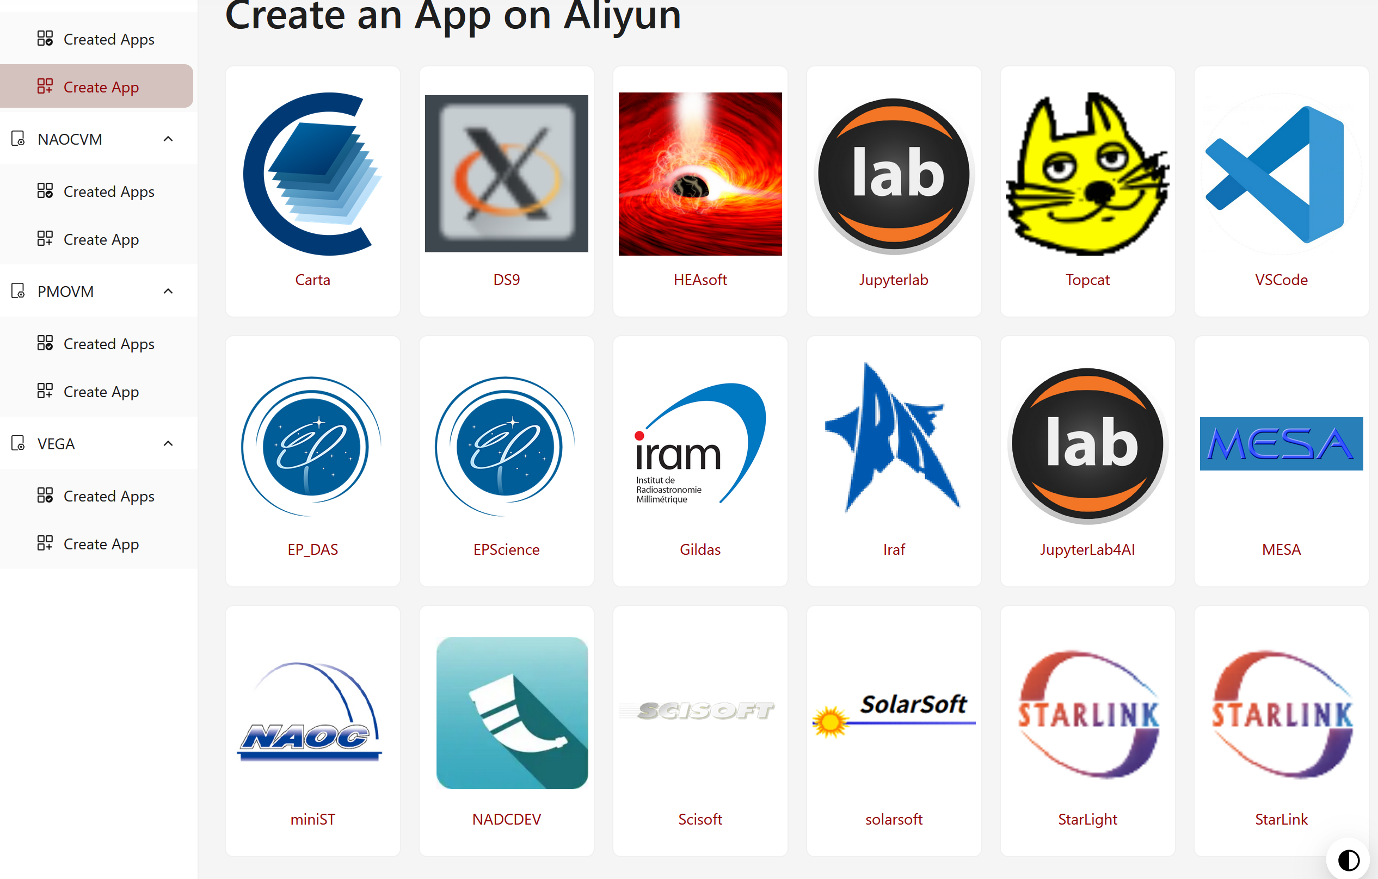
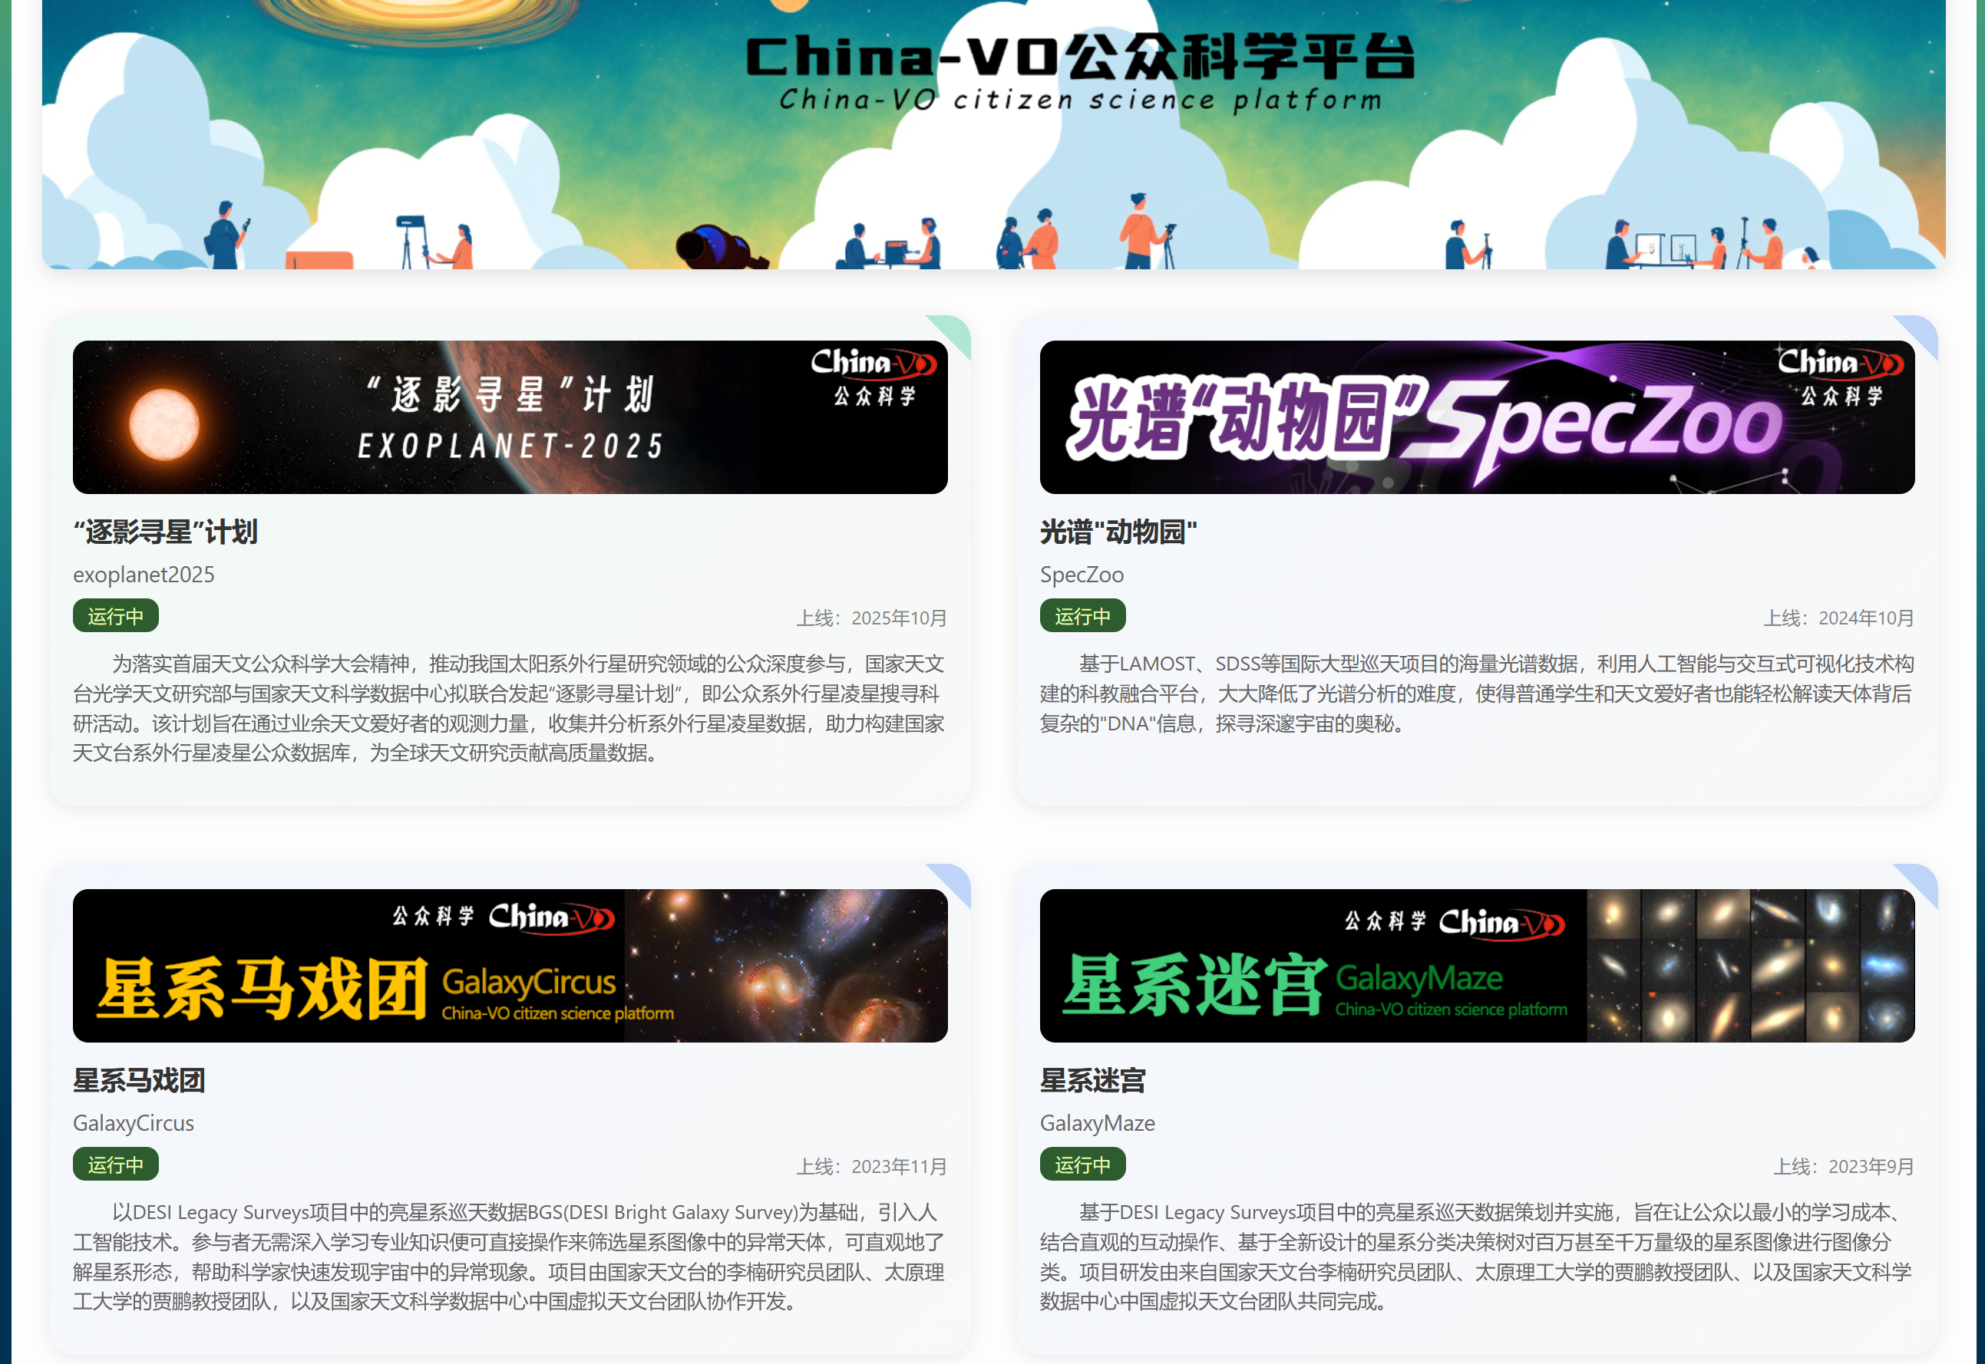
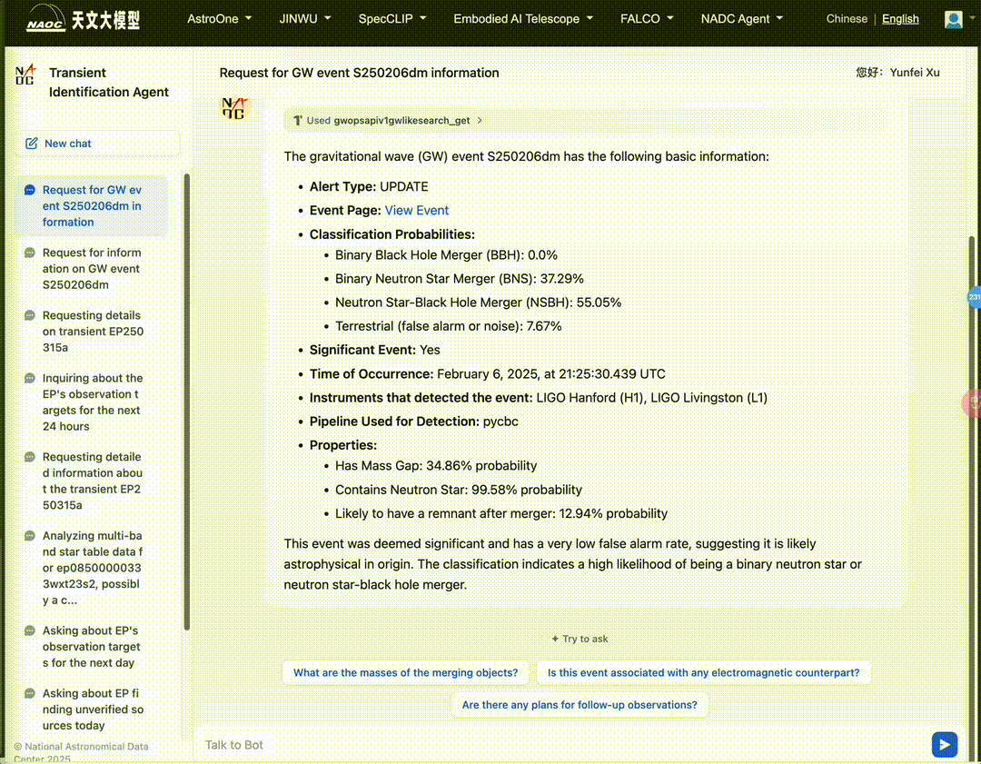
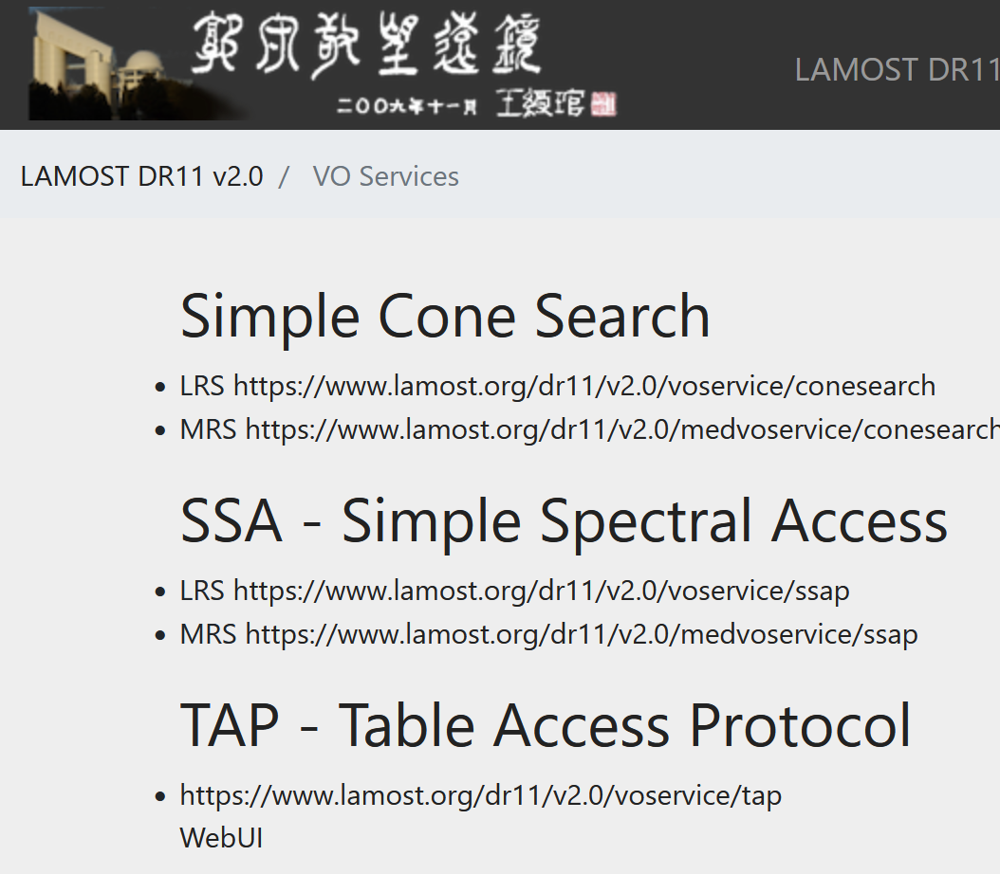
China-VO Latest State
Registered Users: 43099
Datasets: 1072
Open access: 1027
China-VO Science Platform
4 nodes
18 apps
230 users
Citizen Science Projects: 9
IVOA Interfaces: 160
MCP Server Tools: 28

Slide 16

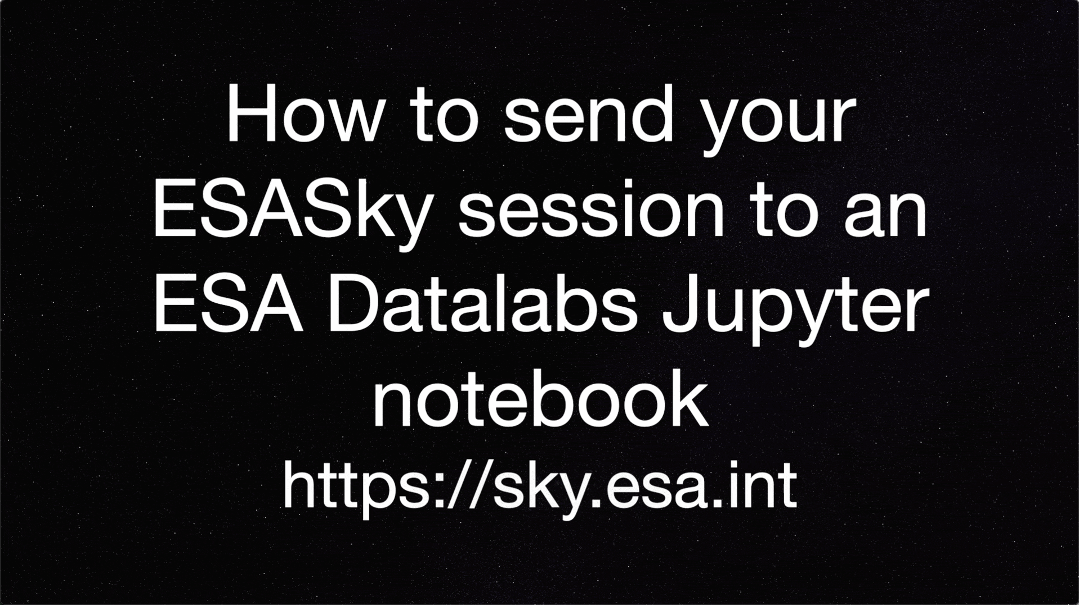


ESA Science Archives VO updates
VO Resources improvements
JWST, Hubble, Integral, XMM-Newton TAP now fully compliant
Working on other TAPs and SIAP, SSAP compliance
ESDC TAP common code now stateless (see Osinde talk)
Euclid iDR1 release on 31 October
TAP, DataLink, SIA, SSA, SODA, VOSpace
Gaia DR4 (Dec 2026) preparation:
Datalink products from Parquet files
Various ESASky releases
Supporting Euclid iDR1
Seamlessly interactions with ESA Datalabs

Slide 17
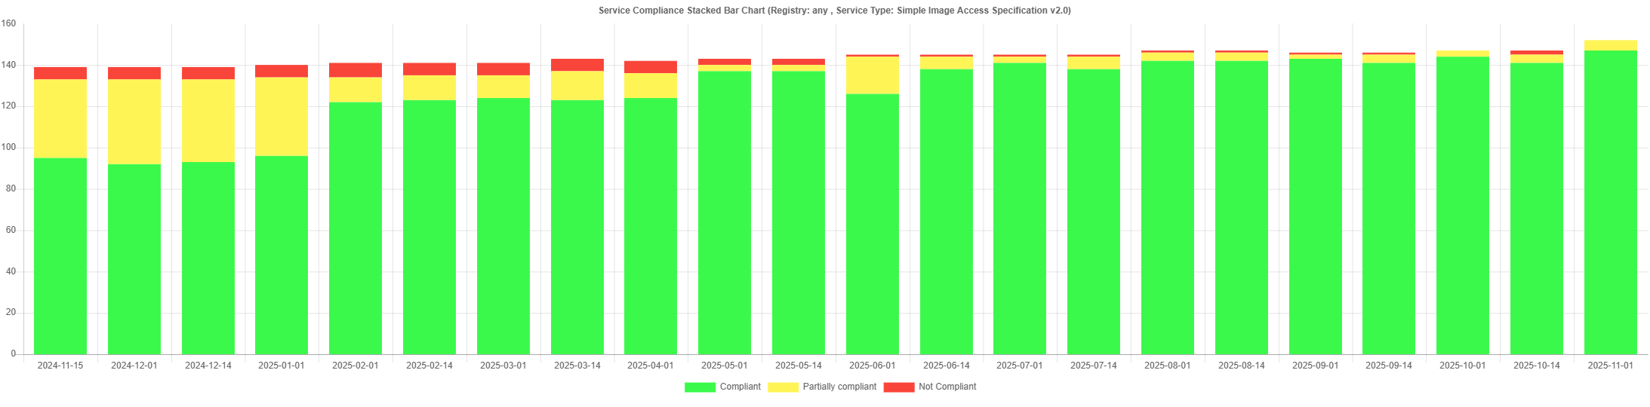
Euro-VO Registry - Highlights
Euro-VO Registry 5.5
Improvement of validator of VO Resources
New validator for Object Observability Simple Access Protocol services – DAL session presentation
Improving the quality of the VO ecosystem
Contacted the owners of almost all (98%) VO services with no or partial compliancy with the standard
~90% response and fix rate
Details during the Euro-VO Registry Weather report presentation (Ops session)
SIAP v2.0 services compliancy
Nov 2024
Nov 2025

Slide 18

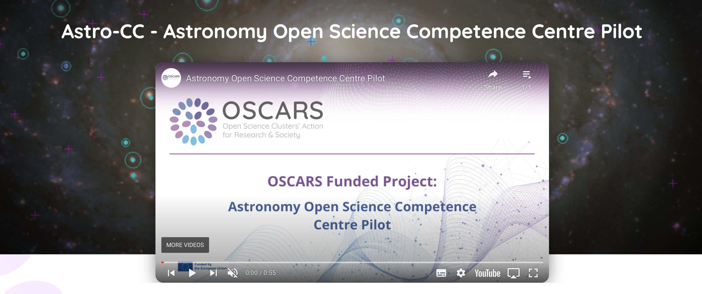
Euro-VO Activities
The “Astronomy Open Science Competence Centre Pilot” project (Astro-CC) is supporting community events for the use and development of the VO:
Project started officially in April 2025, for 2 years
https://www.oscars-project.eu/projects/astro-cc-astronomy-open-science-competence-centre-pilot
Funded by the EC Horizon Europe OSCARS project, and connected to ESCAPE collaboration
Partner leads:
CDS/CNRS (M. Allen PI)
INAF (M. Molinaro)
INTA (E. Solano)
UHEI (J. Wambsganss)
ObsParis (B. Cecconi)

Slide 19


The project is a pilot of a “Competence Centre” for Open Science in the context of the European Open Science Cloud (EOSC).
Focused on community events:
2 Technology Forum events - for the developers of software/services, to discuss and refine community open interoperability standards.
First Tech Forum: week of October 2025, Trieste, Italy (30 participants)
https://indico.in2p3.fr/event/36318/
Second Tech Forum: late 2026 in Paris
2 Scientific Training events - for Ph.D students and early career researchers, to learn using interoperable tools and services as well as to gain skills for Open Science publication and research in astronomy.
First School: 2-4 December, Madrid, Spain (aiming for ~30 participants)
https://indico.in2p3.fr/event/36738/
Second School: 2026 in Strasbourg
Data Provider Forum event - for astronomy data providers to use standards to ensure their data is FAIR
25-27 March 2026, Heidelberg, Germany – to be advertised.
✓ done

Slide 20
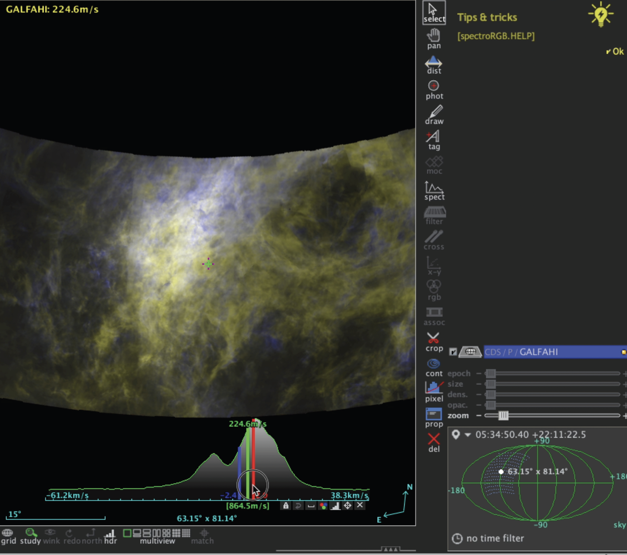
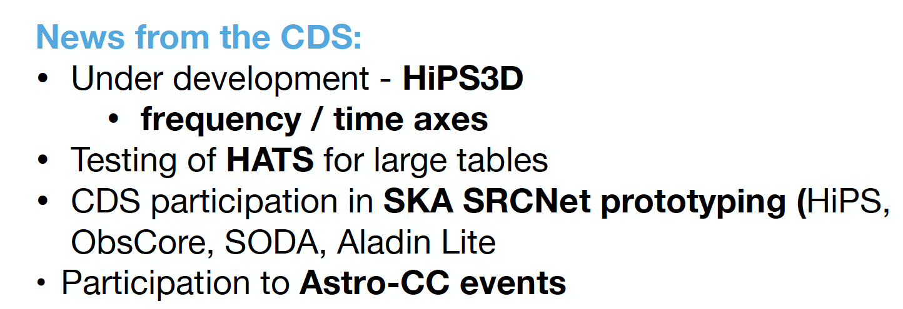
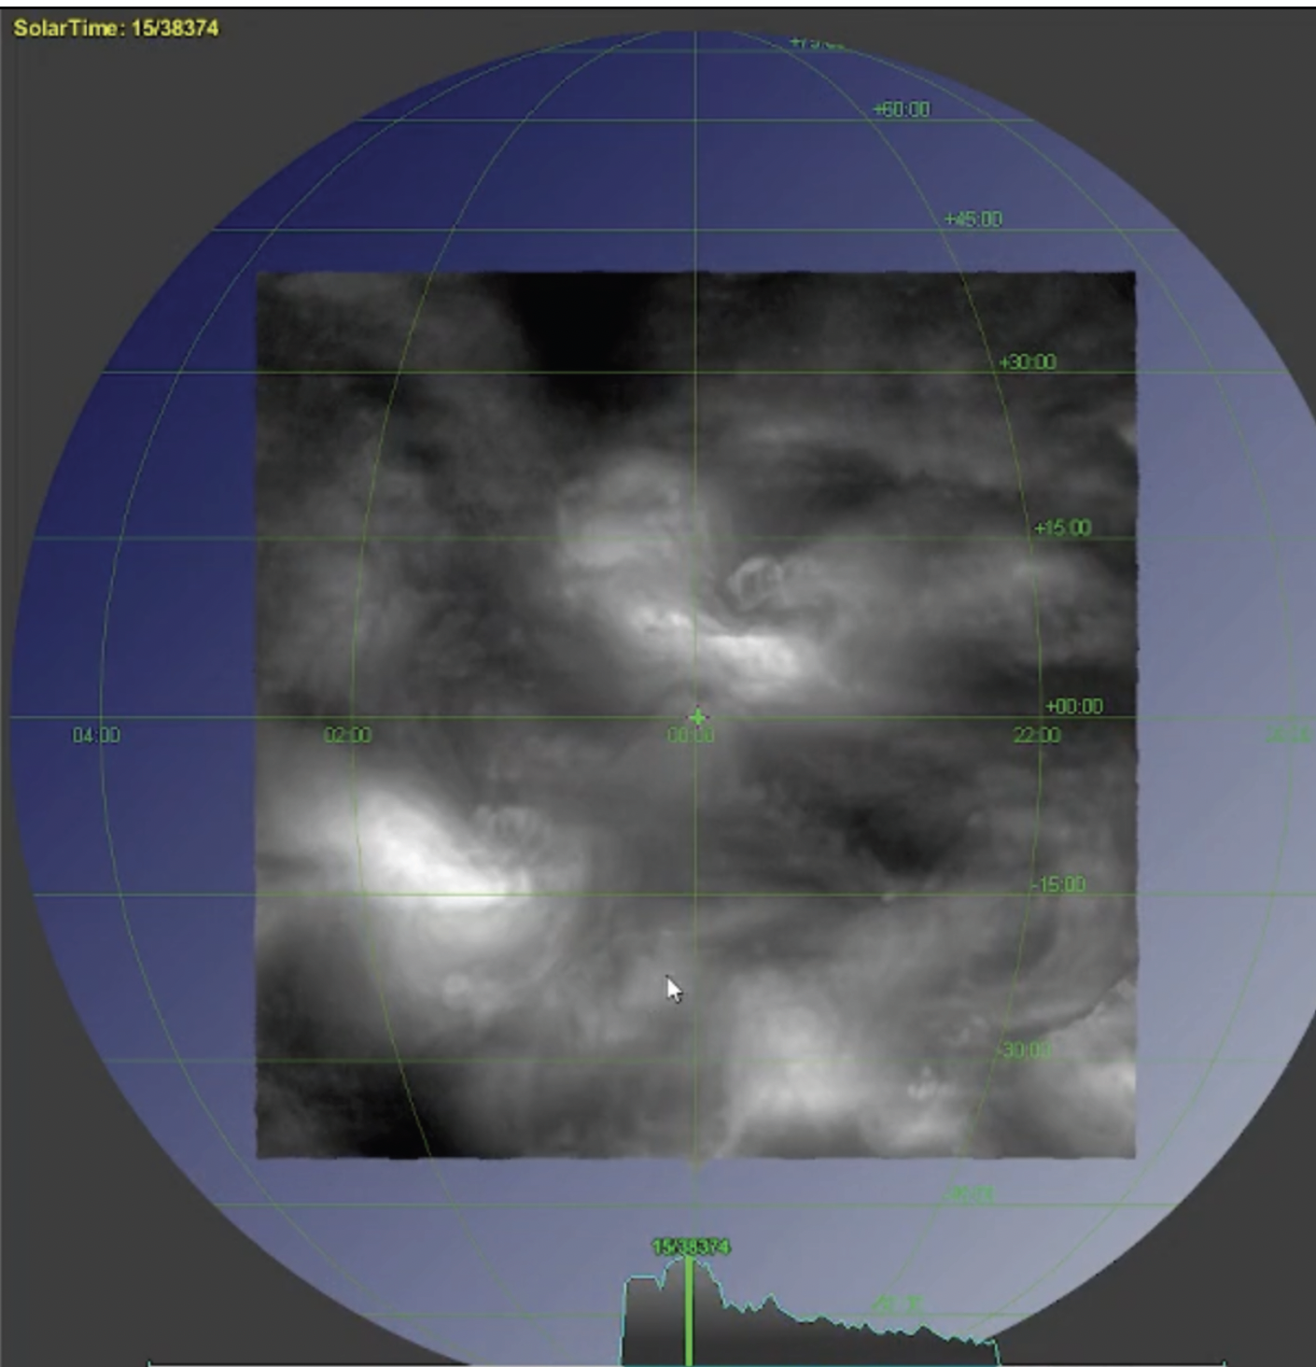
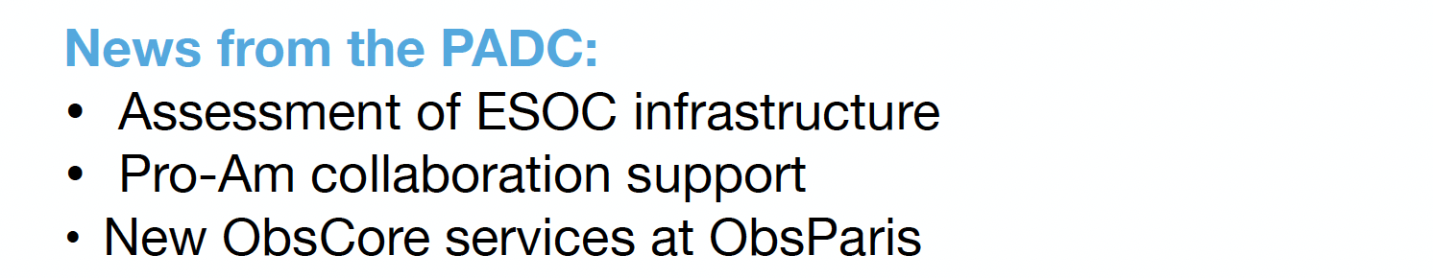
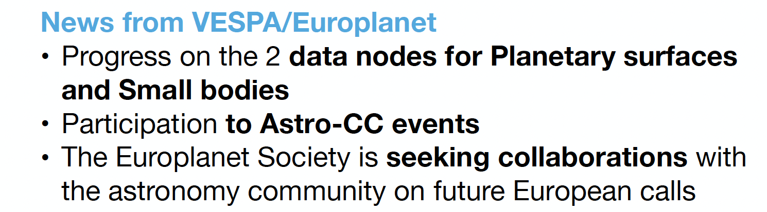

Slide 21
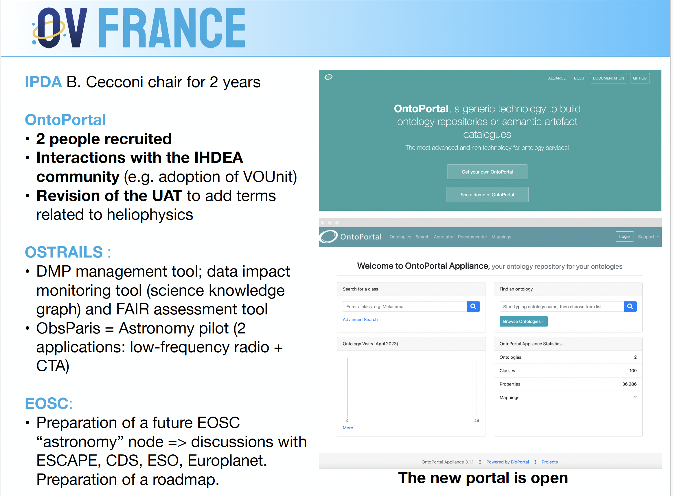

Slide 22






GAVO
GAVO
German Astrophysical
German Astrophysical Virtual Observatory
Virtual Observatory
The GAVO data centre keeps adding a few resources per semester; Flagship this time: Carmenes DR1 spectra and time series, a true curation challenge.
Maintenance of the VO server package DaCHS: (e.g., prototype for registration of VOEvent streams).
GVO is moving! Five positions at DZA for VO work will open over the next few years. If interested, please talk to Markus!.
Mastodon move: New resources in the Registry now tooted at gavo@fediscience.org.
Please review DocRegExt quickly: https://dc.g-vo.org/VOTT
ivoa.net
19

Slide 23


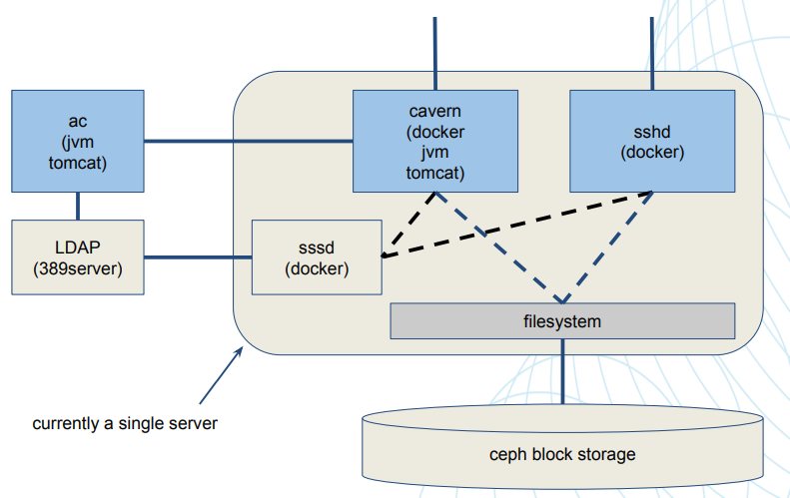
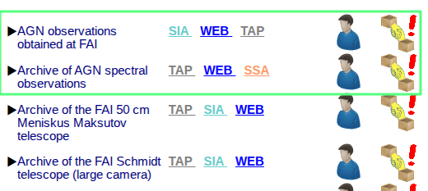
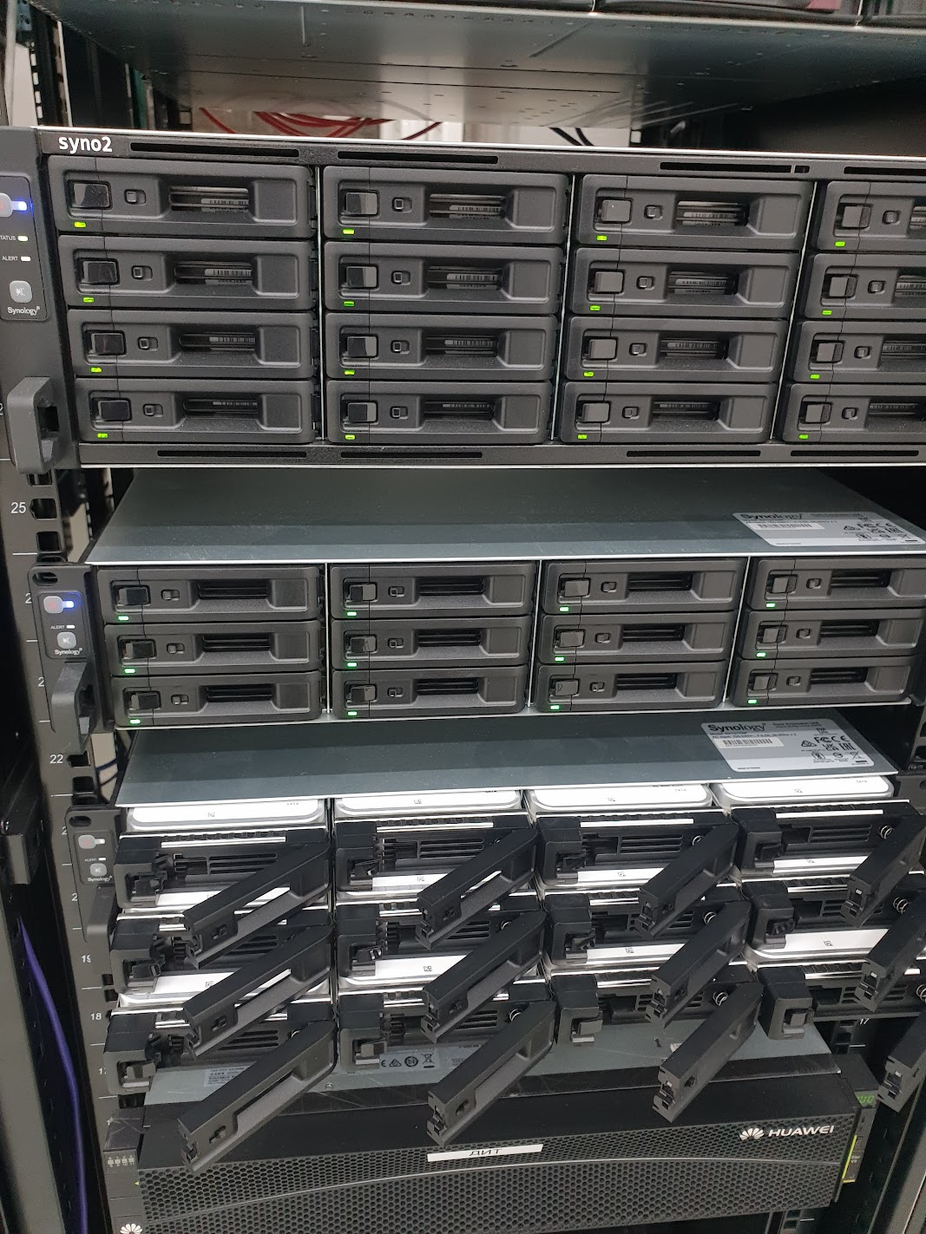
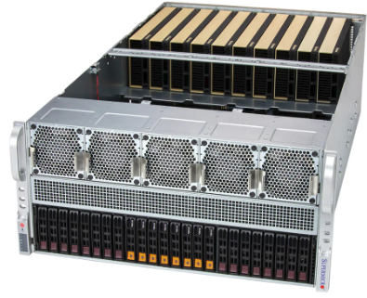
Kazakh National Virtual Observatory
Latest updates
FESENKOV
ASTROPHYSICAL
INSTITUTE
A VOSpace service compliant with IVOA standards has been deployed within the FAI’s infrastructure, providing unified REST-based access to astronomical data. It is built on the Cavern (CADC) server and runs in a Debian 11 container with Tomcat 9, OpenJDK 11, and PostgreSQL. The service integrates with a FAI’s NAS via NFS for centralized and fault-tolerant storage. External access is available at https://vos.fai.kz/cavern through an HTTPS proxy, and testing confirmed full functionality and compatibility with standard VOSpace clients.
The first release of photometric and spectroscopic data was completed within the Kazakhstan Virtual Observatory (KazVO) infrastructure in accordance with IVOA standards. A full technological workflow was refined — from metadata generation to exposure through VO protocols (TAP/ADQL, ObsCore, DataLink). Photometric data and three VO-compliant spectroscopic catalogs were published, successfully validated, and registered in the IVOA registry. The work confirmed KazVO’s readiness for large-scale integration of modern and archival data into the global Virtual Observatory ecosystem and established a foundation for future releases aligned with the FAIR principles.
Computational and Storage Capabilities of KazVO has been expanded: KazVO’s infrastructure was upgraded with a Supermicro AS-5126GS-TNRT2 server featuring dual 128-core AMD EPYC 9755 CPUs. Storage was doubled to 589 TB using 40-drive Synology RS4021xs+ NAS units in HA-mode. This upgrade significantly enhanced KazVO’s readiness for data analysis, machine learning, and VO-standard archival publication.

Slide 24
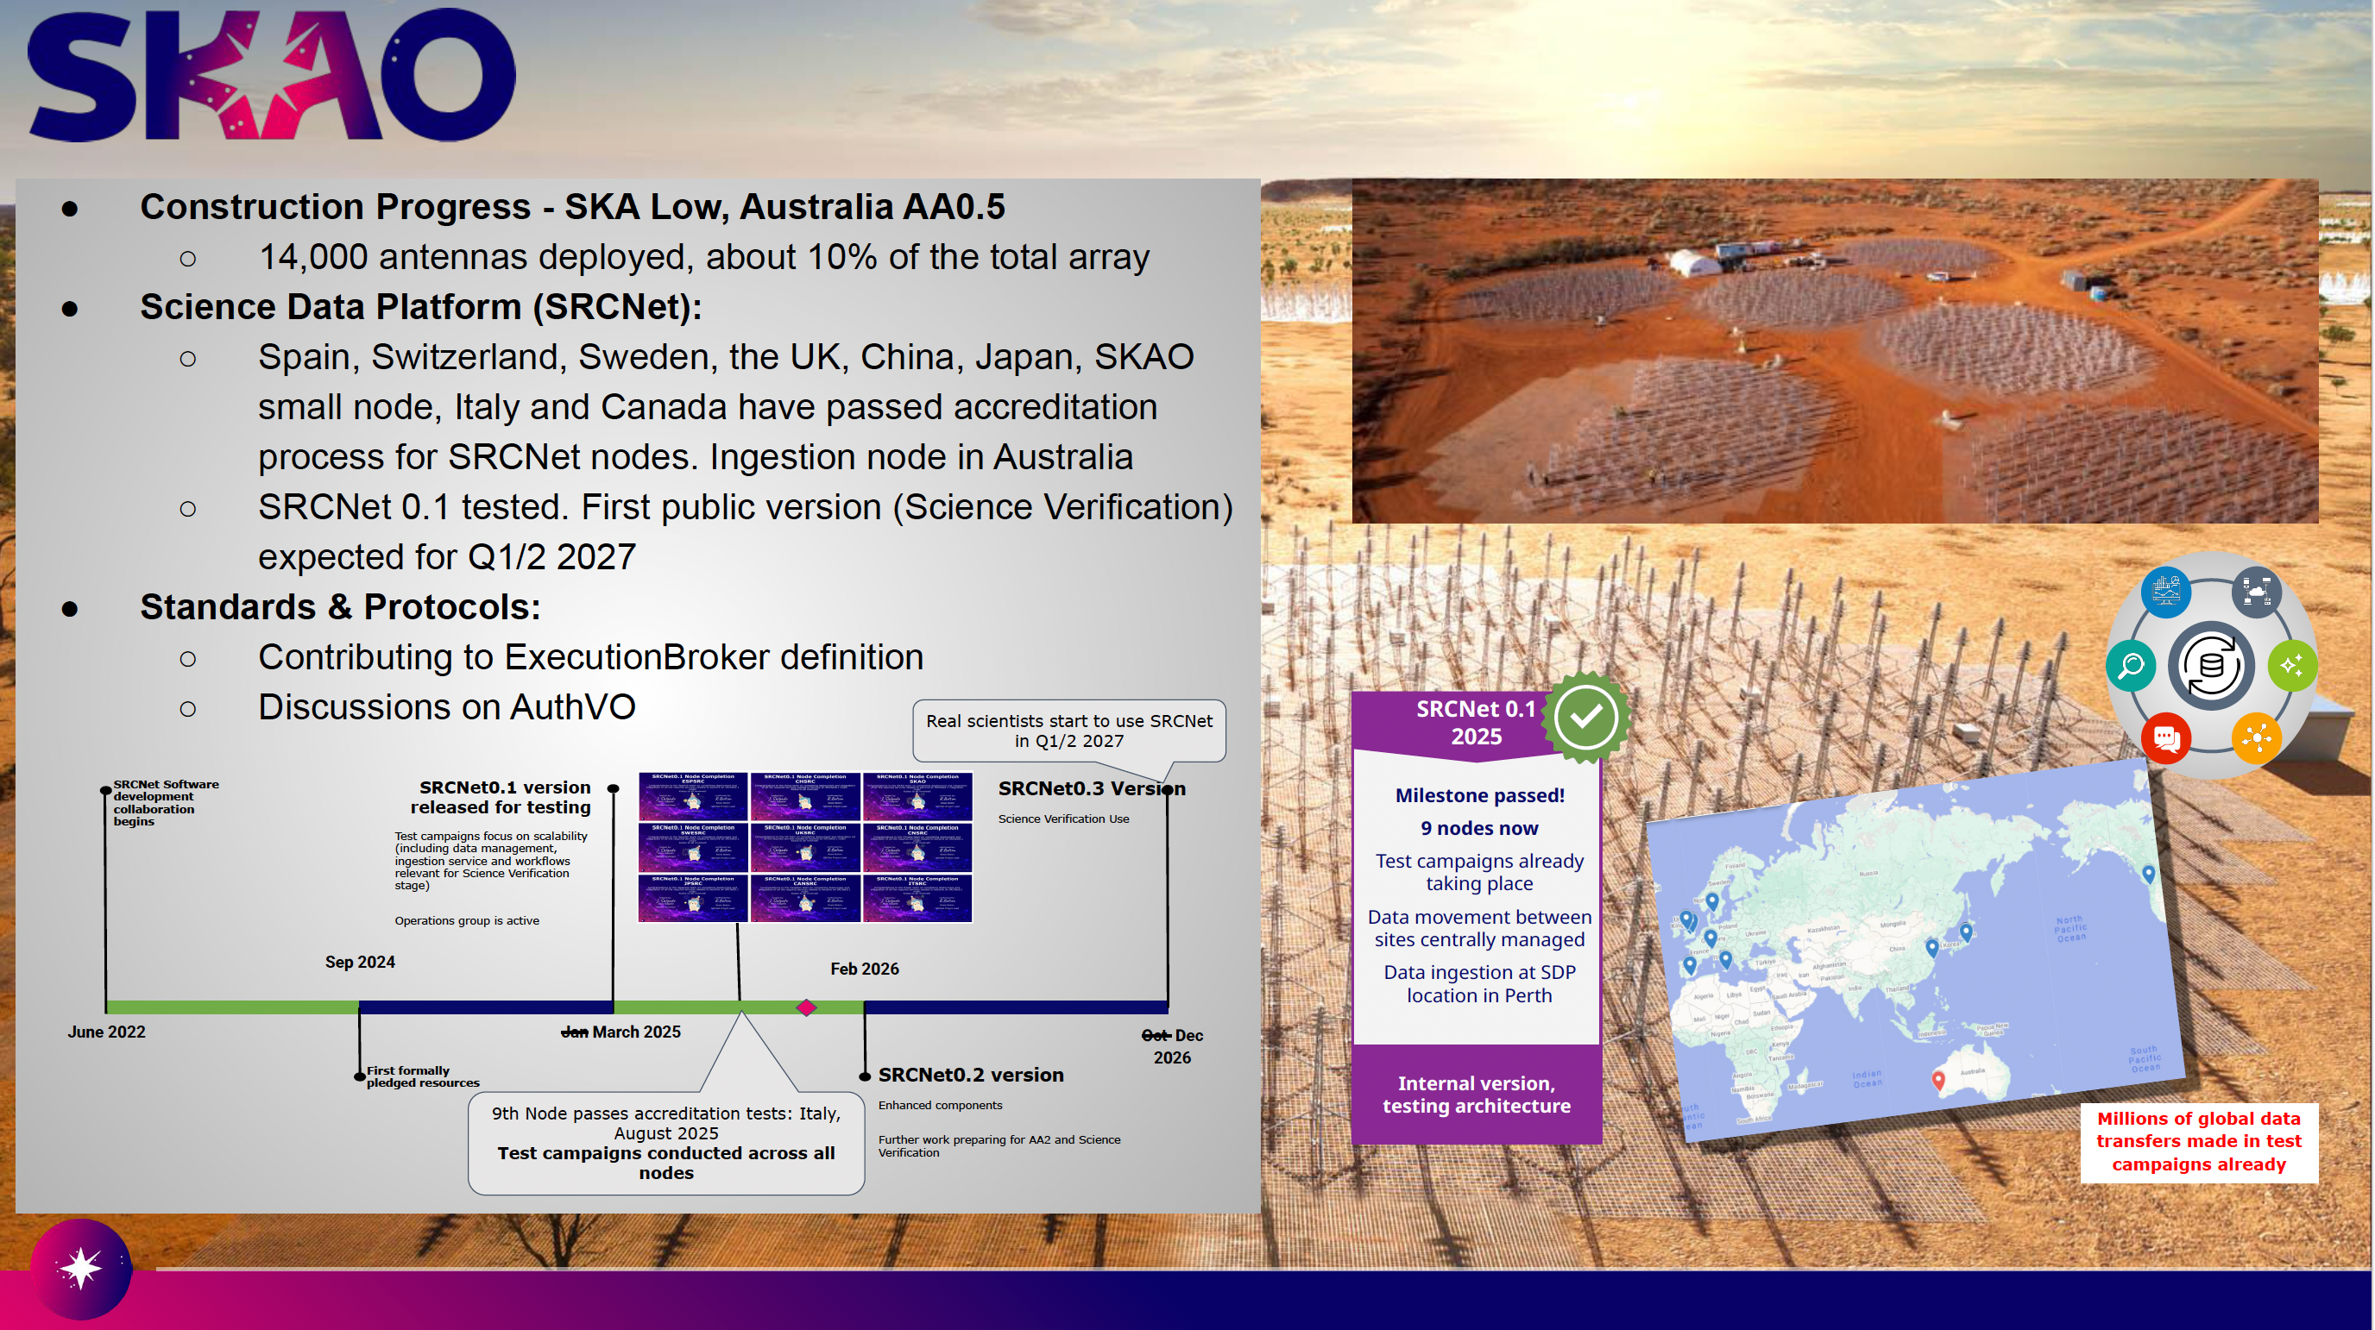

Slide 25

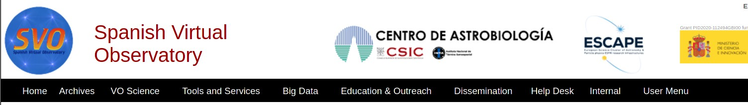
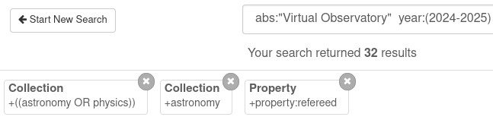
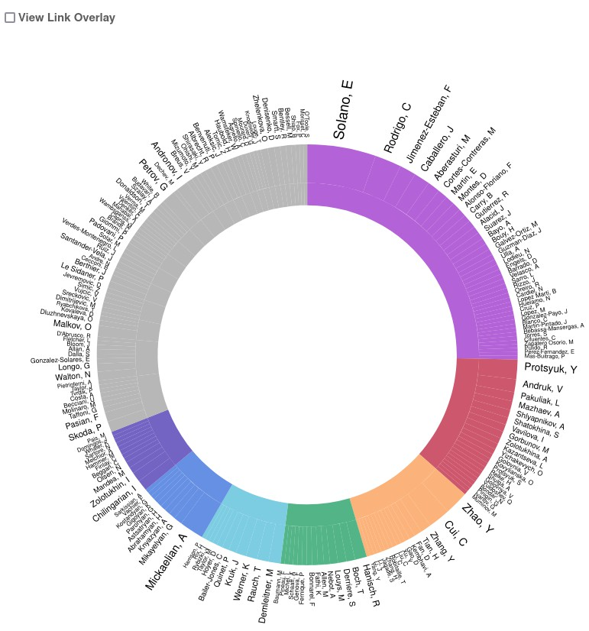
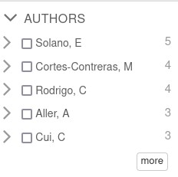
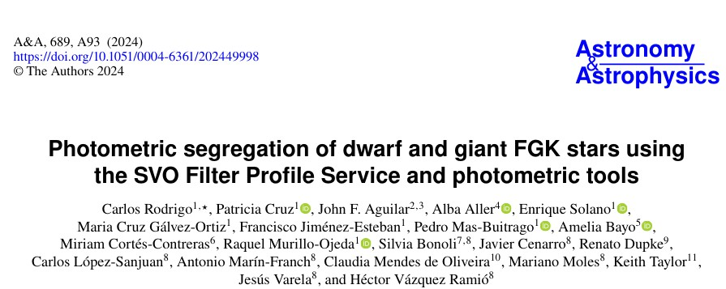
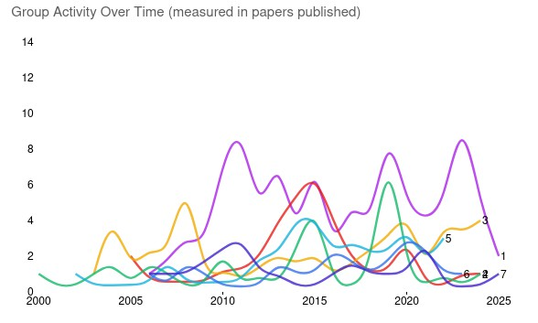

https://svo.cab.inta-csic.es

Slide 26
USVOA Report
CfA/CXC, NAVO, NOIRLAB, NRAO, ADS

Slide 27
USVOA Collaboration
A splinter session of the AAS Jan 2026 meeting on VO activities and prospects has been scheduled for Monday January 5, 2026

Slide 28
USVOA/CfA Participation (1/3)
Technical Coordination Group (TCG)
M. Dittmar serving as Chair of Data Model Working group
J. Evans serving as V Chair of High Energy Interest group
Working HEIG ObsCore Extension Note with completion expected by end of year
R. D’Abrusco is contributing to the DCP note on DOI usage
Upgraded the CXC TAP service to bring into compliance with current standards

Slide 29
HEIG Interest Group (2/3)
I Evans is major contributor to the ObsCore Extension Note
J Evans is working with Chair to manage HEIG efforts through meetings, notes, & actions
M Dittmar is participating in meetings and providing Data Model WG insight
CXC archive team working on a prototype for Discovery of High Energy Data based on the note

Slide 30
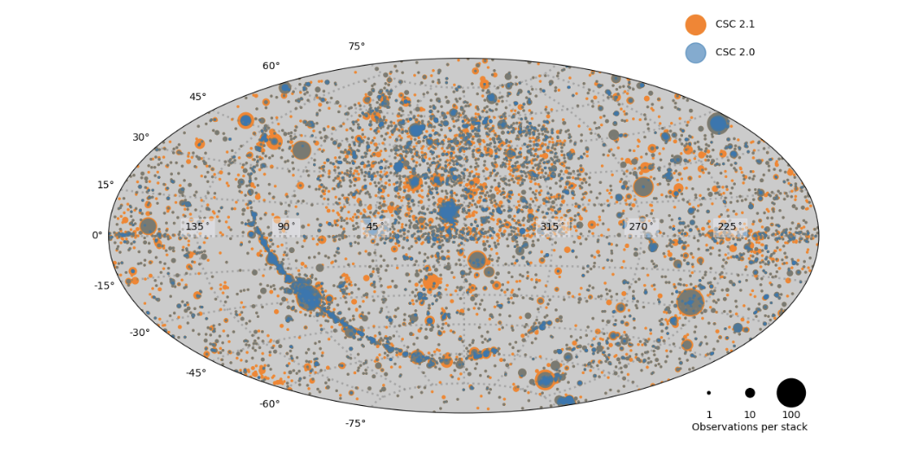
CSC 2.2 Planning (3/3)
Planning CSC 2.2 catalog production processing run
Add 2 years to the current Catalog – 2022 – 2023
Plan to start production Mid-Dec and complete in 2026
Mostly speed improvements and short list of upgrades gathered from last run
HEIG ObsCore extension will enable CSC data discovery in the IVOA
CSC 2.1 408K srcs
CSC 2.0 317K sources
CSC 2.2 Adds 2 years of data to the CSC

Slide 31
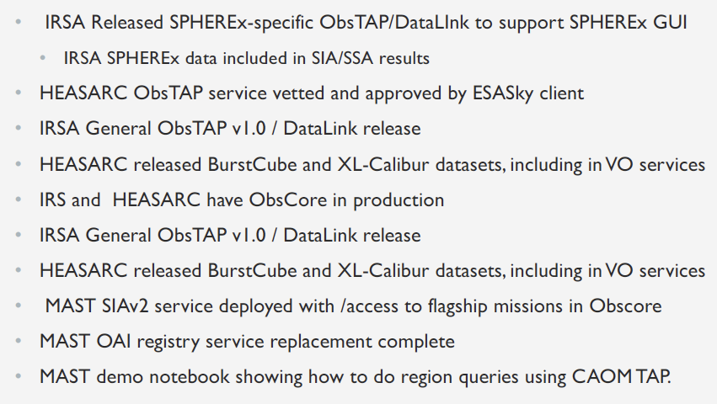
NAVO

Slide 32
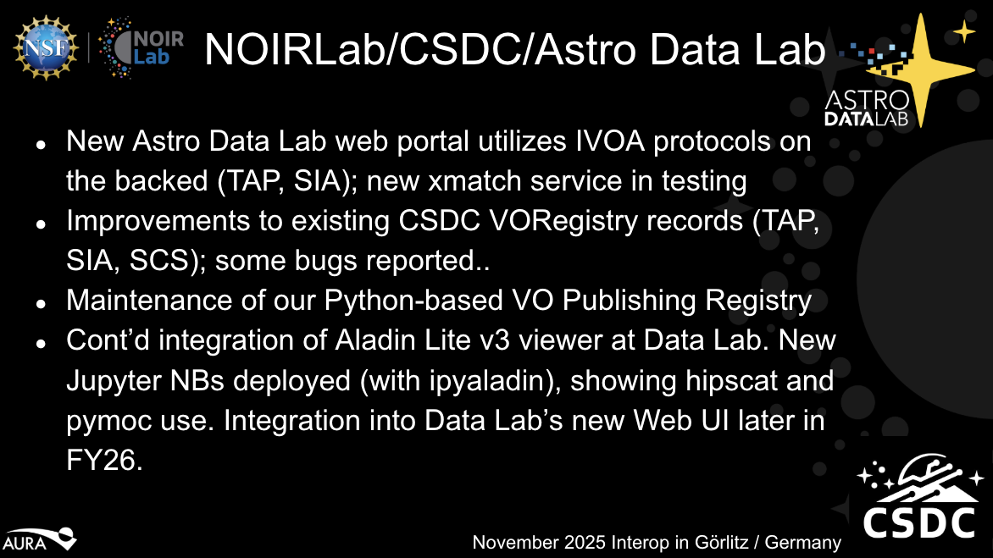
NAVO

Slide 33
VO Updates from Rubin (1/3)
Since our small-scale Data Preview 1 launched at the end of June, we have serviced 2 million TAP queries from registered users (and returned 1.7TB of catalog results) and we are nearing 1 million cutouts. This is just a small dataset from our commissioning camera.... everything is fine...

Slide 34
VO Updates from Rubin (2/3)
Our TAP service (based on the CADC TAP service) has had major upgrades
Introduced a kafka-based "bridge" system between TAP and the database back end. This has been Invaluable to regulate user query volumes (eg apply per-user limits for concurrent queries in flight)
Added support for TAP Upload to our Qserv-backed TAP service
Added VOParquet support for catalog results - managing performance at this scale is an issue, with the VOTable serialization taking longer than the query takes to execute

Slide 35
VO Updates from Rubin (3/3)
Added DataOrigin to our SIAv2 service
We continue to upstream to the community, with over 10 pyvo merged PRs, and a number of related packages, such as to astropy's votable support.

Slide 36
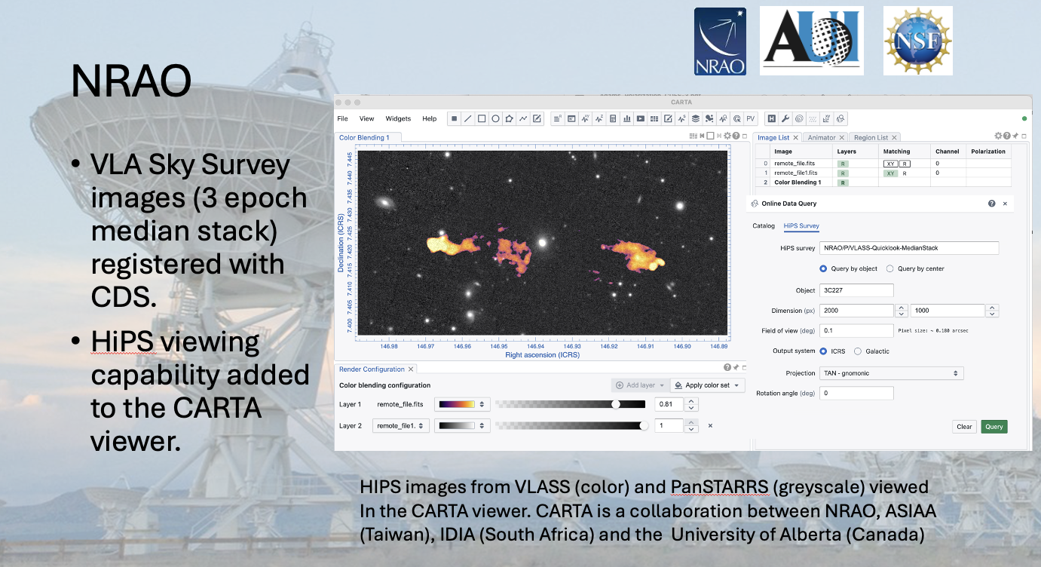

Slide 37


ADS Updates
The ADS team has launched the Science Explorer platform covering all Earth and space science in addition to astronomy: https://scixplorer.org
Tracking of software, data mentions and citations
Tracking of grant acknowledgements
Labeling of astronomy papers with Unified Astronomy Thesaurus (https://astrothesaurus.org) concepts
ADS is harvesting and indexing data links from the VO registry using the BibVO protocol. Do you want data links to your archives? Add a biblink-harvest endpoint to your registry entry
ADS is planning on de-prioritizing (not abandoning) the use of bibcodes in the future. If you have concerns, please get in touch

Slide 38
Meeting attendance – 77 in person – 30 remote

Slide 39
IVOA Code of Conduct
It is the policy of the IVOA that its members and all participants in IVOA activities should experience an environment that is free from harassment. We want to promote a diverse and inclusive environment with respectful and courteous behaviour and therefore we expect all participants to adhere to the following guidelines:
Behave professionally. Refrain from harassment in any form, including: sustained disruption of talks or other events; inappropriate physical contact or intimidation; potentially offensive comments related to for example: age, gender, sexual orientation, disability, physical appearance, race, nationality, politics or religion.
Ensure that all communications are appropriate for a professional audience that may include people with different backgrounds. Sexual or sexist language and imagery are never appropriate.
Be considerate and respectful to others.
Critique ideas, not people.
This code of conduct applies to all IVOA community interactions online and offline, including mailing lists, forums, social media, conferences, meetings, associated social events, and one-to-one interactions.
Because of the wide international nature of the IVOA, it is important to realize that behaviour and language that are welcome/acceptable in one particular cultural environment may be unwelcome/offensive in another. Consequently, individuals must use discretion to ensure that their words and actions communicate respect for others.
Anyone who witnesses a deviation from these guidelines is asked to communicate confidentially to the Chair or Vice Chair or any member of the IVOA Executive Committee. The IVOA Executive will take the necessary corrective measures.
We thank you for helping us to make the IVOA a welcoming, diverse and respectful environment for all.
See online here https://www.ivoa.net/members/IVOA_Code_of_Conduct.pdf
ivoa.net

Slide 40



Let’s get to work!
Thanks to:
German Astrophysical Virtual Observatory, Heidelberg University, and Deutsches Zentrum für Astrophysik (DZA) for organizing the meeting.
Financial Support:
Thanks to the Marco and Tom and the WG/IG chairs for organizing the program, which is key to making this meeting worth attending.
And, about lowing those barriers, recall that this meeting is in Hybrid mode so keep attention to the remote participants.

