Slide 1

MAST/VAO Portal Development
Tom Donaldson
Tony Rogers
October 17, 2011

Slide 2
Project Goals
Unify web access to MAST data and services
  Data Discovery and Exploration
  Visualization
  Download and analysis
  Mission-specific features
Share infrastructure between MAST and VAO Portals
  Efficient use of limited resources
  Seamless access to VAO data and services
Extensible and flexible architecture
  Allow growth to Mobile, Desktop and Script access
  Allow for the evolution of client and server technologies
  Allow utilization of existing services

Slide 3
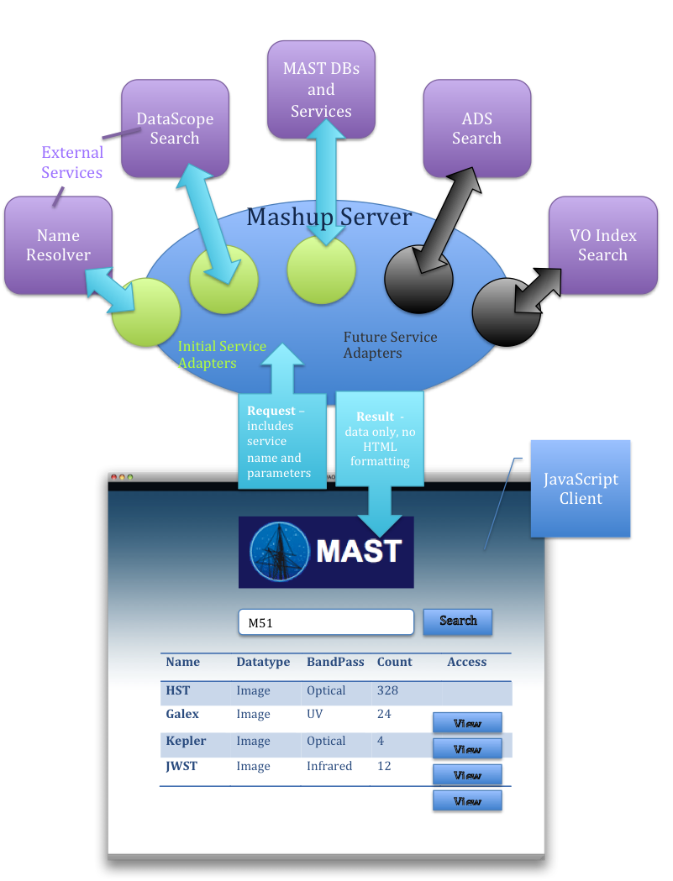
Architecture Overview

Slide 4
Architecture (Mashup Server)
Unifies access to variety of data resources
  MAST databases
    HLA, GALEX, CAOM, HLSP
  MAST and External VO services
    Vo Inventory, DataScope, All Cone and SIAP services
  Other web services
    MAST Name Resolver
  Uploaded Data Files
All queries return only data, not html.
  Clients decide how to use the data.
Data available in multiple formats
  JSON for client use.
  Csv, xls and VO Table for user download
  Formatted html, probably for printing
  Soon: Server-side paging, sorting and filtering

Slide 5
Architecture (Web Client)
Client GUI written entirely in JavaScript
  Using Ext JS
  Runs in all modern web browsers
  No GUI components are generated by the server
    GUI can be rearranged/rewritten without changing the server
Results data stores can be local or proxied to server
Results displayed in flexible data grids
  Scrollable, even for thousands of data rows
  Faceted filtering
  Column manipulation
    Sorting, hiding, reordering, resizing
  Can include graphics such as image thumbnails
Displayed results downloadable in multiple formats

Slide 6
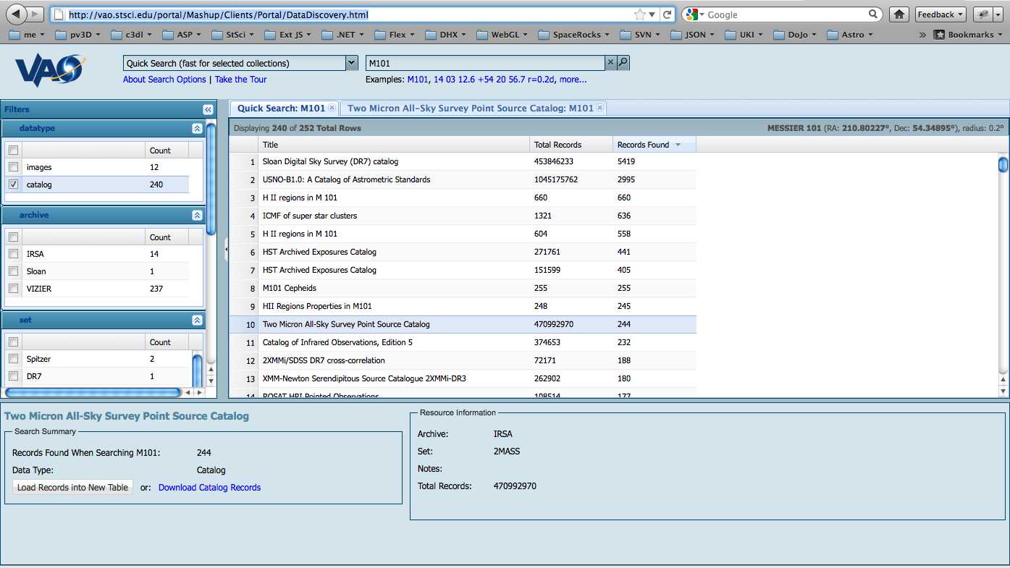
Demo

Slide 7
Future Plans
Searches based on observation metadata
All-Sky image browser with overlay graphics
  Observation footprints
  Catalog objects
Custom image cutouts
Publication links and searches
Server-side data storage and workspace
Define conventions for intercomponent communication (SAMP inside the web page?)

