Slide 1
A Possible Relational Schema for the Registry.
Paul Harrison
JBCA, University of Manchester

Slide 2
Motivations
Registry Interface Standard has standard query language which was a subset of the original ADQL/x 1.0
Not expressive enough
Only limited parts of the registry data model can be accessed
Only limited selection criteria
Rather verbose
AstroGrid chose to implement registry as a native XML database
Registry content is defined by a set of XML schema – can be thought of as the Registry Data model (Registry “crown jewels”)
Implemented all internal AG inter-tool/service queries on the registry as XQuery
Very expressive – can specify exactly what is returned.
Standardized.
At last Interop there was discussion about the limitations of current query language summarized by Ray Plante
http://www.ivoa.net/cgi-bin/twiki/bin/view/IVOA/RestfulRegistryInterfaceReq
Suggestion that query part could reuse TAP
Need a relational registry data model

Slide 3
Design Aims
Reduce the number of Tables to the minimum
Makes queries easier
Still able to express the entire XML schema model
Be able to do the transform XML<->RDB with no ambiguities

Slide 4
Methodology
Initially tried to use the VO-URP framework developed by the Theory WG.
Created UML model of Registry schema and then ran tooling
Does not regenerate XML schema exactly
Second approach starting from XML Schema.
Use standard Java XML and Relational object mapping technologies
Allows flexibility of mapping via Java annotations
XML Schema
JAXB
Java Objects
JPA
XML Schema
Notes:
VO-URP would have been the way to go if we were starting from scratch, but we have a legacy of XML schema to deal with in Registry.
Already had customized version of the first (JAXB) step in AstroGrid libraries – xjc tool of JAXB
Mapping flexibility important because of constraints mentioned

Slide 5
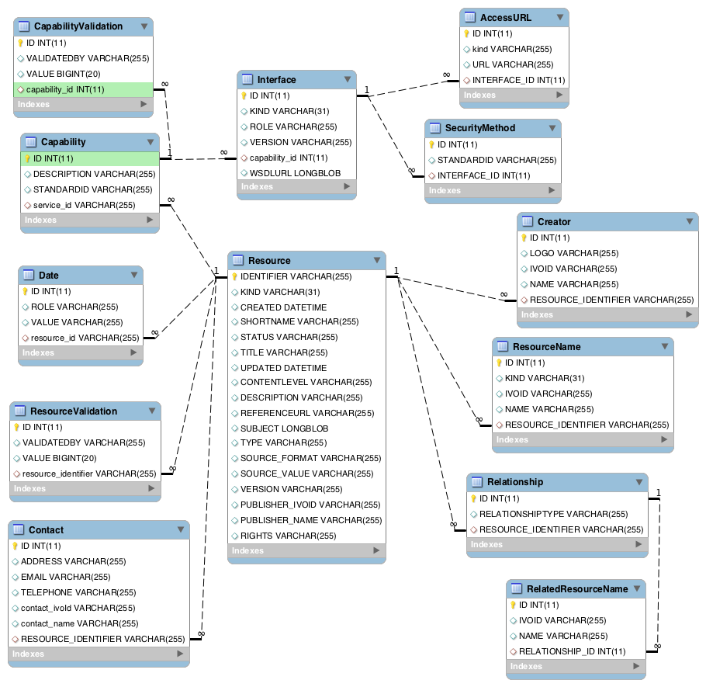
Result
VOResource only
13 Tables
Notes:
Note that this is for the VOResource schema only.
Note that there might be some details to finalize, but I think that the overall “shape” of the schema is correct.

Slide 6
Mappings – One to Many
One-to-Many containment relation between types is modelled as a separate table with a foreign key relation in the many side.
Possible because the registries are in general un-normalized so that there are no many-to-many relations which would require separate join tables.
E.g. there might be many “Creator” rows relating to the same actual creator
Could be argued that the registries should be more normalized.
Loose definition of ResourceName (does not have to have a IVORN) responsible

Slide 7
Mappings - Subtypes
Type hierarchies are collapsed into a single table
with a column “KIND” used to distinguish between the types
Properties of the sub-type are allowed to appear as nullable columns in the table.
E.g. Resource type – has sub-types Service, Organization and Authority.

Slide 8
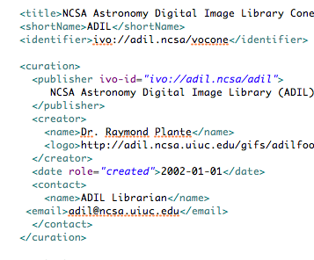
Mappings - Embedding
If an XML type is a directly embedded member of its parent – i.e. has a 1:1 cardinality in the XML – then its properties are added as extra columns in the parent table
E.g. Publisher
Adds two columns to Resource
Publisher_ivoid
Publisher_name

Slide 9
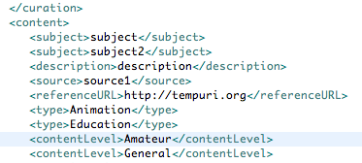
Mappings - Enumerations
Lists of enumerations have been transformed to a single field with a delimited list of enumeration values
Eliminates the need for a separate table
e.g. contentLevel, type

Slide 10
Changes to existing XML schema.
Could simplify the relational schema if some changes were made to existing XML Schema
reducing cardinalities eliminates table joins
Allow only one RelatedResource inside a Relationship
Multiple relationships are possible already
Allow only one AccessURL inside an Interface
No registry entries make use of this facility
The above are almost zero impact from operational point of view as - long as they are done retrospectively to existing schema without changing namespace/version.
Notes:
See http://www.ivoa.net/pipermail/registry/2011-June/004799.html for more detail
Note this would provide some simplification of the RDB schema, but perhaps not enough to make the changes worthwhile
There are other more radical changes to the XML schema that might be desireable, but would break backwards compatibility.
1. we allow a multiple Relationship elements which can each have multiple RelatedResource elements within them. The purpose of this is to allow the related resources to be grouped by relationshipType - however the same effect can be obtained by only allowing a single RelatedResource element within the Relationship element and then repeating Relationship elements.
In the AstroGrid registry there are 1208 resources that use the relationship element and of those only 2 use multiple relatedResource elements within a single relationship
ivo://org.gavo.dc/__system__/tap/run
ivo://org.gavo.dc/lensunion/q/im
2 AccessURL - I remember the argument for having multiple accessURLs - i.e. to be able to specify fallback URLs - however there are no resources in the registry that make use of this - perhaps this is outside the scope of what the registry should be trying to do - fallback on a single address should be done via network layer techniques.
3. curation/date - do we need this at all? the resource record itself has attributes that seem to cover the needs (unless an audit trail of all the update dates is required)- it is used by a lot of records (9888) but only
ivo://ivoa.net/rofr
ivo://CDS.VizieR
ivo://CDS.VizieR/registry
use it more than the single time - if it were removed then it would require automated editing of many records, but again if it were given a cardinality of 1 only a handful of records would need hand editing...
Now for the even more controversial aspect (for the purists) - I suggest that we make a retrospective change to VOResource 1.0 without making a change to the namespace - this would be much less disruptive - A handful of resource records needing to be edited compared with potentially many software systems if the namespace is changed (Admittedly depending on whether the software uses the live schema or not, it will need changes - so that it does not allow the newly forbidden multiple cardinalities - but these can be done gradually, and the whole registry does not become instantly invalid/outdated).

Slide 11
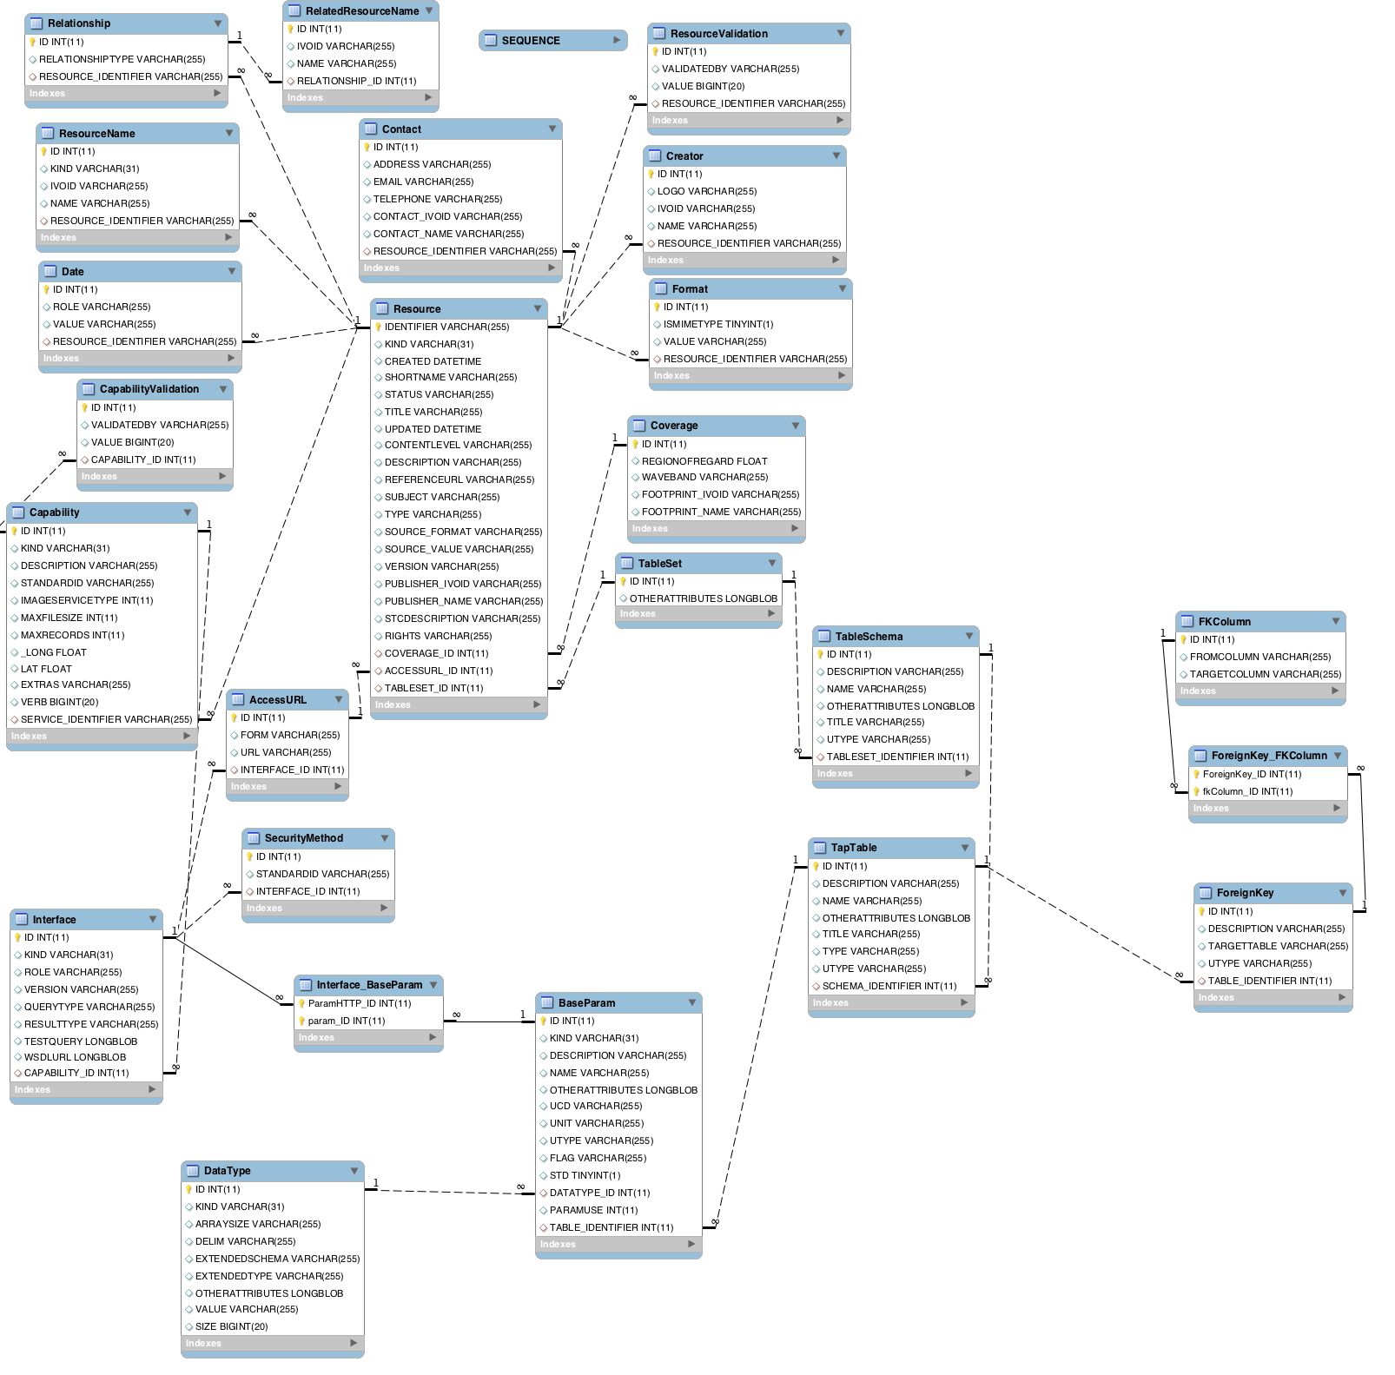
VODataService
Included!
Notes:
Schema including

Slide 12
Conclusions
It is possible to map fully the XML schema to a relational schema
However this is not the “three-table-or-so” solution that was talked about – but to avoid the mistakes that were made in the simplified mapping of the 1.0 registry query language we should use the full mapping.
IVOA should publish XML and RDB schema for all registry extensions.
I have a Java “reference implementation” already
The exercise did show some areas of the current XML schema that might be cleaned up.
See http://www.ivoa.net/cgi-bin/twiki/bin/view/IVOA/RelationalRegistryDM for more information.
Notes:
Note that for “simple” use cases query templates could be provided on a particular registry interface.
One complaint that we have often heard with the simple "keyword" style searches is that different registries ended up giving different answers - I think that this is probably a consequence of the "registry data model" not being tightly enough defined - we defined the data model with XML schema and had a rather loose mapping to a possible relational model. I think that if we are to have consistency we need to be able to express the "keyword" style queries directly in whatever the lowest level query language is, so that the "keyword" style interfaces are merely convenience interfaces that are defined formally to run a specific query in the low level query language.

