Slide 1
Worldwide Telescope
Education and outreach examples

Slide 2
Worldwide Telescope Audience
Researchers: First Priority is Astronomy & Earth Science Researchers
Integrated VO Clients & Standards
Integrated OGC viewers
Flexible visualization of just about any catalog and image data.
Education and outreach
Tour authoring and playback allows story telling with data
Students can jump in and eventually work their way up to high-end research features.
General public

Slide 3
Quick Demo
WWT Sky
3D Universe
VO Tools integration
Full Dome
Kinect Interface

Slide 4
WorldWide Telescope Ambassadors Program
Based at Harvard/CFA: Alyssa Goodman and Patricia Udomprasert
Works with middle school students to team astronomy with modern tools like WWT
Has studied improvements from interactive teaching methods
Provides information and tours for other programs to use WWT in their outreach
http://wwtambassadors.org

Slide 5
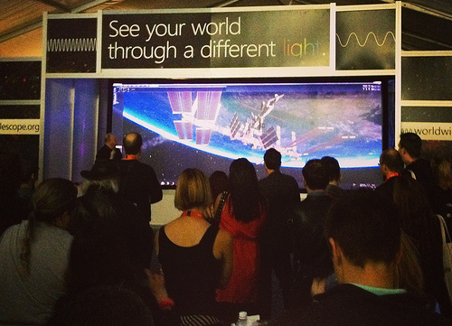
Outreach with NASA/JWST/STSci @SXSW
Life Sized JWST Model
7 Meter Kinect Driven
WWT Display
World Record for Astronomy
Lesson

Slide 6
Adler planetarium
Uses WWT for full dome Show “Cosmic Wonder” launched in May, around 100k viewers so far.
Adler creates full dome shows for talks done by visiting astronomers
The Space Visualization Lab host tens of thousands of visitors each year with more than 6 WWT exhibits including a Kinect Driven WWT Visualization wall.
Adler has hosted summer programs where kids learn astronomy concepts, then create full dome shows for their friends and family to see.
Many interactive exhibits in museum floor, created using interactive tours.

Slide 7
Adler Summer program dome show

Slide 8
Morrison Planetarium
WWT used for interactive portion of every show, about 600k viewers a year.
Summer programs teach kids to use WWT to create tours and show them
Several Exhibits use WWT for interactive Kiosks and displays.

Slide 9
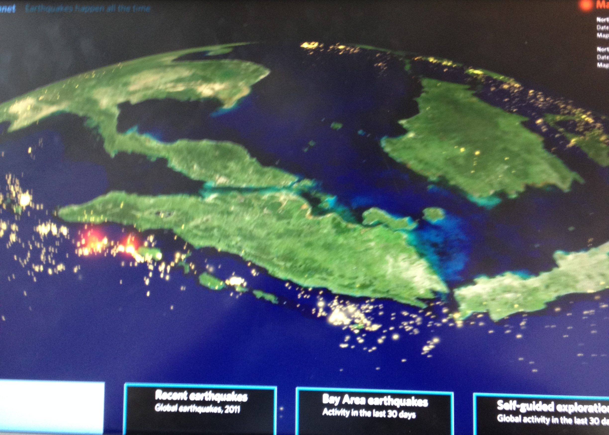
Morrison “Earthquake” Show
Interactive view of Resent Quakes
Kiosk for exhibit
Build as interactive Tour

Slide 10
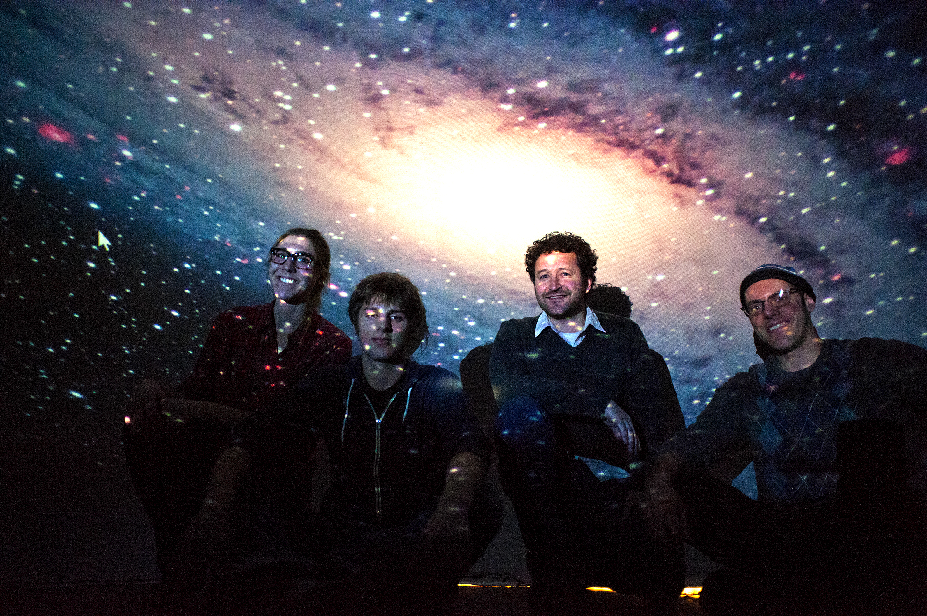
University of Washington
Digital planetarium project – Designed for WWT from day one.
Integrating full dome visualization into classes
Using astronomy visualization in CS classes, including developing dome applications
Grad students using WWT & VO to create tours for teaching undergraduates
Mobile Planetarium that Travels to schools and events with UW astronomy students teaching

Slide 11
International Partners
ChinaVO – WWT Planetarium, China WWT Cache, education & outreach with WWT translations
Russia – WWT planetariums
Argentina – WWT planetariums and Education programs.
India – Translation to several Indic languages.
Many others: Over 50% of users are outside the USA, on all 7 continents

Slide 12
LAKE Washington School District
WorldWide Telescope installed on all student and teacher computer systems
Teachers integrating WWT into astronomy & earth science programs
Organically grown program was initiated without any external collaboration with WWT Team.
One example of many similar across the US and intenationally

