Slide 1


Chandra X-Ray data in the
Virtual Observatory
The Chandra X-ray Observatory has nearly 20 years of public data in its archive. Chandra data is easily accessible to the scientific community through VO-enabled services and interfaces.
cxc.harvard.edu
International Virtual Observatory Alliance
CXC
Image credit: X-ray: NASA/CXC/UMass/D. Wang et al.; Optical: NASA/ESA/STScI/D.Wang et al.; IR: NASA/JPL-Caltech/SSC/S.Stolovy

Slide 2
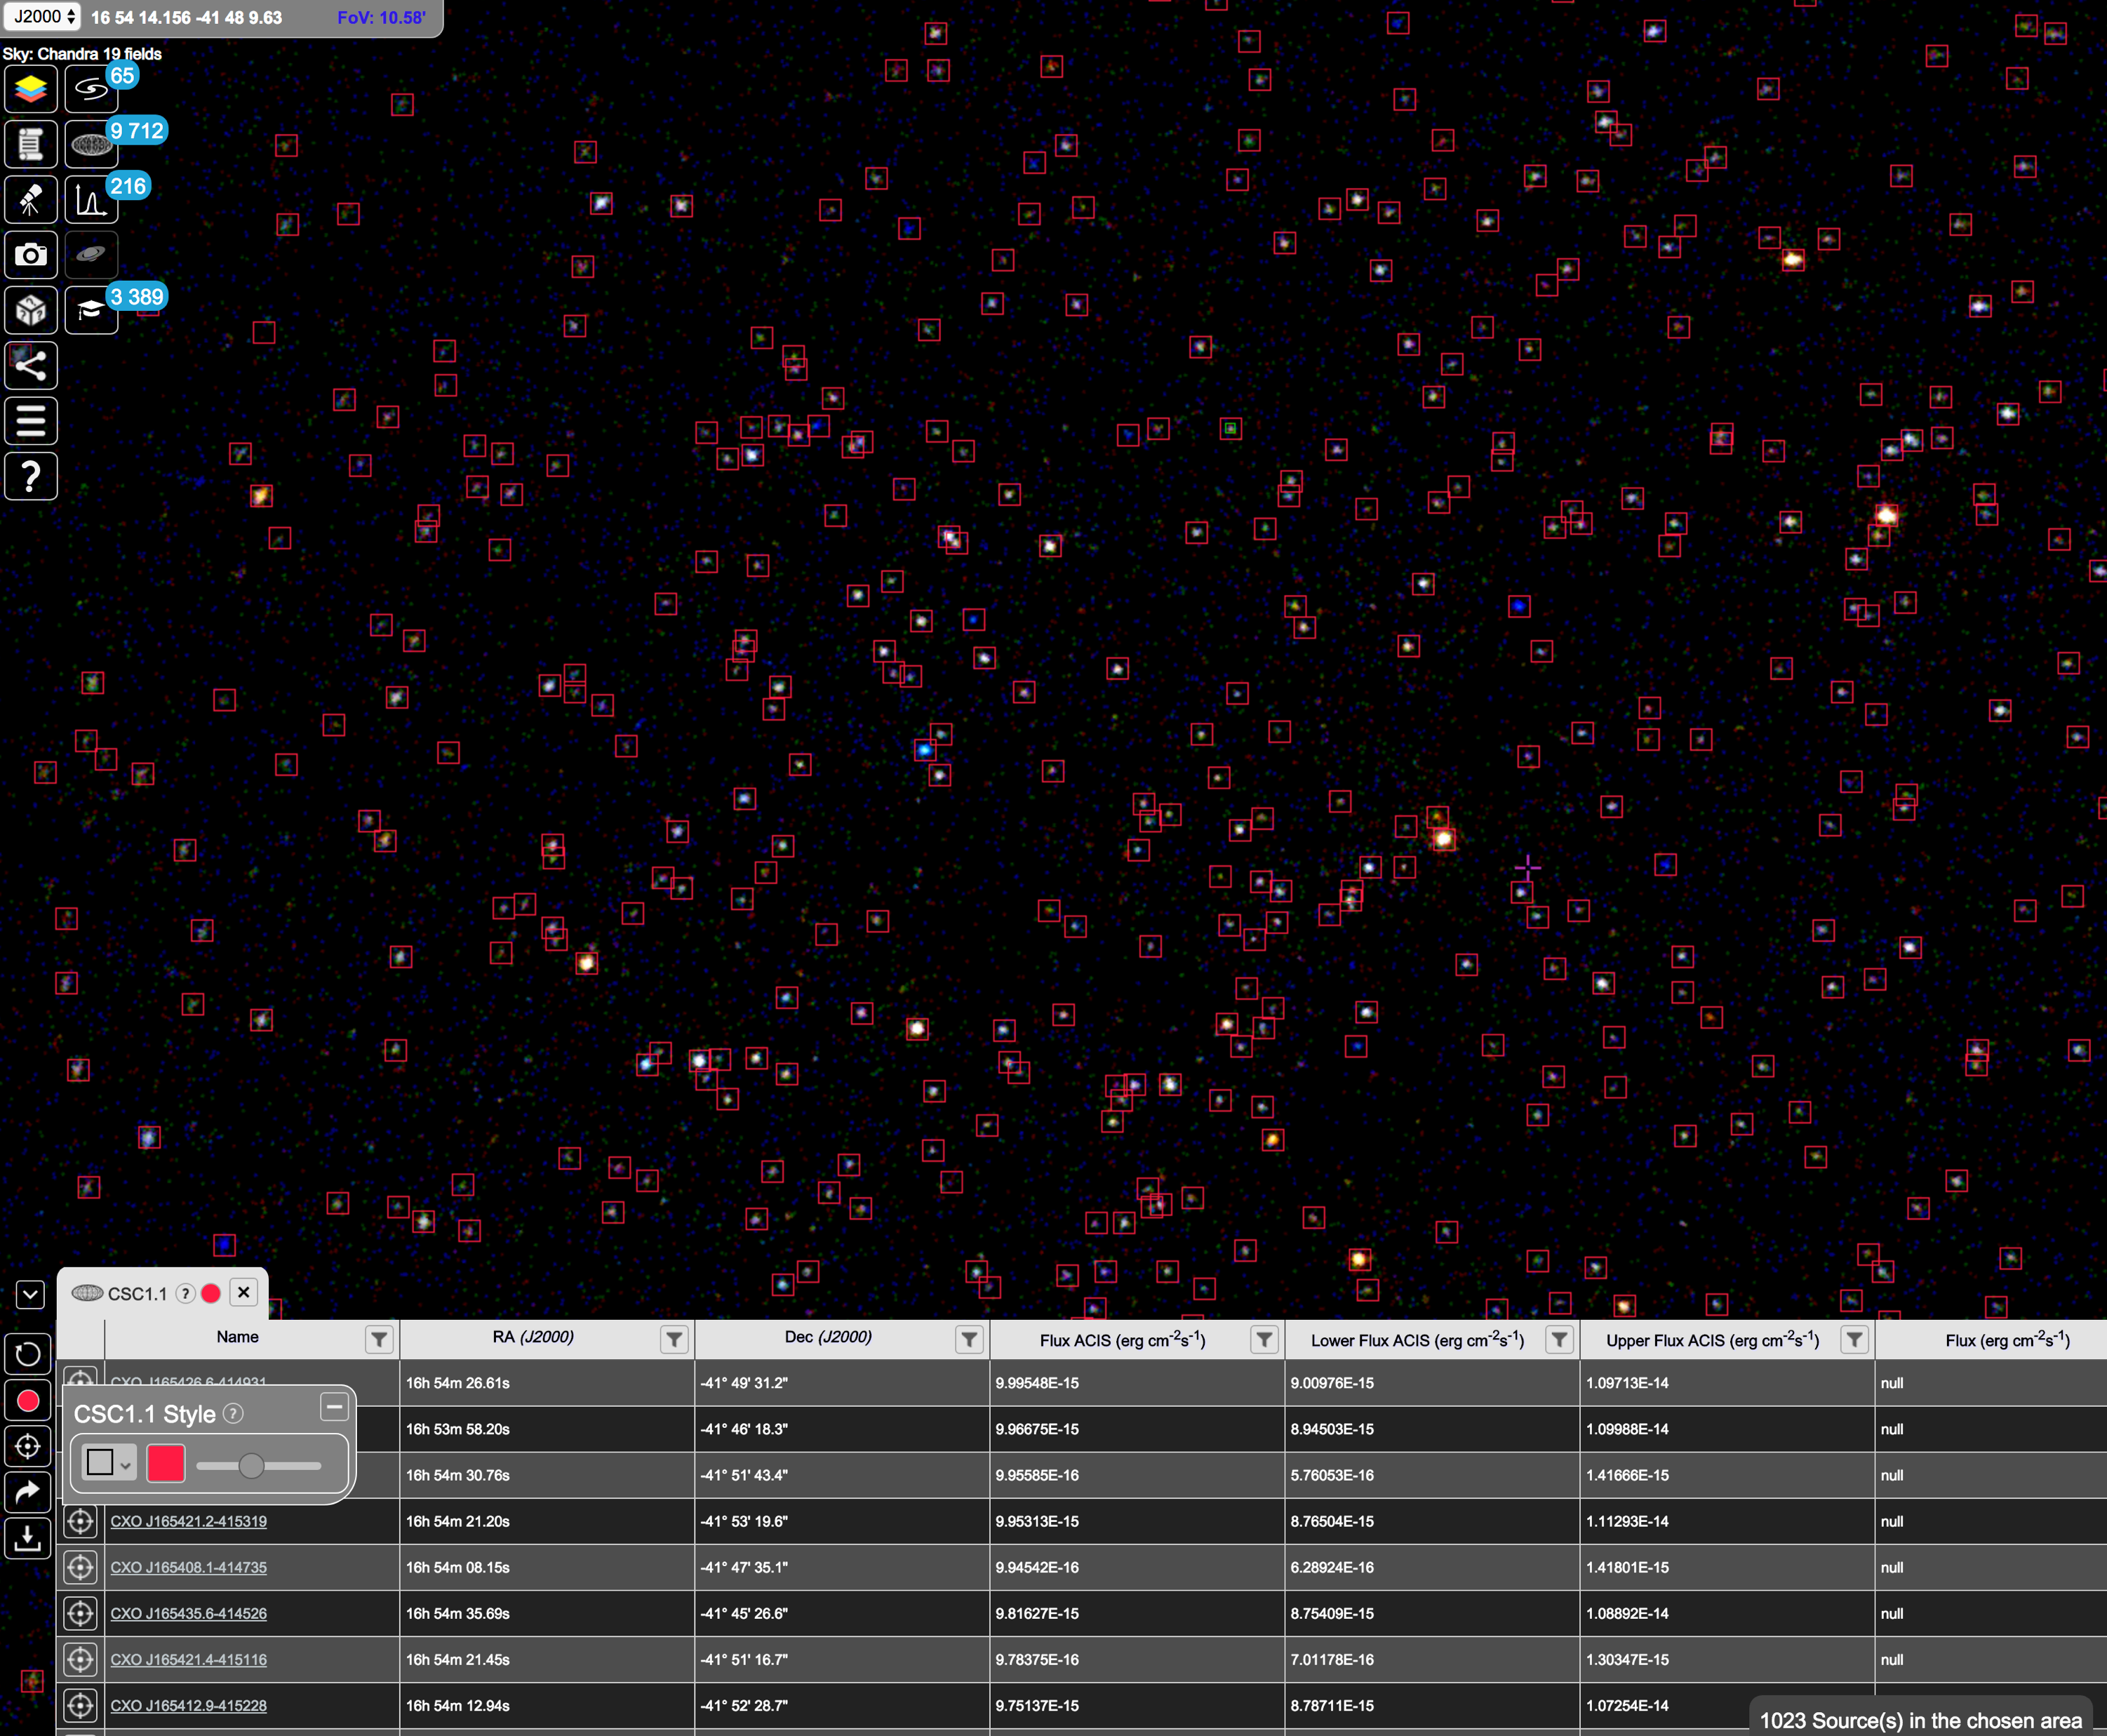
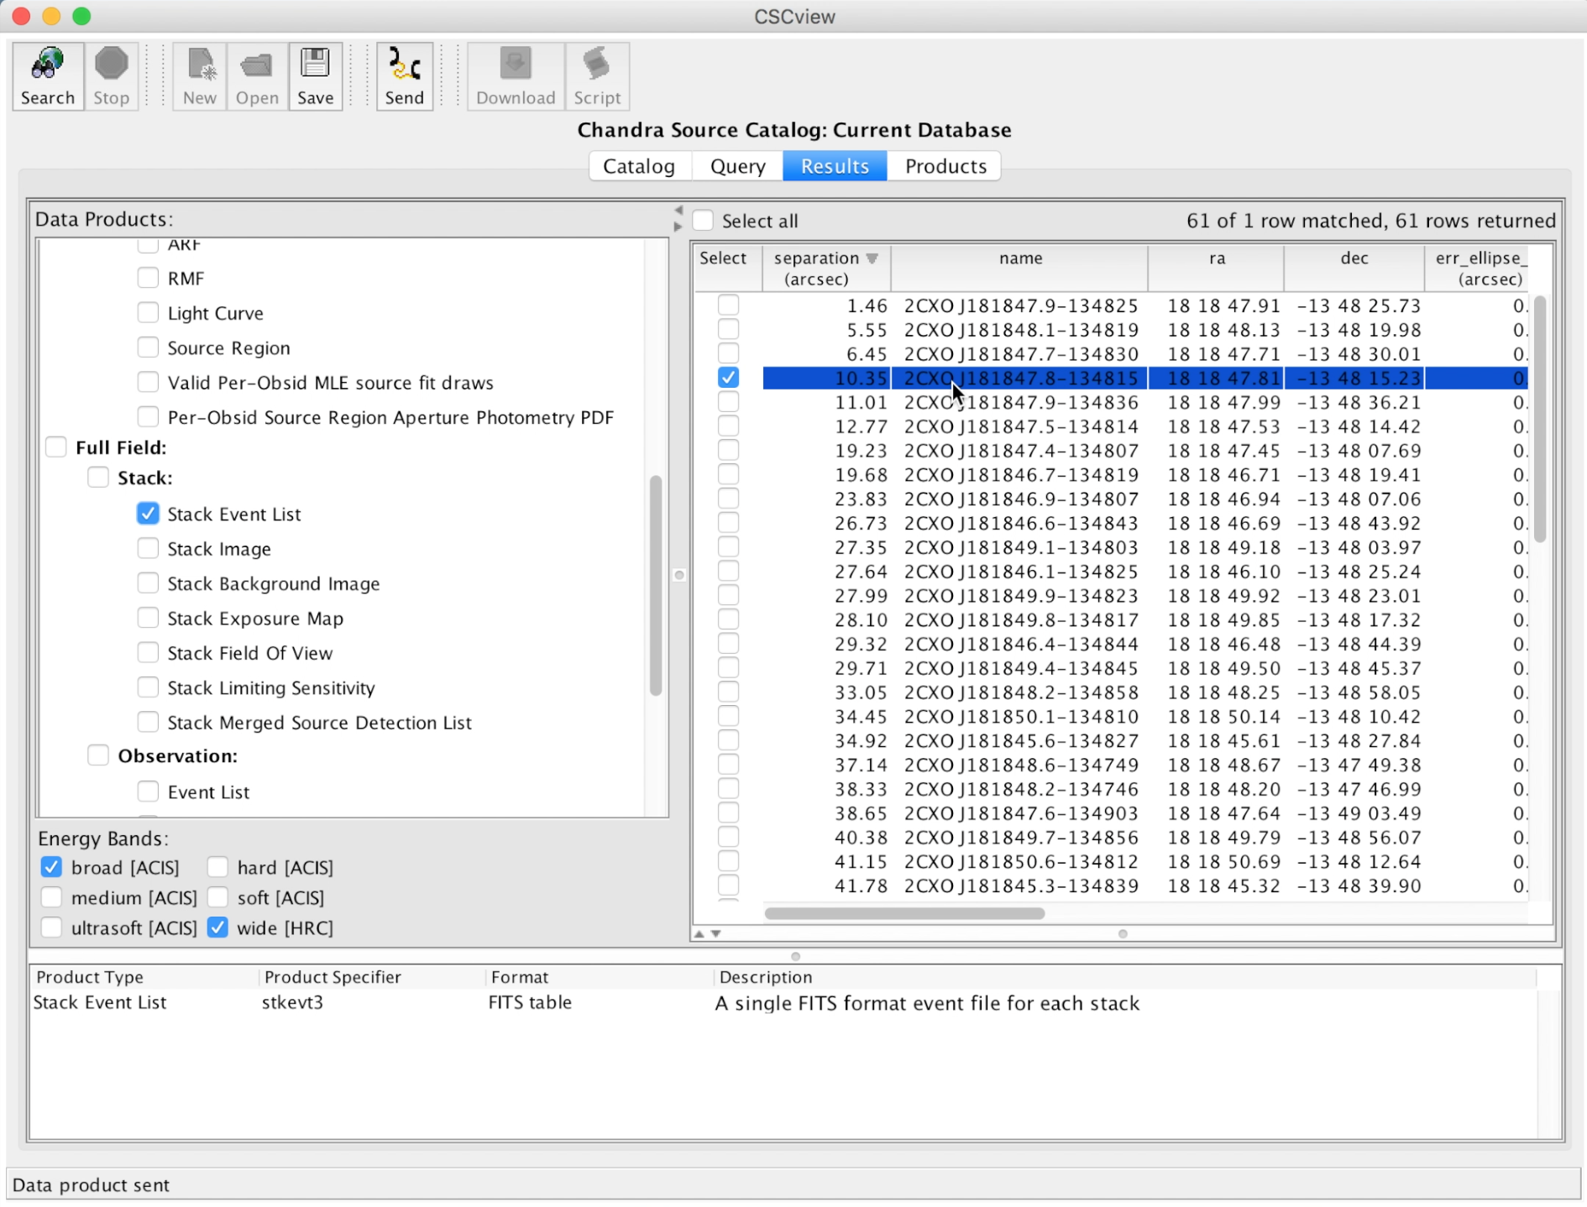
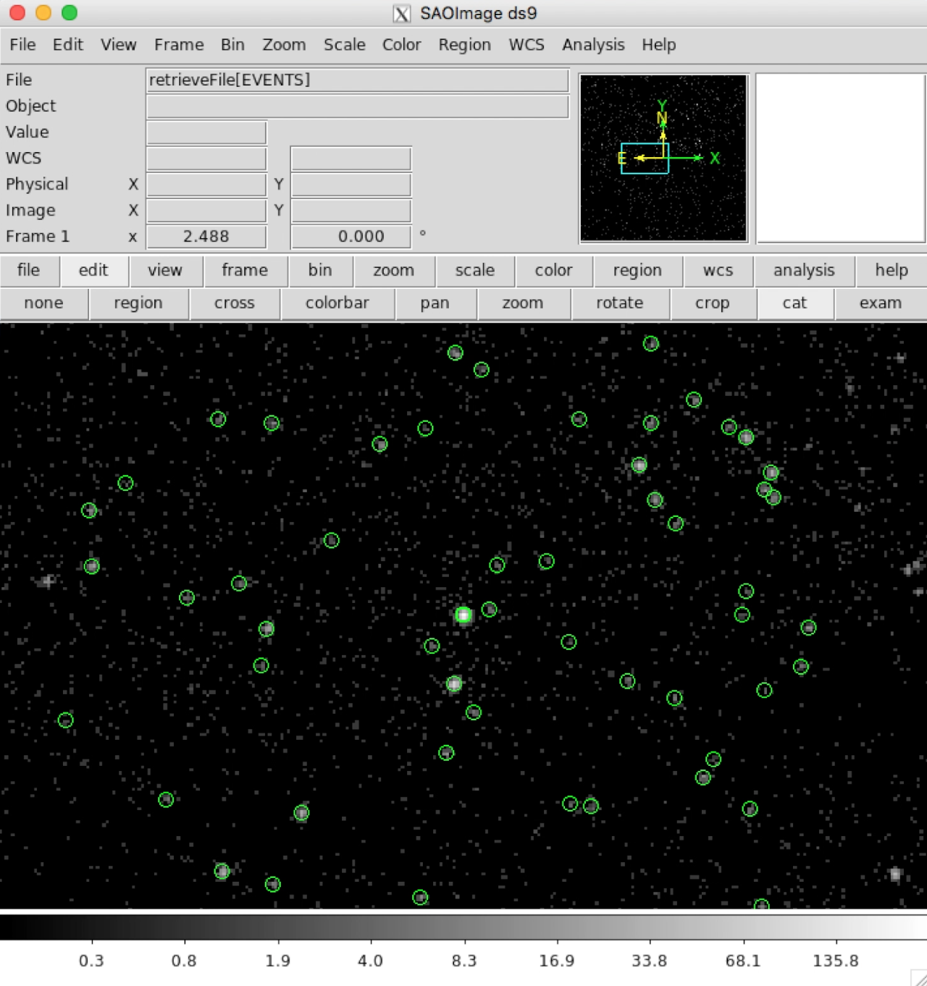
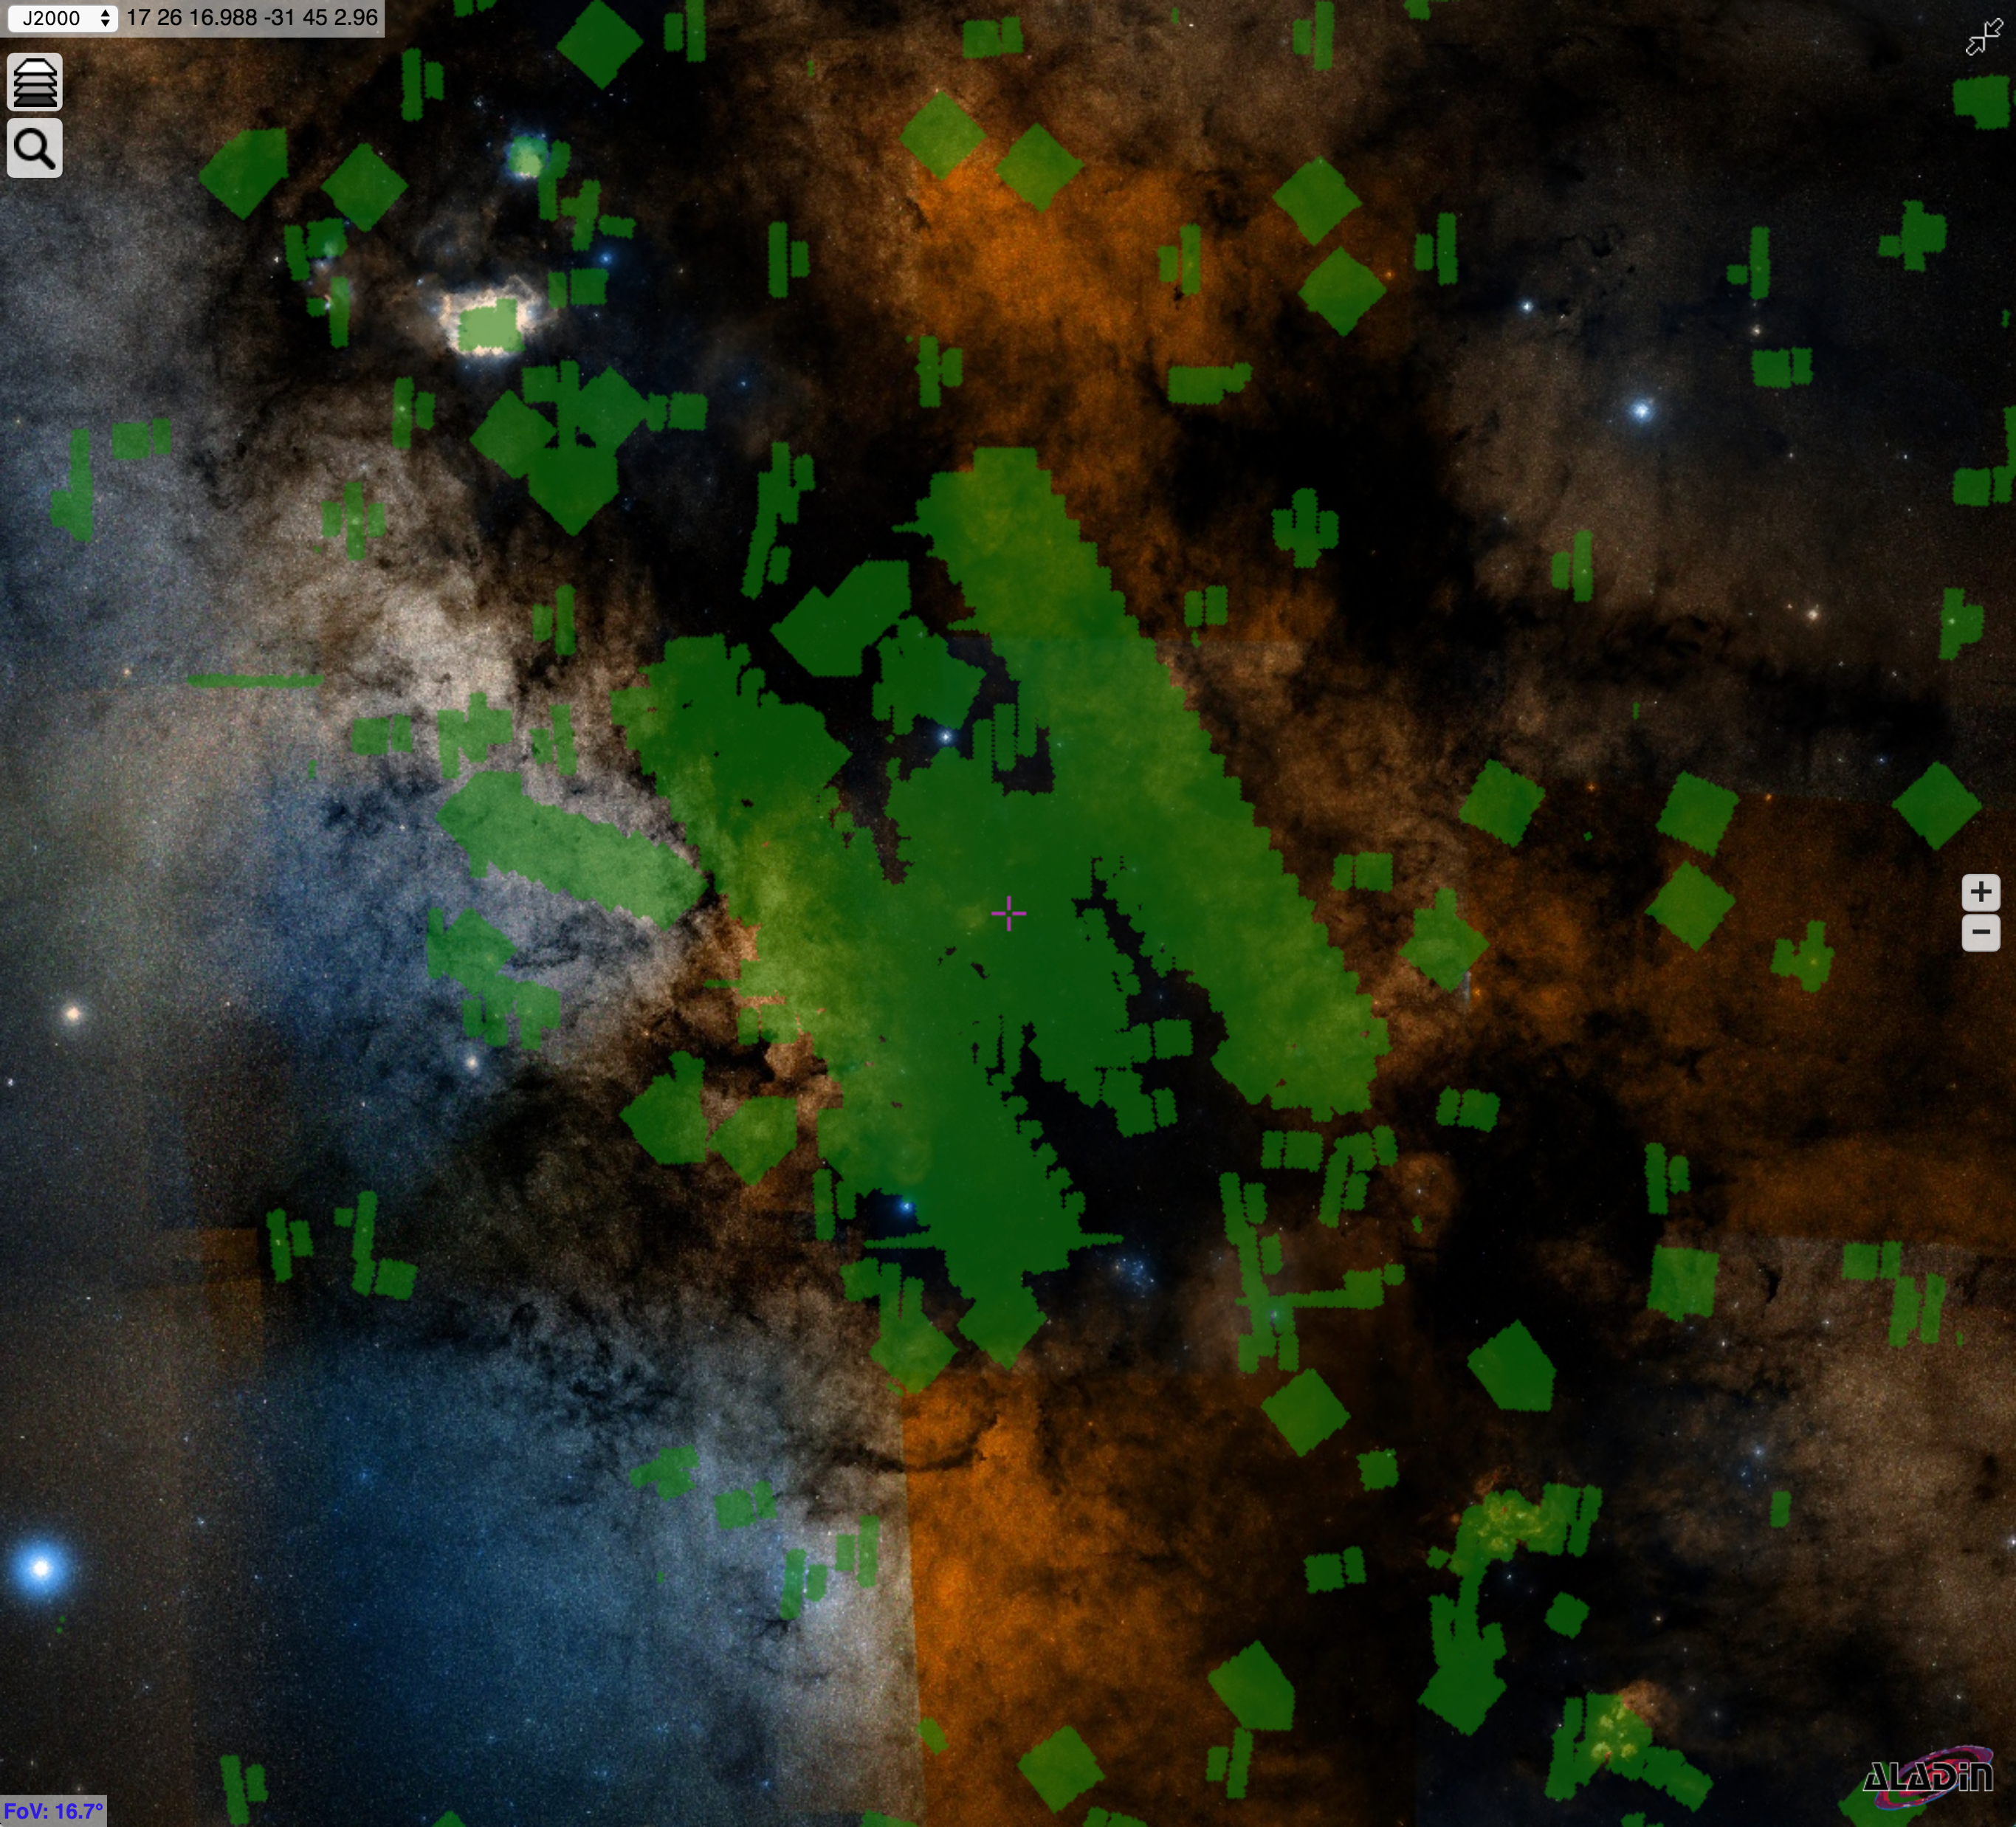

Access Chandra X-ray data through Virtual Observatory Services & Interfaces
Chandra Hierarchical Progressive Survey (HiPS)
Visualize sky regions with source overlays as you zoom in/out
VO-enabled archive interfaces: ChaSeR & CSCview
Discovery, Query & Access Chandra data through VO interfaces
VO: ADQL, VOTable, SAMP
HEALPix Multi-Order Coverage maps (MOCs)
Find sky regions that have been observed by Chandra
Chandra HiPS of NGC 6231 with
CSC1.1 sources in ESA Sky
More Chandra VO
Access Chandra data from other VO tools
and services with:
Simple Cone Search
Simple Image Access (SIAP)
Table Access Protocol (TAP)
Chandra coverage in the Galactic center on DSS HiPS
Visualized in ESA Sky
bit.ly/cxc-iau30
International Virtual Observatory Alliance
CXC
Image credit: X-ray: NASA/CXC/UMass/D. Wang et al.; Optical: NASA/ESA/STScI/D.Wang et al.; IR: NASA/JPL-Caltech/SSC/S.Stolovy

