Slide 1



Standing Committee for Science Priorities (CSP) status
Francesca Civano
NASA - GSFC
(Chief Scientist - Physics of the Cosmos Program)
Chair of the IVOA Committee for the Science Priorities

Slide 2
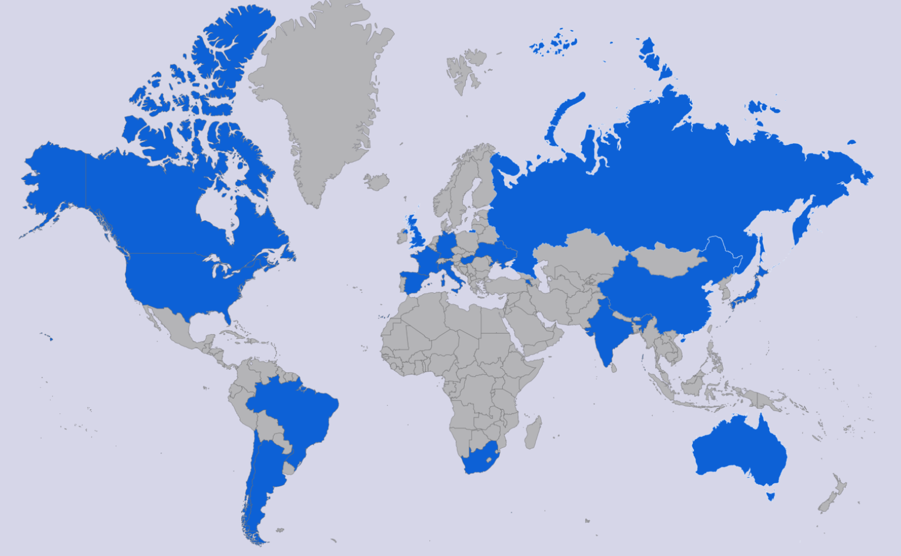
The CSP of the IVOA
Who is in the CSP?
  Members of the science community and active astronomy projects.
Members
  Members: Mark Allen, Chenzhou Cui, Raffaele D’Abrusco, Gregory Dubois-Felsmann, Janet Evans, Pepi Fabbiano, Minh Huynh, Mark Lacy, Marco Molinaro, Ada Nebot, Kai Lars Polsterer, Judy Racusin, Enrique Solano, Rachana Bhatawdekar and Rosie Bolton
  Chairs: Francesca Civano (chair), Vandana Desai (vice-chair)
  http://ivoa.net/twiki/bin/view/IVOA/IvoaSciencePriorities
CSP status - Interop Spring 2025
Notes:
The CSP is formed by members of the community actively involved in astrophysics projects. We have at this time 17 members, listed there,

Slide 3
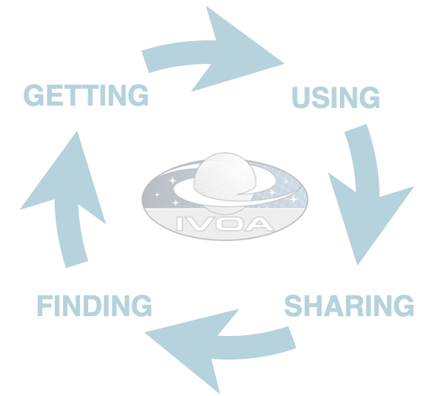
Goal of the CSP
What is the goal of the CSP?
Sustain the scientific impact of the VO as an interoperable ecosystem to support science
Ensure continuous engagement of the international astronomical community
Community
  The astronomy community comprises missions that are active or under development, operating observatories, astronomical archives, and teams of astronomers performing research and disseminating data products to the community.
Notes:
The goal of the csp is to be the liason between the astronomy community and the VO to first of all sustain the scientific impact of the VO as an interoperable ecosystem to support science which can be achieved only with the continue engagement with the community

Slide 4
Activities of the CSP
Recommend scientific priorities and scientific requirements
Driven by scientific use cases that are developed in cooperation with the scientific community.
Will influence the development of new protocols which will be developed by the IVOA and coordinated by the TCG
Scientific community
IVOA Committee Scientific Priorities
IVOA Technical Coordination Group
Ensure community engagement
Encourage engagement, adoption and feedback of implementations by the international astronomical community
Support VO members in developing tutorials, technical and scientific workshops and scientific training materials.
Notes:
By being in touch with the community, The CSP contributes to identify scientific priorities and bring the requirements to the TCG, which then coordinate the development of new standards and protocols and works on what the community needs.
The CSP should then report back to the community and solicit the community to implement the standards and get their feedback.

Slide 5
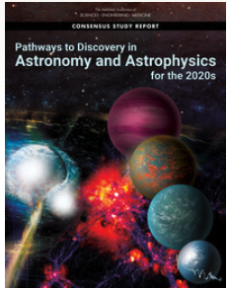
Science Priority Areas
    Pathways to Habitable Worlds
      JWST, DKIST
      Ground-based ELTs equipped with high-resolution spectroscopy, high-performance AO, high-contrast imaging
      Future: HWO
    New Windows on the Dynamic Universe
      Rubin, Euclid and Roman ... ELT
      COSI, UVEX, ULTRASAT
      next generation radio observatories
      updates to current ground-based GW facilities and LISA
      high energy neutrino observatories
      Einstein Probe
    Unveiling the drivers of galaxy growth
      JWST, Rubin, Roman, Euclid, SPHEREX
      progress in numerical simulations
      ELT
    Data Science
      Big data, cloud resources
      The rise of science platforms
    Heliophysics and Solar System
      Data archives
Notes:
When we talk about science prioiorities needs, we should look at the international astronomical community, look at the reports, one example being Astro 2020, and identify the priorities and the projects/missions involved.

Slide 6
Important considerations
      Identify the current main science cases in the community
      Engage with large and small projects
      Ensure IVOA is building standards, data models and provide coordination and information to those groups building tools and services responding to these science cases
      Ensure right balance for these standards
        Not too generic, not too specific
        Implementable standards, while not too simplistic
        Need for new standards, or updating existing standards
        Addressing new data types, new areas in astronomy

Slide 7
Activities at the last Interop
Plenary Session in Malta on High Energy and Time Domain with the goal of hearing from high-energy projects about their involvement in IVOA and their use of standards.
  Topics covered:
    How does your project make their data discoverable? Are data from your project in the IVOA registry? Are there problems in the IVOA Obscore definition preventing or limiting it?
    What data products are used in your data analysis and are they interoperable with data from other projects? Do you use a data model?
    What do you use for an alert system? Do you use VOevent, and if not, can you address the issues you see?
    How do you coordinate rapid follow up observations currently? Are the Observing plan of your project/mission available externally and is there coordination of your project/mission among the HE projects? Are you familiar with the IVOA ObsLocTAP protocol and ObjObsSAP working draft of the IVOA?
  Session outcomes:
    Approval of the High Energy Interest Group
    Promoting the HEIG work on obscore extension
Organized a session focusing on VOevent and how to move towards a VOevent 3.0

Slide 8
Data management challenges and solutions
Notes:
data management challenges and solutions, focusing on recent and upcoming missions and how IVOA can be a resource.

Slide 9
Data management challenges and solutions
Topic of discussion: data management challenges and solutions, focusing on recent and upcoming missions and how IVOA can be a resource
Missions: Euclid, Roman, SPHEREX and COSI
For missions already launched
  Brief overview of mission
  What are the major data management issues faced by the data management team, archive, users?
  What solutions have you adopted and have those worked?
  What lessons have you learned?
  What are the outstanding issues that the IVOA could be helpful with?
For mission in development/to be launched:
  Brief overview of mission
  What are the major data challenges that you foresee: data size, archive, users?
  Are you considering data standards and aligning with IVOA?

