Slide 1
SourceDM: Use Cases and Update
Jesús Salgado - ESAC Science Data Center (ESDC)
Markus Demleitner - German Astrophysical Virtual Observatory (ARI)

Slide 2
Source DM group
Objective:
Create a simple (but useful) SourceDM definition that could help in the publishing of catalogues through VO protocols
Support on the definition for catalogues metadata for near-future missions (e.g. Gaia, Euclid,…) and allow the mapping for old ones
Support interoperability operations between catalogues (SED creation, crossmatch operations, etc)
Initial Team:
Gerard Lemson, Sebastien Derrier, Laurent Michel, Bruno Merin, Tom Donaldson, Arnold Rots and myself
Strong collaboration from Markus Demleitner on use cases
Open for contributors

Slide 3
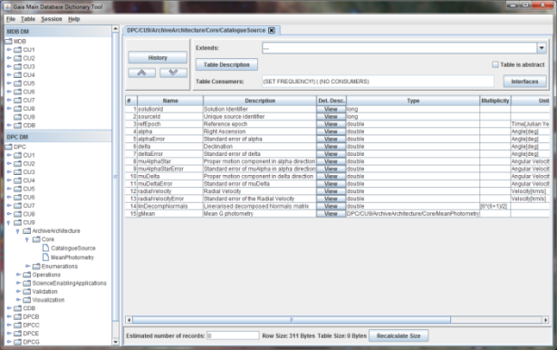
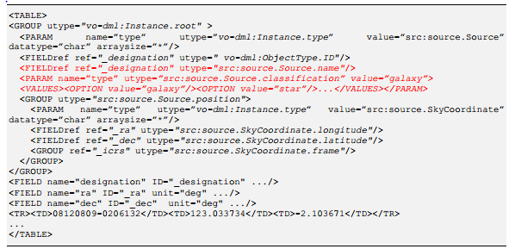
Gaia: DM in the core
Gaia Archive TAP server
Gaia DM
VOTable response with
VO-DML
TAP_SCHEMA
gbin
DB Schema Creator
VO-DML Annotations in TAP_SCHEMA?
Different structure?

Slide 4
Use cases (I)
Identities
Catalogue annotators want to express whether or not two instances (``rows'') refer to the same physical object on the sky. Client authors want to be able to match known-identical sources, for instance to aggregate information from several different catalogues.
Practical example: Pre-computed crossmatch tables are going to be provided between Gaia and common astronomical catalogues. Cross-reference will be used
Native Frames
Catalogue annotators want to give coordinates in their catalogue's native frames and for whatever epoch is convenient for them in order to achieve maximum precision, avoid hard-to-control error propagation in transformation requiring additional information, and keep provenance simple.

Slide 5
Use cases (II)
Precise Astrometry
Client authors want to recognise all information in catalogues relevant to precision astrometry (e.g., distances or radial velocities as necessary in foreshortening calculations). This also involves the position of the observer, at least for a few standard reference positions
Crossmatching
Client authors want to implement smart crossmatching schemes between different catalogues. This includes reducing catalogues to common reference frames and epochs, but also unifying non-positional source characteristics (e.g., photometry).
Automatic Errors
Where catalogues contain the necessary information, tool authors want to provide sound error estimates for derived quantities

Slide 6
Use cases (III)
Annotation of Existing Catalogues
Catalogue annotators do not want -- and indeed, in general cannot change catalogue data. SourceDM must therefore be flexible enough to enable the meaningful annotation of a large majority of the catalogues already in the VO.
Combining Data
Following a crossmatch (or just within a single table), tool authors want to aggregate various pieces of information into new data points or products.
Colours or even SEDs from photometry points
Proper motions or even orbits from positional measurements
Time series from, say, radial velocity measurements

Slide 7
Use cases (IV)
Standard Properties are Annotated
Client authors want to find scientifically relevant source properties easily. These could include:
Source type
Position
Radial Velocity
Proper motion
Parallax/distance
Classification
Photometry
Redshift

Slide 8
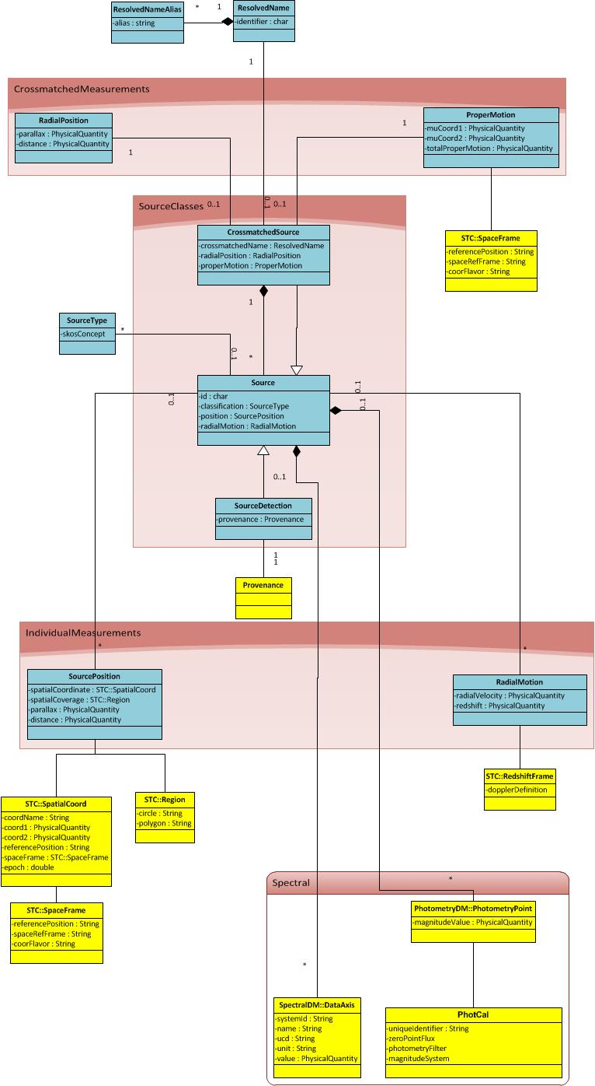

Slide 9
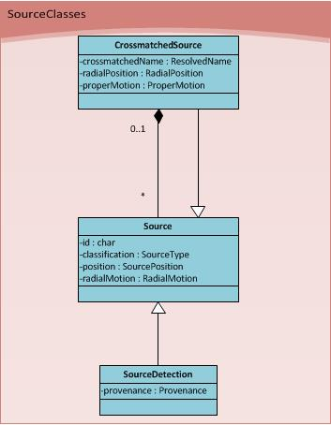

Slide 11
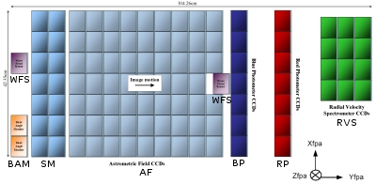
Individual Meassurements
Radial velocity usually measured due to spectroscopic analysis
Combination of the object radial velocity and cosmological redshifts

Slide 13
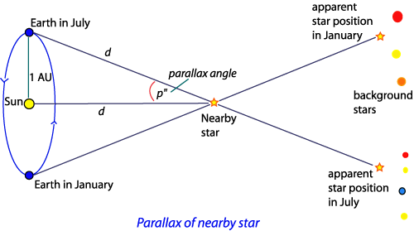
Crossmatched Meassurements
Conversion from parallaxes to distance requires certain assumptions
Parallaxes are preferred as a closer concept to a measurement quantity
$$d=1/ρ$$
Where $ρ$ is the parallax angle expressed in arseconds that produce a distance in parsecs.

Slide 14
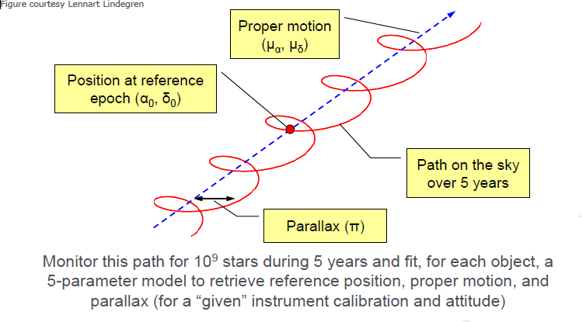
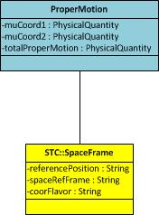
Crossmatched Meassurements (II)
$$pm_{ra}=\frac{∆ra}{\cos\left(δ\right)}$$
$$pm_{δ}=∆δ$$

Slide 16
Luminosities
Most of the catalogues are connected to luminosities through magnitudes/fluxes
Photometric values are usually represented by:
Magnitude value and error
Photometric system description
Zero point
Link to transmission curve
Colours?
Flux values are usually represented by:
Flux value and error
Spectral coverage
Include PhotometryPoint as direct element from PhotometryDM
More complex connections by link to SpectralDM 2.0
Spectra
Time Series

Slide 17
Photometry DM

Slide 18
Schedule
Very preliminary SourceDM v0.1 at IVOA pages
http://wiki.ivoa.net/internal/IVOA/SourceDataModel/WD-SourceDM-0.1-20160430.pdf
Iterate on UML
Exercise to map Gaia catalogue (CatalogueSource) to the IVOA Source DM
Modify Gaia Archive TAP+ component to include VO/DML preamble with SourceDM metadata
Agree with other catalogue providers on independent implementation
Thanks!

