Slide 1
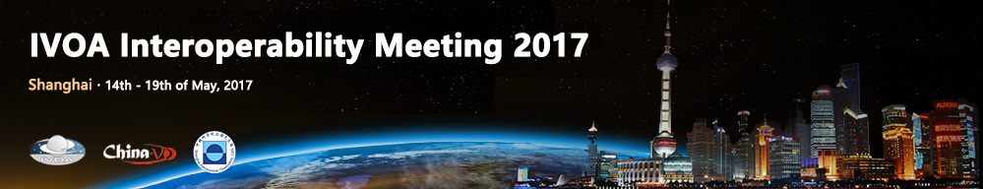

State of the IVOA
Pepi Fabbiano
Chair of the IVOA Executive Committee
IVOA Interoperability Meeting Opening Session
Shanghai, China, 14/May/2017

Slide 2
Great Attendance
116

Slide 3
The Big
Picture

Slide 4
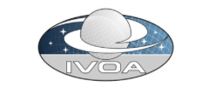
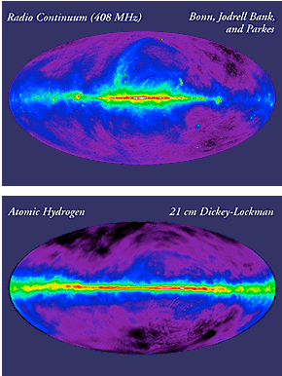
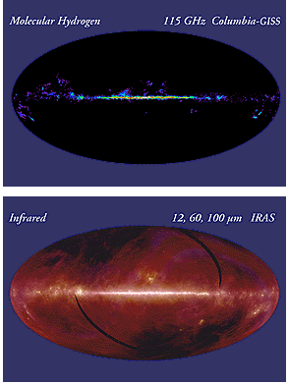
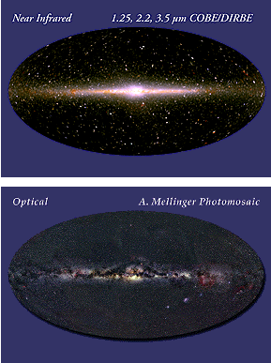
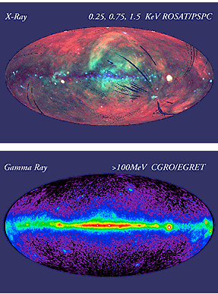
What is the Virtual Observatory?
A multi-wavelength digital sky that can be searched, visualized, and analyzed in new and innovative ways Space, Ground, and Theory data

Slide 5
What is the Virtual Observatory?
The VO is a paradigm for Supporting interdisciplinary and collaborative research in astronomy and exploiting the full power of growing and emerging data sets
The latest stage of good data practices in astronomy
FITS provided a first standardization, the Virtual Observatory is the natural progression towards interoperability of data, services and tools
The VO is a framework
For data centers to provide co-operating data services,
For software providers to offer a variety of compatible analysis and visualization tools and user interfaces

Slide 6

The VO is not a Killer Application
Dr. Strange

Slide 7
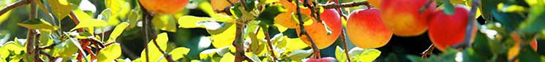
The VO is an Evolving Ecosystem
  IVOA defines VO “ecosystem” and interoperability standards
  VO registries, Archive interfaces and VO-enabled software offer Entry Points to VO resources, Visualization, Analysis
  Astronomy projects and data services build VO services and VO applications
  Projects are welcome and encouraged to participate in the standards process

Slide 8
Open Universe
Initiative of UNOOSA (United Nations Office for Outer Space Affairs) and Italy (Agenzia Spaziale Italiana)
Part of the activities of UNISPACE+50
  2018 marks the 50th anniversary of the first United Nations Conference on the Exploration and Peaceful Uses of Outer Space
Preparatory ‘Expert’ meeting held in Rome (ASI) in April 2017
  Fabbiano, Allen, Schade, Arviset, Kovaleva attended for IVOA & stressed the importance of using established interoperability standards and working with the IVOA
Meeting in Vienna, Austria, 20-22 Nov. 2017

Slide 9
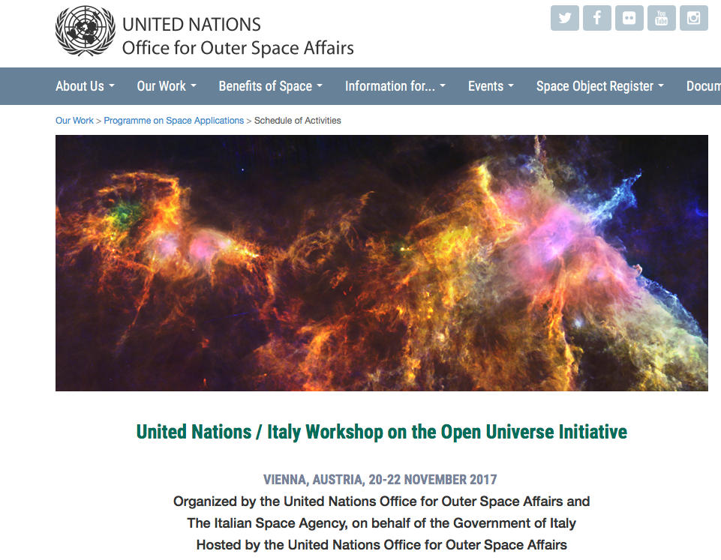
Open Universe
http://www.unoosa.org/oosa/en/ourwork/psa/schedule/2017/workshop_italy_openuniverse.html

Slide 10
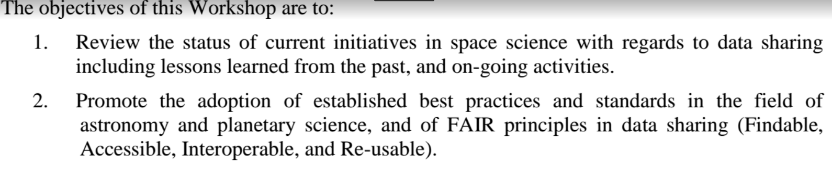
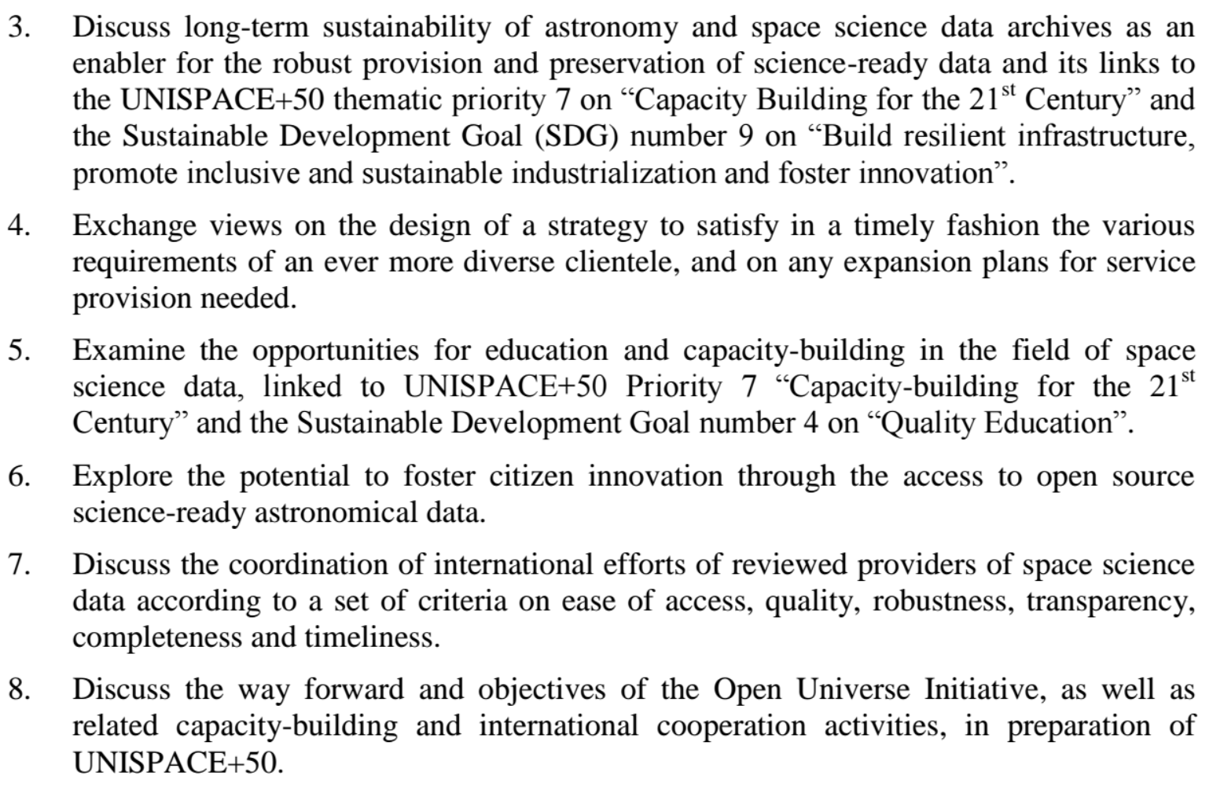
Open Universe
http://www.unoosa.org/oosa/en/ourwork/psa/schedule/2017/workshop_italy_openuniverse.html

Slide 11
Open Universe
http://www.unoosa.org/oosa/en/ourwork/psa/schedule/2017/workshop_italy_openuniverse.html

Slide 12
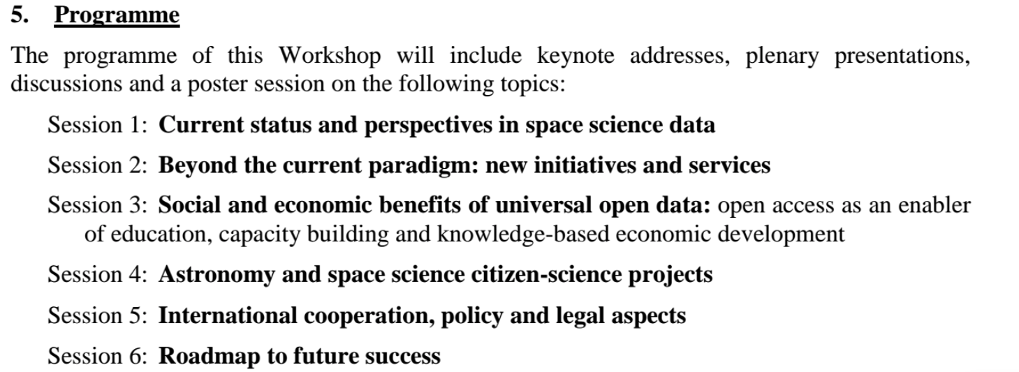
Open Universe
http://www.unoosa.org/oosa/en/ourwork/psa/schedule/2017/workshop_italy_openuniverse.html

Slide 13

Open Universe & IVOA
It is important that the IVOA be visible in these activities
The IVOA is the international astronomy interoperability standards organization
Participant Data Centers are centers of data access & interoperability activities for science and education
The IAU is making use of IVOA standards and services for education and outreach activities
However, the IVOA is not easily recognizable

Slide 14
Open Universe & IVOA
It is important that the IVOA be visible in these activities
The IVOA is the international astronomy interoperability standards organization
Participant Data Centers are centers of data access & interoperability activities for science and education
The IAU is making use of IVOA standards and services for education and outreach activities
However, the IVOA is not easily recognizable
We need to enhance our visibility

Slide 15
IVOA News

Slide 16
IVOA Organization Chart
Executive
Committee
Committee on Science Priorities
Technical Coordination Group
Standards & Processes Committee
Working Groups
Interest Groups
Applications
Data Access
Layer
Data
Model
Data Curation
& Preservation
Education
Theory
Knowledge Discovery in Databases
Grid & Web Services
Registry
Semantics
Time Domain
Operations

Slide 17
IVOA Organization Chart
Executive
Committee
Committee on Science Priorities
Media Group
Technical Coordination Group
Standards & Processes Committee
Working Groups
Interest Groups
Applications
Data Access
Layer
Data
Model
Data Curation
& Preservation
Education
Theory
Knowledge Discovery in Databases
Grid & Web Services
Registry
Semantics
Time Domain
Operations

Slide 18
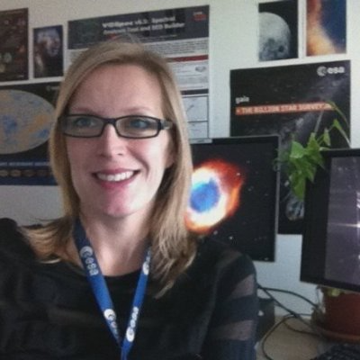

The IVOA Media Group
Welcome to the Media Group
  Debbie Baines (ESA) – Lead Newsletter Editor
  Simon O’Toole (Aus-VO)– Lead for other media presence
  Li Shanshan (China-VO)
  Yihan Hao (China-VO)
  Jamie Anne Budynkiewicz (USVOA)
  Teresa Dower (USVOA)
Group in charge of assembling & producing IVOA newsletters
Also exploring a more complete media presence
If interested in helping out, ask Debbie
June 17 issue of Newsletter being prepared

Slide 19
Trying something new for the CSP session
How can we involve more young astronomers in the IVOA?
  Mutual benefit
    Raise awareness of IVOA standards in the community
    Bring in new science needs and ideas
This year the CSP is trying a new ‘lightning session’ – short science talks
  A few openings still available (5 min talks)
  If interested, see Mark Allen
In future meetings we may consider poster sessions
Comments?

Slide 20
Good Progress in Standards
ObsCore1.1, SimDAL1.0, VTP2.0 approved by Exec
HiPS 1.0, VOAI 1.1, SimpleDALRegExt 1.1, DocStd 2.0, SSO 2.0 for approval this meeting

Slide 21
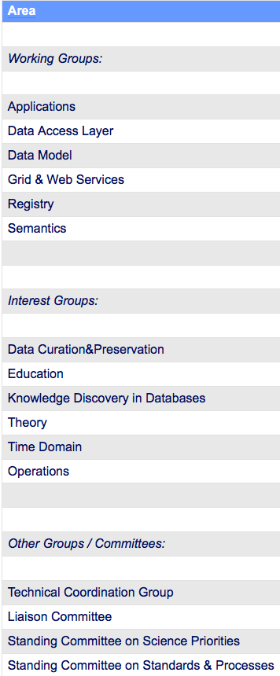
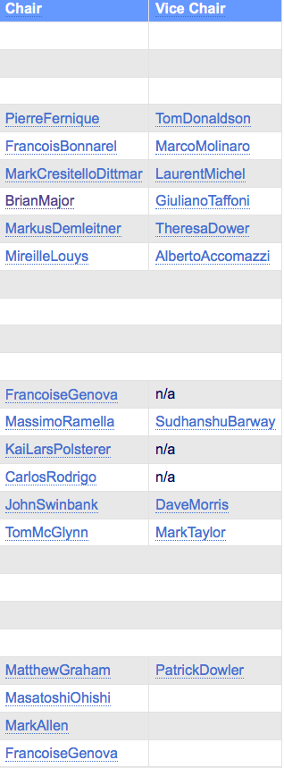
Chair
&
Vice-chair Rotation
Possible 1yr ext.
No ext.
Ready to move on

Slide 22
Other News
Chenzhou Cui initiated and is now chairing the new IAU Working Group "Data-driven Astronomy Education and Public Outreach”
SAO/CXC hosted a well-attended workshop at the Jan 2016 AAS, featuring Sherpa and IRIS in python
Bruce Berriman and NAVO colleagues submitted proposal to NASA for continuation of NAVO activities
Euro-VO news – next 2 slides

Slide 23

Euro-VO: The ASTERICS Cluster project
Work Package Data Access, Discovery and Interoperability (DADI)
  Collaboration with the large ‘ESFRI’ projects: CTA, EGO(/VIRGO), Km3Net, SKA, including pathfinders – ESA and ESO associate partners
  Involves the European VO initiatives (France, Germany, Italy, Spain, UK)
Strands of work
  Support the large projects and the scientific community in their uptake of the VO and gather their requirements
  Technological work to update VO standards and tools
Multi-D data, time domain, Provenance, HiPS/MOC, A&A, …

Slide 24
Euro-VO Workshops
ESFRI Forum & Training Events (Trieste, 2015, 2017) – to gather the ESFRI requirements
European Data Provider Forum and Training Events (Heidelberg, 2016, 2018) – to gather the European community of astronomical data providers
DADI Schools (Madrid 2017, 2017; Strasbourg 2016, 2018)
Technology Forums (Strasbourg 2015, 2017, 2019; Edinburgh 2016, 2018)
Additional meetings: Provenance, Gravitational Waves, Time Domain
Web site with all the slides https://www.asterics2020.eu/dokuwiki/doku.php?id=open:wp4:start
Science tutorials: http://www.euro-vo.org/?q=science/scientific-tutorials

Slide 25
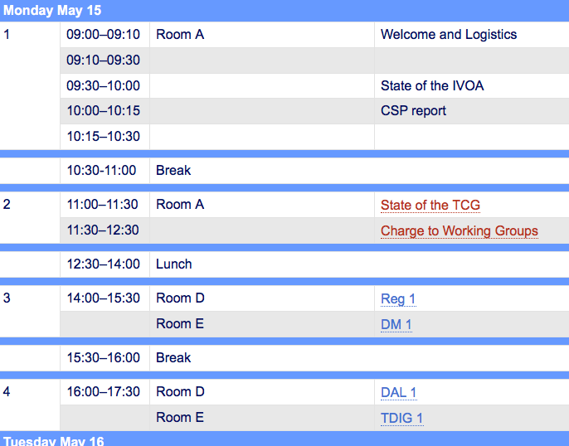
Lets go to work…
And now lets go to work…
  We have a packed program
  And don’t forget the visit to Sheshan Station organized by Chenzhou
Thank you Chenzhou
and the LOC

