Slide 1
ESA Gaia Archive TAP+
Jesús Salgado, Juan González, Raúl Gutiérrez, Juan Carlos Segovia, Javier Durán, Elena Racero, Sara Nieto, Bruno Merín, Christophe Arviset
Gaia Archive Development Team - ESAC Science Data Center (ESDC)

Slide 2
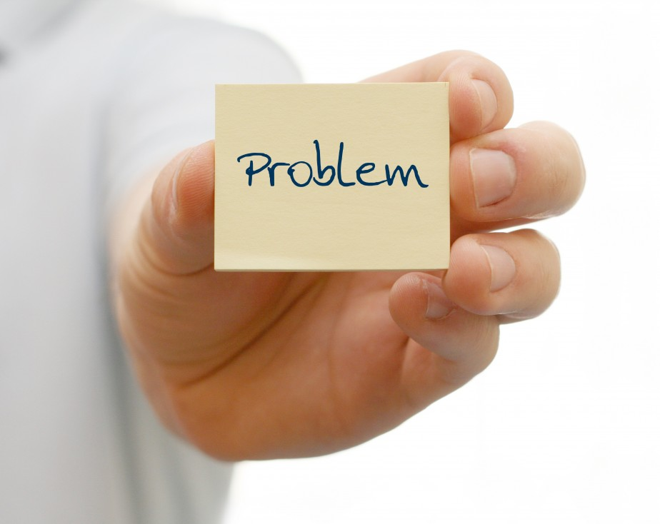

Slide 3
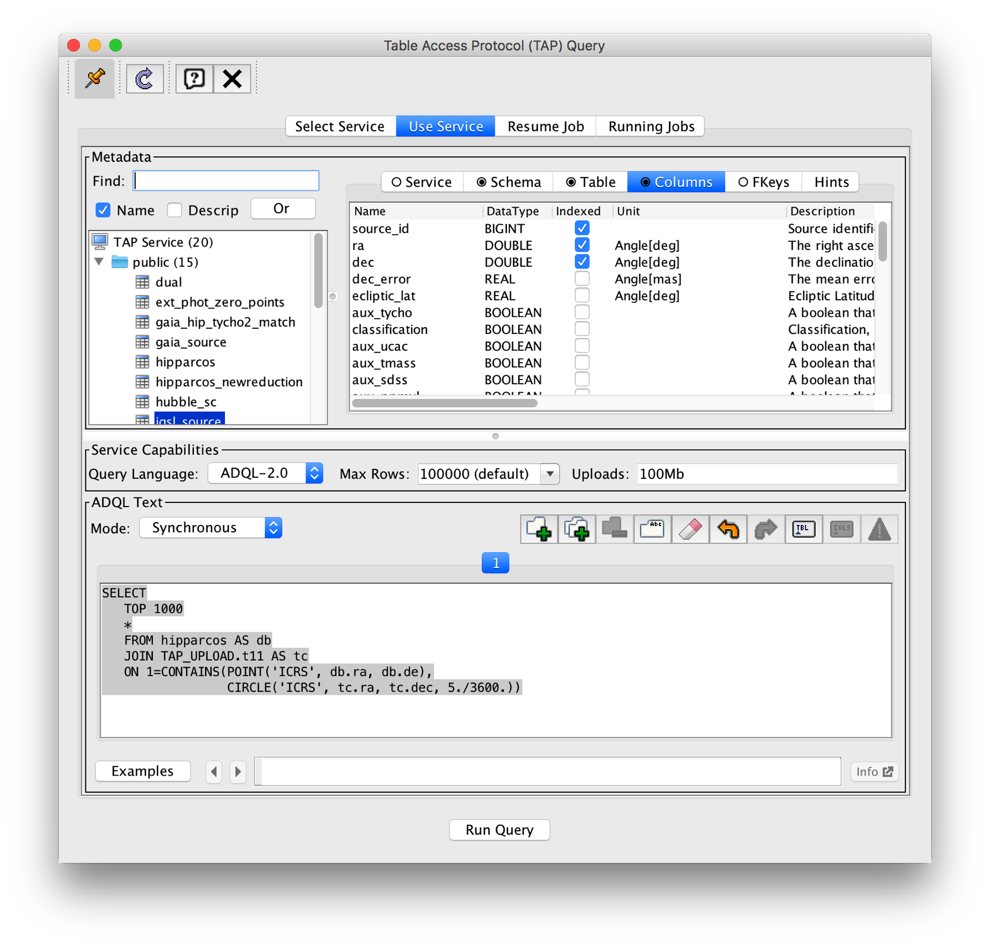
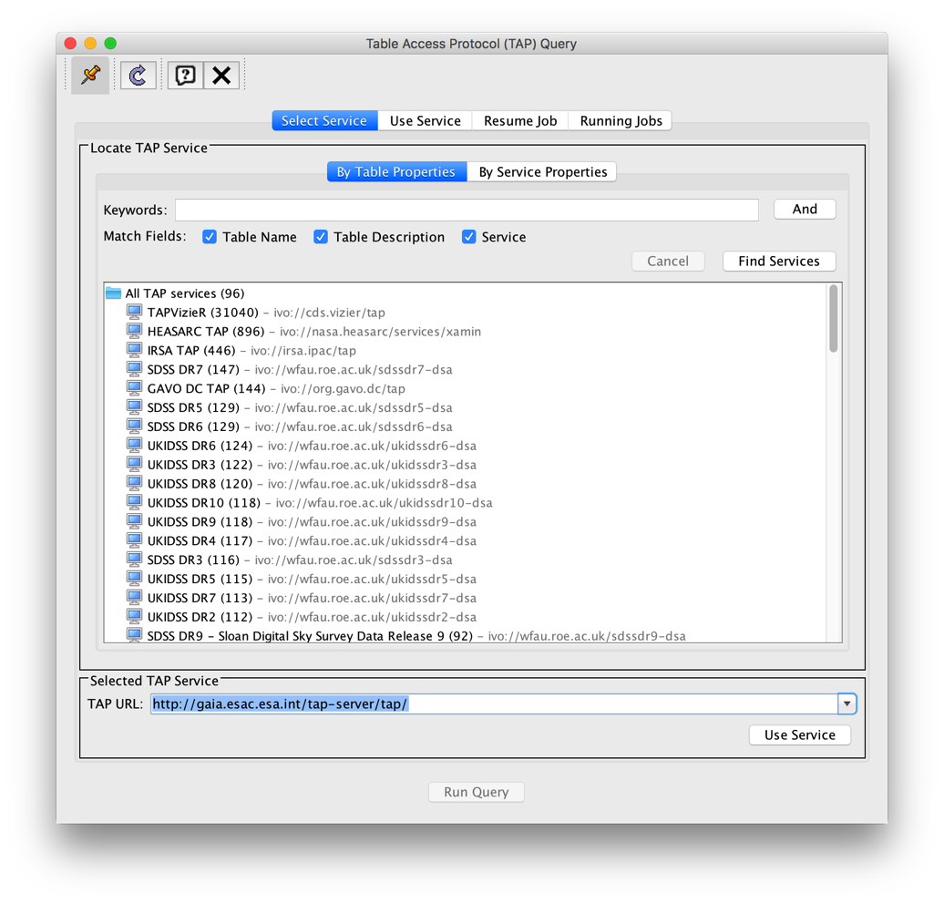
Working with my tables in TAP
Volatile upload of tables is supported by TAP/ADQL: UPLOAD/QUERY/DELETE
Service URL: http://gaia.esac.esa.int/tap-server/tap/
SELECT *
FROM hipparcos AS hip
JOIN TAP_UPLOAD.t1 AS myTable
ON 1=CONTAINS(POINT('ICRS', hip.ra, hip.dec),
CIRCLE('ICRS', myTable.ra, myTable.dec, 5./3600.))

Slide 4
Crossmatch for my objects: TAP approach
archive
USER
White Dwarfs
TAP
Upload & Query
Results
Repeat operation n-times
User Disk

Slide 5
Crossmatch for my objects: TAP+ approach & VOSpace+
archive
USER
TAP
Upload
White Dwarfs
n TAP Queries
Results
Results
USER
User Disk

Slide 6
Gaia archive requirements for TAP
Gaia Data Model
Gaia has its own DM that is propagated and used for all the software developed in the consortium
Private Queries
The queries should be only visible for the user that execute them (for logged users)
Private Data
Users should have their own data/catalogues close to the archive
Login must be supported
Crossmatch
Crossmatch between Gaia catalogue and user catalogues to be executed as a user ADQL function

Slide 7
Crossmatch for my objects: TAP+ approach & VOSpace+ & SaaS
archive
USER
TAP
Upload
White Dwarfs
n TAP Queries
Results
Results
USER
User Disk

Slide 9
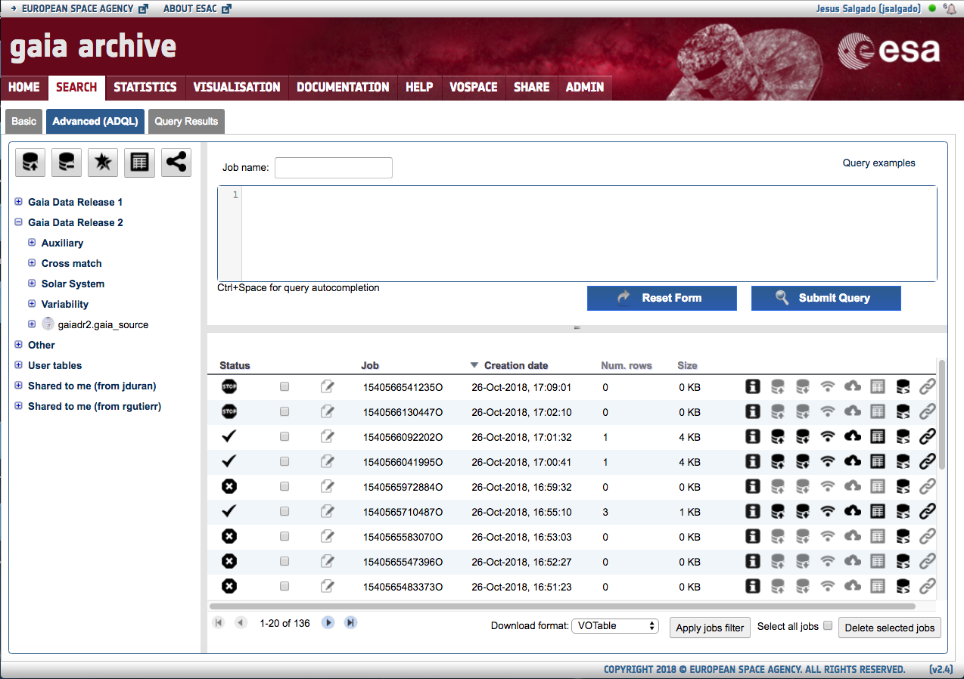
Gaia Archive: TAP+ Interface

Slide 10
TAP+: Private Data
Jobs should allow a “non anonymous” execution
Jobs Visibility (TAP/UWS)
ADQL queries inside the jobs under this mode should be only accessible by the owner
ADQL queries are a description of ongoing scientific work so they have to be hidden
Persistent upload (TAP)
Data-centric architecture impose users data close to the server
Tables uploaded by user should be maintained at the server in a persistent way
Login/Authorization/server capabilities/sharing (VOSpace)
TAP Schema (TAP)
TAP_SCHEMA per user

Slide 11
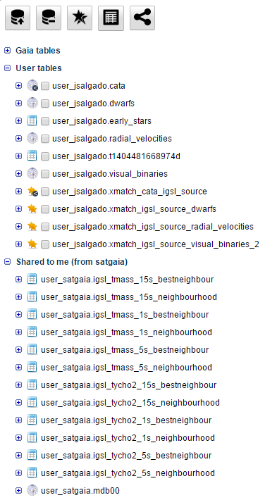
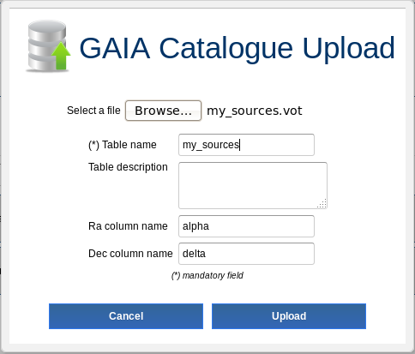
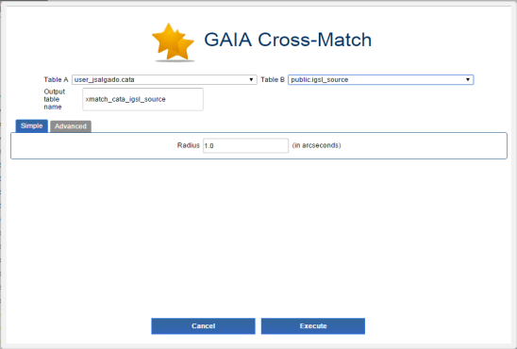
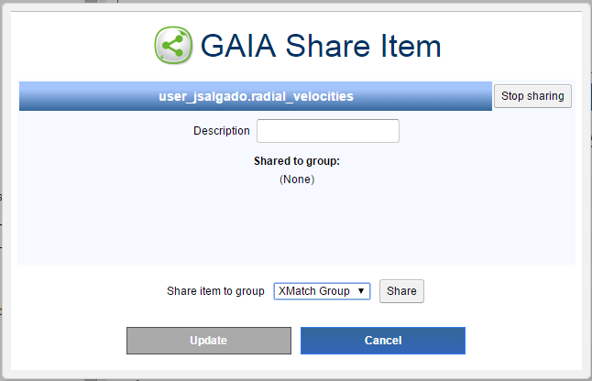
Gaia Archive: TAP+ Schema
Persistent Upload
Server Crossmatch
Table sharing

Slide 12
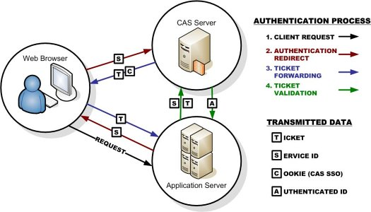
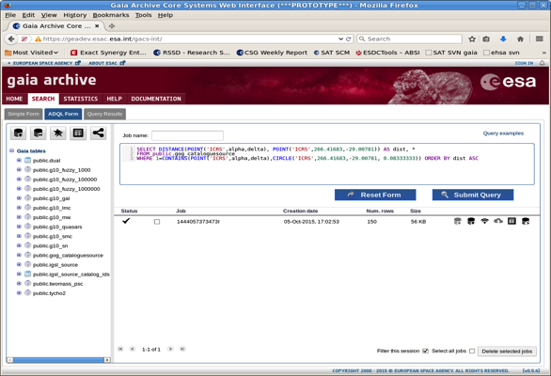
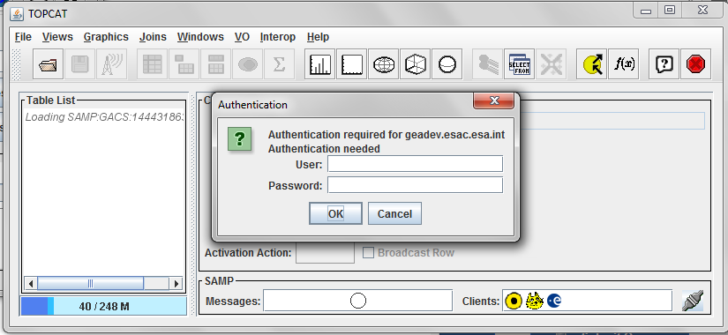
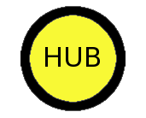
Gaia Archive Security
Single Sign-on through CAS server (both GACS and VOSpace)
Authorization through CAS proxy tickets
SAMP simple authentication
Full support on SAMP https for Web profile still pending at protocol level
SAMP
SAMP
Authenticated SAMP

Slide 13
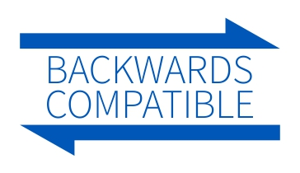

Slide 14
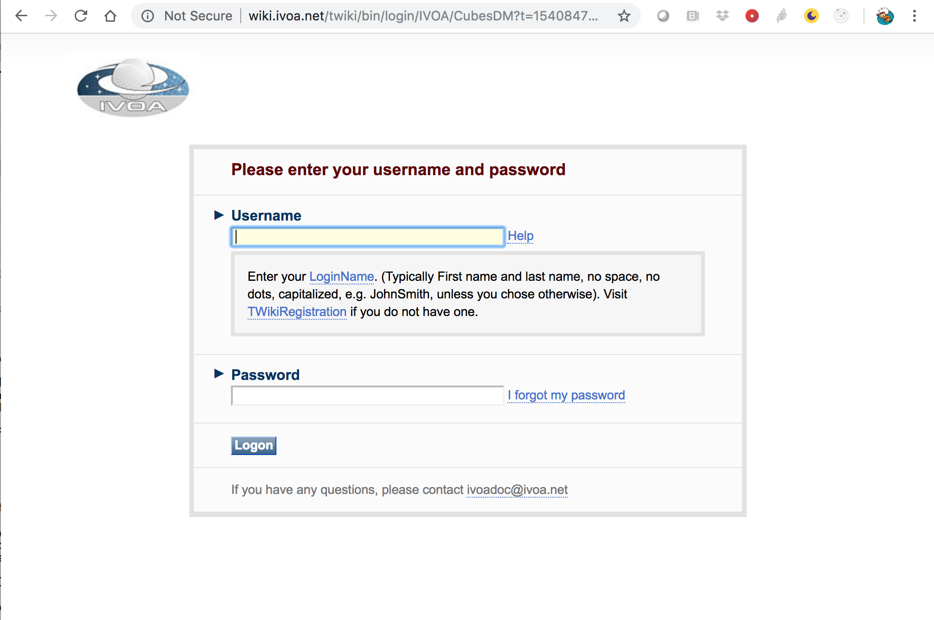
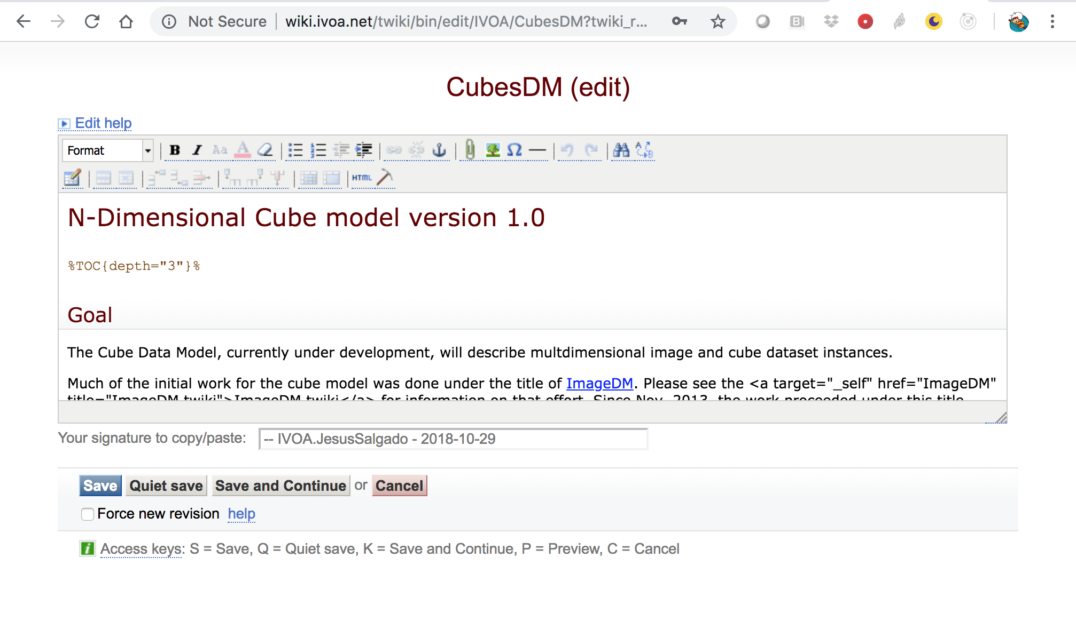
Same URL

Slide 15
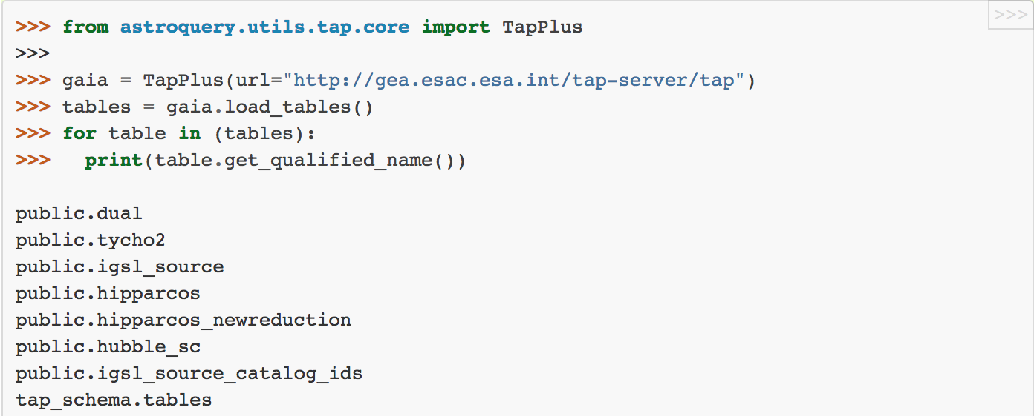
Astroquery: Load tables

Slide 16
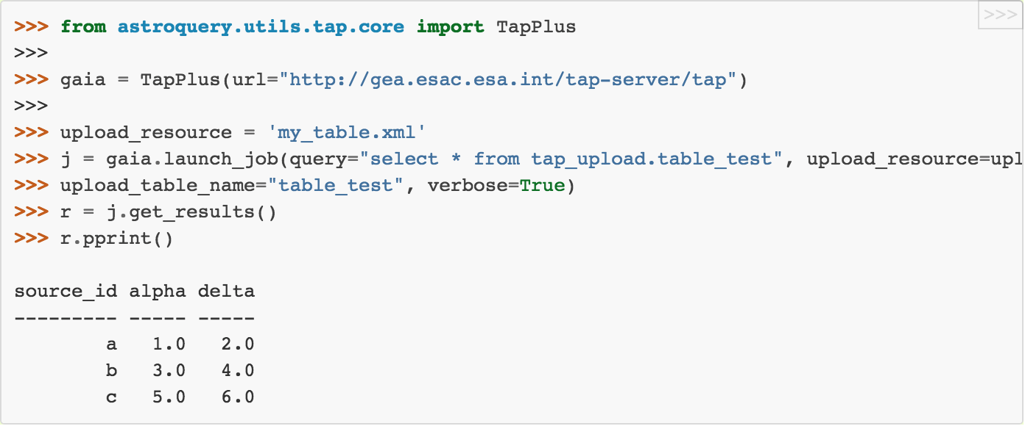
Astroquery: Synchronous query on an ‘on-the-fly’ uploaded table

Slide 17
Astroquery: Login and extra functionality
Login (several methods)
User shared tables

Slide 18
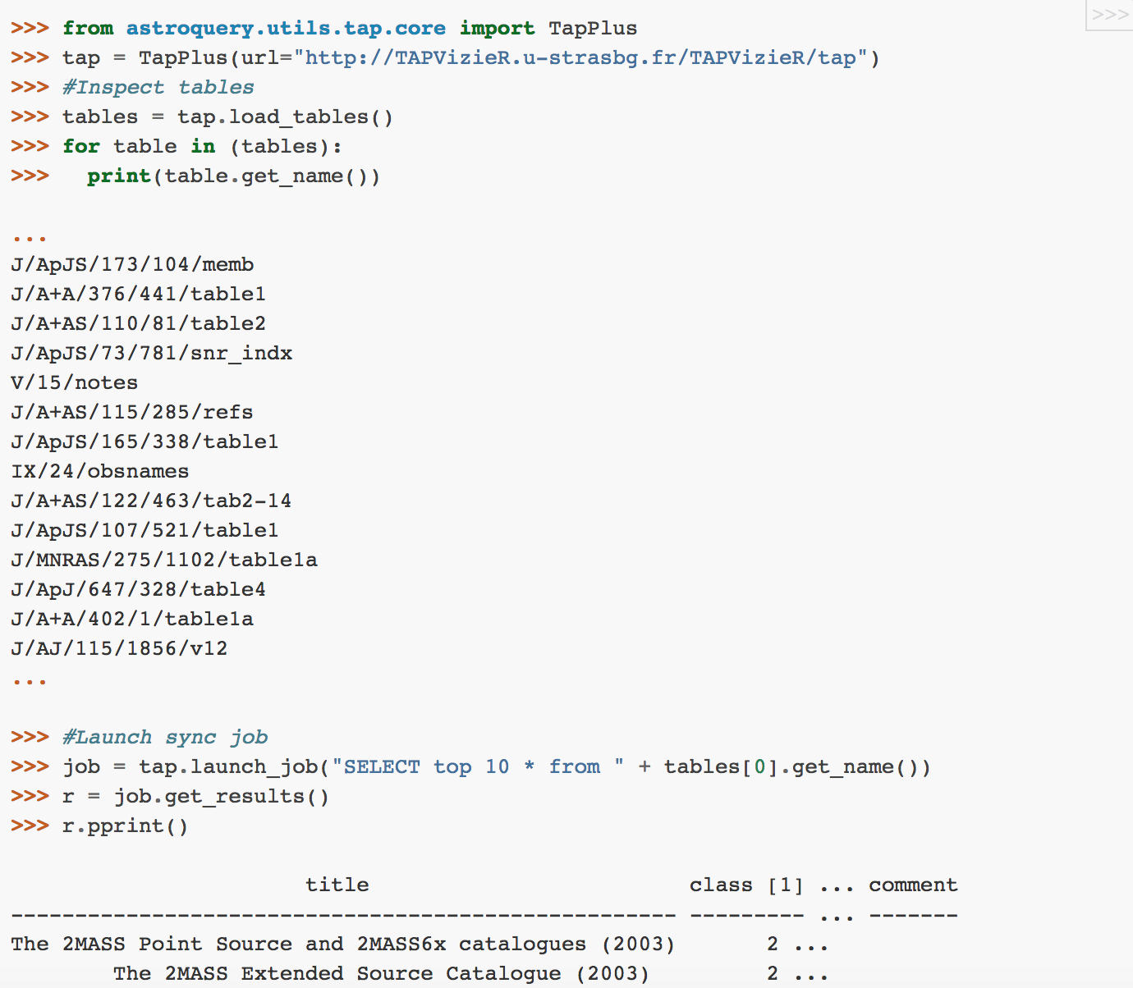
TAP+ is TAP compliant

Slide 19
Conclusions
Single URL for public and secure methods
TAP+ (authenticated methods) is extending a normal TAP
Added functionality accessible after login
Cookies (and other authentication mechanisms) are used to handle credentials and system behaves differently
Some requirements were needed into the protocol to create an operational archive:
Security
user DB schema
persistent upload
sharing
Possible draft to standardize this?

