Slide 1
TheorY/DAL Session
2011 Oct 18

Slide 2
Agenda
DAL/Theory session: Tuesday 16:30 - 18:00 Bhaskara 3
  Goals
  explore the current ideas on what SimDAL must/should do to allow discovery and access all theoretical data
  discuss which part of the SimDM could be registered
  discuss the specific way TAP could be implemented in SimDAL and which tables has to be provided
Talks/Discussions:
  Hervé Wozniak: review of current ideas on SimDAL and SimDB
  David Languignon: SimDAL
  Discussion

Slide 3
SimDAL / SIMDB

Slide 4
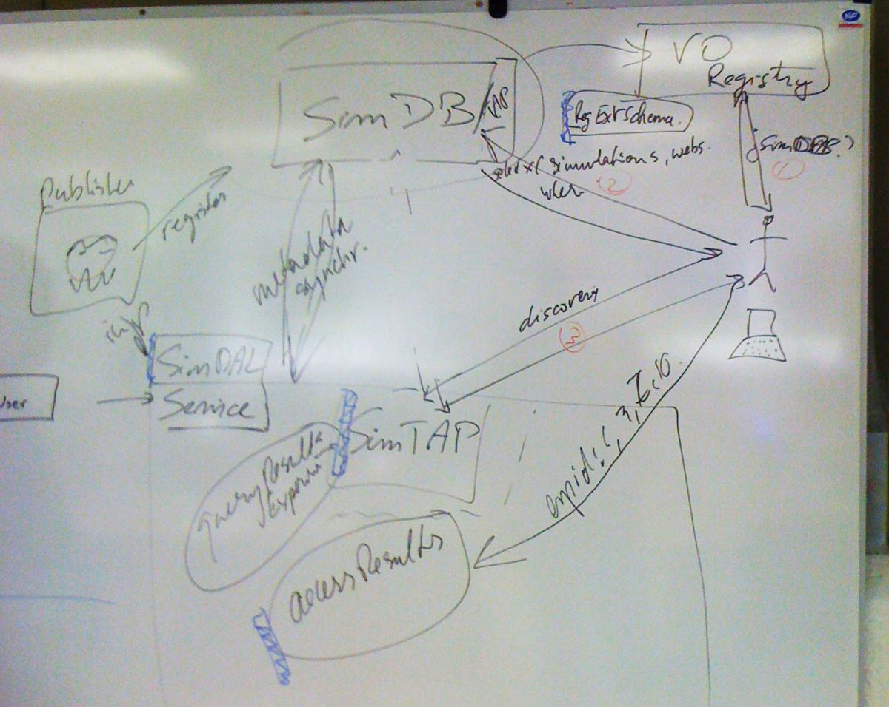
Strasbourg Sep 2010

Slide 5
Strasbourg Sep 2010 slightly updated after Nara INTEROP Dec2010
Synchro
mechanism
for metadata
SimDM
VO Registry
SimDB
TAP service
REST service
SimDB?
protocols?, webapps? SimDAL? etc...
medata synchro
very complex queries
REQUEST=?
Table/columns definition ?
SimDM
subset
TAP
TAP: ADQL and? PQL (for S3-like
queries)
ListExperiments
ListOutputDatasets
VOSI services
getAvailability
getCapabilities
Data processing services:
Preview
Cutout
Custom
queryExperiments
queryOutputDatasets
SimDAL
data delivery
Preview ?
Cutout ?

Slide 6
An extreme case without SimDB
VO Registry
SimDM
subset 1
SimDB
SimDM
RegExt
Which part(s) of
SimDM
in
RegExt
Protocol=X AND
SimDAL AND
webapps?
TAP service
REST service
not compliant with use cases
(eg Find all SPH simulations
with galaxy mass between
10⁹ and 10¹⁰ M_{sun})⇒? define
strong use cases
medata synchro
REQUEST=?
Table/columns definition?
SimDM
TAP
TAP: ADQL
and? PQL
(for S3-like
queries)
ListExperiments
ListOutputs
VOSI services
getAvailability
getCapabilities
Data processing services:
Preview
Cutout
Custom
queryExperiments
queryOutputs
SimDAL
data delivery

Slide 7
TAP in SimDAL proposals
create one SimTAP schema per Protocol (G. Lemson, Nara Dec’10)
  each schema contains tables: 1 Experiment, ≥ 1 Product (OutputDataset) + …
  differences in colums ⇒ needs many SimTAP schema ⇒ let their definition outside SimDAL spec?
  how to standardize SimTAP schemas alone ?
specify 4 tables in TAP_SCHEMA.tables (Experiment + OutputDataset + 2 tables for mappings) allowing to discover almost 80% of use cases (D. Languignon, this meeting)
  which ones are mandatory ?
  TAP_SCHEMA.colums not specified apart from protocol_did, experiment_did
  can we forget the remaining 20%?
one SimDAL by Protocol, full TAP implentation + 2 (or more) mandatory Tables (names fixed by SimDAL : Experiments, OutputDatasets)
  But a Project may contain several instances of Protocol

Slide 8
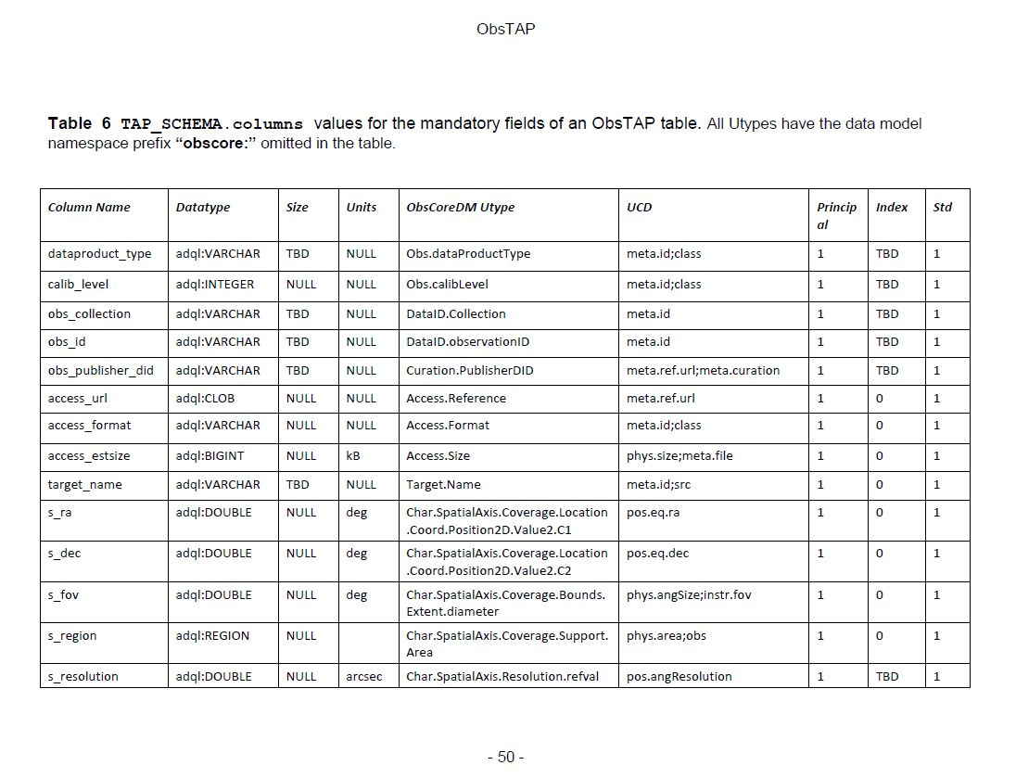

Slide 9
issues with VO registry

Slide 10
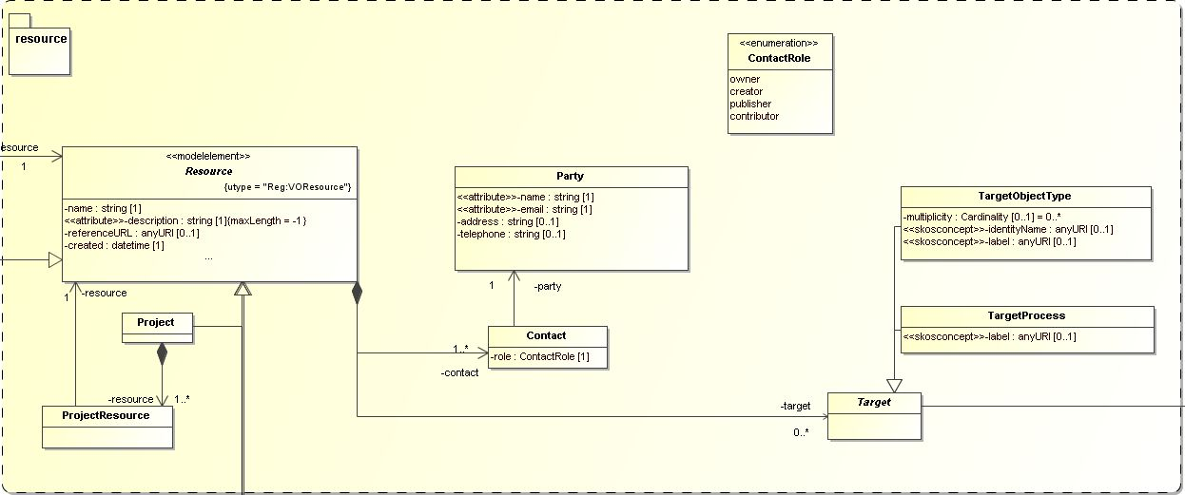
Issues
How much of SimDM in Registries (via RegExt)?
  Are Registry clients able to make complex queries
    No ⇒ SimDB proposal
    Yes in case of SKOSConcepts use in Registries?
  SimDM/resource seems mandatory

Slide 11
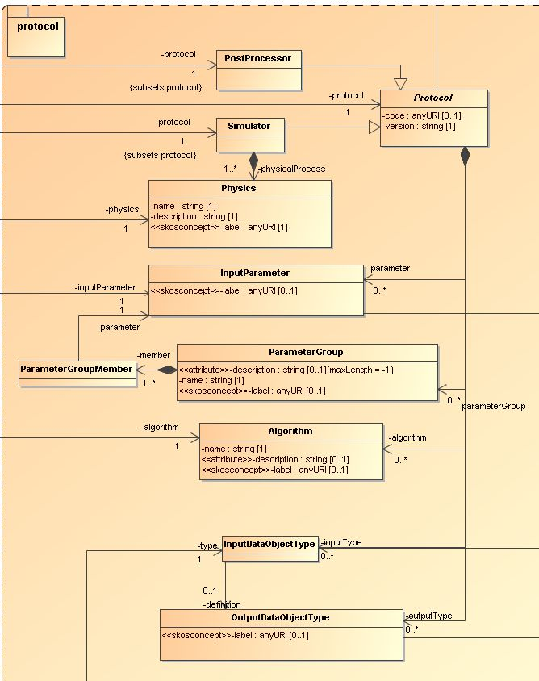
Issues
How much of SimDM in
Registries (via RegExt)?
  Part of SimDM/protocol
  Protocol = OK?
  What about Physics and
  Algorithm?
  What else?

Slide 12
Strasbourg Sep 2010: scenario 1
SimDM xml
query-able
repository
SimDB
Part(s) of
SimDM
XML
RegExt
VO Registry
TAP
SimDB?
Synchronisation
mechanism
for metadata
simulations?, webapps? etc...
getCapabilities
SimDAL
mine Experiments, Results / Preview / (Cutout)
TAP_SCHEMA?
Metadata query
Data query
Data listing
Datasets listing
Preview
Cutout
Custom
(Sim)TAP
Preview ?
Cutout ?
TAP: ADQL
and? PQL
(for S3-like
queries)
Services
retrieve dataset
(download)

Slide 13
Oct 2011: scenario 2 (D. Languignon talk)
As much as possible
SimDM
xml
RegExt
Useless ?
SimDB
VO Registry
TAP
SimDAL AND
simulations AND
webapps?
getCapabilities
SimDAL
TAP_SCHEMA?
2 tables:
Experiments
ParametersSettings
Metadata query
Data query
Data listing
Datasets listing
Preview
Cutout
Custom
(Sim)TAP
Preview ?
Cutout ?
lost information on
algorithms
physical processes
Services

