Slide 1
SourceDM: Some thoughts
Jesús Salgado
ESAC Science Data Center (ESDC)

Slide 2
Source DM group
Objective:
Create a simple (but useful) SourceDM definition that could help in the publishing of catalogues through VO protocols
Support on the definition for catalogues metadata for near-future missions (e.g. Gaia, Euclid,…) and allow the mapping for old ones
Support interoperability operations between protocols (SED creation, crossmatch operations, etc)
Initial Team:
Gerard Lemson, Sebastien Derrier, Laurent Michel, Bruno Merin, Tom Donaldson, Arnold Rots and myself
Open for contributors
Status:
DM activities still quite packed
Discussions at Gaia DPAC Consortium level

Slide 3
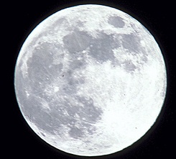
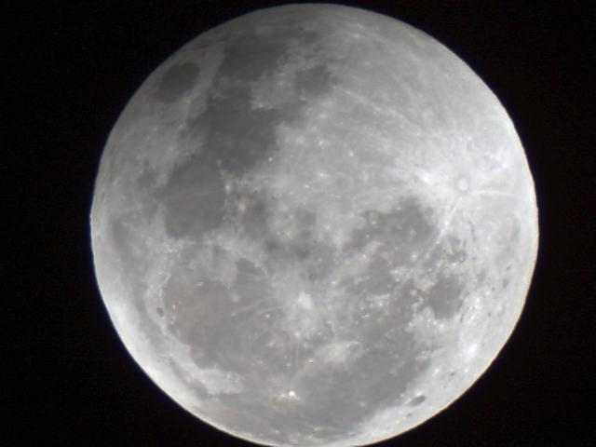
External members
Moon from Sydney

Slide 4
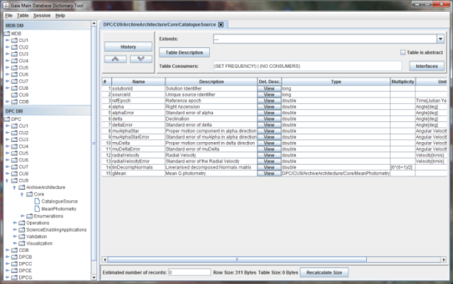
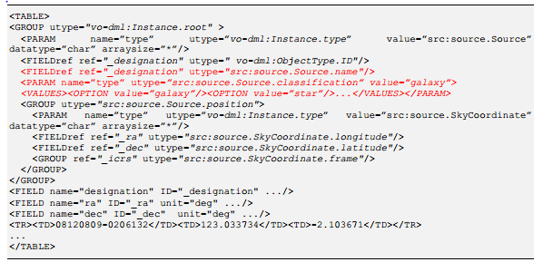
Gaia: DM in the core
Gaia Archive TAP server
Gaia DM
VOTable response with
VO-DML
TAP_SCHEMA
gbin
DB Schema Creator
VO-DML Annotations in TAP_SCHEMA?
Different structure?

Slide 5
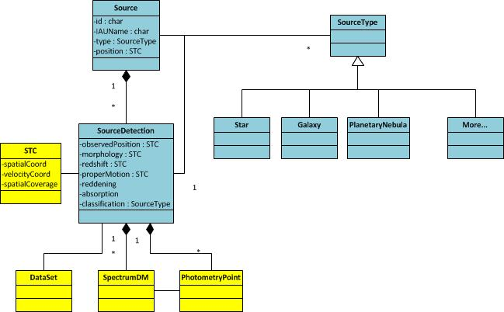
SourceDM v0.1

Slide 6
Source DM geometrical Support
STC-2
Attributes for:
Position
Errors
Epoch/Reference frames
Velocities/proper motion
Extended sources (?)
Redshift
Other attributes identified that could be needed
Parallaxes
Correlations

Slide 7
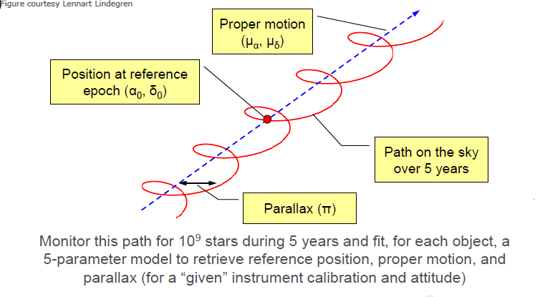
STC discussion flow
Jos de Bruijne, 2012

Slide 8
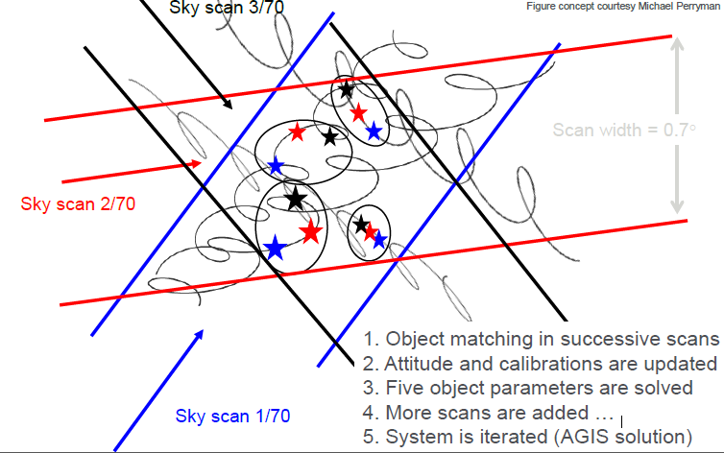
STC discussion flow
Jos de Bruijne, 2012

Slide 9
Positions and proper motion
Positions:
(ra, dec) equatorial coordinates
Different coordinates systems could be (should be?) covered so we should need just to reuse the STC definitions but this produces certain complexities for the velocities
Maybe, this could go as a compulsory/optional depending on the protocol
Support to other coordinates within DM
Epoch
(raError, decError)
Proper motion:
(muRa, muDec)
Proper motion on the two spherical coordinates
Discussions on the projection
(muRaError, muDecError)

Slide 10
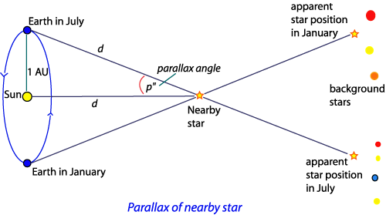
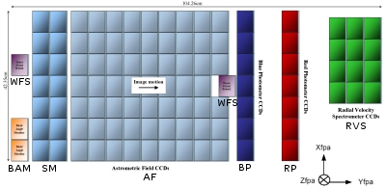
Distances, parallaxes and radial velocity
Distance is a derived quantity. Conversion from parallaxes to distance requires certain assumptions
Parallaxes are preferred as a closer concept to a measurement quantity
Both added to the DM
Radial velocity usually measured due to spectroscopic analysis
Combination of the object radial velocity and cosmological redshifts
Probably, radial velocity (in units of redshift) is better

Slide 11
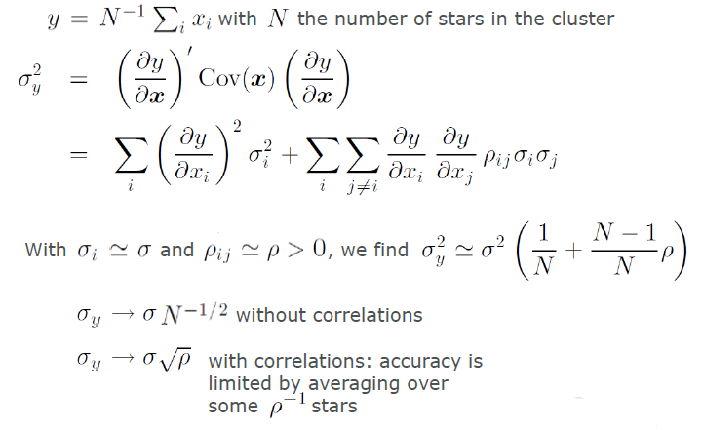
Correlations
Not only errors are needed to understand the accuracy of the astrometric solution. Correlations are also needed.
Holl et at, 2010

Slide 12
Correlations (II): Hipparcos
column | Concept | Description
H19 | Crl_Dec_RA | (Dec over RA)xCos(delta)
H20 | Crl_Plx_RA | (Plx over RA)xCos(delta)
H21 | Crl_Plx_Dec | (Plx over DE)
H22 | Crl_pmRA_RA | (pmRA over RA)xCos(delta)
H23 | Crl_pmRA_Dec | (pmRA over DE)
H24 | Crl_pmRA_Plx | (pmRA over Plx)
H25 | Crl_pmDec_RA | (pmDE over RA)xCos(delta)
H26 | Crl_pmDec_Dec | (pmDE over DE)
H27 | Crl_pmDec_Plx | (pmDE over Plx)
H28 | Crl_pmDec_pmRA | (pmDE over pmRA)

Slide 13
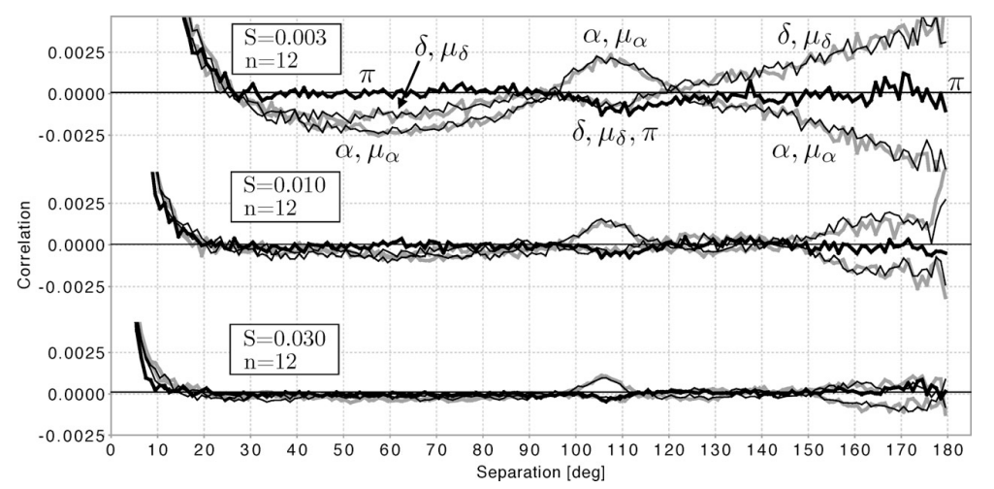
Correlations (III): Gaia simulations
Holl et at, 2010

Slide 14
Luminosities
Most of the catalogues are connected to luminosities through magnitudes/fluxes
Photometric values are usually represented by:
Magnitude value and error
Photometric system description
Zero point
Link to transmission curve
Colours?
Flux values are usually represented by:
Flux value and error
Spectral coverage
Include PhotometryPoint as direct element from PhotometryDM
More complex connections by link to SpectralDM 2.0
Spectra
Time Series

Slide 15
Photometry DM

Slide 16
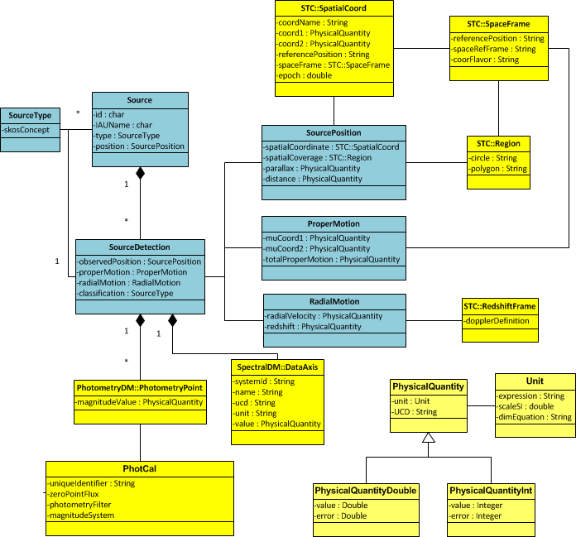

Slide 17
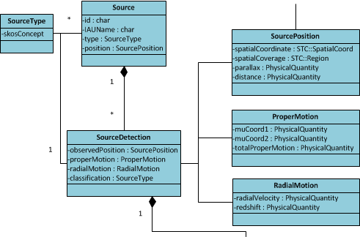

Slide 18
Schedule
Iterate on DM UML during next months
Mapping to IVOA reused components
VO/DML model
Create a written version of the draft for next interop
Exercise to map Gaia catalogue (first and CompleteSource) to the IVOA Source DM
Modify Gaia Archive TAP+ component to include VO/DML preamble with SourceDM metadata
Agree with other catalogue providers on independent implementation
Thanks!

