Slide 1
Data modeling in the Virtual Observatory Framework
Mireille Louys
CDS, Strasbourg Observatory
ICube Laboratory , Strasbourg University, FR

Slide 2
A collaborative effort thanks to
Jesus Salgado, Carlos Rodrigo, Pedro Osuna, Mark Allen, Mireille Louys,
Jonathan McDowell, Deborah Baines, Jesus Maiz Apellaniz, Evanthia Hatziminaoglou, Sebastien Derriere, Gerard Lemson, Laurent Bourges, Miguel Cervino, Claudio Gheller, Norman Gray, Franck LePetit, Benjamin Ooghe, Rick Wagner, Herve Wozniak, Igor Chilingarian, Marie-Lise Dubernet, Evelyne Roueff, Matteo Guainazzi, Enrique Solano, Joe Mazzarella, Raffaele D’Abrusco, Tamas Budavari, Markus Dolensky, Inga Kamp, Kelly McCusker, Doug Tody,
Pavlos Protopapas, Arnold Rots, Randy Thompson, Frank Valdes, Petr Skoda, Bruno Rino, Jim Cant, Omar Laurino, Patrick Dowler, Daniel Durand, Laurent Michel, François Bonnarel, Mark Cresitello-Dittmar, Mark Markus Demleitner, Tom Donaldson, Patrick Dowler, Matthew Graham,Jose Enrique Ruiz,
Kristin Riebe, Michèle Sanguillon, Mathieu Servillat, Catherine Boisson

Slide 3
IVOA Working Groups / Interactions
Theory IG
Applications
VOEvent IG
Visualise, compare, compute
DataAccess
Layer (Protocols)
Registry
Exchange, circulate
Localise resources and services
Data Model
Query Language for astronomical databases
VOQL
Grid/Webservices
WS FrameWork
Grid Computing facilities
Semantics
VOTable
Unified Content Descriptor,
Vocabulary, Units
Transport: XML

Slide 4
Metadata modeling goals in the VO context
Describe metadata for all datasets exchanged in the astronomical community in an homogeneous way.
Sustains the interoperability objective of the Virtual Observatory
Based on the requirements:
For users :
To be able to ask the same question/query to various astronomical data bases, select the results and then retrieve data.
Search seamlessly for observational data at all wavelengths and for all instruments.
For data providers :
Expose and distribute more data with a standardized metadata description.
In core in the DB structure or as an interoperability layer on existing architecture (DB view).

Slide 5
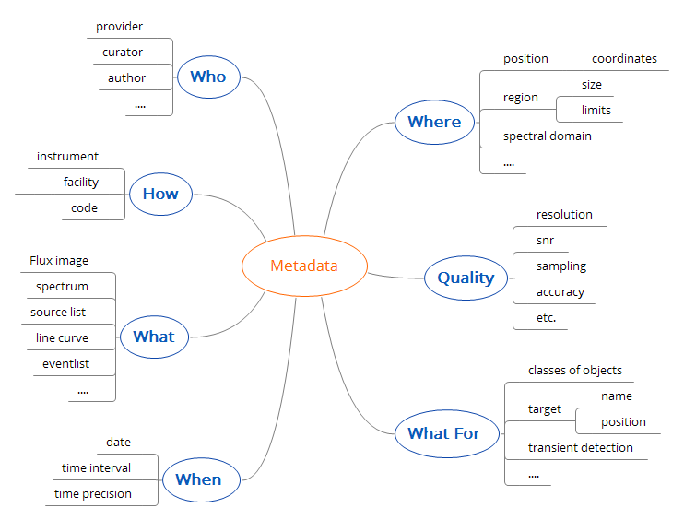
What is metadata in our context ?
Organize
Describe at the appropriate level of details
Each use-case sets its own quality requirements and criteria
Describe all properties on each physical axis of the data: spatial, temporal, spectral, polarization, etc.

Slide 6
Modeling Strategy
Following the principle of Object Oriented Design :
Describe the responsibilities and properties of the metadata involved for data produced by an observation or a simulation process.
A dialog between data providers and users who came up with :
Root concepts qualifying astronomical data
A vocabulary (list of terms) based on existing practises (FITS, bibliographic services, archives contents, interviews from astronomers and data providers ..)
logical structure showing the dependencies and relations between all pieces of metadata
→ A general schema for metadata representation built from commonalities and specificities used at various data providers archives

Slide 7
General building blocks models
Metadata features | Data model name&version | Year | Status
Astronomical Space Time Coordinates | STC v 1.33 | 2007 | REC
 | STC v 2.0 | 2016 | WD
Physical axis description and properties | Characterization v1.13 | 2008 | REC
REC : IVOA Recommendation PR: Proposed Recommendation WD: Working Draft

Slide 8
Observational Metadata
Metadata features | Data model name &version | Year | Status | Protocol | Applications
Spectral Line Transitions | Simple Spectral Line | 2010 | REC | SLAP | VOSpec, SPLAT-VO
1D Spectrum, Light Curves | Spectrum v1.0 | 2007 | REC | SSA 1.0
1D Spectrum, Light Curves | Spectrum v1.1 | 2011 | REC | SSA 1.1 | SPLAT-VO, IRIS
SED, Photometric Points, Time series, Multi-segment 1D spectrum | Spectral v2.0 | 2014 | PR | SSA 1.1 | SPLAT
Observational dataset Core Components | ObsCore v1.0 | 2011 | REC | TAP 1.0, SIAv2 | TAPHandle, TOPCAT
(All data products for global discovery) | ObsCore v1.1 | 2016 | PR | TAP 1.0 | TAPHandle, TOPCAT
Photometric calibration | Photometry v1.0 | 2013 | REC |  | SPLAT-VO, CDS Sed browser, SVO Filter Profile Service
All observation datasets (Fine grain description ) | DataSet Metadata v1.0 | 2015 | WD
N-D cubes; pixelated images, sparse data | NDCube v1.0 | 2015 | WD |  | SPLAT-VO/time

Slide 9
Other Metadata
Metadata features | Data model name &version | Year | Status | Protocol | Applications
VOEvent: transients observations | VOEvent v2.0 |  | REC | VTP 1.0 | Service embedded desc .
Simple time series | Simple time series v1.0 | 2014 | Note
Simulation Data
Simulations, data and code description | Simulation v1.0 | 2012 | REC | SimDAL | DEUVO, Meudon PDR code, MilleniumDB, etc.
Micro simulations, Implementations of SimDM | Implementations of the Simulation DM v1.0 | 2012 | Note
Provenance metadata
Datasets generation process, Progenitors | Provenance DM v1.0 | 2016 | WD | TBD

Slide 10
2007
2008
2010
2011
2012
2013
2014
2015
2016
Spectrum 1.0
Spectrum 1.1
Spectral 2.0
NdimCube 1.0
ObsCore 1.0
ObsCore 1.1
Characterisation 1.13
DataSet Metadata 1.0
STC 1.33
Single Spectral Lines 1.0
Photometry 1.0
STC 2.0
Provenance 1.0
VOEvent 1.0
VOEvent 2.0
Simple Time Series 1.0
Simulation 1.0
ivoa.net/Documents
Legend
Re-use Link
In Apps or Protocols
Encyclopedic DM

Slide 11
Structural aspect
The DM fields arrangement contains the dependencies between different pieces of metadata
Can be expressed as
UML class diagram
Mind maps
Tables
Lists
Suitable the most for interpretation by humans (graphs) or by machine (tables, lists, XML documents)

Slide 12
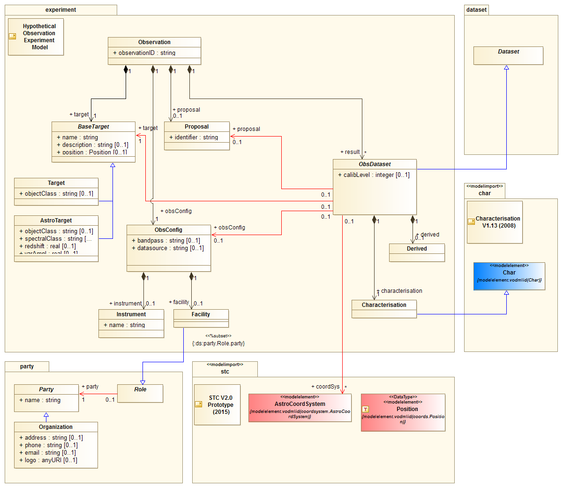
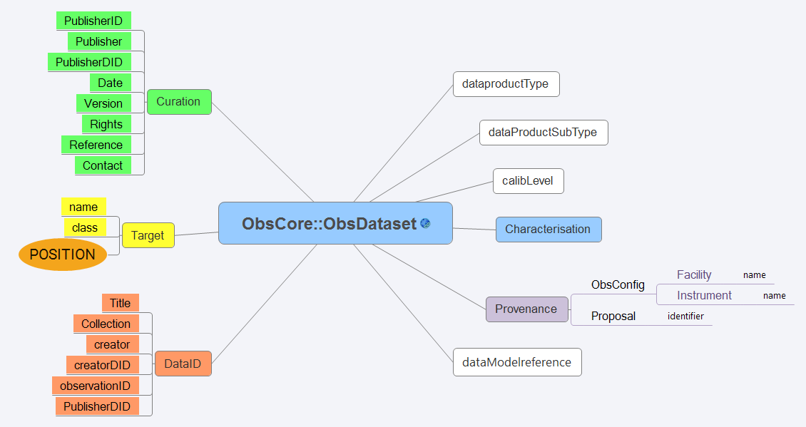
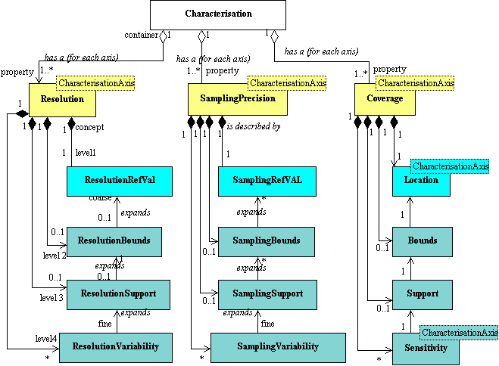
Graphs
UML main class diagram
Mind map
UML partial
class diagram

Slide 13
Data Model Table description (ObsTAP)
SEMANTICS
STRUCTURE
nameattr | unit | ucd | utype | dataType | description
obs_publisher_did |  | meta.ref.url;meta.curation | obscore:Curation.PublisherDID | VARCHAR | publisher dataset identifier
obs_collection |  | meta.id | obscore:DataID.Collection | VARCHAR | short name for the data colection
facility_name |  | meta.id;instr.tel | obscore:Provenance.ObsConfig.Facility.name | VARCHAR | telescope name
instrument_name |  | meta.id;instr | obscore:Provenance.ObsConfig.Instrument.name | VARCHAR | instrument name
obs_id |  | meta.id | obscore:DataID.observationID | VARCHAR | internal dataset identifier
dataproduct_type |  | meta.id | obscore:ObsDataset.dataProductType | VARCHAR | type of product
calib_level |  | meta.code;obs.calib | obscore:ObsDataset.calibLevel | INTEGER | calibration level (0,1,2,3)
obs_release_date |  | time.release | obscore:Curation.releaseDate | TIMESTAMP | timestamp of date the data becomes publicly available
target_name |  | meta.id;src | obscore:Target.Name | VARCHAR | name of intended target
s_ra | deg | pos.eq.ra | obscore:Char.SpatialAxis.Coverage.Location.Coord.Position2D.Value2.C1 | DOUBLE | RA of central coordinates
s_dec | deg | pos.eq.dec | obscore:Char.SpatialAxis.Coverage.Location.Coord.Position2D.Value2.C2 | DOUBLE | DEC of central coordinates
s_fov | deg | phys.angSize;instr.fov | obscore:Char.SpatialAxis.Coverage.Bounds.Extent.diameter | DOUBLE | size of the region covered (~diameter of minimum bounding circle)
s_region | deg | phys.outline;obs.field | obscore:Char.SpatialAxis.Coverage.Support.Area | REGION | region bounded by observation
s_resolution | arcsec | pos.angResolution | obscore:Char.SpatialAxis.Resolution.refval.value | DOUBLE | typical spatial resolution
s_xel1 |  | meta.number | obscore:Char.SpatialAxis.numBins1 | BIGINT | dimensions (number of pixels) along one spatial axis
s_xel2 |  | meta.number | obscore:Char.SpatialAxis.numBins2 | BIGINT | dimensions (number of pixels) along the other spatial axis
t_min | d | time.start;obs.exposure | obscore:Char.TimeAxis.Coverage.Bounds.Limits.StartTime | DOUBLE | start time of observation (MJD)
t_max | d | time.end;obs.exposure | obscore:Char.TimeAxis.Coverage.Bounds.Limits.StopTime | DOUBLE | end time of observation (MJD)

Slide 14
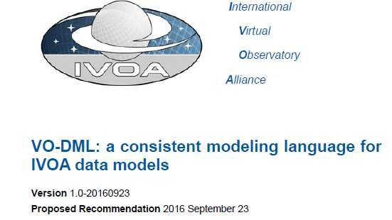
VO-DML data model description
Derived from UML modeling
Expressed following the VO-DML meta-model
Describes all datamodel classes, attributes and relations in a dedicated XML document
On going specification in proposed recommendation phase

Slide 15
Interaction aspect /server side
Data Model
IVOA standard document
DM element<-> DB column
Schema
XML schema
VO-DML desc.
DB schema/views
Mapping rules
Validation
DM items <-> table column
Client
Application
VO Query
Data provider
Server
VO Response
VOTable document
XML, JSON

Slide 16
Interaction aspect /client side
Data Model
IVOA standard document
Documentation
Annotation
Schema
XML schema
VO-DML desc.
Meaning
types,
units,
rules ,
Etc.
Object
Design
Mapping rules
Client
Application
VO Query
Data provider
Server
VO Response
VOTable document
XML, JSON

Slide 17
Data models in action
Models
Dataset Metadata (abstract DM)
Data Dataset DataID Target Curation Characterisation
uses concepts from
Data
Model
Spectral DM
ObsCore DM
extends
ND-Cube DM
defines
Dataproduct Class
SED
Spectrum
TimeSeries
ObsDataset
ND-Cube
projection
Serialised
Instance
SED
Spectrum
TimeSeries
ObsDataset
NDCube
transported
by
Protocol
SSA
TAP
ObsTAP
SIA v2
Protocols

Slide 18
Lessons learnt (development strategy)
Incremental development
Gathering use-case has proven to be effective
Discussions with data providers can be cumbersome but are essential
Testing in real context with applications, protocols and data model update sets up a positive development feedback
It was challenging to adjust the granularity level :
Details specific to particular data archives are not covered, but the common interoperable description layer works

Slide 19
Lessons learnt (technical aspects )
Easy to prototype, but long and painful to get everything consistent and persistent in a large reference picture.
Important to find the appropriate scope for data modeling:
Common features → mandatory data model fields
Specific features → optional features
We target interoperability and not exhaustivity
Data model compliance checks improved when we can validate serialisations (owing to the Operations WG)

Slide 20
Conclusion
VO data models offer a rich set of data models describing most of observation and simulation data products
A good learning curve for VO developers thanks to the motivation of the actors
Data models build up the underlying semantic and structural layer that binds together the VO framework
Join us at IVOA meetings or contact us on dm@ivoa.net

Slide 21
Thanks for your attention Thanks to all people involved

Slide 22
A collaborative effort thanks to
Jesus Salgado, Carlos Rodrigo, Pedro Osuna, Mark Allen, Mireille Louys,
Jonathan McDowell, Deborah Baines, Jesus Maiz Apellaniz, Evanthia Hatziminaoglou, Sebastien Derriere, Gerard Lemson, Laurent Bourges, Miguel Cervino, Claudio Gheller, Norman Gray, Franck LePetit, Benjamin Ooghe, Rick Wagner, Herve Wozniak, Igor Chilingarian, Marie-Lise Dubernet, Evelyne Roueff, Matteo Guainazzi, Enrique Solano, Joe Mazzarella, Raffaele D’Abrusco, Tamas Budavari, Markus Dolensky, Inga Kamp, Kelly McCusker, Doug Tody,
Pavlos Protopapas, Arnold Rots, Randy Thompson, Frank Valdes, Petr Skoda, Bruno Rino, Jim Cant, Omar Laurino, Patrick Dowler, Daniel Durand, Laurent Michel, François Bonnarel, Mark Cresitello-Dittmar, Mark Markus Demleitner, Tom Donaldson, Patrick Dowler, Matthew Graham,Jose Enrique Ruiz,
Kristin Riebe, Michèle Sanguillon, Mathieu Servillat, Catherine Boisson

