Slide 2
The Art of Noise – Paranoimia

Slide 3
The Art of Noise: Optimal DN encoding for CCD and CMOS detectors
D
S
M
Rob Seaman – NOAO SDM

Slide 4
Data vs. Datum
Is data singular?
Definitely not
Are data plural?
In origin, but not in current usage

Slide 5
Mass nouns
Rather data is a mass noun, not a count noun
only count nouns can be singular or plural
Think applesauce and orange marmalade
not apples and oranges
Usage is distinguished by English grammar
can’t enumerate mass nouns – can’t say “two data”
different quantifying words – not “a data”
do say “much data” (but not much apple or apples)
can stand alone – Data is good; I like data.
but not – [The] Apple is good; I like [the] apple.

Slide 6
Substances
“An important clue to the mental model of matter behind mass nouns is that in some ways they act like plurals of count nouns.”
– Steven Pinker, The Stuff of Thought
For example, spatial words like “all over”:
Applesauce is all over the floor.
Data is (or are) all over the internet.
Substances (mass nouns) and multitudes (plurals) are jointly subclassed from “aggregates”:
No intrinsic boundaries, can assume any shape
Substances coalesce: data plus more data remains data
And divide: half of any amount of data is still data

Slide 7
What is the stuff of data?
Pinker’s thesis is that grammar reveals underlying truths about how our minds work.
In particular, that language rests on a physical model (but that’s another talk).
How we talk about data matters:
“Scientific language is metaphorical”
Data may be metaphorically a substance: “data mining”, “data fusion”, “data reduction”, and of course “data compression”, but…
…the kind of substance matters

Slide 8
As with all questions of physics & metaphysics, the answer lies with 80’s sampled Synthpop
With the invention of the machine, Noise was born.
Today, Noise triumphs and reigns supreme over the sensibility of men. – Luigi Russolo, “The Art of Noises”, 1913

Slide 9
Poisson encoding for astronomical data
Tile Compression collaboration with Bill Pence of GSFC & Rick White of STScI
Figures borrowed from the latest draft (and from Janesick)
However, any half-baked ideas are mine alone
Many papers on compression issues, including ADASS
Formalize basis for astronomy

Slide 10
FITS Tile Compression
A FITS standard – compressed data are FITS binary tables
Headers remain readable
Tiling permits rapid random read/write access
Supports multiple compression algorithms
Both lossless and lossy
As much about throughput as storage
CFITSIO supports on-the-fly (un)compression
First and every copy can be in native compressed format

Slide 11
Supported algorithms
Rice (quick & simple)
blocked difference coding with adaptive noise partitioning
Rice is best trade-off between compression and speed
Hcompress (complex)
1) wavelet transform (2-D Haar)
2) optional quantization to discard noise (lossy)
3) quadtree coding of coefficient bitplanes
GZIP (pattern matching)
coded dictionary of repeated byte sequences
PLIO (special purpose)
run-length encoding specialized for masks

Slide 12
All Noise, all the time
For most astronomical data (eg., Mosaic and NEWFIRM), the compression ratio depends only on background noise
Background σ from 3rd order median absolute difference:
σ = 0.6052 × median (–x_{i–2} + 2x_{i} – x_{i+2}) via fast median algorithm
Effective noise bits from quantization condition:
N_{bits} = log₂ (σ √12) σ in quantized units
N_{bits} = log₂ σ + 1.792 but, non-linear for small N_{bits} (σ² = (2^{2N} – 1) / 12)

Slide 14
Noise is incompressible
Signal in astronomical data comes at negligible cost
Compression ratio definition:
R = size_{ORIGINAL} / size_{COMPRESSED}
Theoretical best:
R = BITPIX / N_{bits} =
Real-world algorithms impose a tax of K bits/pixel:
R = BITPIX / (N_{bits} + K) K ~ 1 for Rice
BITPIX × npixels
N_{bits} × npixels

Slide 15
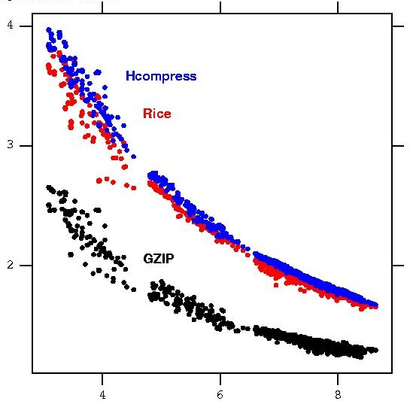
Compression ratio
Compression correlates closely with noise
Distinctive functional behavior
For three very different comp. algorithms
For flat-field and bias exposures as well as for science data
That is, for pictures of: the sky a lamp in the dome no exposure at all
Signal doesn’t matter!
Mosaic II
R
Noise bits

Slide 16
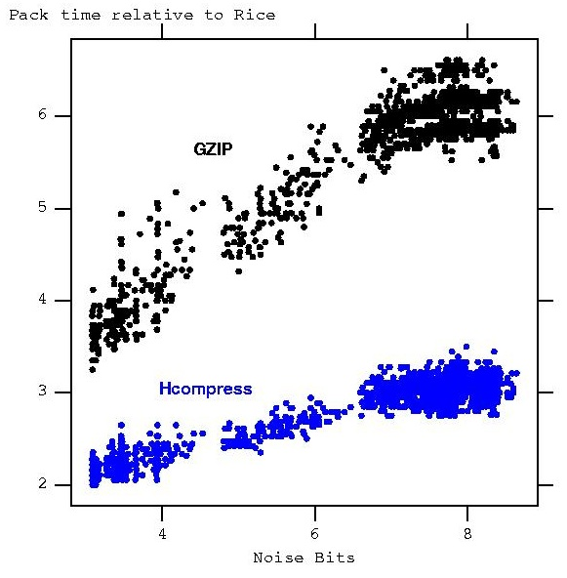
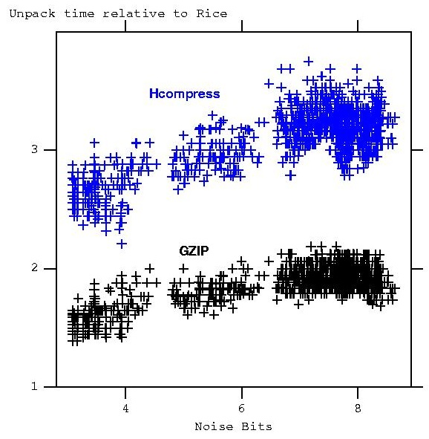
Speed matters
Rice
Rice
(GZIP means tiled “gzip -1”)

Slide 17
Compressing Mosaic data
Tight correlation between R & N_{bits}
Even tighter per chip (see inset)
Line is synthetic Gaussian noise
Symbols are data from community instrumentation
BIASES
SCIENCE exposures
Extreme crowding,
Overlapping PSFs
FLATS

Slide 18
A better compression diagram
R = BITPIX / (N_{bits} + K)
Effective BITPIX:
BIT_{EFF} = BITPIX / R
BIT_{EFF} = N_{bits} + K
Linear with:
Slope = 1
Intercept = K
Lossy algorithms
shift left to move down
.
.
.
Limit for perfect algorithm
GZIP
Rice
Hcompress
Predicted non-linearity
Margin for improvement

Slide 19
16-bit ^{versus} 32-bit
Non-linear GZIP deficit
for numerical data
8-bit boundary
visible for GZIP
3.5
1.2
7.6
1.8
K
R
1.2
1.4
GZIP performance also
suffers for science data
K
R
1.2
2.8
Rice output is same size whether input is 16-bit or 32-bit.
(not to same scale)
GZIP is 20% larger than 16-bit Rice, but 57% larger for 32-bit data.
Solid lines are synthetic data with N_{bits} of uniform random noise.
Symbols are data with N_{bits} equivalent gaussian noise.

Slide 20
Numerical compression
FITS is a numerical standard (unlike non-science image formats)
So FITS Tile Compression convention can support numerical compression algorithms
Also since R = BITPIX / (N_{bits} + K)
Compression ratio automatically scales upward with BITPIX for same data (same pixel values, thus same N_{bits})
Thus no penalty for choosing a 32-bit format
Integer scaling option also provides high compression ratios for 32-bit floating point data (but that is another talk)

Slide 21
Software
CFITSIO (& fpack / funpack):
http://heasarc.nasa.gov/lheasoft/fitsio/fitsio.html
DES/DECam, LSST, …
Internal to SDM E2E system
IRAF FITS kernel and tasks
DS9, etc
Your favorite software package or library

Slide 22
Part 2 of talk
Turbo-charged Rice compression
or
Noise canceling headphones for
astronomical archives

Slide 23
How much is enough noise?
Lossy algorithms
shift left to move down
Quantize floating point
to pack into integers
In general, seek the
natural noise level
Limit for perfect algorithm
GZIP
Rice
Hcompress
Predicted non-linearity
Margin for improvement

Slide 24
CCDs are linear
What does this mean?
It does not mean that DNs must be represented on a linear scale

Slide 25
Heteroscedasticity
A vector of random variables (ie., an image) is heteroscedastic if the variance depends on the signal
CCD and CMOS are photon counting devices
thus shot noise
so these are poisson processes, not gaussian,
with noise ~ sqrt (signal)
Many familiar statistical techniques formally require homoscedasticity, for example, least squares fitting
Penalty for ignoring this may be negligible or significant

Slide 26
Variance stabilization
Techniques exist to “stabilize” variance
Anscombe transform
(really Johnson’s result extended from Bartlett)
Convert poisson to (near) gaussian with unit variance:
S’_{xy} = 2 × sqrt (S_{xy} + 3/8)
(for S > ~30 e–)
also Box-Cox, many references

Slide 27
Generalized Anscombe Transform
Real CCDs are Poisson + Gaussian
Bijaoui with Starck & Murtagh:
I’_{xy} = (2/α) × sqrt (α×I_{xy} + (3/8) α² + σ² – α×mean)
α = 1 / gain (gain in e– / ADU)

Slide 28
In usual CCD terms:
I’_{xy} = 2 × sqrt (gain × (I_{xy} – bias) + read² + 3/8)
I_{xy} in DN (ADU)
bias in ADU
gain in e– / ADU
read noise in e–

Slide 29
Was reminded of…
The CCD photon transfer technique
For example the IRAF task, findgain, to measure the gain of a CCD from flat-field and bias exposures
Gain is the slope of the mean-variance relation
So went looking for…

Slide 30
Janesick’s Big Book

Slide 31
Basic References
Scientific Charge Coupled Devices, Janesick, SPIE Press, 2001
Photon Transfer, DN -> lambda, Janesick, SPIE Press, 2007

Slide 32
Noise sampling
Brighter pixels greatly oversample the noise:
ADC quantizing noise = sqrt (1 / 12)
To avoid aliasing, keep gain < readnoise
So readnoise ~ 1 DN rms (1 bit)
High end governed by shot noise (& full well):
Noise @ DN = 64K (16 bits) is 256 (8 bits)

Slide 33
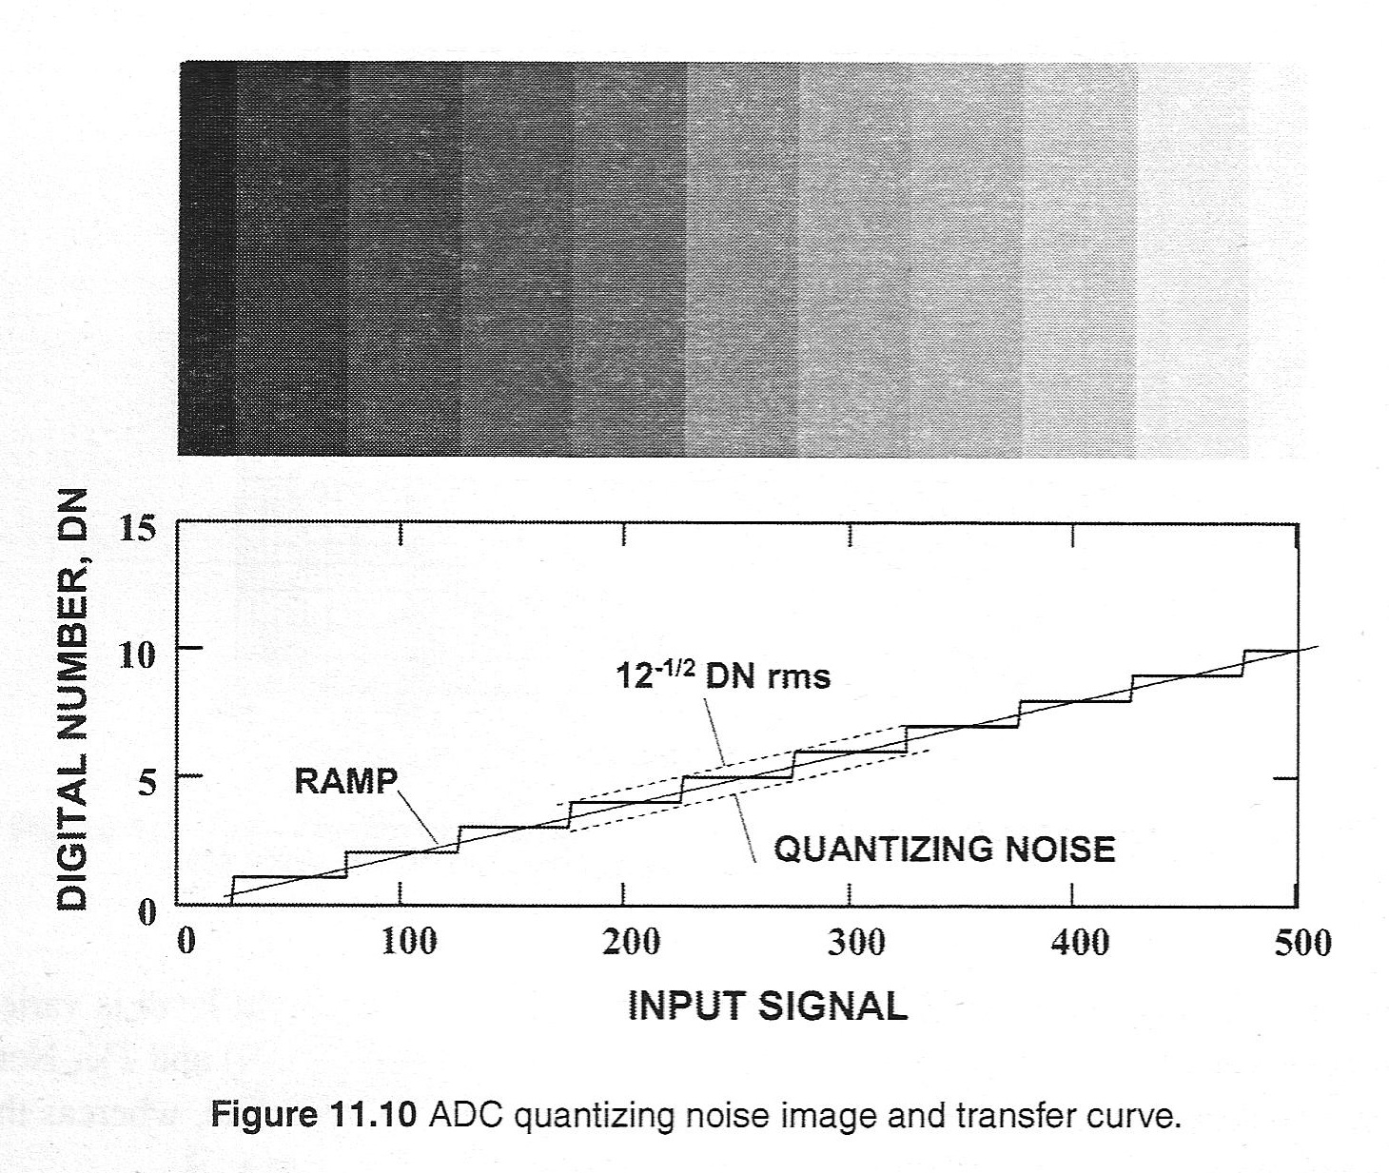
ADC quantization noise

Slide 34
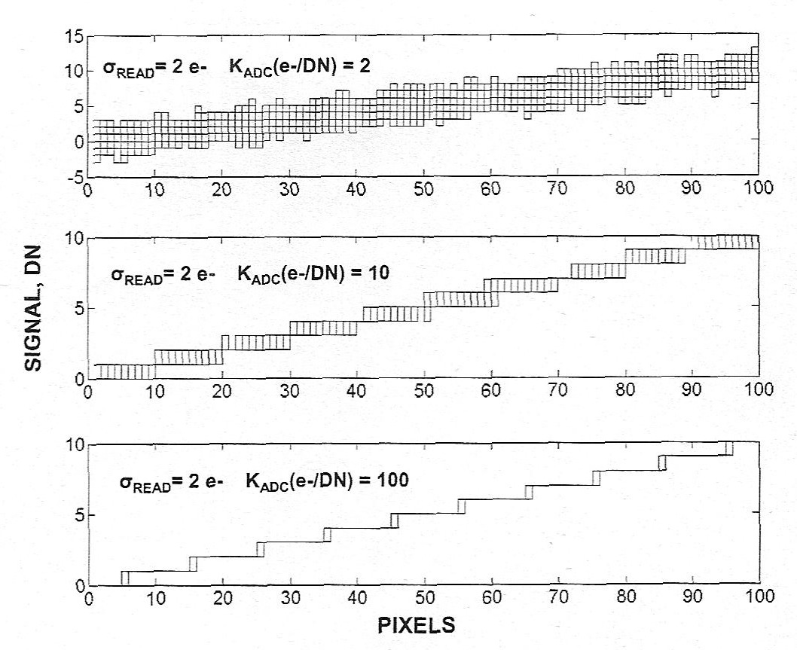
Read noise masks quantization

Slide 35
Compact encoding
Seven bits of the brightest pixels represent uselessly oversampled noise
Low end is properly (?) sampled
Intermediate pixels ~ square root
Thus can encode CCD / CMOS images into far fewer DNs

Slide 36
“Square rooter”
In either hardware or software:
DN_{out} = sqrt (DN_{in}) × 2^{(N}out ^{– bitpix/2)}
same as Anscombe if N_{out} = 1 + bitpix/2
ie., N_{out} = 9 for bitpix = 16

Slide 37
Implementation
Map input to output DNs via Look Up Table
Modify FITS tile compression convention (or FITS itself) to convey and apply LUTs on input/output
For some purposes, use raw square root values:
Display (8-bit LUTs could suffice)
Multiresolution / wavelets
Principle Components Analysis

Slide 38
Optimal encoding
Only technically lossy
Ideally would apply this before the ADC
But after ADC, penalty is a modest sqrt(1/12)

Slide 39
Back to compression
Advantage is not as dramatic in bits
Reducing 64K range (16 bits)
to 0.5K range (9 bits) is R = 1.78

Slide 40
More references
Simple square-rooter combined with Rice:
Data Compression for NGST
– Nieto-Santisteban, et al., ADASS VIII, 1999
Various other references, eg.:
Poisson Recoding of Solar Images for Enhanced Compression
– Nicula, et al., Solar Phys. 228, 2005

Slide 41
Tame the noise
Use for space missions is generally presented as “lossy”
Not if noise isn’t trimmed beyond detector’s innate level
Variance stabilization tells you what that is
The square root of a gaussian is a gaussian (formalize this)
Narrower for typical astronomical data
So background N_{bits} can be minimized
Rice is blind to an additive offset
Allowing an adjustment for the bias
Tempering the noise allows Rice to maximize compression
More work needed to characterize possible benefits

Slide 42
Issue #1
Per Pence, et al., only the background noise matters in typical astronomical cases
So need to handle low end properly
Transition to linear?
(also to keep radicand positive)
But that squanders advantage where needed
Want to avoid having to go actually lossy

Slide 43
Issue #2
CCDs (+ CMOS) are Gaussian + Poisson
Raw detectors also have Fixed Pattern Noise (FPN):
Sensitivity = sqrt (read² + η×S + (P_{N}×S)²)
quantum yield, η = 1 e– / γ for CCDs
FPN quality factor, P_{N} (~ 1 %)
FPN dominates bright pixels!

Slide 44
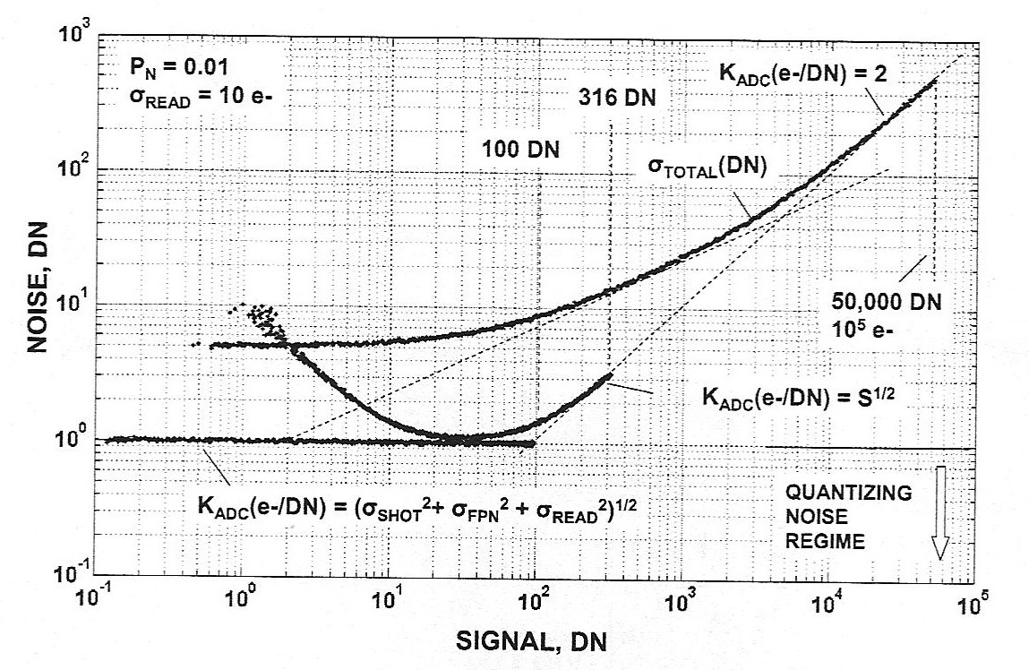
Square-rooter PTC response
Naïve use can increase
noise in the background
Used with care could
change R=2 to R=3
DN ~ 30

Slide 45
Just a 15% improvement in network throughput and storage efficiency is the same as eliminating the overhead of one whole copy of the archive and the perpetual latency of one replication leg

Slide 46
Issue #3
Bringing generalized Anscombe and “generalized Janesick” into alignment
Easy to get lost in DNs versus electrons
What Janesick calls sensitivity, most call gain
Need to fold quantum yield into Anscombe

Slide 47
Conclusions
Issue #3 just requires more work
Issue #2 doesn’t apply to flat-fielded data
and care more about background, not bright pixels
Issue #1 depends on the intended purpose
for compression, any pragmatic compromise will work
stabilizing variance for image processing techniques (eg., PCA) needs care

Slide 48
Know your data!
Observations on Max Headroom
Max resembles CGI, but…
…is really an actor in physical makeup and costume
Even the background line art is hand drawn
(via Amiga in U.S. Series)
Music of “Art of Noise” is heavily sampled
All images are not created equal
Video artifacts were intentionally introduced
Original series in UK (PAL)
U.S. series (NTSC)
YouTube (Flash, MPEG, QuickTime)
Intraframe versus interframe compression

Slide 49
Part 3 of talk
Compression of astronomical floating-point images
ADASS XIX poster:
http://www.adass2009.jp/poster/files/PenceWilliam.pdf

Slide 50
Optimal compression of floating-point images
Next step in Tile Compression collaboration with Bill Pence of GSFC & Rick White of STScI
FP is noisy
Quantize into integer levels
Dither to preserve background
“Subtractive dither” permits removal of this signature

Slide 51
Floating-point is noisy
Mantissa preserves artificially high levels of noise
Noise is incompressible
Thus floating-point data tends to compress poorly
This is not inherent in the data, but rather in its numerical representation

Slide 52
Best practices
Several recent papers advocate same cure:
Quantize onto integer grid
For example, astrometry.net, JDEM, Kepler:
Price-Whelan & Hogg (2010PASP..122..207P)
Bernstein, et al. (2010PASP..122..336B)
Caldwell, et al. (arXiv: 1001.0216v1)

Slide 53
Quantization noise
sigma ~ sqrt (1 / 12)
Widrow & Kollár, “Quantization Noise”:
http://www.mit.bme.hu/books/quantization
“Sheppard’s correction”:
W. F. Sheppard (1897) "On the Calculation of the Average Square, Cube, of a Large Number of Magnitudes", Journal of the Royal Statistical Society, 60, 698–703.
“Stochastic resonance”

Slide 54
FPACK q-scaling
Separation between integer levels is sigma / q
sigma(q) = sigma(0) sqrt (1 + 1 / (12 q^2))
Multiple scaling cycles:
sigma(q) = sigma(0) sqrt (1 + N / (12 q^2))

Slide 55
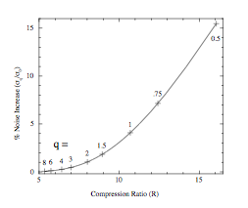
Q determines R
Q = 4 -> R = 6.5
Q = 1 -> R = 10.5

Slide 56
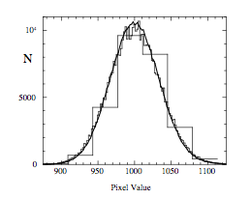
Dithering permits smaller Q
Kepler is using q=1.15
w/o dithering

Slide 57
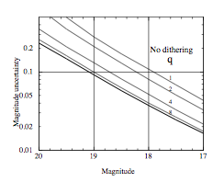
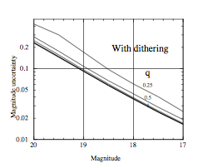
Order of magnitude improvement (at faint end)

Slide 58
Subtractive Dithering
Removes dither signature
Acts likes a catalyst
Built in to FITS Tile-compression, CFITSIO, FPACK
Can think of it as a generalization of the original FITS BSCALE/BZERO

