Slide 1
GPS1(Gaia-PanSTARRS1-SDSS) Proper motion catalog
Haijun Tian (Member of China-VO)
(CTGU & MPIA)
Collaborators: Branimir Sesar, Hans-Walter Rix, etc.
2017-05-17 ShangHai

Slide 2
outline

Slide 3
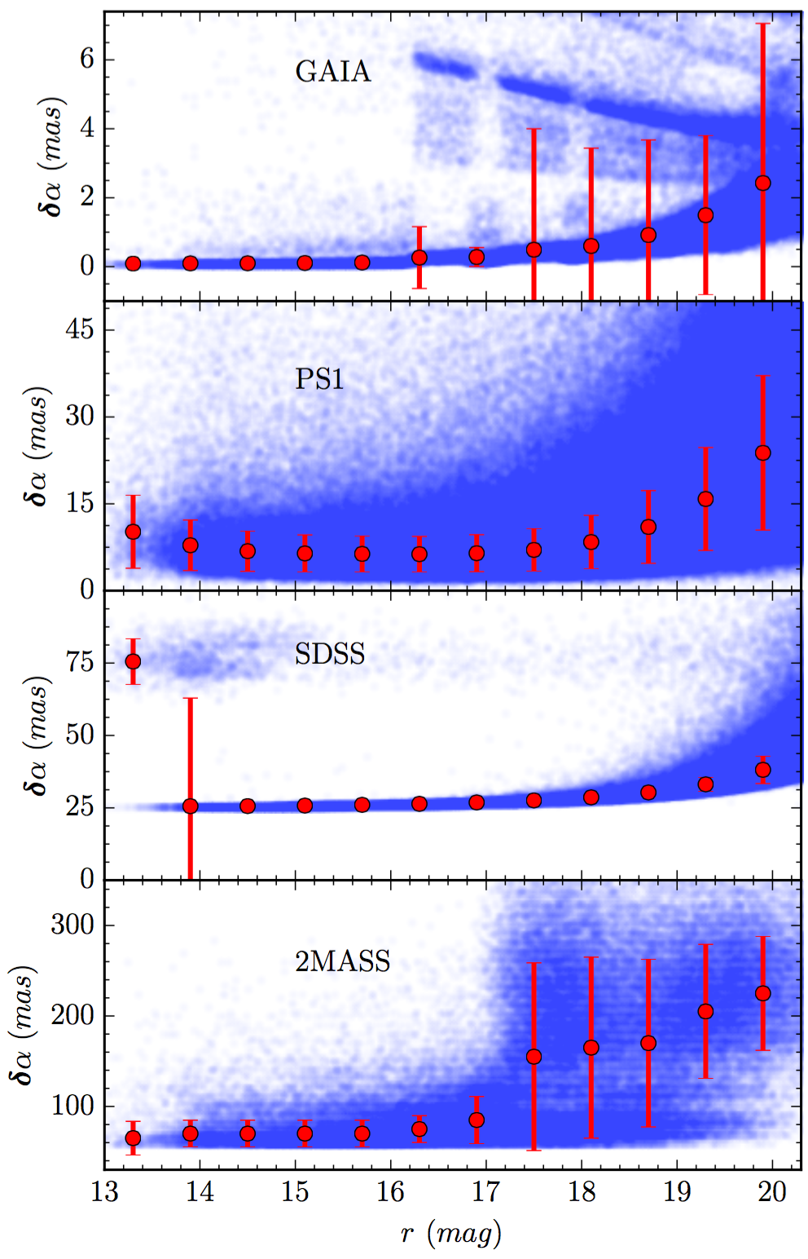
Data
Data for the proper motions
- GAIA (1-year, <2mas)
- PS1 (>4 years, ~10mas)
- SDSS (~10 years ago, ~25 mas)
- 2MASS (~10 years ago, ~100 mas)
How to cross-calibrate stars in the different surveys?

Slide 4
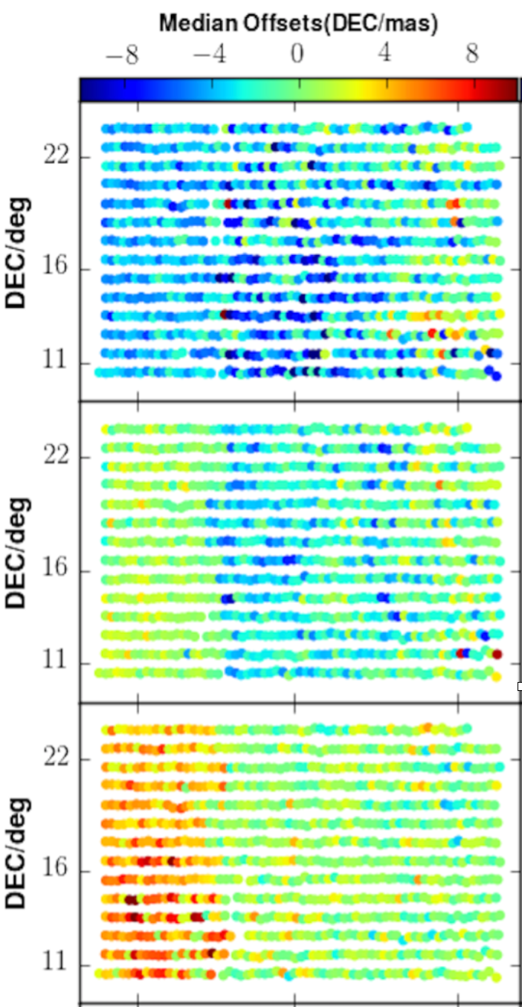
X-calibration
(direction dependent offset pattern)
Mean offsets of galaxy position between different years
The direction-dependent offsets (Galaxies NOT move!)
2010
2011
2012

Slide 5
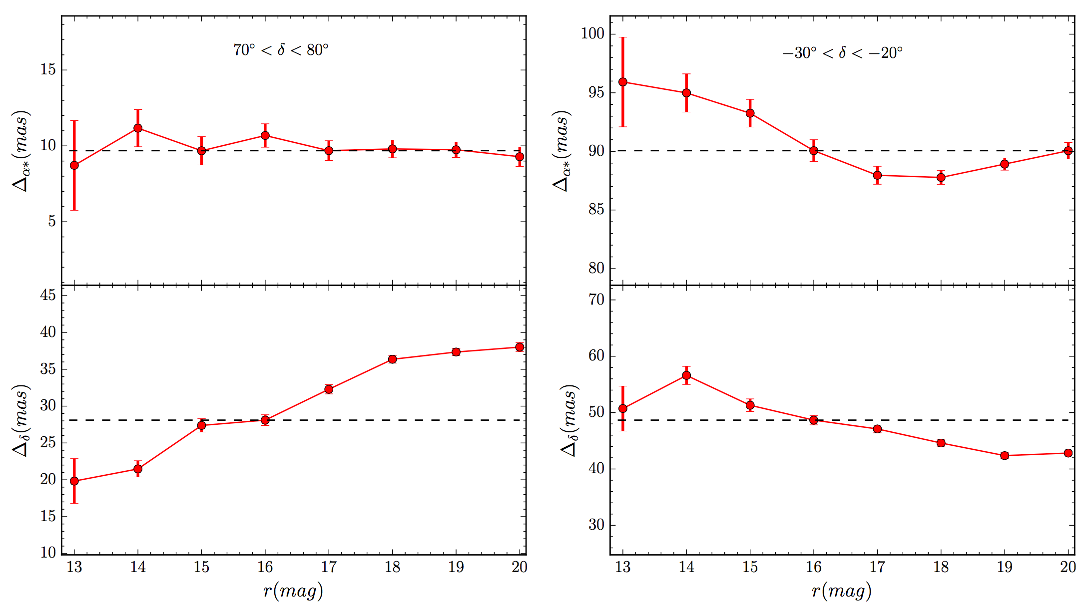
X-calibration
(magnitude and declination dependent offset pattern)
70<delta/deg<80
-30<delta/deg<-20
The magnitude and declination dependent offsets (Gaia)

Slide 6
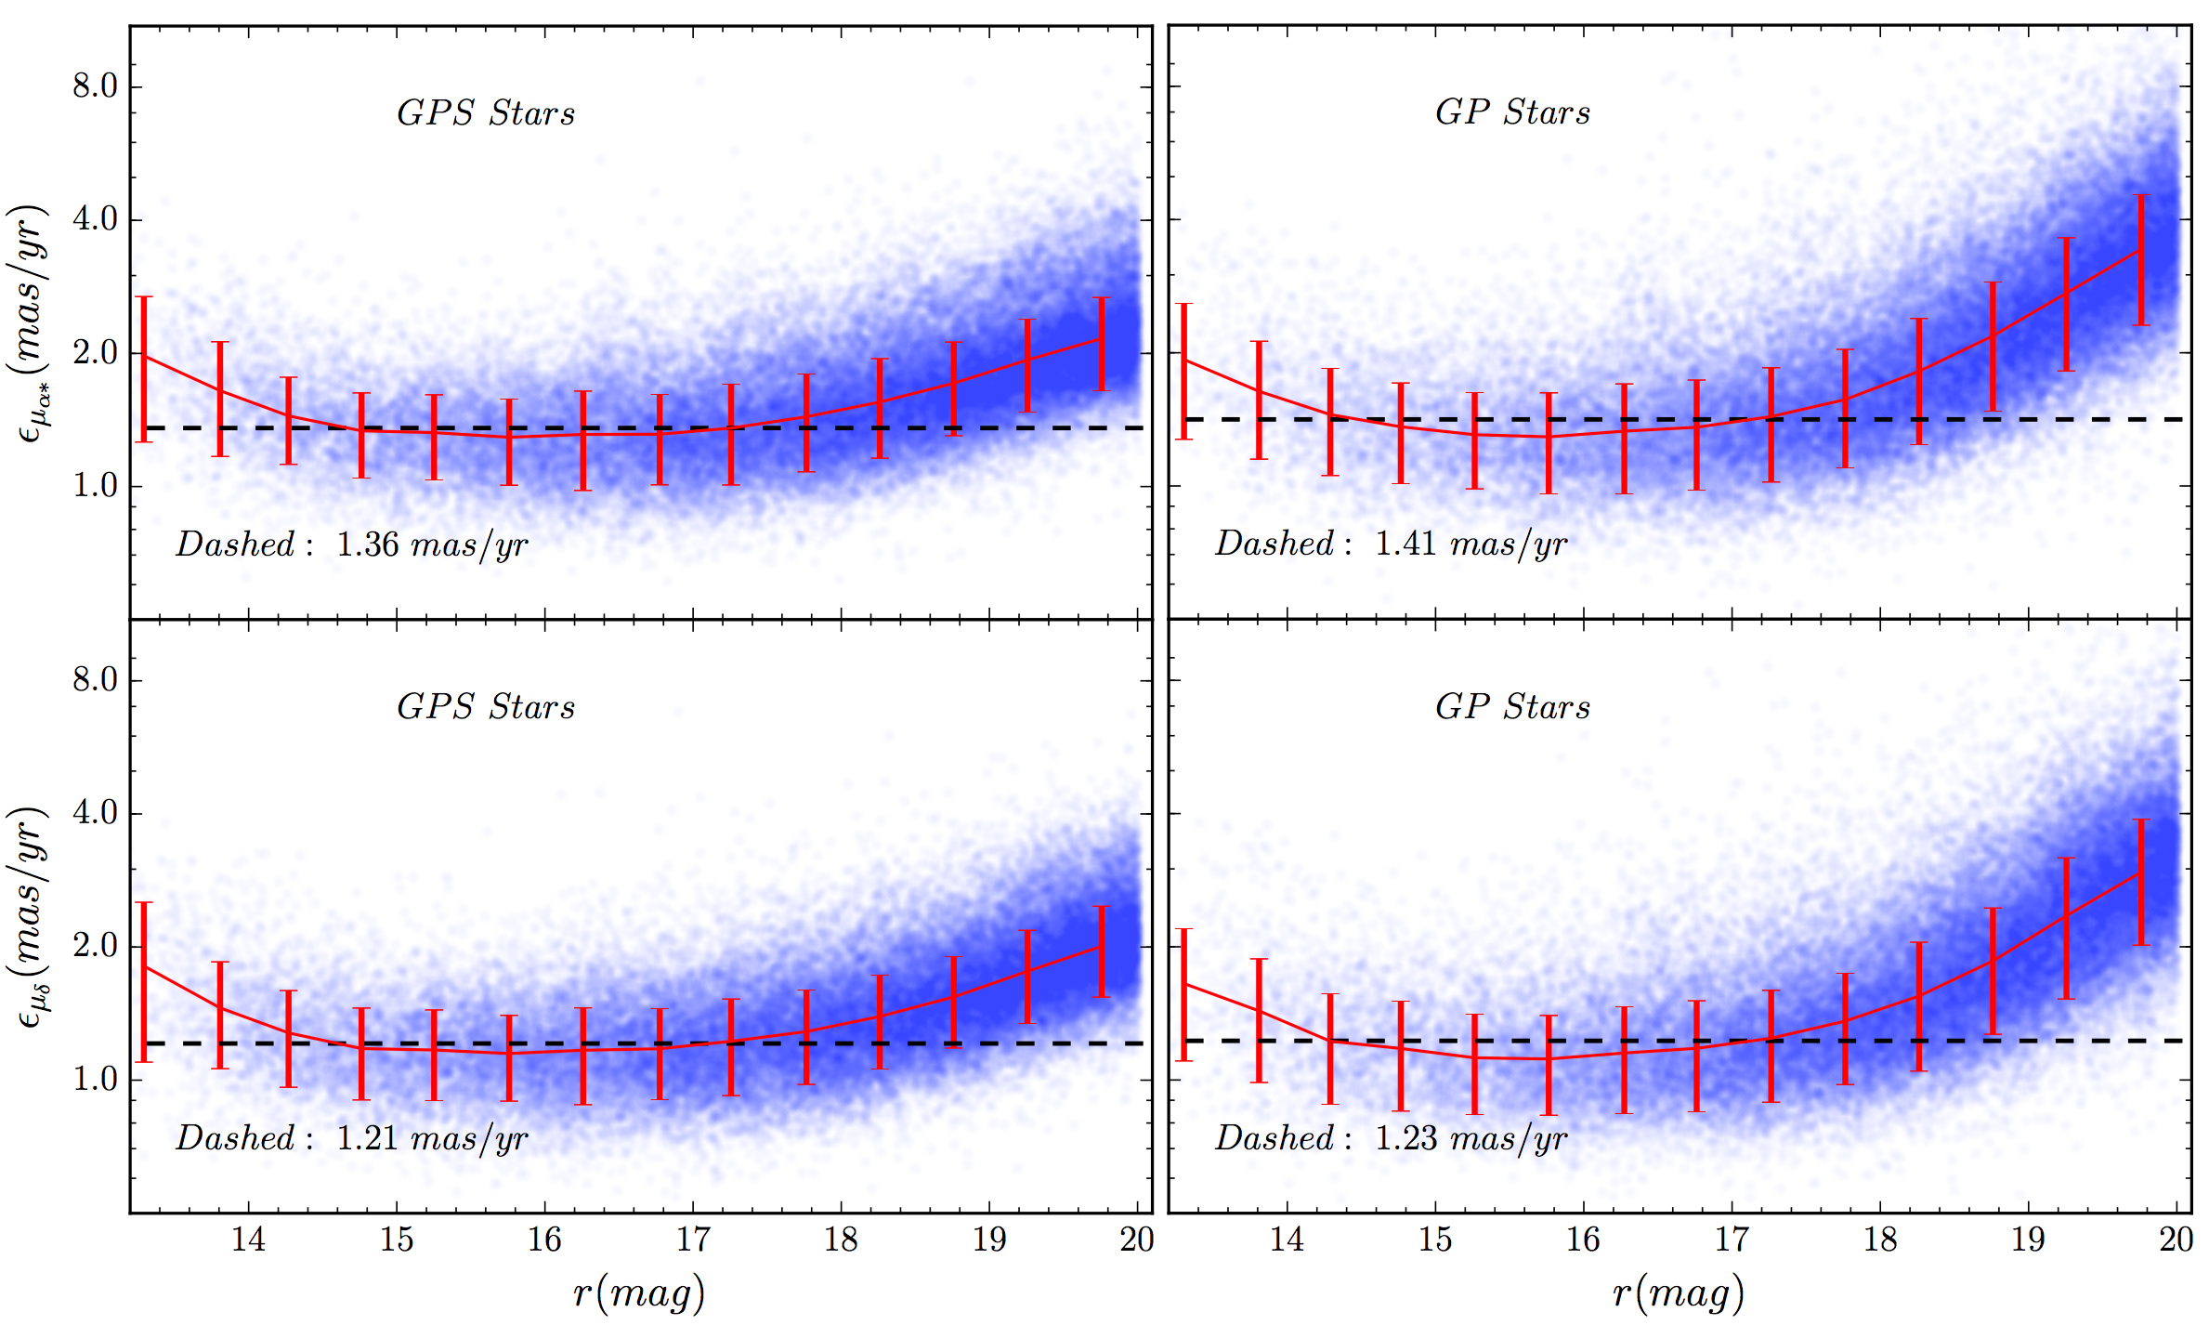
results
(precision, with gaia)
GPS(\apha): 1.35 mas/yr
GP(\apha): 1.41 mas/yr
GPS(\delta): 1.21 mas/yr
GP(\delta): 1.23 mas/yr

Slide 7
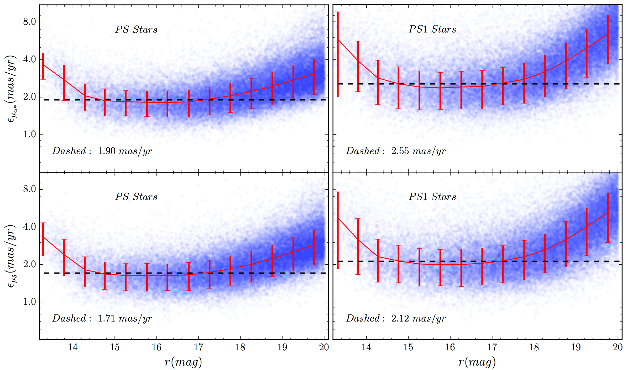
results
(precision, without gaia)
PS(\apha): 1.91 mas/yr
PS1(\apha): 2.55 mas/yr
PS(\delta): 1.71 mas/yr
PS1(\delta): 2.12 mas/yr

Slide 8
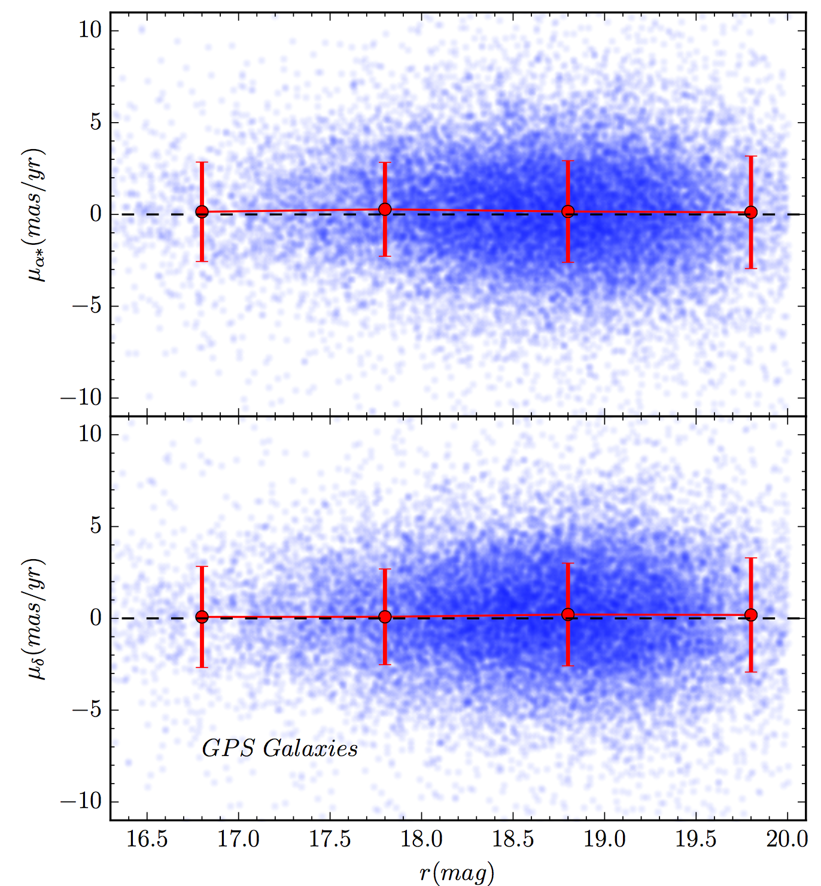
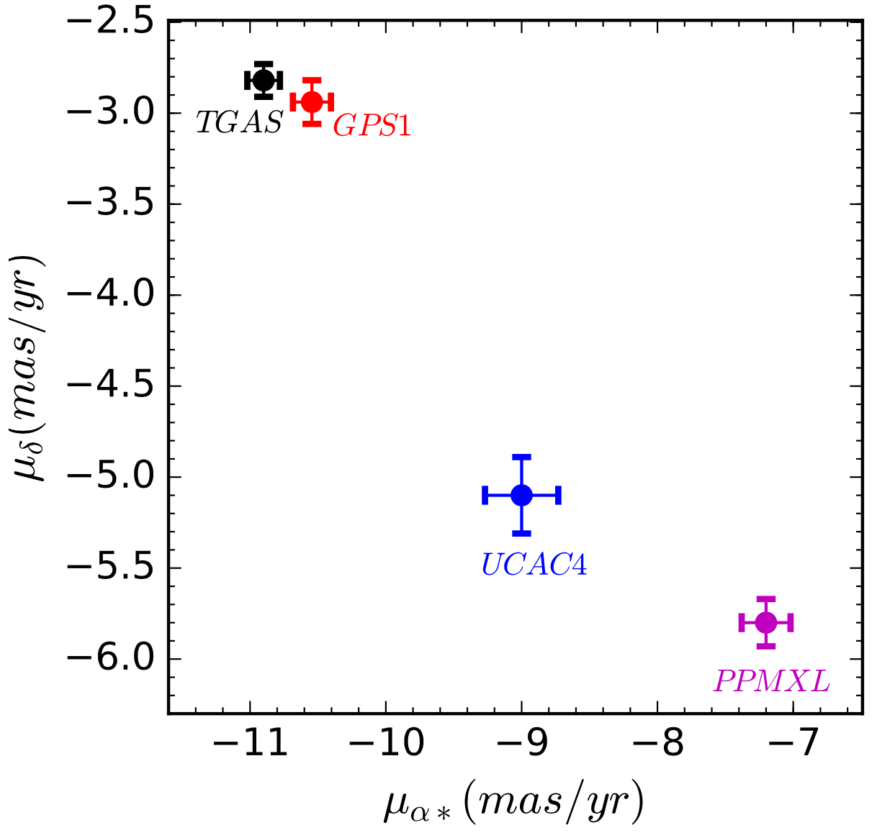
validation
(accuracy, galaxies, Open cluster)
Galaxies
M67
The systematic error <0.3 mas/yr (~10x better than PPMXL, UCAC4)

Slide 9
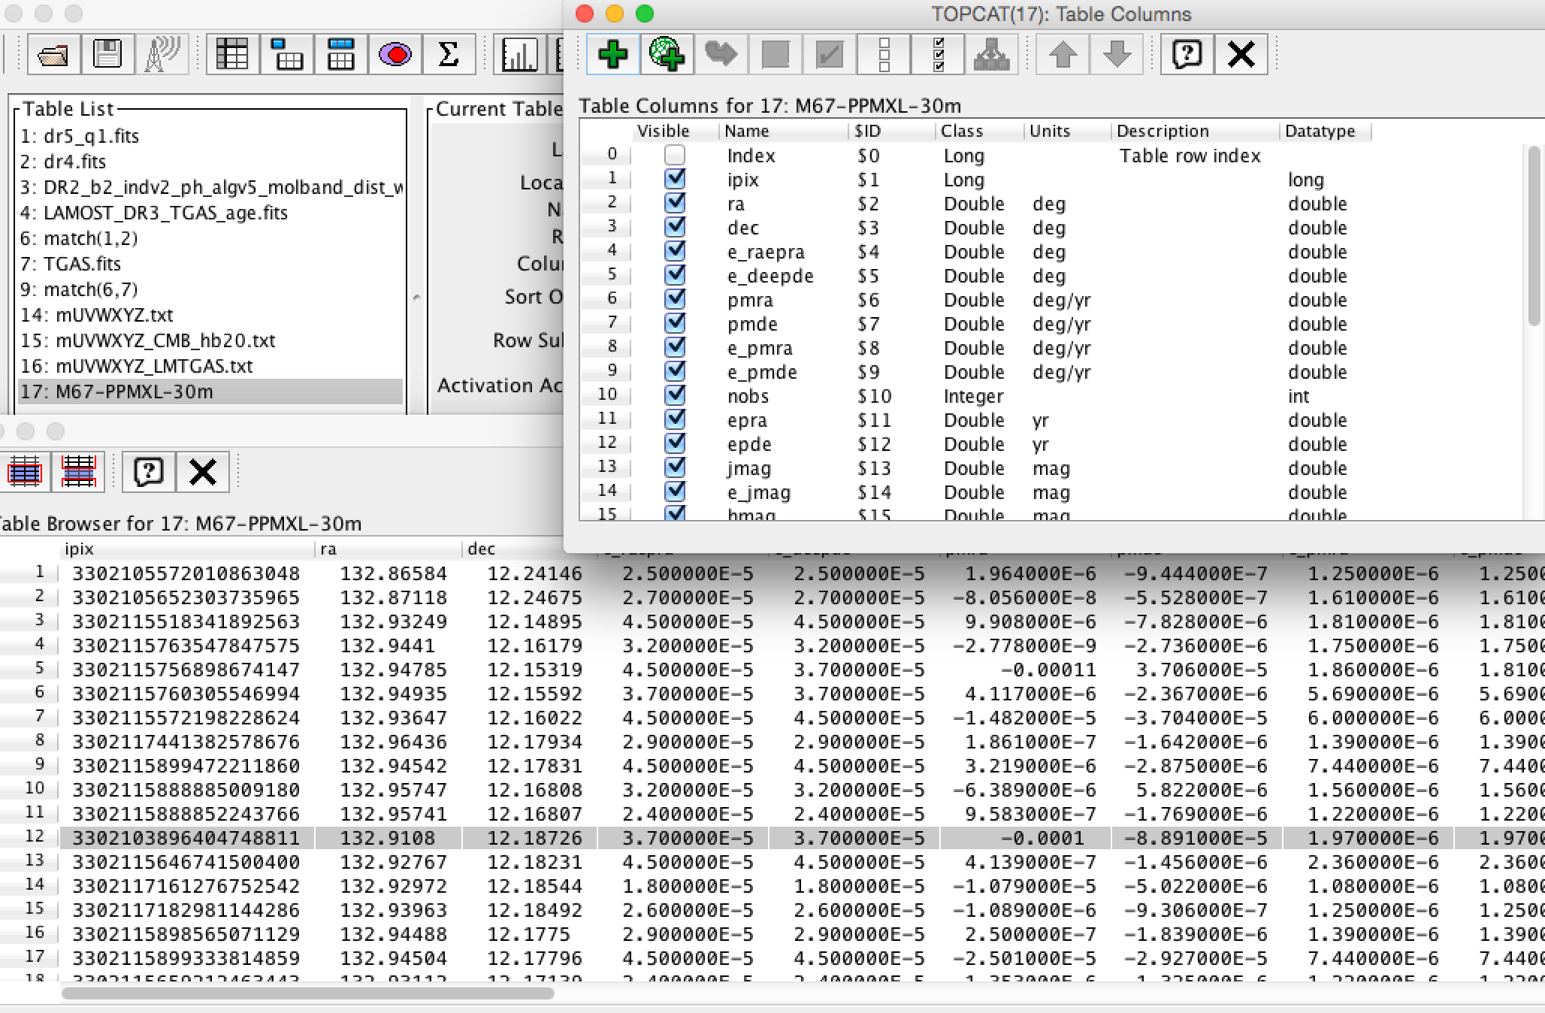
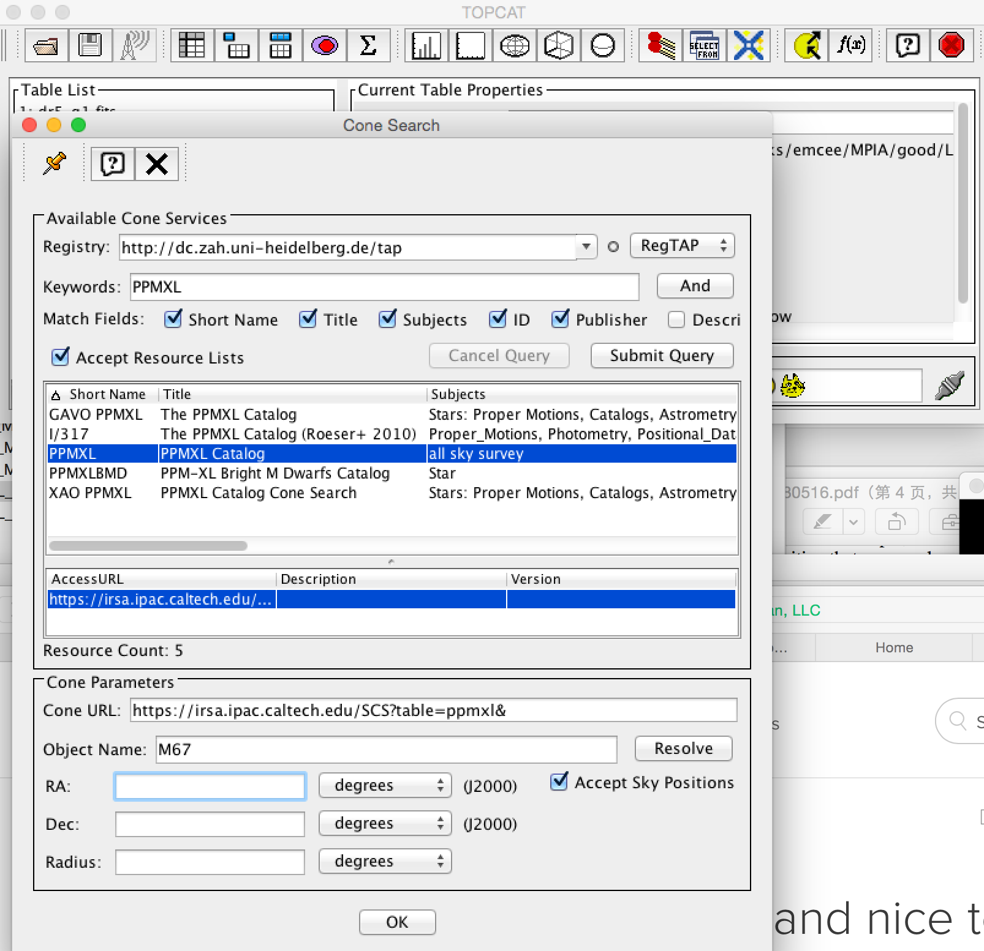
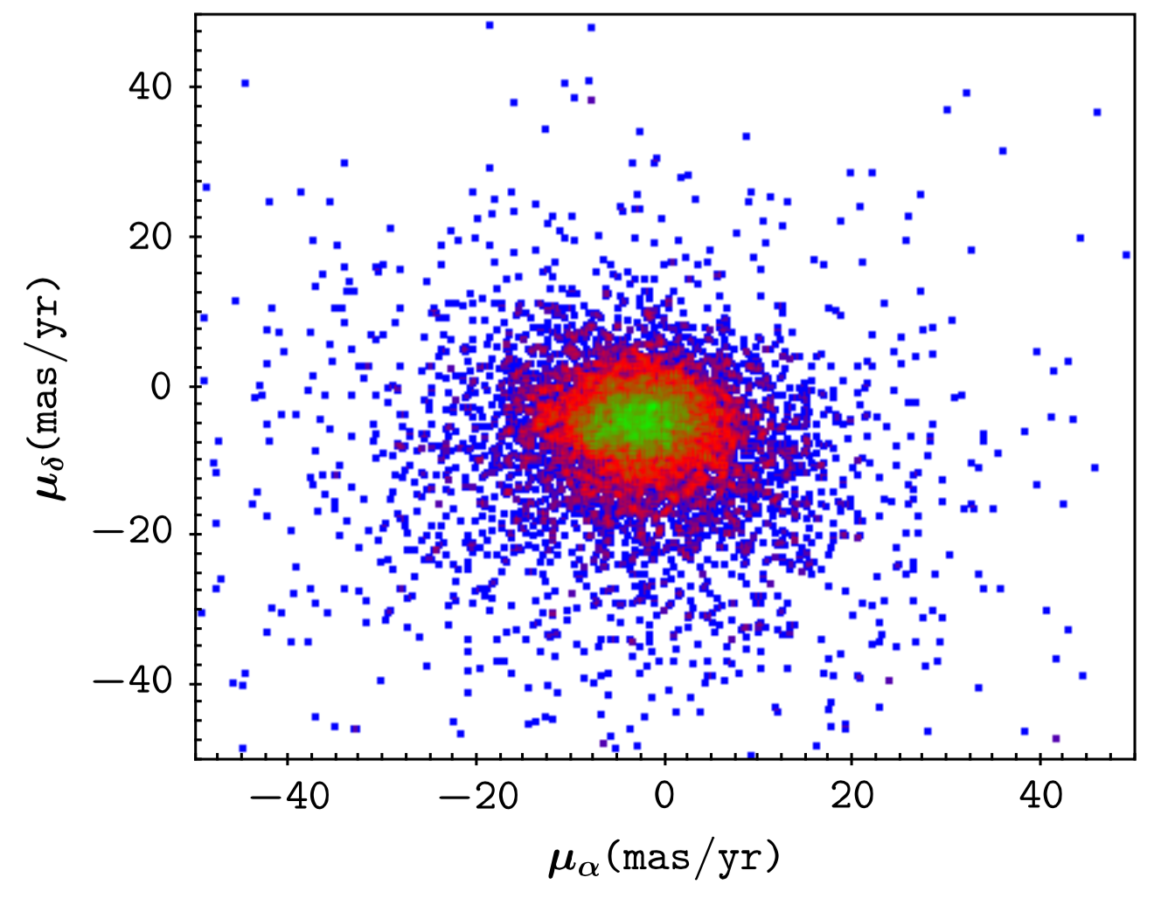
use case with VO
(proper motion of m67)
GPS1

Slide 10
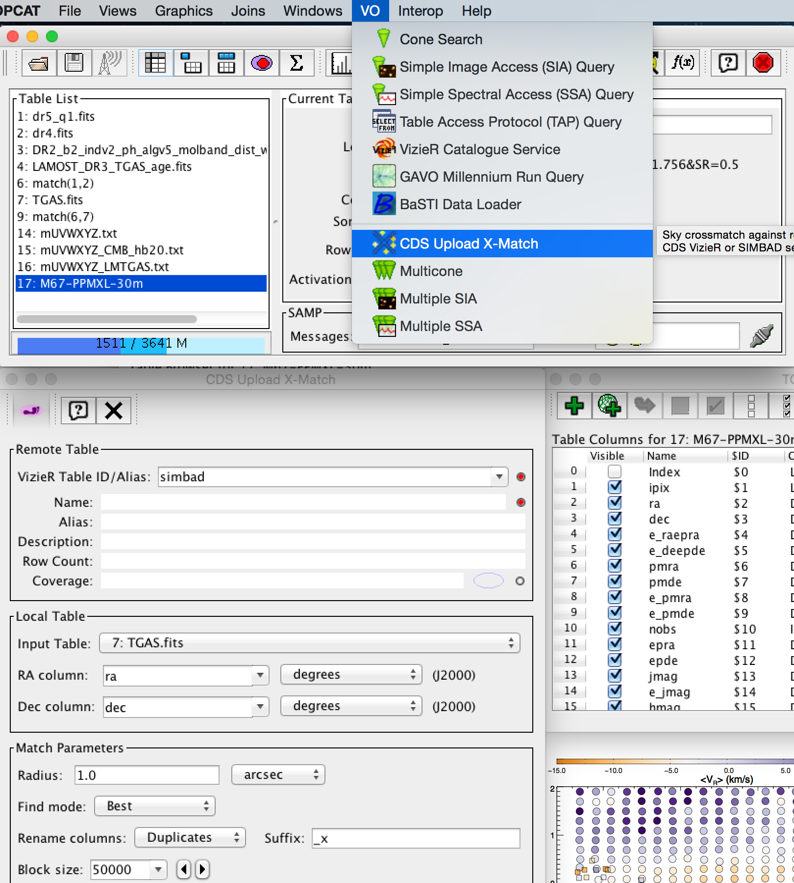
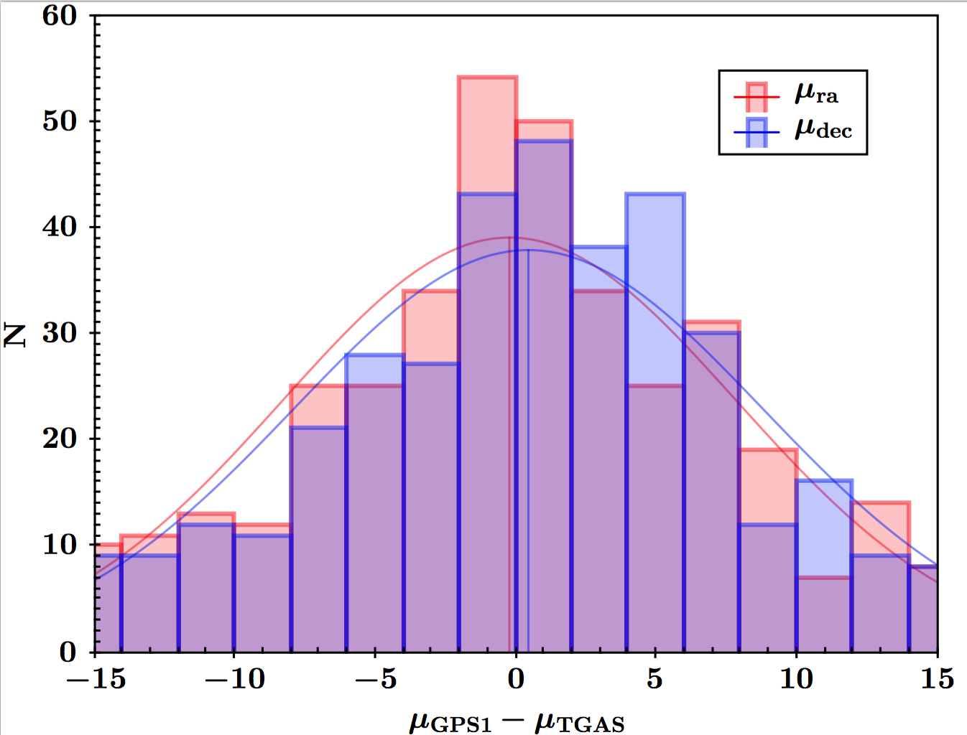
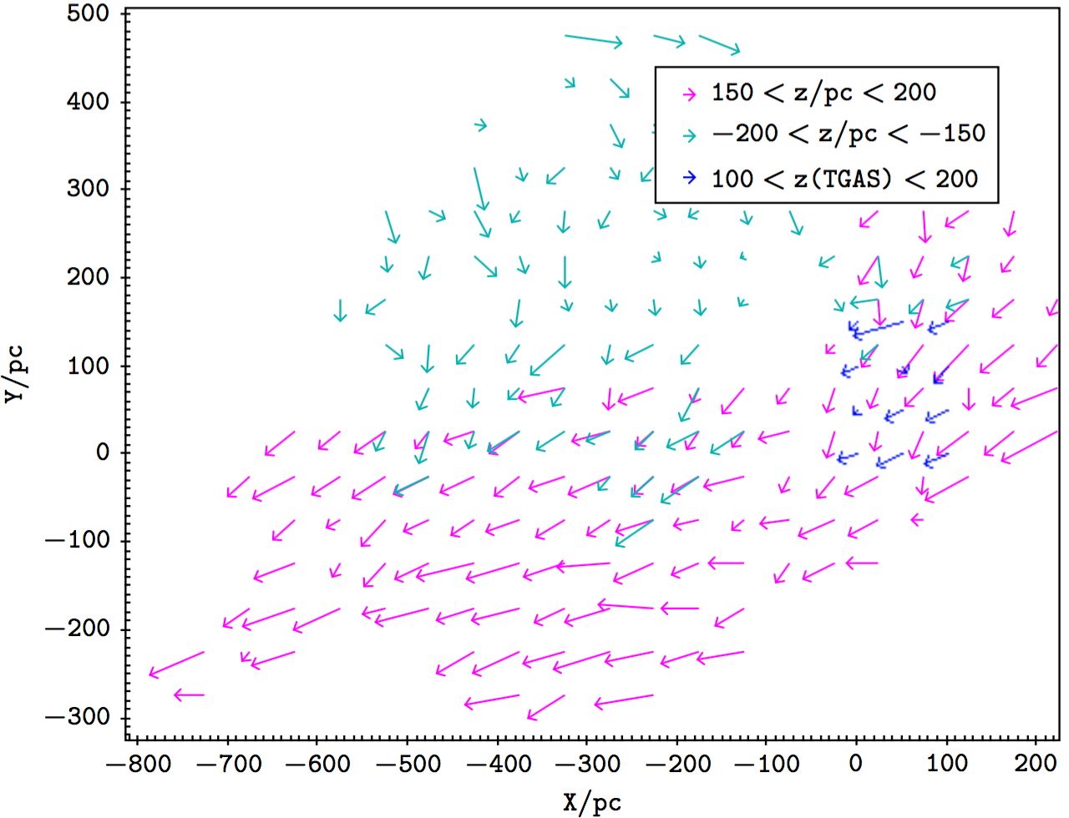
use case with VO
(CDs upload X-match )
GPS1

Slide 11
Conclusion
(taking-home points)
With Gaia+PS1+SDSS, we construct a proper motion catalog (GPS1) for ~350 million stars (~100GB) across 3/4 sky region, down to mr<20.
The characteristic systematic error <0.3 mas/yr (~10x better than PPMXL, UCAC4), the precision ~1.5 mas/yr. (~4x better than PPMXL, UCAC4)
VO will makes GPS1 more powerful and easier to be used for researches. (Markus Demleitner, DongWei Fan)

Slide 12
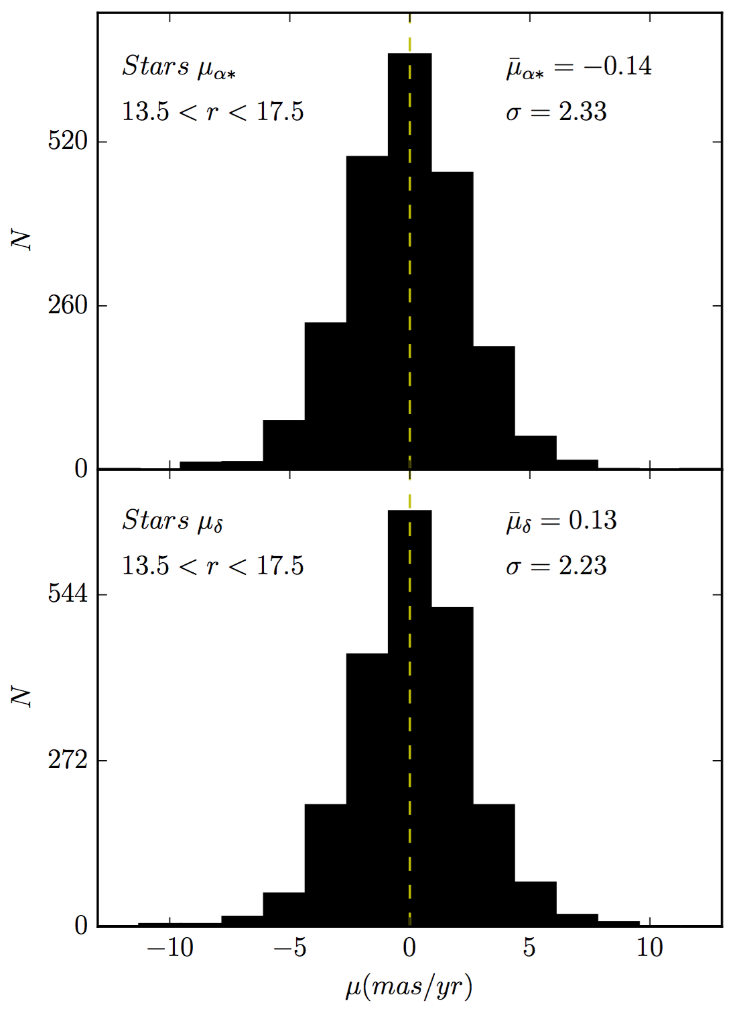
validation
(accuracy, distant stars)
~2200 BHB (Xue +, 2010) and Giant stars (Xue, + 2014)
(d>20kpc, 13.5<r<17.5)

Slide 13
performance on qsos
GPS1, QSOs
Significant differential chromatic refraction (DCR) impact on QSOs

