Slide 1
Gaia DR2/3: Serving Time Series, Spectra, SSOs in the VO
J. González-Núñez - ESAC Science Data Center (ESDC)
J. Salgado, A. Mora, J. Bakker, E. Racero, D. Baines, B. Merín, R. Gutiérrez-Sánchez, JC. Segovia, J. Durán, C. Arviset

Slide 2
VO Inside
Homogeneity through common Data Models
Mission DMs in line with VO DMs
Interoperability through Open Protocols
VO protocols as core of archive architectures
Extend instead of replace
Goal: Transparent access to Archives and Data providers worldwide

Slide 3
Data Release Scenario

Slide 4
MDB Data Volumes
Main Database Statistics
 | Volume today | Estimation 5-year ext.
Size (as of today) | 225 TB | ~1.4 PB
Number of objects (sources, transits…) | 1300 billion | ~6000 billion

Slide 5
Archive content @ DR1
Total DR1: 1.6 TB
Crossmatches
Crossmatch tables between Hipparcos, 2MASS, Tycho2… and Gaia expressed as neighbourhood and best neighbour, e.g:
Gaia
Gaia DR1 catalogue 1.1x10⁹ rows
TGAS 2.0x10⁶ rows
AllWise-Gaia neighbourhood 3.1x10⁸ rows
External Catalogues
Hipparcos & Hipparcos new red. 1.2x10⁶ rows
IGSL (Initial Gaia Source List) 1.2x10⁹ rows
2MASS 4.7x10⁸ rows
Tycho2 2.5x10⁶ rows
UCAC4 1.1x10⁸ rows
Hubble Source Catalogue v1.0 2.9x10⁷ rows
11.59 Billion rows through TAP+

Slide 6
Archive content @ DR2
DR2 contents (April 2018)
Main Catalogue
Astrometric 5 parameter solution for “all” stars
G magnitude for “all” stars
RV for bright sources (Grvs < 12)
Astrophysical parameters for bright sources (G<17)
BP/RP integrated photometry
Variables: All sky RR Lyrae stars, Cepheids, LPVs, Short-Time scale, Classification all types, (and EB for CU4, not DR2)
Xmatches with “main” catalogues
SSOs
Detections for MPC objects
Epoch Photometry
~ 100 million sources

Slide 7
Archive content @ DR3
DR3 contents (TBD ~2020?)
Main Catalogue
Spectra
RVS (Averaged, Epoch)
BP/RP (Averaged, Epoch) (~ 1E9, ~70 obs)
Epoch Photometry (~ 1E9)
SSOs

Slide 8
SSOs

Slide 9
SSOs integration
TAP service adaptation for SSO handling
UDFs definition for SSOs
Based upon IMCCE Eproc integration performed for ESASKy SSO search service
Possible ADQL extension with datatypes and functions to EPN-TAP?
SSO Data Model
EPNCore V2 draft
1st Step
2nd Step
ORBITAL PARAMETERS
Ephemerides computation
EPHEMERIDES TABLE
(per Object and ref ref frame)
Position/time resolution functions
TAP interface

Slide 10
Time Series and Spectra

Slide 11
VO Inside Time Series & Spectra
DAL side
Extension of DataLink through Custom Access Data Service
No protocol extension needed
Archive data distribution has Mission specific features
DataLink recognition
On the fly data serialization to requested formats
SSAP, Obscore TS vs SVO TS-SSAP?

Slide 12
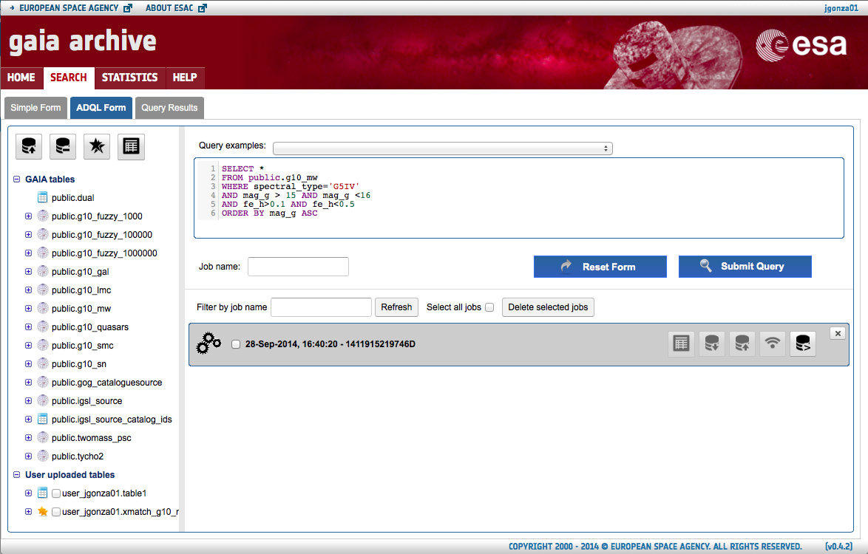
DataLink/SSAP int. with TAP+
TAP+
Catalogues
DataLink
* DR2
SSAP
* DR3
Time Series
Spectra

Slide 13
VO Inside Time Series & Spectra
DAL side
Extension of DataLink through Custom Access Data Service
No protocol extension needed
Archive data distribution has Mission specific features
DataLink recognition
On the fly data serialization to requested formats
SSAP, Obscore TS vs SVO TS-SSAP?
DM side
OK for spectra, pending Time Series
DR2 ~April 2018
Need to base in and extend current WIP (Nadvornik TS draft)

Slide 14
VO Inside Time Series & Spectra
DAL side
Extension of DataLink through Custom Access Data Service
No protocol extension needed
Archive data distribution has Mission specific features
DataLink recognition
On the fly data serialization to requested formats
SSAP, Obscore TS vs SVO TS-SSAP?
DM side
OK for spectra, pending Time Series
DR2 ~April 2018
Need to base in and extend current WIP (Nadvornik TS draft)
Applications
Spectra (VOSpec, SPLAT-VO)
Time Series (A. Nebot talk on SCI session)

Slide 15
DR2 Contents
Thanks!

