Slide 1
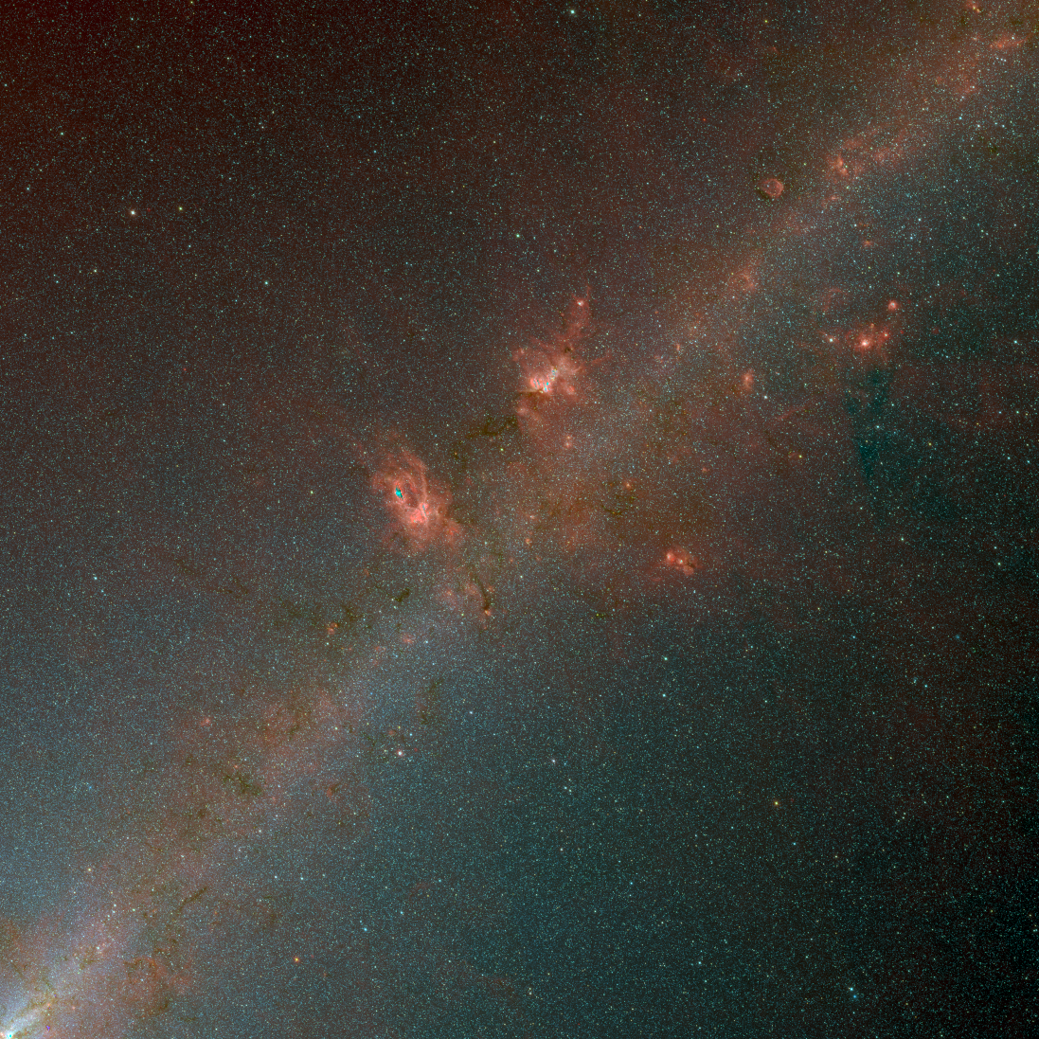






Montage and HiPS
G. Bruce Berriman
John Good
Vandana Desai
Steve Groom (Caltech/IPAC)
Notes:
Challenges for KOA
-

Slide 2
What Is Montage?
Open source image mosaic engine (BSD 3-clause).
Written in ANSI-C for performance and portability.
Notes:
-

Slide 3
What Does Montage Bring to HiPS?
Rectifies backgrounds by modeling differences between images.
Adaptive stretch for visualization.
  See Berriman and Good 2017 PASP 129 058006 (https://doi.org/10.1088/1538-3873/aa5456)
Supports HPX (Version 5; Dec 2016).

Slide 4
The Goal
WISE performed an all-sky image-survey at 3.4 μm, 4.6 μm, 12 μm, and 22 μm 18,240 images 4095x4095 pixel @1.375"/pix.
Build HiPS maps of WISE down to level 9 tiles, level 18 pixels (1 arcsecond).

Slide 5
Creating a HiPS Map of WISE Data
Computing HPX mosaics of WISE data.
  Background rectification.
Creating HiPS tiles from the HPX mosaics.
  Image data → display values.
  Adaptive stretch.
Optimize use of hardware resources.

Slide 6
Creating WISE Mosaics
This is the hard part:
  Compute intensive.
  Backgrounds icky at the longer wavelengths.
Use existing Montage tools delivered in Version 5.
Use mProjectQL (image interpolation) for reprojection.
Create set of overlapping image plates.
  32 x 32 plates with 128 pixel overlap.
  Plates 10.6° on a side.

Slide 7
Creating WISE mosaics
Create HPX plate headers.
Find files in each region.
Reprojection.
Background rectification.
Co-add files to create plate.
Do global background corrections.

Slide 8
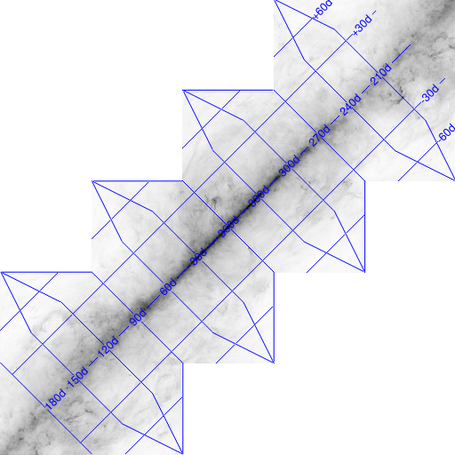
Cutting out HiPS Tiles
Prescription:
  Create HiPS tile header.
  Co-add images.
  Shrink and repeat
  Generate PNGs
Notes:
Shrink and repeat

Slide 9
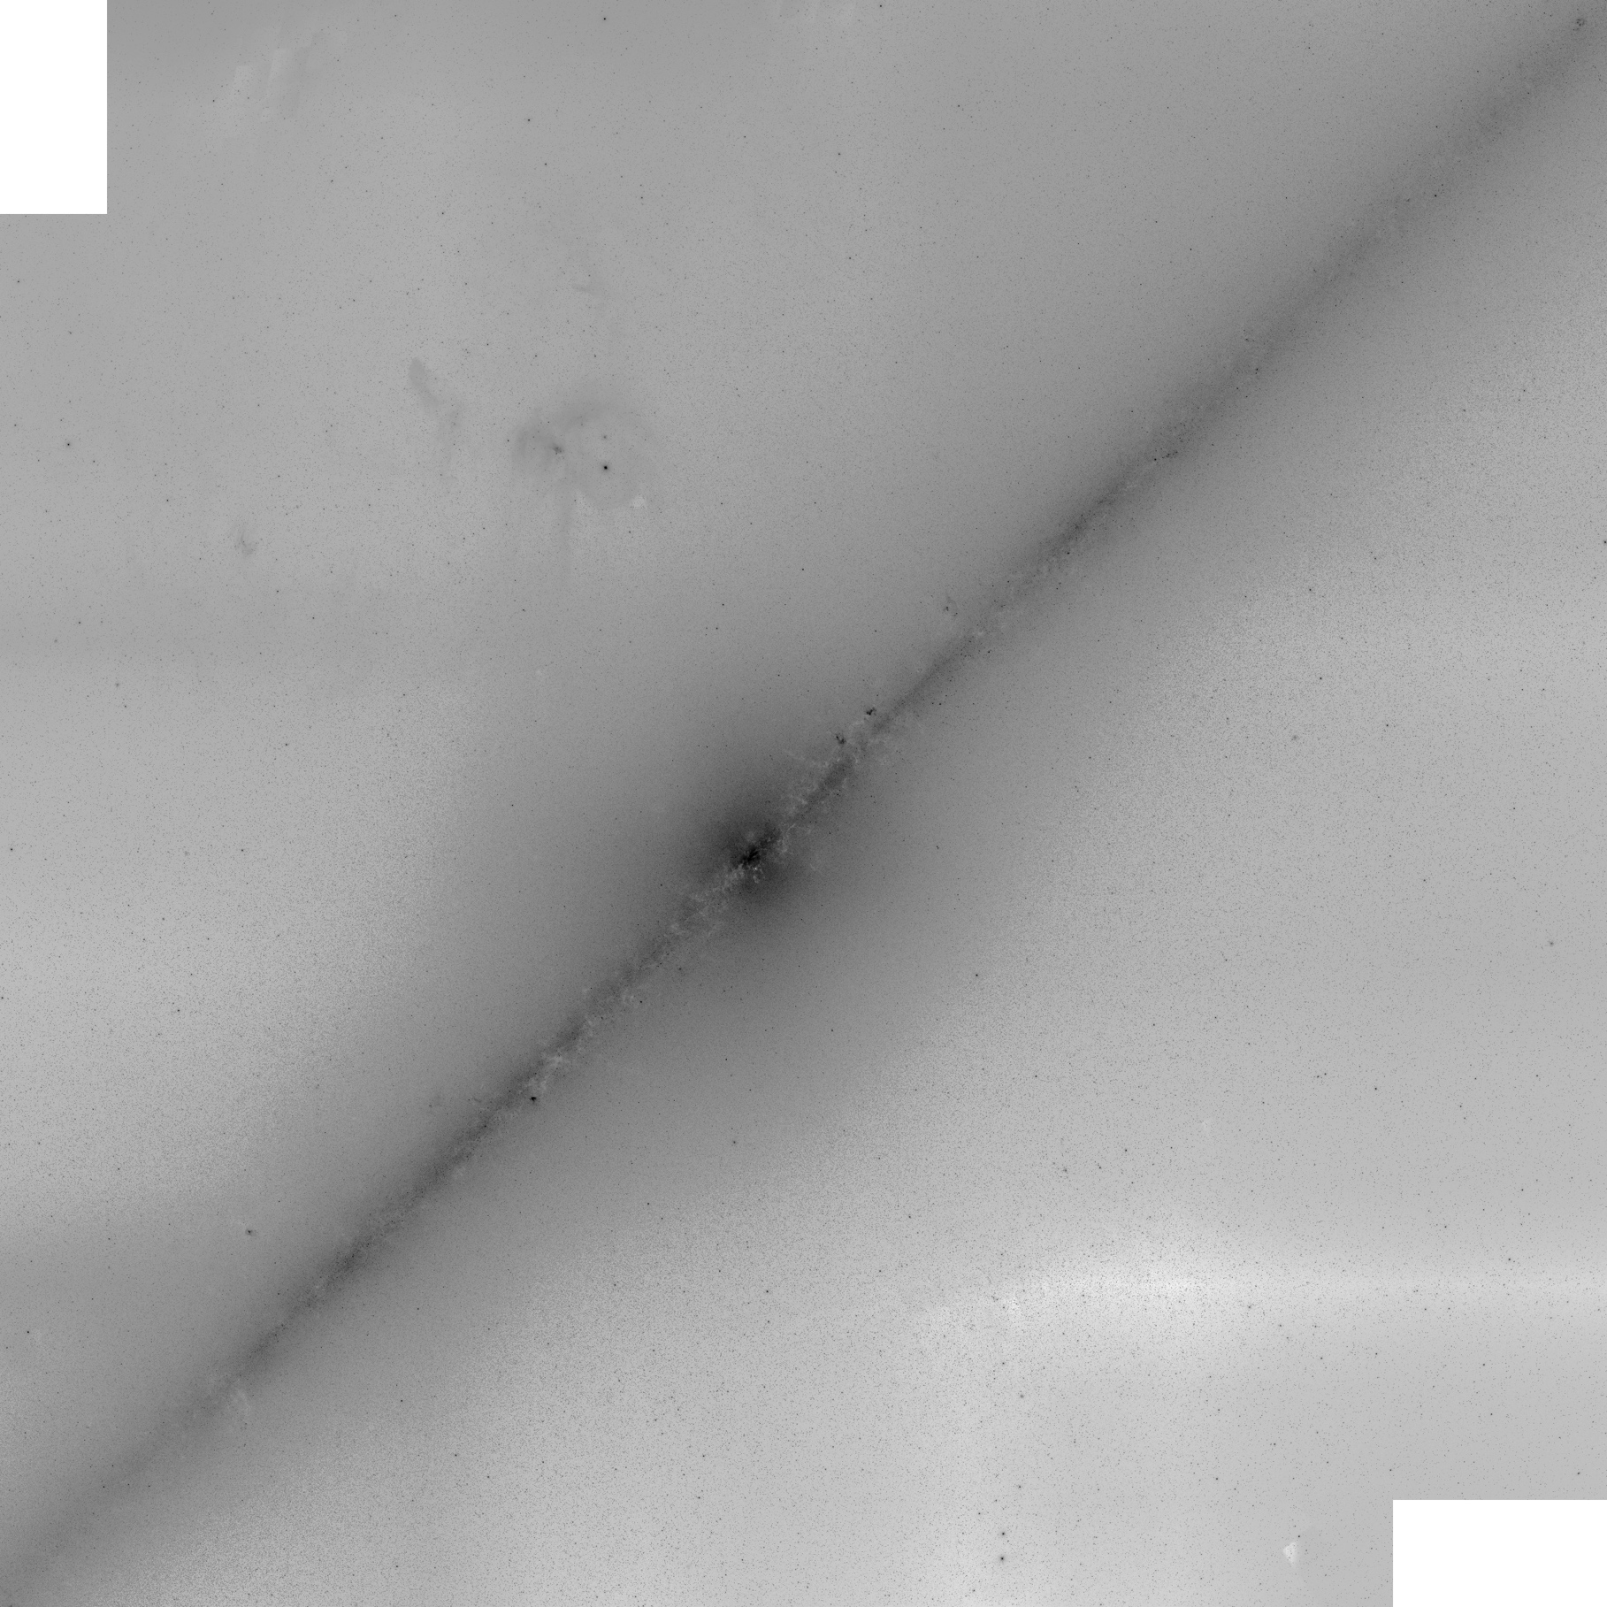
WISE band 1 Level 3
Image is 74.7 deg across
2404 x 2404 pixels

Slide 10
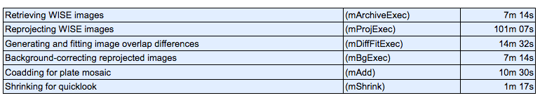
Processing Times
Times for one of the 32 x 32 plates
  Three nodes on a cluster of 3 GHz, 20 core machines
  40 days to complete
  Optimize processing … good candidate for cloud processing.
Total = 141m 54s

Slide 11
Formal Release Summer 2019
Formally test new HiPS modules.
Create Python binary extensions of new modules and test them.
Optimize processing.
…. Contact Bruce if you want to do a shared-risk test drive
gbb@ipac.caltech.edu

Slide 12
Montage and Social Media
Web http://montage.ipac.caltech.edu
Git Hub https://github.com/Caltech-IPAC/Montage
Facebook: https://www.facebook.com/montagemosaicsoftware/
YouTube: https://www.youtube.com/channel/UCFjmHCDrq4YIUly1r082TjA

