Slide 1
Object Visibility SAP & Observation Locator TAP
Jesús Salgado¹
Aitor Ibarra¹, Richard Saxton², Jan-Uwe Ness⁴, Erik Kuulkers⁴, Carlos Gabriel⁴, Bruno Merin⁴, Peter Kretschmar⁴,Matthias Ehle⁴, Emilio Salazar³, Celia Sánchez³
^{1 Quasar for ESA}
^{2 TPZ-VEGA for ESA}
^{3 ATG for ESA}
^{4 ESA}

Slide 2
Use Case

Slide 3
Scientists Require Coordinated Multi-wavelength Observations
Increasing interest to simultaneously observe the same target at different wavelengths. Example use cases:
X-ray binary ToOs
Gaia transients
Optical & radio transients
TDEs, GRBs
GW & neutrino follow-up
Some observatory numbers:
NuSTAR: 30% of the observations are coordinated with other observatories.
XMM-Newton: ~12% coordinated observations (NuSTAR, HST, Chandra, VLT, Swift).
INTEGRAL: ~10% of the observations are coordinated with other observatories.
Chandra has expanded the time available via joint programs.
Middelton et al. 2017

Slide 4
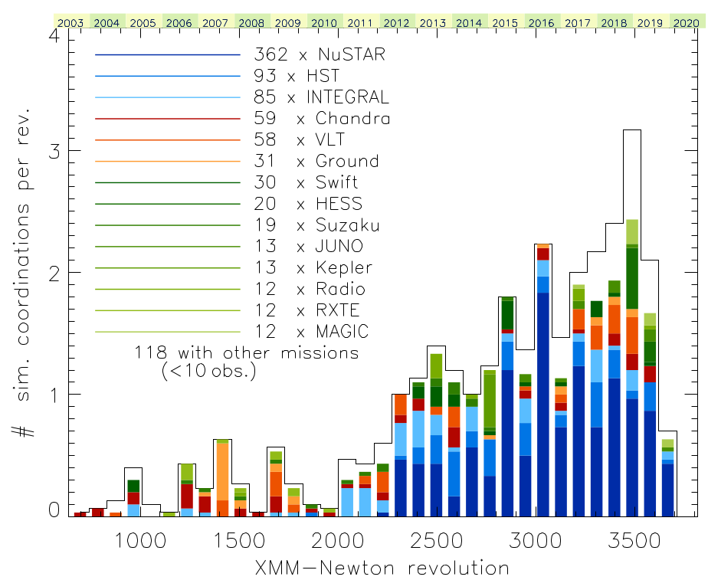
Coordinated Observations

Slide 5
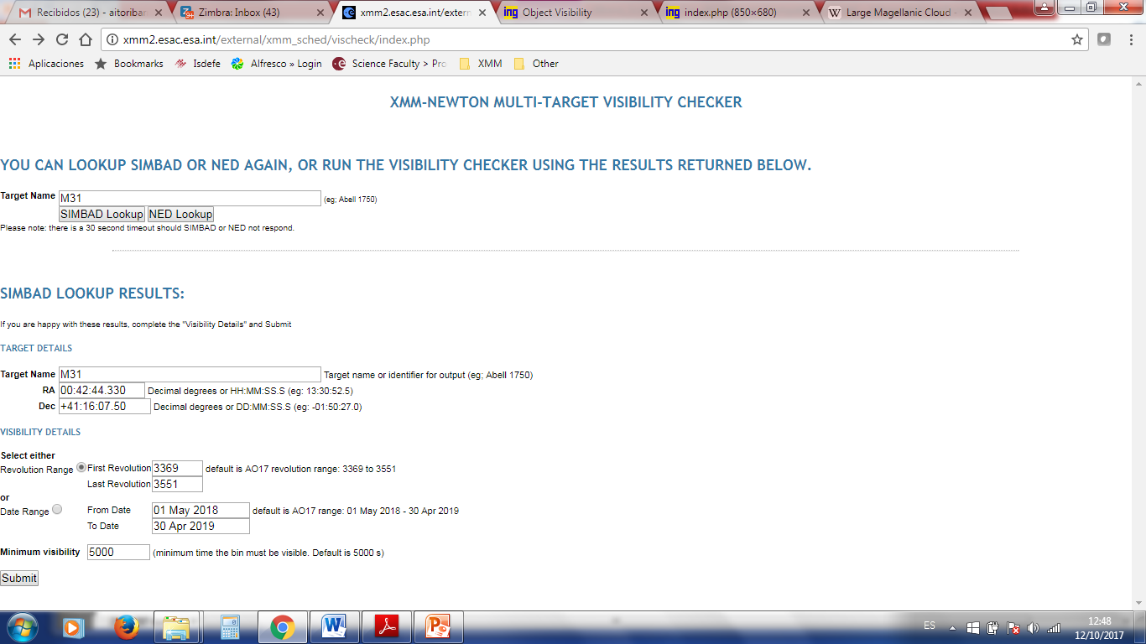
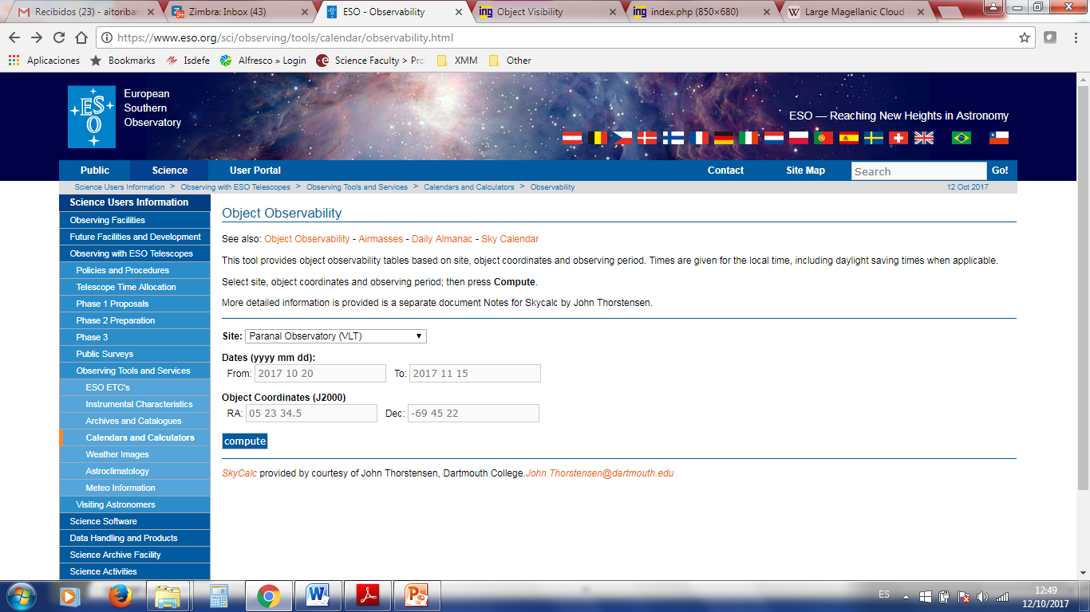
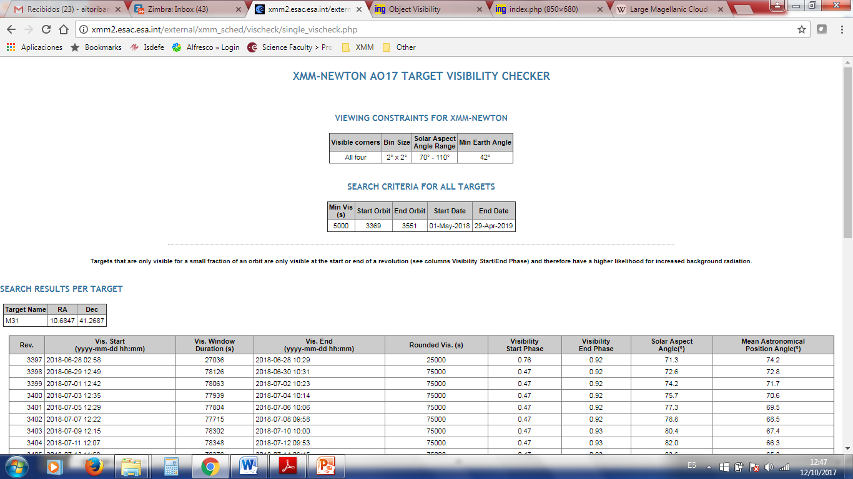
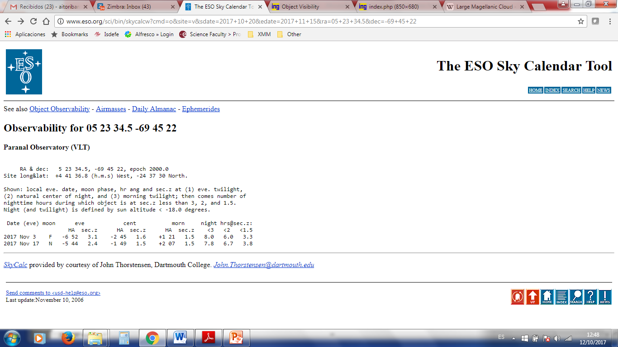
Visibility services

Slide 6
Planned Observations Services

Slide 7
Use Case
Standard Solution

Slide 8
Observatory Visibility

Slide 9
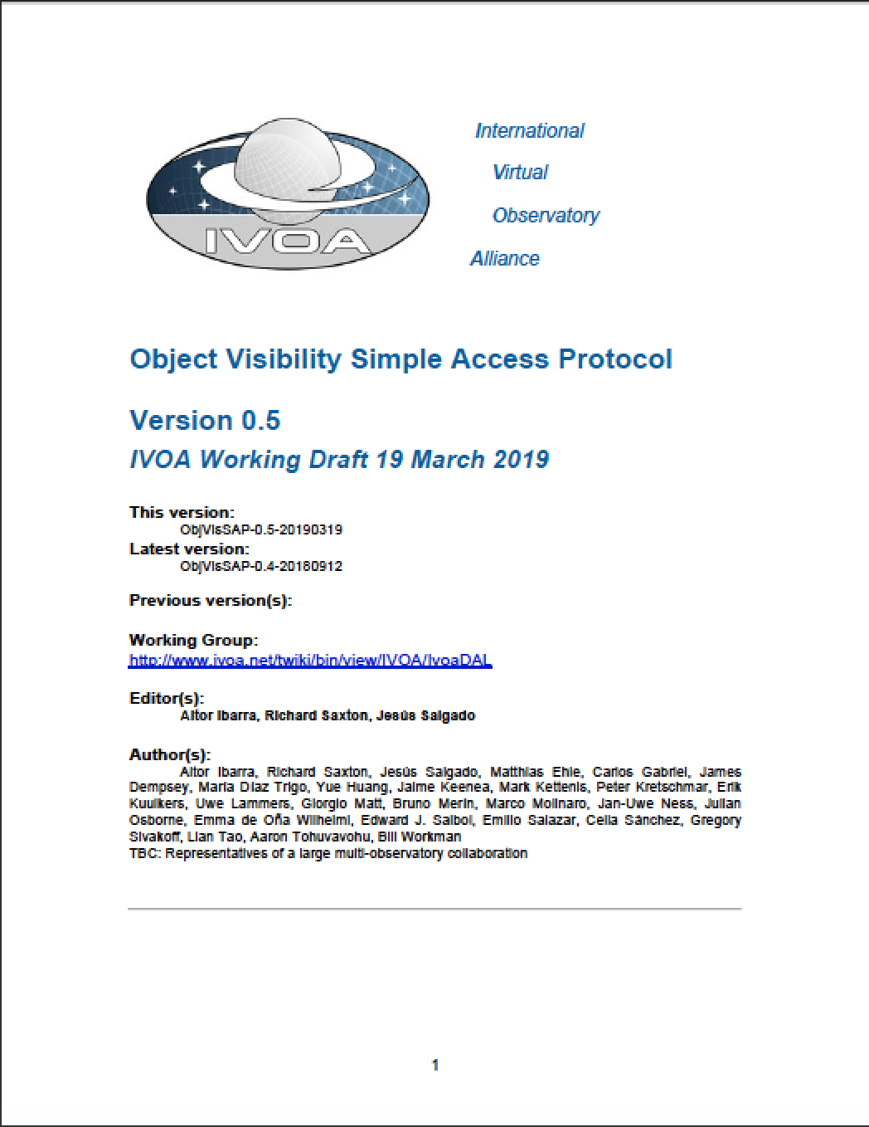
Object Visibility Simple Access Protocol
ObjVisSAP v0.5
Defines the standard for retrieving object constraint-free visibility time intervals through a uniform interface within the VO framework for given object coordinates to be observed by a given Astronomical Observatory
Stable in version 0.5. Some minor changes to be promoted to 1.0
Five server reference implementations and 1 client

Slide 10
ObjVisSAP protocol: Input parameters
Compulsory:
s_ra: Right Ascension - Equatorial J2000
s_dec: Declination – Equatorial J2000
t_min: Time period start time - MJD
t_max: Time period end time - MJD
Optional:
min_vis: Minimum visibility time - seconds

Slide 11
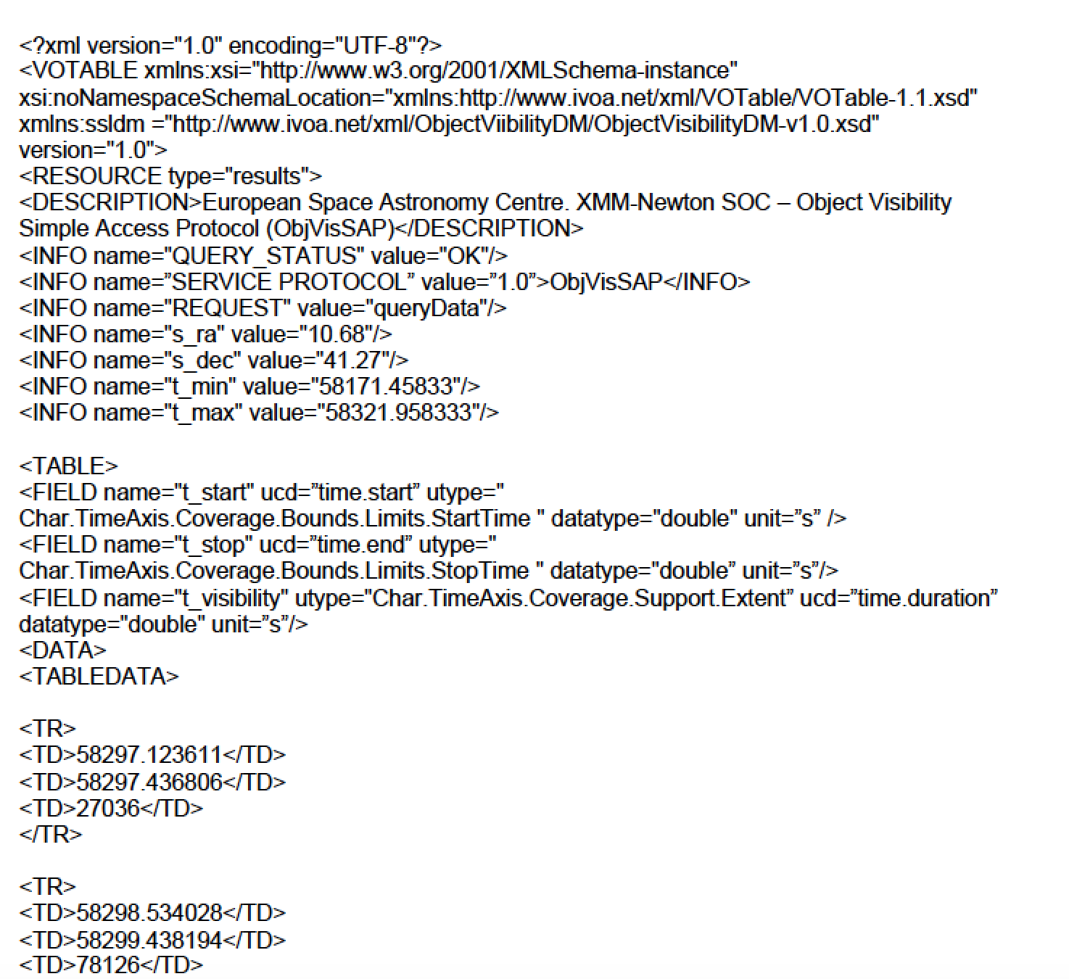
ObjVisSAP protocol: Output

Slide 12
ObjVisSAP protocol: Optional Output
pos_angle: For space missions, expected position angle for the observation during these period
em_min/em_max: Low and high energy bound for this particular sky
position and visibility time interval
elevation_min/
elevation_max: Minimum and maximum elevation for this particular sky position and visibility time interval (ground based observatories)
min_moon_sep/
max_moon_sep: Minimum and maximum moon separation for this particular sky position and visibility time interval

Slide 13
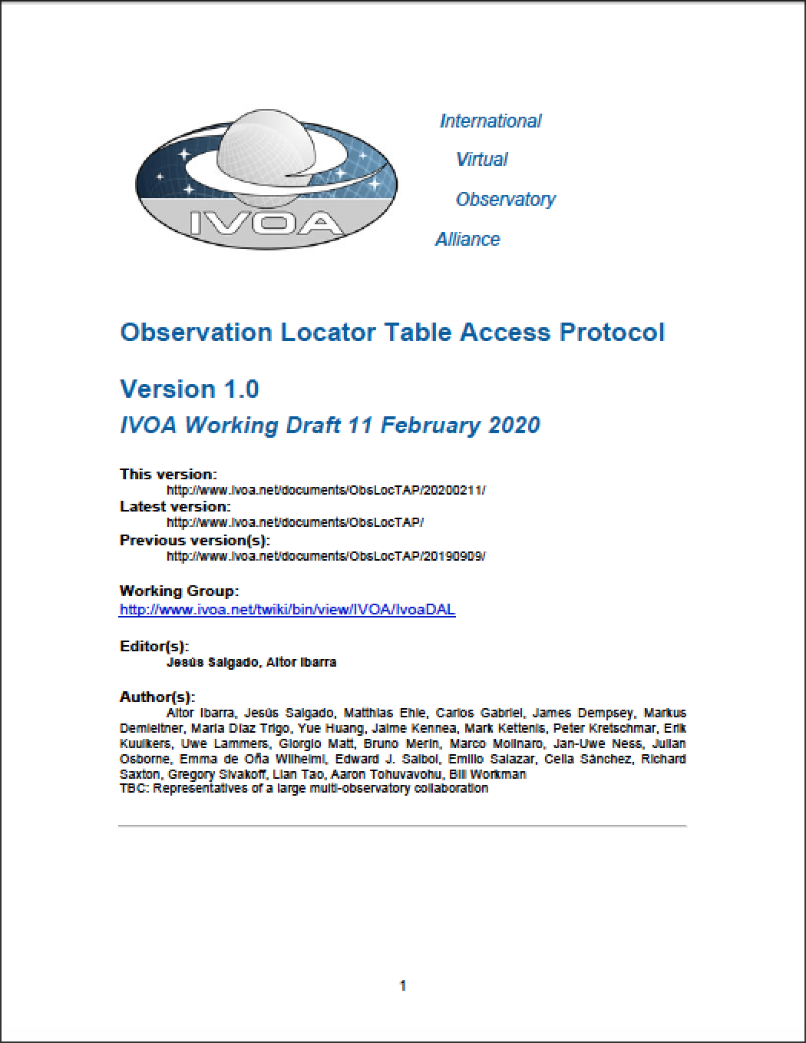
ObsLocTAP: Observation Locator Table Access Protocol
ObsLocTAP v1.0 WD
http://www.ivoa.net/documents/ObsLocTAP/
Observation Locator Table Access Protocol (ObsLocTAP henceforth)
specifies in a standard format the services to retrieve information about planned, scheduled and performed observations of a given target (or coordinates) for a given astronomical observatory
Version 1.0, ready for PR
Two server reference implementations (other two in development) and 1 client

Slide 14
Observations Life cycle
Planned
Scheduled
Performed
Archived
Aborted

Slide 15
ObsLocTAP Use Case I
Discovery of observations scheduled for a certain observatory
The observatory receives observatory proposals by the scientists
Proposals are ranked
Proposals are inserted into the observation planning system
Observation planners schedule short-medium plan trying to maximize the relevance of a certain observation period (e.g. per night or orbit revolution) and taking into account the constrains of the observatory (e.g. visibility of the object, geometrical constrains like the Sun or the Earth for space based observatories, etc)
In case of unexpected events like, e.g. targets of opportunity, scheduled plan could be replaced by another one modifying the short or medium plans.

Slide 16
ObsLocTAP Use Case II
Follow-up of Target of Opportunities
Two types of ToOs in astronomy:
Unpredictable ToOs: Astronomical events that require immediate or almost immediate observations and that, generally, require also coordination between different observatories.
Predictable ToOs: These astronomical events are related (not always) to known transient phenomena or due to coordinated observations of targets special interest.
For the first type, short-term plan can be affected in a very short time scale as per triggering of follow-up observations of a certain astronomical event.

Slide 17
ObsLocTAP Protocol Summary
TAP based
References done to TAP to implement it
Similar to ObsCoreTAP
Why different protocol?
Different community
Different data model
Somehow different use cases
Data model decoupled from ObsTAP to prevent versioning coupling (ivoa.obsplan)

Slide 18
Use Case
Standard Solution
Reference Implementations

Slide 19
ObjVisSAP Implementations
Five observatories have implemented the protocol:
Integral
Chandra
Gaia
XMM-Newton
Insight-HXMT (Hard X-ray Modulation Telescope)
One initiative to provide a simple implementation to be used as example for missions (E. Salazar)https://github.com/emiliosalazardonate/visibility-service/blob/master/README.md
Services integrated in reference implementation TOBY (see later)

Slide 20
ObsLocTAP Implementation
Two missions implementing the service:
Chandra and Integral
Other two missions in development phase:
XMM-Newton and NuStar
Implementation notes created at:
https://www.cosmos.esa.int/web/vovisobs_protocols obsloctapimplguide
Two options:
Guide to create a TAP service using IVOA toolkits (DACHS, SAADA, TAPTuto) and ObsLocTAP table creation
Using docker instances:

Slide 21
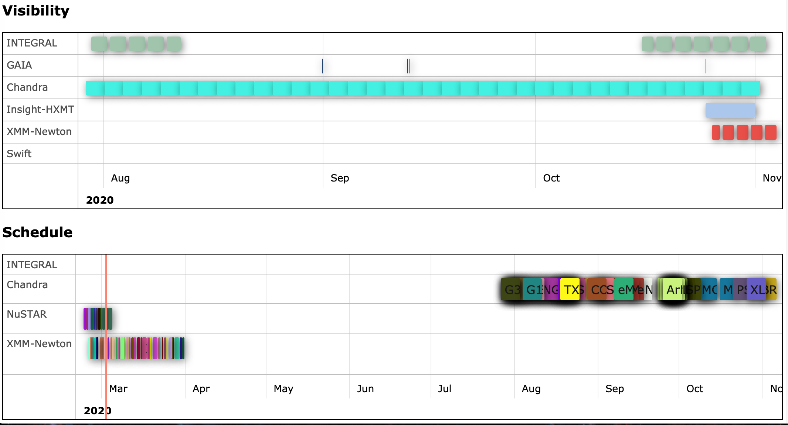
Reference implementation client
As ObsLocTAP is TAP based, any TAP client could be used to check the services.
An integrated services client, TOBY (Tool for Observation visiBilitY and schedule) (E. Salazar)
http://integral.esa.int/toby/
Other clients expected: MySpaceCal (calendar for many missions), ESASky, etc

Slide 22
Roadmap
If not problems found, promote ObsLocTAP from
WD1.0 to PR1.0 after this meeting
Prepare a version 1.0 for ObjVisSAP to be distributed to the WD for comments
Ideally, ObsLocTAP as recommendation during the Summer and a PR version of ObjVisSAP for next interop

Slide 23
Thanks!

