Slide 1
Visualisation of data from the VO in a dome
O.R.Williams, University of Groningen
12/10/2019

Slide 2
Visualisation of VO Data in a Dome: Contents
Principles of visualisation in a dome
Projecting in a dome
Software systems available
SkySkan
OpenSpace
Importing source catalogue data into a dome
VO Formats ➔ Dome compatible formats
KiDS survey as an example

Slide 3
Projecting in a Dome
Multiple projectors each covering a segment of the screen
8 Projectors in this dome
Problems with reflected light
A bright source on the dome will illuminate the opposite side
Mitigated by having a dome which is less than 50% reflective
Results in a reduction of ~50% brightness
Stereoscopic systems result in a reduction of brightness by 60%

Slide 4
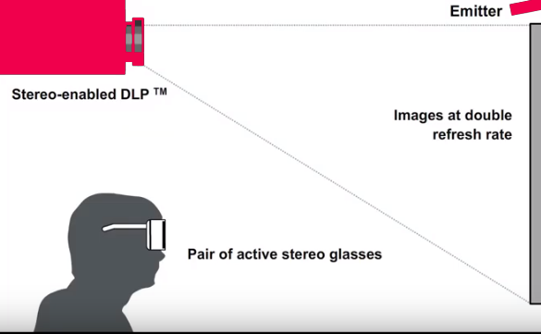
Stereoscopic Projection: Active Stereo

Slide 5
Visualisation Software
The following can all be used on systems varying from Domes to a simple laptop. All are stereo capable
Uniview – The earliest system? A commercial product based on a system developed by Norkopping Visualisation Centre.
World Wide Telescope – Originallly developed by Microsft, now open source.
SkySkan Digital Sky 2– Commercial product (used in this Dome and will be demonstrated shortly)
DigiSTAR – Commercial product marketed by Evans & Sutherland
OpenSpace – Open source visualisation programme. Collaboration including NASA, Norkopping and Hayden Planetarium.

Slide 6
Visualisation Software: SkySkan Digital Sky 2
3D Models (e.g. Satellites such as ISS or Euclid)
Fish-eye images or videos
Simulations (Cubemaps)
Data2Dome not supported (but is in later release Dark Matter)
Astronomical catalogues.
The digital universe collection is available in our SkySkan system.
But is out of date (e.g. SDSS V6) and seems not to be actively curated.
New catalogues can be imported
Options exist to view and fly through these catalogues
Different type of source characteristics can be used to determine the source colour.

Slide 7
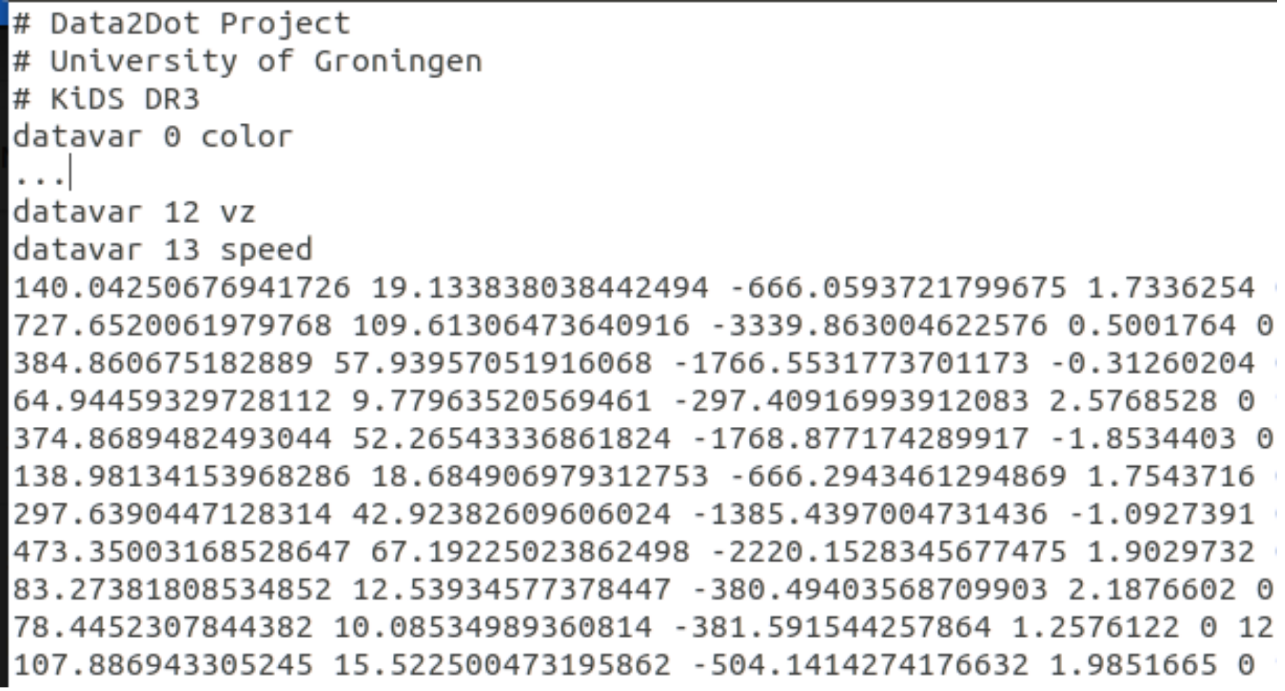
Visualisation Software: SkySkan Digital Sky 2
Catalogue format
Only file format support is Partiview
Ascii files one line per sources starting with position in x,y,z centred on solar system barycentre
Doesn’t scale well for larger catalogues (e.g. whole KiDS catalogue)

Slide 8
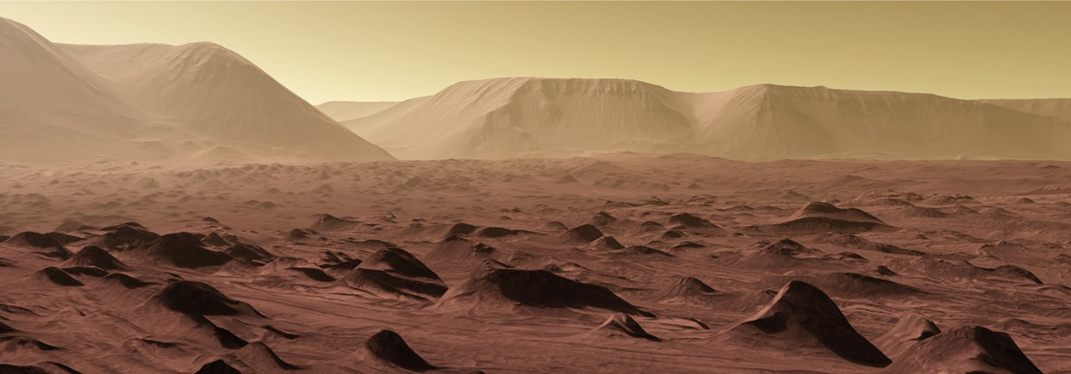
Visualisation Software: OpenSpace
Open source, with a large and helpful community
Large set of GIS data available: Mars & Moon particularly spectacular
Astronomical catalogues: the digital universe collection is available as in most systems
Can handle larger catalogues than SkySkan (e.g. GAIA DR)
Unfortunately not yet commissioned in this dome (hopefully by Nov 2019).

Slide 9
Visualisation Software: OpenSpace
Catalogue format
Supports FITS, Partiview, binary Octree
An octree is a tree data structure in which each internal node has exactly eight children.
Octrees are often used to partition a three-dimensional space by recursively subdividing it into eight octants.
We have generated Octree files for Gaia DR2, KiDS and SDSS, ready for deployment in Dot.

Slide 10
Importing data into a Dome: I
In an ideal world one would be able to browse source catalogues in real time and select the ones to use.
Online selection is possible for data in the Data2Dome project but otherwise not
For GAIA data:
ADQL QUERY
CONVERT FORMAT
INGEST
GAIA Archive
VOTable
OctTree
Datafile with Gaia data in Openspace

Slide 12
Importing data into a Dome: II
For KiDS a similar process was used to get data I will show later
Only had to limit data to sub-set to avoid limitations of system
DOWNLOAD
FITS FILES
SELECT DATA
INGEST
KIDS Archive
Local FITS files
Partiview file(s)
Datafile with all selected KiDS data in Sky SKan
CONVERT FORMAT

Slide 13
What is next?
What we have to date is simply a collection of python scripts
Next task is to wrap them in a GUI so that new data files can easily be created, by non-technical staff.
SkySkan is interested in cooperating with this.
Manual ingestion of files will still be required
Next stage will be to look if this GUI can be incorporated directly into OpenSpace.
Ideal world: can sit here in Dot and be able to create new datasets on-the-fly.

Slide 14
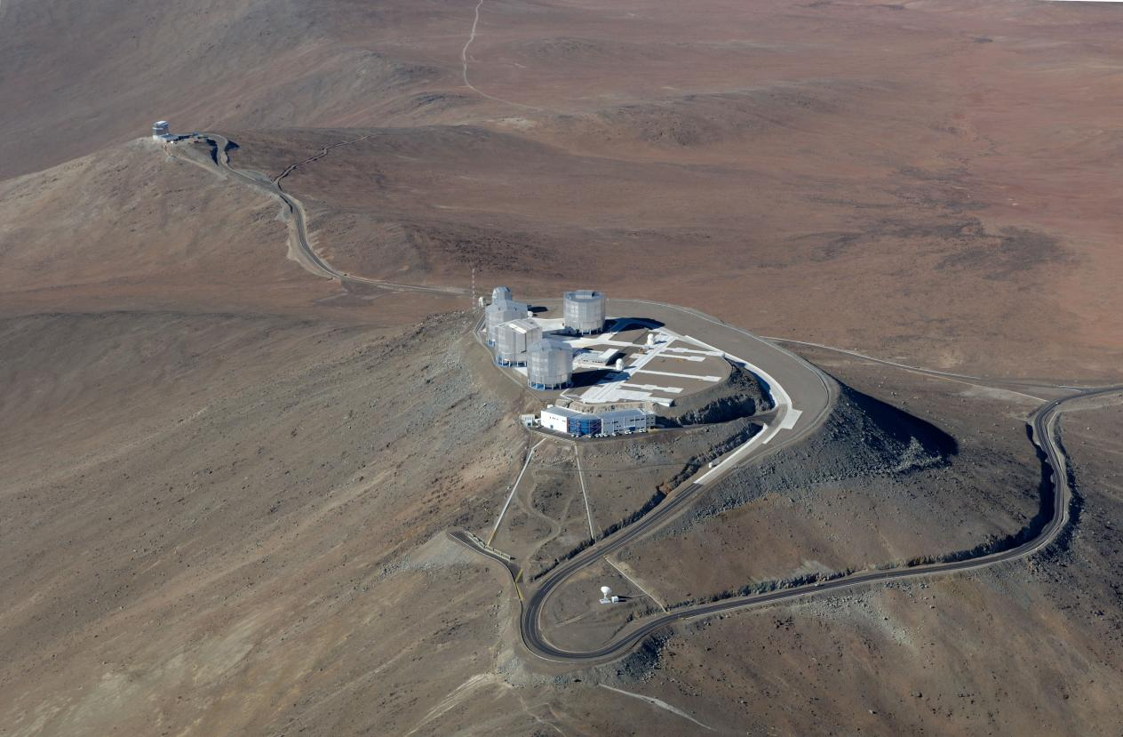
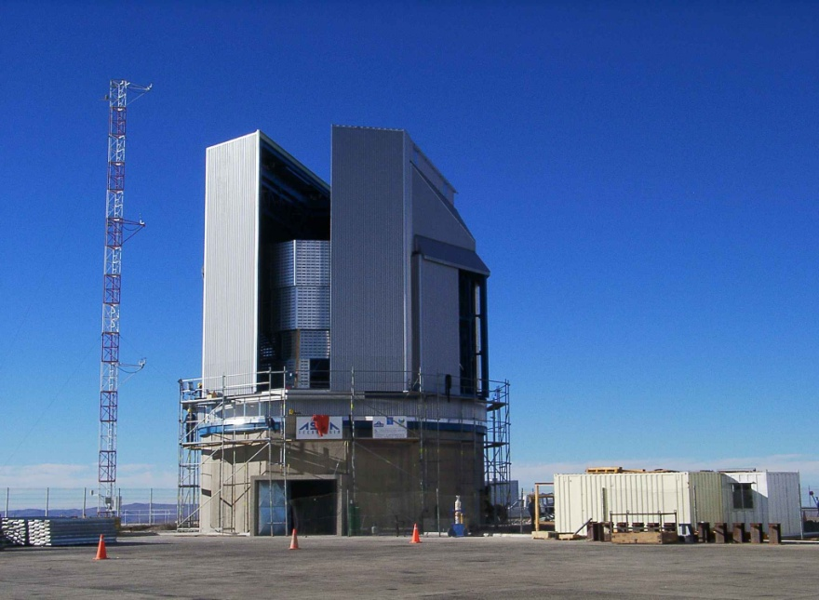
KiDS
440 nights
VST
1500 sq degrees
2.6m telescope
1 sq.deg. optical cameraOmegaCAM
32 2kx4k detectors

Slide 15
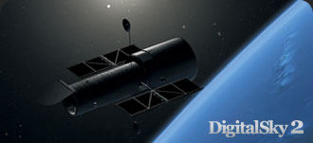
SkySkan DigitalSky Demo

Slide 16
Demo visualisations
Simulations (one of):
Millenium
Aquarius
Illustrius
3D Models
Hubble
Catalogue datasets In stereo
SDSS
Tully

