Slide 1
Implementing MIVOT into PyVO
Tom Donaldson
IVOA Interop – Northern Fall 2022

Slide 2
Astropy and PyVO
Astropy – A Community Python Library for Astronomy
The astropy package contains key functionality and common tools needed for performing astronomy and astrophysics with Python. It is at the core of the Astropy Project, which aims to enable the community to develop a robust ecosystem of affiliated packages covering a broad range of needs for astronomical research, data processing, and data analysis.
Open development process
All are welcome and encouraged to contribute
See the Developer Documentation for all the details
GitHub: https://github.com/astropy/astropy
PyVO – A Community Python Library for Accessing the Virtual Observatory
One of Astropy's affiliated packages
Uses the same open development process as Astropy
GitHub: https://github.com/astropy/pyvo
Astropy Slack has a #pyvo channel (get an account)

Slide 3
Astropy VOTable Parser
PyVO relies on Astropy's VOTable Parser
Submodule astropy.io.votable
Astropy changes for MIVOT (if any) would likely be there
e.g., to ensure that MIVOT artifacts are retained and available after parsing
⚠️ Note that astropy will soon be forcing the use of Black for code formatting
See APE-20 for how this will work
See Astropy VOTable Documentation for API details
To read in a VOTable file, pass a file path to parse:
votable is a VOTableFile object, which can be used to retrieve and manipulate the data and save it back out to disk, or to an Astropy table using to_table()
Note this is integrated with Astropy table read() and write() using format='votable'
from astropy.io.votable import parse
votable = parse("votable.xml")

Slide 4
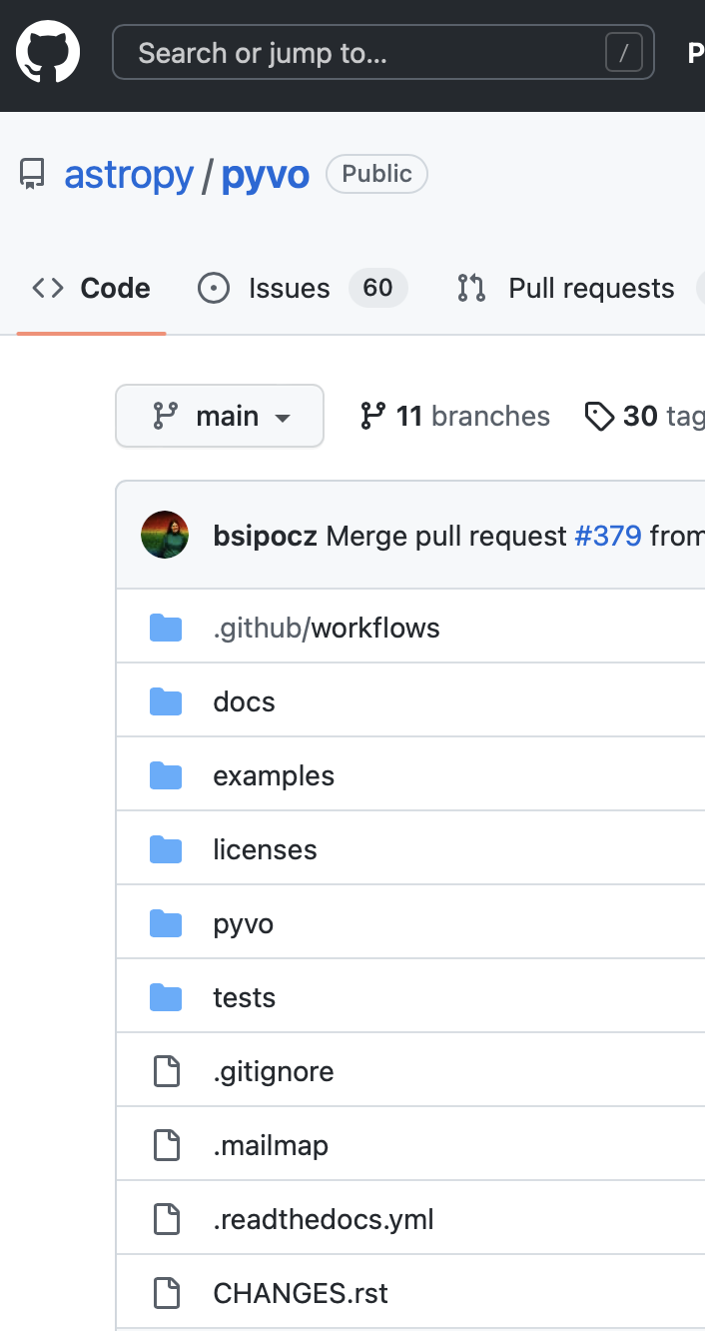
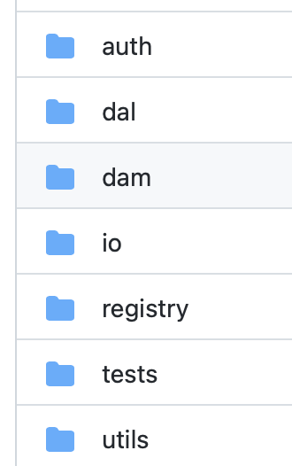
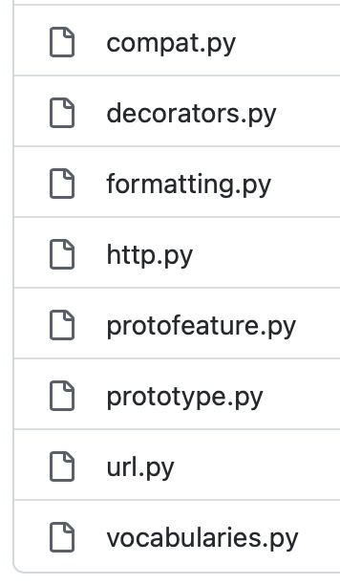
PyVO Components
Prototype feature
made by Omar Laurino
Encapsulates code for standards in progress
RST format documentation for readthedocs pages
Main code

Slide 5
Development Process (same for Astropy and PyVO)
See the Astropy Developer Documentation for all the details! Summary below…
Fork the repository (one time only)
(Optional) delete your main branch

Slide 6
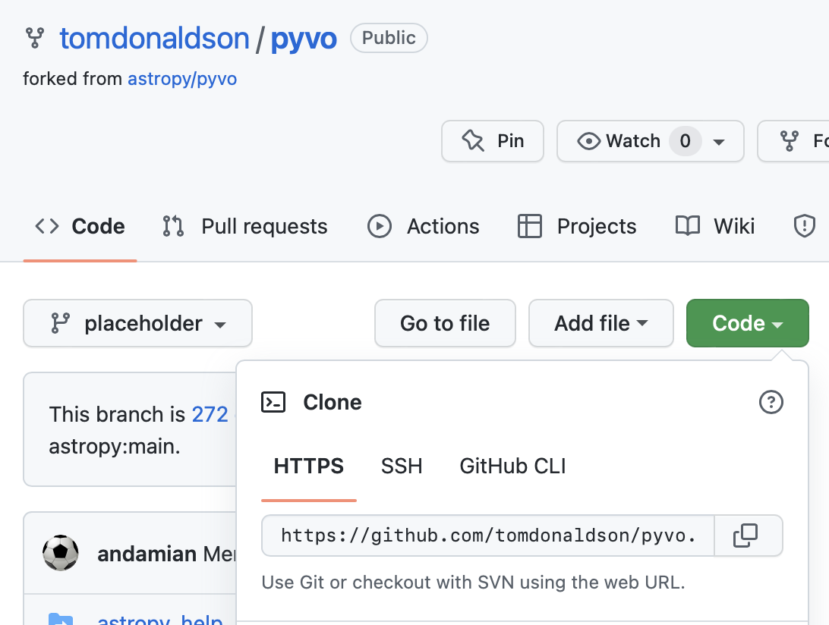
Development Process - Clone
Clone your own repository (one or more times)
git clone https://github.com/<yourgithubname>/pyvo.git
cd pyvo

Slide 7
Development Process – Create Branch
(Optional) Add easy reference main astropy/pyvo repository
Create (and checkout!) branch based on pyvo/main
git remote add pyvo https://github.com/astropy/pyvo.git
# Make sure local repo has everything from upstream
git fetch pyvo –tags
# Create and checkout your branch
git branch mivot-work pyvo/main
git checkout mivot-work
# (Optional) Have commits automatically go to your new branch on your github
git push --set-upstream origin mivot-work

Slide 8
Development Process – Create Development Environment
Conda or Python Virtual Environment
conda create --name mivot-work-env python=3.8
conda activate mivot-work-env
# Install pyvo from the local clone; code changes are part of environment
pip install –e .
# Install other packages that may be useful during development
pip install -U tox pytest-astropy requests_mock pillow

Slide 9
Development Process – Local Testing
Run tests locally
Worth checking that everything is working before you make changes
Can also check codestyle (more useful after you've made changes)
Then make your code changes
Don't forget to add tests and documentation changes!
tox -e test # local only
pytest # Alternative to tox that does less setup
tox -e test-online # with remote-data
tox -e codestyle

Slide 10
Development Process – Commits and Pull Requests
Commit and push changes (as often as needed)
Create Pull Request (in GitHub page for your repo)
Ensure that tox test and codestyle work locally
Ensure all local code is committed and pushed
Use Draft PRs to stimulate early discussion and reviews, esp. for larger projects.
Does not all need to be in a single PR
Request reviewers
Need not be PyVO maintainers, they will see the PR anyway
Respond to comments on the PR until it's approved and merged
Use PyVO GitHub issues to report problems and start discussions
git commit -m "My awesome changes" # Saves changes in local repo
git push # Saves commits to your branch on github

