Slide 1
NAVO Monitoring and Validation Results
Tom McGlynn
Michael Preciado
NASA/NAVO, HEASARC

Slide 2
Service Reliability: 2015
Average fraction passing uptime tests in NAVO monitoring.
NAVO tests all sites each hour.
Very substantial overweighting of small sites (one test/site/svc.type)
Look at weighting by number of services provided/requests made/…?

Slide 3
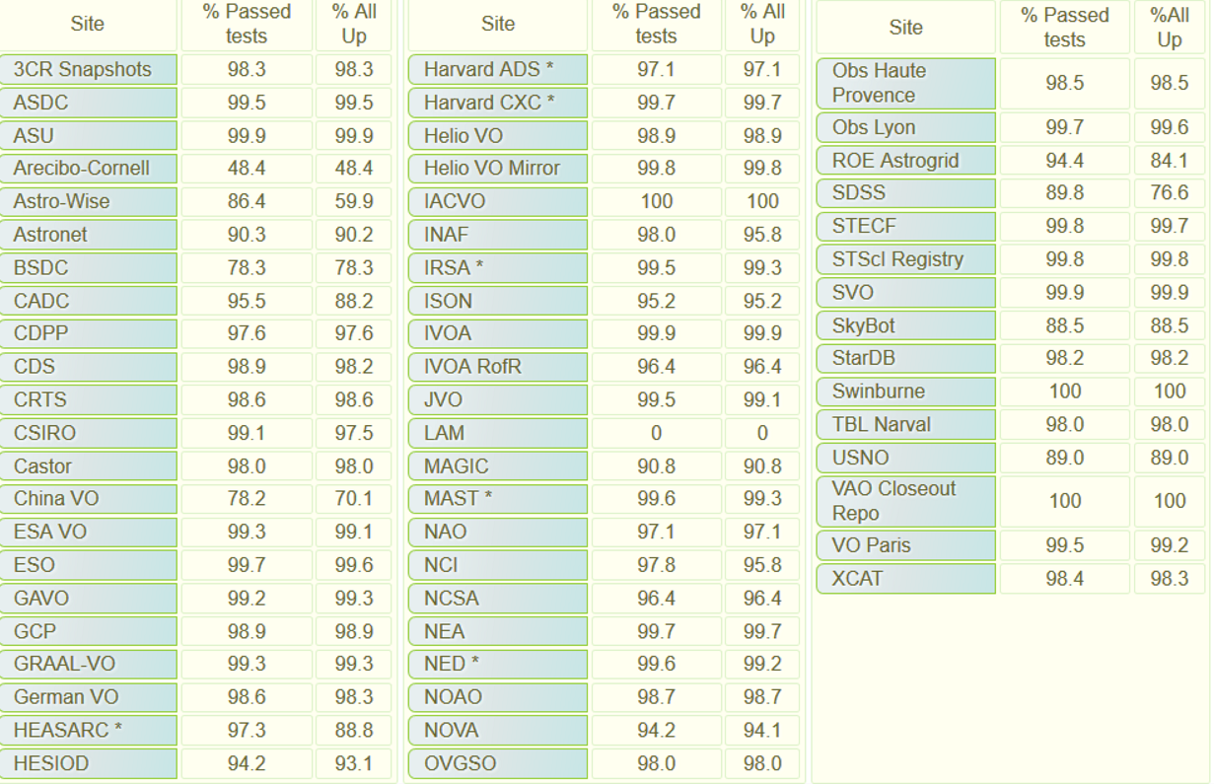
Uptime Statistics for June 30 – October24, 2015

Slide 4
Site issues
Astro-wise –intermittent SIAP service issues.
Arecibo-Cornell – cone service being shut down. Hard to get rid of registry entry.
BSDC - no specific issues. Internet?
China VO-intermittent issue with the CSTAR Cone service.
HESIOD - Issues with the HESIOD SIAP service which was down in August
LAM - Obsolete entry
SDSS – Persistent redirection problem for pointing to ‘latest’ SDSS service, but individual releases were OK.
SkyBot - Occasional issues seen over the weekend
USNO -The Nomad Cone service test was failing intermittently.

Slide 5
Validation summary ?
H
V
O

Slide 6
Take away
Validation progress has been slow
Need to disaggregate statistics
NAVO/HEASARC now runs NCSA validation software locally but no current support for user initiated validation through validation web site.

Slide 7
Site | Total | Pass # | Pass % |  | Site | Total | Pass # | Pass % |  | Site | Total | Pass # | Pass %
3CRSnapshots | 1 | 1 | 100 |  | German VO | 5 | 0 | 0 |  | NED | 3 | 0 | 0
ANU | 7 | 6 | 85.7 |  | HEASARC | 784 | 674 | 85.9 |  | NOAO | 4 | 0 | 0
ASDC | 1 | 0 | 0 |  | HESIOD | 3 | 0 | 0 |  | NOVA | 2 | 0 | 0
ASU | 2 | 2 | 100 |  | Harvard ADS | 1 | 1 | 100 |  | OV-GSO | 1 | 0 | 0
Arecibo-Cornell | 2 | 0 | 0 |  | Harvard CXC | 7 | 0 | 0 |  | Obs Haute Provence | 1 | 0 | 0
Astro-Wise | 4 | 0 | 0 |  | Helio Registry | 2 | 0 | 0
Astronet | 27 | 0 | 0 |  | Helio Registry Mirror | 3 | 0 | 0 |  | Obs Paris | 0 | 0 | 0
BSDC VO | 4 | 2 | 50 |  | IA2 Inaf | 36 | 25 | 69.4 |  | ROE Astrogrid | 241 | 97 | 40.2
CADC | 5 | 0 | 0 |  | IACVO | 3 | 0 | 0 |  | SDSS | 24 | 0 | 0
CDPP | 1 | 0 | 0 |  | IAP VOPDC | 1 | 1 | 100 |  | STECF | 4 | 0 | 0
CDS | 1 | 0 | 0 |  | IPAC | 358 | 7 | 1.95 |  | STScI Opo | 1 | 0 | 0
CDS SIMBAD | 2 | 1 | 50 |  | ISON | 1 | 0 | 0 |  | STScI Registry | 37 | 24 | 64.8
CDS Vizier | 10431 | 8177 | 78.3 |  | IVOA NET | 1 | 0 | 0 |  | SVO CAB | 35 | 3 | 8.57
CESAM | 2 | 0 | 0 |  | JVO | 25 | 2 | 8 |  | SVO IFCA | 1 | 0 | 0
CSIRO | 4 | 0 | 0 |  | LAM | 1 | 0 | 0 |  | StarDB | 1 | 0 | 0
CXC MIT | 2 | 1 | 50 |  | MAGIC | 1 | 0 | 0 |  | Swinburne | 1 | 0 | 0
 |  |  |  |  | MAST II | 3 | 1 | 33.3 |  | TBL Narval | 1 | 0 | 0
Castor | 1 | 0 | 0 |  | Mast | 48 | 44 | 91.6 |  | USNO | 3 | 0 | 0
China VO | 3 | 0 | 0 |  | NAO | 3 | 3 | 100 |  | VO Paris | 8 | 0 | 0
ESAVO | 6 | 0 | 0 |  | NAOC | 1 | 0 | 0 |  | VOPDC | 1 | 0 | 0
ESO | 1 | 1 | 100 |  | NCI | 12 | 7 | 58.3 |  | XCAT | 15 | 0 | 0
GAVO DC | 44 | 36 | 81.8 |  | NCSA II | 2 | 0 | 0 |  | ivo://dame.astro.it/ | 2 | 0 | 0
GRAAL-VO | 1 | 0 | 0 |  | NEA | 1 | 0 | 0

Slide 8
Comparison of Validators
Tom McGlynn, Renaud Savalle, Menelaus Perdikeus

Slide 9
Questions
Are we testing the same things?
Can we use common language?
➔Are we getting the same results?
Haven’t really addressed the third question yet but we’ve got a good start on the first two.

Slide 10
Validator coordination
Detailed comparisons of Cone Search and SIA Validators
(see links on Ops Wiki Page)
Comparison and Standardization of VO Cone Search Validation Services
Introduction
Currently three sites run validation tests of VO services world-wide: VOParis, ESA and the HEASARC which uses validators developed at the NCSA.
This document compares the validation tests for the VO-Paris, ESA and NCSA/HEASARC cone search validator and tries to suggest a common nomenclature for use in describing specific tests. For each site the tests run are described using existing inputs files. Each test is prefixed with a suggested standard name in brackets []. In a number of cases a test at one site combines what is done at multiple tests in another site. The ‘standard’ tests are defined at the finest granularity so that the combining test will …

Slide 11
Test | Description | VOParis | NCSA/HEASARC | ESA
G1 | URL is visible | X | X | X
G2a | Result is well-formed XML |  |  | X
G2b | Result is XSD valid |  |  | X
G2c | Result has appropriate mime-type |  |  | X
G2d | Mime type is text/xml (recommended) |  |  | X
G2e | Mime type is not text/xml;content=x-votable |  |  | X
G2f | Mime type is not text/xml;votable |  |  | X
G2g | Result matches VOTable XSD |  |  | 2.2a-i
CS 2.1a | VOTable has single RESOURCE | X | 2.1a
CS 2.1b | VOTable has single TABLE |  | 2.1b
CS 2.2a | SR=0 returns 0 rows |  |  | 2.2b-i
CS 2.2b | Standard query returns >= 1 row |  |  | 2.2b-ii
CS 2.2.1a | One field with UCD ID_MAIN | 2.2.1 | 2.2.1a | 2.2c-i
CS 2.2.1b | ID_MAIN filed has type char |  | 2.2.1b
CS 2.2.1c | ID_MAIN field has arraysize specified |  | 2.2.1c
CS 2.2.1d | ID_MAIN values are unique |  | 2.2.1d
CS 2.2.2a | One field has UCD POS_EQ_RA_MAIN | 2.2.2 | 2.2.2a | 2.2c-ii
CS 2.2.2b | RA field has type double |  | 2.2.2b
CS 2.2.2c | RA field does not have arraysize |  | 2.2.2c
CS 2.2.3a | One field has UCD POS_EQ_DEC_MAIN | 2.2.3 | 2.2.3a | 2.2c-iii
CS 2.2.3b | Dec field has type double |  | 2.2.3b
CS 2.2.3c | Dec field does not have arraysize |  | 2.2.3c
CS 2.2.4 | At most one PARAM/FIELD with UCD obs_ang-size |  | 2.2.4
CS 2.3a | Errors are properly formatted | 2.3 | 2.3a | 2.3b
CS 2.3b | Error messages are unique |  | 2.3b
CS 2.3c | No INFO error messages in valid response |  |  | 2.3-ii
Cone Search Validation

Slide 12
Comments
Suggested approach for nomenclature:
[Standard prefix] [section number] [Requirement within section as alphabetic suffix]
The section number may be extended if there are explicit but unnumbered subsections (e.g., bulleted list)
Looking only at Musts. Most validators also give advice on should/may’s.
ESA does a much more detailed analysis of the low level protocol
NCSA reports on tests in protocol at finer granularity
Unclear to me that SR=0 requires no results (CS 2.2a) but this is common dialect.

Slide 13
SIA Validation Comparison
Name | Description | VOParis | NCSA/HEASARC | ESA
G1 | Able to access resource | x | x | X
G2a | Resources is valid XML | X | x | X
G2c | Resource has valid mime type |  |  | X
SI1 4.1 | No error seen in legal query |  | 4.1
SI1 4.2.1a | Must have RESOURCE with name ‘results’ |  | 4.2.1a | 4.2.1a
SI1 4.2.1b | RESOURCE with name ‘results’ must have single TABLE |  | 4.2.1b
SI1 4.2.4.1a | Must have unique VOX:IMAGE_TITLE column | 4.2.4.1 | 4.2.4a/a | 4.2.4.a.i
SI1 4.2.4.1b | Image title column must be type char |  | 4.2.4a/b
SI1 4.2.4.1c | Image title column must have arraysize * |  | 4.2.4a/c
SI1 4.2.4.2b | If INST_ID column found must have type char |  | 4.2.4b/b
SI1 4.2.4.2c | If INST_ID column found must have arraysize * |  | 4.2.4b/c
SI1 4.2.4.4a | Must have POS_EQ_RA_MAIN column | 4.2.4.4 | 4.2.4d/a | 4.2.4.a.iv
SI1 4.2.4.4b | RA column must be double |  | 4.2.4d/b
SI1 4.2.4.4c | RA column must be effective scalar |  | 4.2.4d/c
SI1 4.2.4.5a | Must have POS_EQ_DEC_MAIN column | 4.2.4.5 | 4.2.4e/a | 4.2.4.a.v
SI1 4.2.4.5b | Dec column must be double |  | 4.2.4e/b
SI1 4.2.4.5c | Dec column must be effective scalar |  | 4.2.4e/c
SI1 4.2.4.6a | Must have VOX:NAXES column |  | 4.2.4f/a | 4.2.4.a.vi
SI1 4.2.4.6b | NAXES column must be type int |  | 4.2.4f/b
SI1 4.2.4.6c | NAXES column must be effective scalar |  | 4.2.4f/c
SI1 4.2.4.7a | Must have VOX:NAXIS column | 4.2.4.7 | 4.2.4g/a | 4.2.4.a.vii
SI1 4.2.4.7b | NAXIS must have type int |  | 4.2.4g/b
SI1 4.2.4.7c | NAXIS must have arraysize * |  | 4.2.4g/c
SI1 4.2.4.8a | Must have VOX:IMAGE_SCALE column | 4.2.4.8 | 4.2.4h/a | 4.2.4.a.viii
SI1 4.2.4.8b | IMAGE_SCALE must be double |  | 4.2.4h/b
SI1 4.2.4.8c | IMAGE_SCALE must have arraysize * |  | 4.2.4h/c
SI1 4.2.4.9a | Must have VOX:IMAGE_FORMAT column | 4.2.4.9 | 4.2.4i/a | 4.2.4.a.ix
SI1 4.2.4.9b | IMAGE_FORMAT must be char |  | 4.2.4i/b
SI1 4.2.4.9c | IMAGE_FORMAT must have arraysize * |  | 4.2.4i/c

Slide 14
SI1 4.2.4.9d | Image format must be non-null |  | x
SI1 4.2.4.10b | If VOX:STC_REFERENCE_FRAME column type must be char |  | 4.2.4j/b
SI1 4.2.4.10c | … arraysize must be * |  | 4.2.4j/c
SI1 4.2.4.13b | If VOX:WCS_CoordRefPixel type must be double |  | 4.2.4m/b
SI1 4.2.4.13c | … arraysize must be * |  | 4.2.4m/c
SI1 4.2.4.14b | If VOX:WCS_CoordRefValue type must be double |  | 4.2.4n/b
SI1 4.2.4.14c | … arraysize must be * |  | 4.2.4n/c
SI1 4.2.4.15b | If VOX:WCS_CDMatrix type must be double |  | 4.2.4o/b
SI1 4.2.4.15c | .. arraysize must be * |  | 4.2.4o/c
SI1 4.2.4.16b | If VOX:BANDPASS_ID type must be char |  | 4.2.4p/b
SI1 4.2.4.16c | … arrasize must be * |  | 4.2.4p/c
SI1 4.2.4.17b | If VOX:BANDPASS_UNIT type must be char |  | 4.2.4q/b
SI1 4.2.4.17c | … arraysize must be * |  | 4.2.4q/c
SI1 4.2.4.18b | If VOX:BANDPASS_REFVALUE type myst be double. |  | 4.2.4r/b
SI1 4.2.4.18c | … must be effective scalar |  | 4.2.4r/c
SI1 4.2.4.19b | If VOX:BANDPASS_HILIMIT type must be double |  | 4.2.4s/b
SI1 4.2.4.19c | … must be effective scalar |  | 4.2.4s/c
SI1 4.2.4.20b | If VOX:BANDPASS_LOLIMIT type must be double |  | 4.2.4t/b
SI1 4.2.4.20c | … must be effective scalar |  | 4.2.4t/c
SI1 4.2.4.21b | If PIXFLAGS type must be char |  | 4.2.4u/b
SI1 4.2.4.21c | … arraysize must be * |  | 4.2.4u/c
SI1 4.2.4.22a | Must have VOX:IMAGE_ACCESSREFERENCE column | 4.2.4.22 | 4.2.4v/a | 4.2.4.e.i
SI1 4.2.4.22b | … must be type char |  | 4.2.4v/b
SI1 4.2.4.22c | … must have arraysize * |  | 4.2.4v/c
SI1 4.2.4.22d | … must be non-null |  | x
SI1 4.2.4.22e | … must be able to retrieve data from URL matching format |  | x
SI1 4.2.4.24b | If VOX:FILE_SIZE type must be int |  | 4.2.4x/b
SI1 4.2.4.24c | … must be effective scalar |  | 4.2.4x/c
SI1 6.1.1 | Meta RESOURCE only in meta query | 6.1.1
SI1 6.1.2 | Meta results include query params | 6.1.2

Slide 15
SIA Comments
NAVO/NCSA is finer grained
NAVO/NCSA tests required attributes of optional columns
VOParis does additional testing of metadata queries (SI1 6.1.1/2)
NAVO adds tests of data returned by service (SI1 4.2.4.22d/e)
NAVO/NCSA validation more complex than CS, but VOParis is comparable. That approach may be more scalable to ever more complex standards.

Slide 16
Summary
Validators seem to be performing similar tests but details and granularity can differ.
Only NAVO tests are testing availability of data? Should probably be part of validation of data retrieval protocols.
Still haven’t done detailed comparisons of validators for results of particular checks.

Slide 17
Future directions
Do detailed comparison of validation results: validate the validators!
Look at existing SSA, SLAP, registry tests
Encourage standard vocabulary.
SIAv2 validator at VOParis in testing
DataLink validator?

