Slide 1
ESA Gaia Archive DR1:
A VO compliant archive
Jesús Salgado, Juan González, Raúl Gutiérrez, Juan Carlos Segovia, Javier Durán, Bruno Merín, Sara Nieto, Christophe Arviset
Gaia Archive Development Team - ESAC Science Data Center (ESDC)

Slide 2
Data Volumes
Statistics 25 July 2016
 | Volume
Science data collected | 38 TB
Stars having passed focal plane | 5 x 10¹⁰
Astrometry transits | 4 x 10¹¹
Photometry transits | 1 x 10¹¹
Spectroscopy transits | 9 x 10⁹
Number of stars having passed RVS | 3 x 10⁹

Slide 3
Gaia Archive current content
External Catalogues
IGSL (Initial Gaia Source List) 1.2x10⁹ rows
2MASS 4.7x10⁸ rows
Tycho2 2.5x10⁶ rows
UCAC4 1.1x10⁸ rows
Crossmatches
Crossmatch tables between Hipparcos, 2MASS, Tycho2… and Gaia expressed as neighbourhood and best neighbour, e.g:
Hipparcos & Hipparcos new red. 1.2x10⁶ rows
Hubble Source Catalogue v1.0 2.9x10⁷ rows
Gaia
Gaia DR1 catalogue 1.1x10⁹ rows
TGAS 2.0x10⁶ rows
AllWise-Gaia neighbourhood 3.1x10⁸ rows

Slide 4







Crossmatch for my objects:
TAP+ approach & VOSpace+
archive
TAP
Upload
White Dwarfs
n TAP Queries
Results
Results
User Disk

Slide 5





Crossmatch for my objects:
TAP+ approach & VOSpace+ & SaaS
archive
TAP
Upload
White Dwarfs
n TAP Queries
Results
Results
User Disk

Slide 6
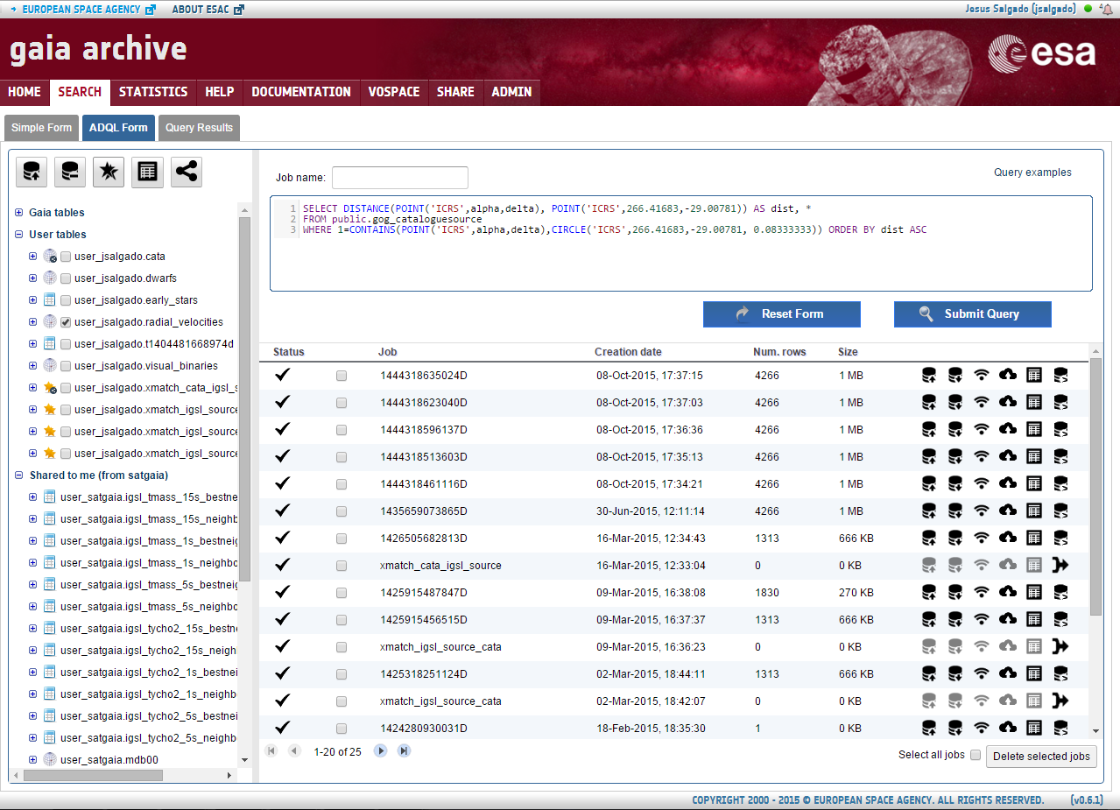
Gaia Archive: TAP+ Interface

Slide 7
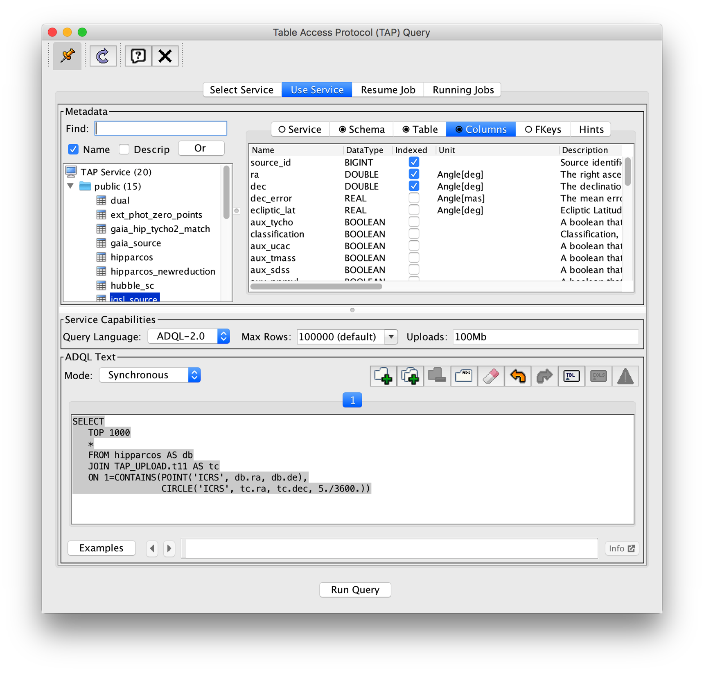
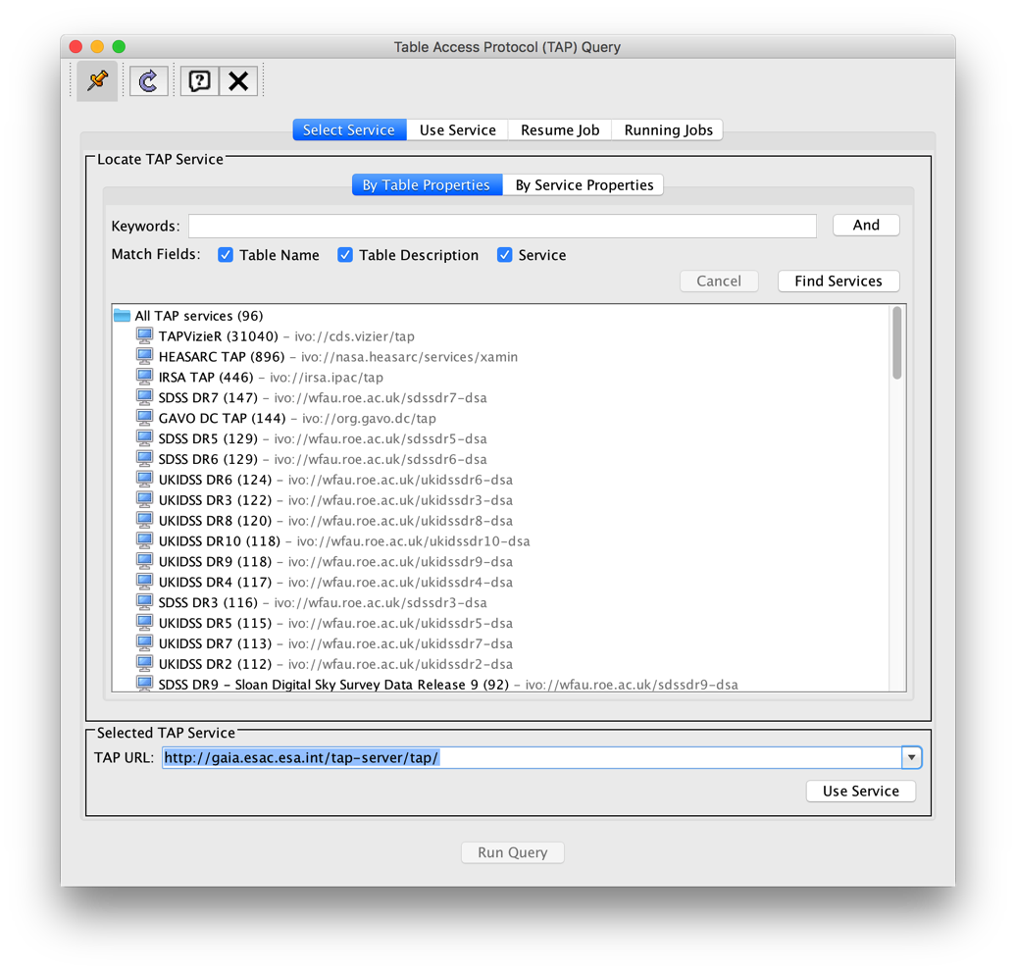
TAP supported
Volatile upload of tables is supported by TAP/ADQL: UPLOAD/QUERY/DELETE
Service URL: http://gaia.esac.esa.int/tap-server/tap/
SELECT *
FROM hipparcos AS hip
JOIN TAP_UPLOAD.t1 AS myTable
ON 1=CONTAINS(POINT('ICRS', hip.ra, hip.dec),
CIRCLE('ICRS', myTable.ra, myTable.dec, 5./3600.))

Slide 8
TAP+: TAP standard evolution
Gaia Data Model
Gaia has its own DM that is propagated and used for all the software developed in the consortium
Big output results
TAP server should be able to handle very big catalogues and very big output responses
Private Data
Users should have their own data/catalogues close to the archive
Login must be supported
Crossmatch
Crossmatch between Gaia catalogue and user catalogues to be executed as a user ADQL function

Slide 9
TAP+: Private Data
Jobs should allow a “non anonymous” execution
Jobs Visibility (TAP/UWS)
ADQL queries inside the jobs under this mode should be only accessible by the owner
ADQL queries are a description of ongoing scientific work so they have to be hidden
Persistent upload (TAP)
Data-centric architecture impose users data close to the server
TAP Upload using workflow UPLOAD/QUERY/DELETE
Tables uploaded by user should be maintained at the server in a persistent way
Login/Authorization/server capabilities/sharing (VOSpace)
TAP Schema (TAP)
Queries should be allowed on TAP schema tables
TAP_SCHEMA per user

Slide 10
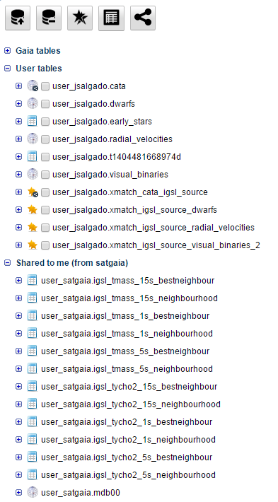
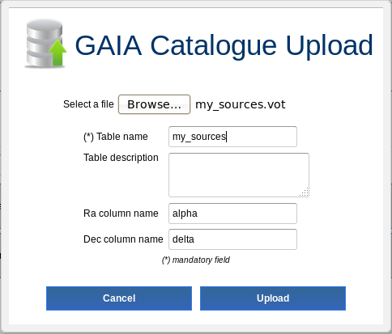
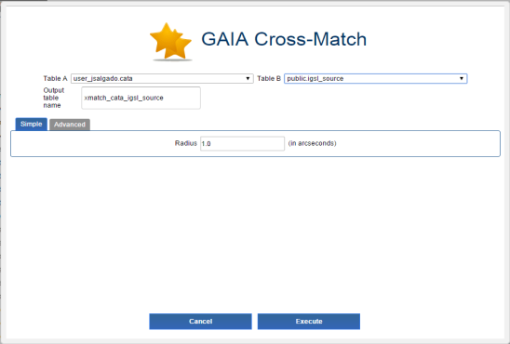
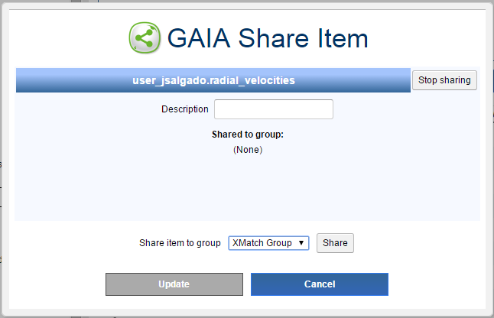
Gaia Archive: TAP+ Schema
Persistent Upload
Server Crossmatch
Table sharing

Slide 11
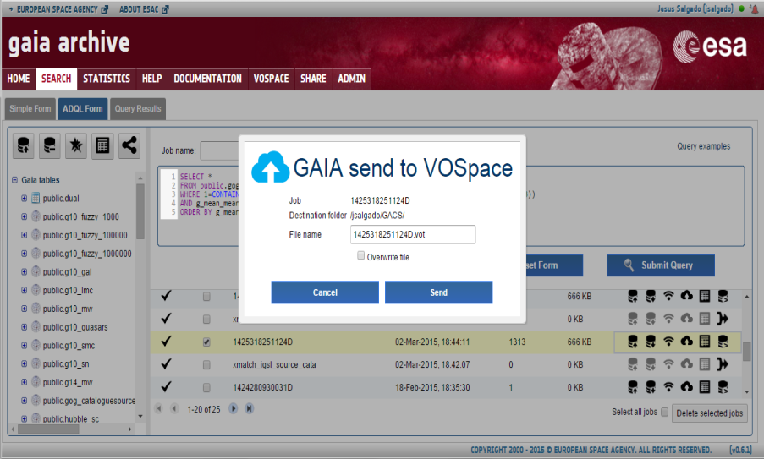
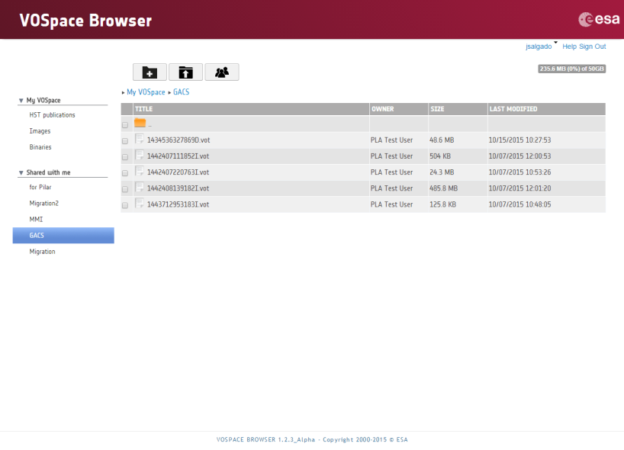
VOSpace :
Virtual storage for collaboration
Astronomy DropBox
VO protocol
InterOperable
Accessible by VO Applications
Accessible by REST
Close to data
See
Sara Nieto
presentation
(for details)

Slide 12
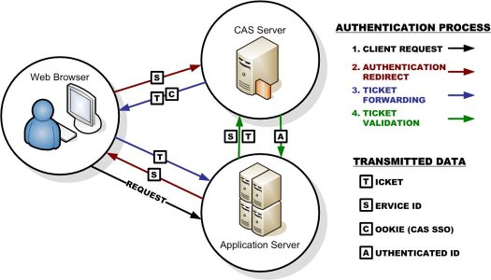
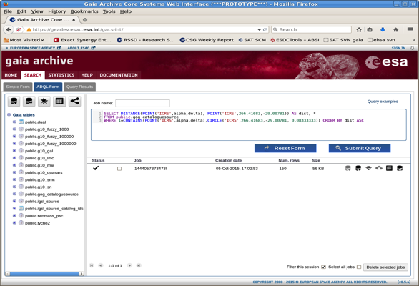
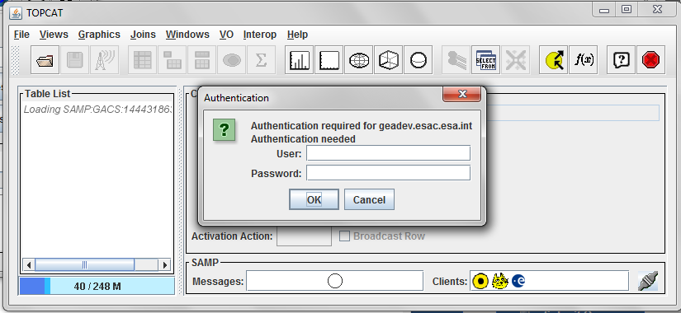
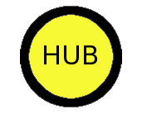
Gaia Archive Security
Single Sign-on through CAS server (both GACS and VOSpace)
Authorization through CAS proxy tickets
SAMP simple authentication
Full support on SAMP https for Web profile still pending at protocol level
SAMP
SAMP
Authenticated SAMP

Slide 13
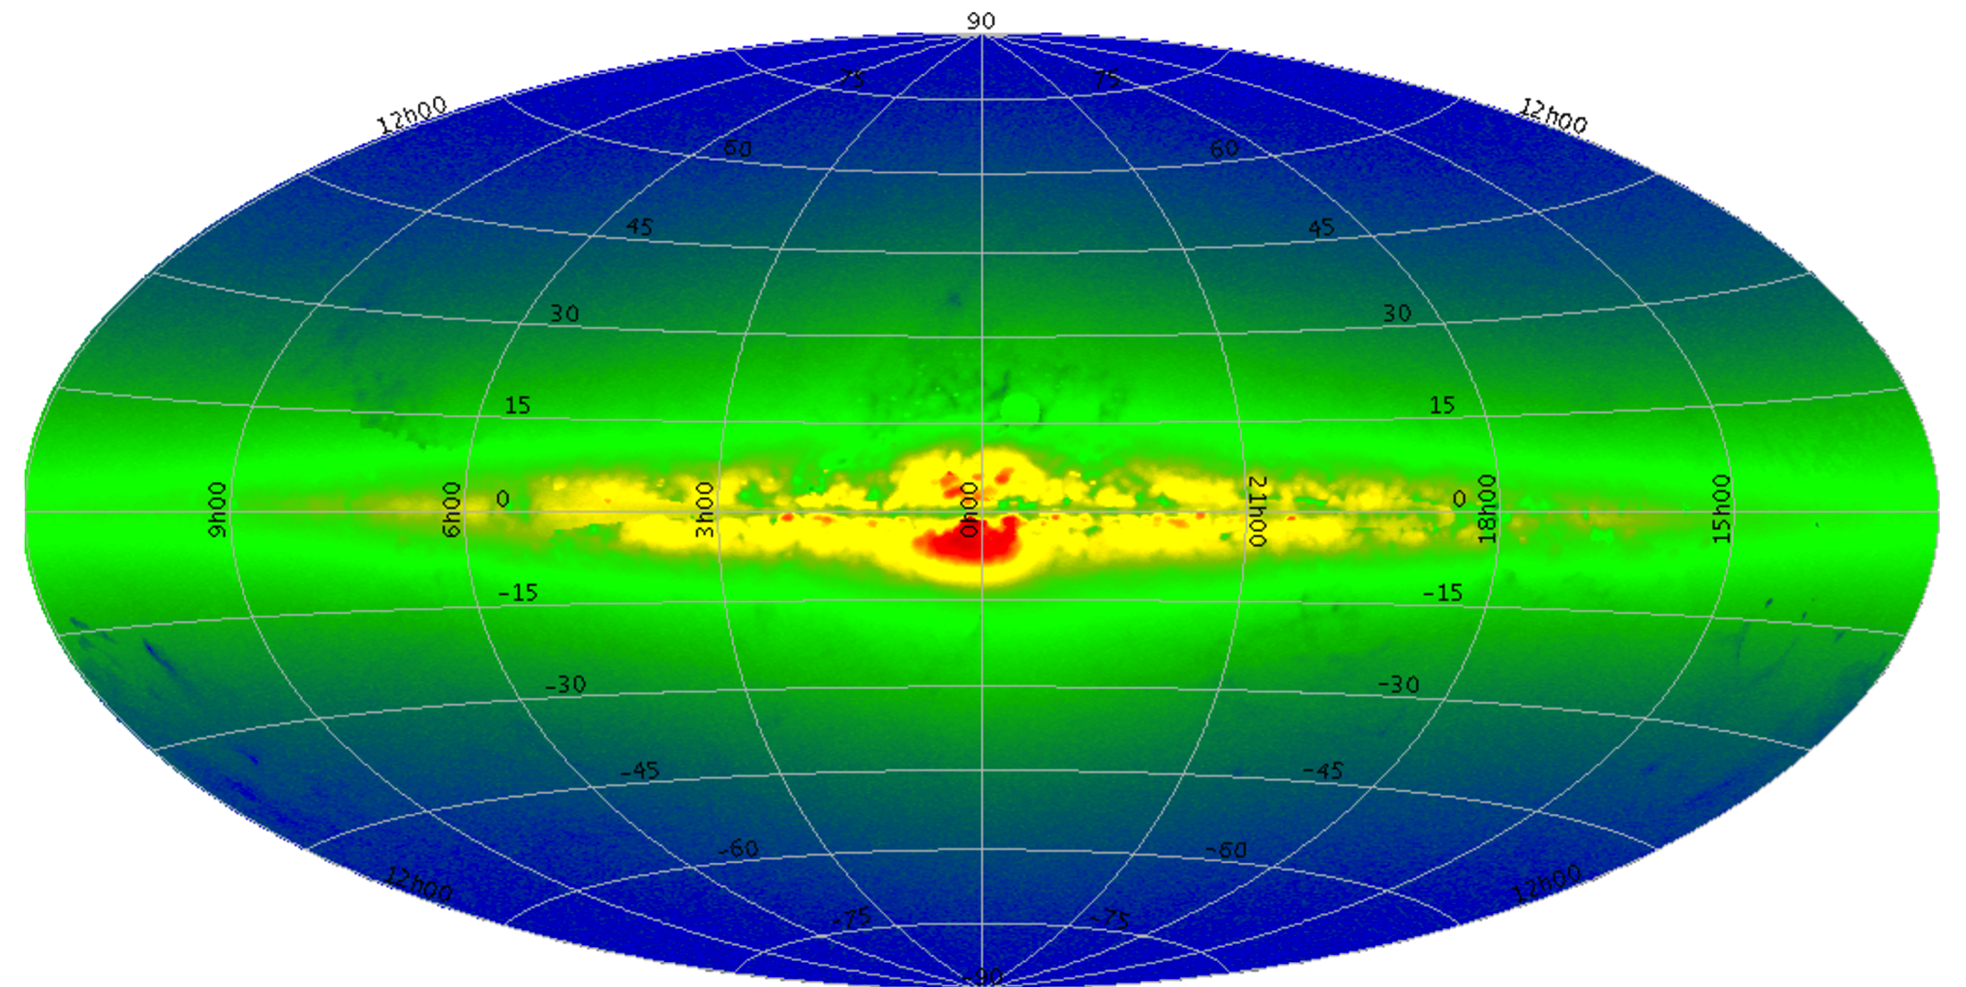
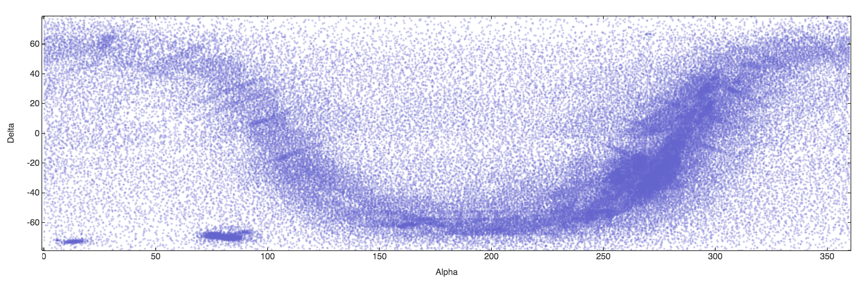
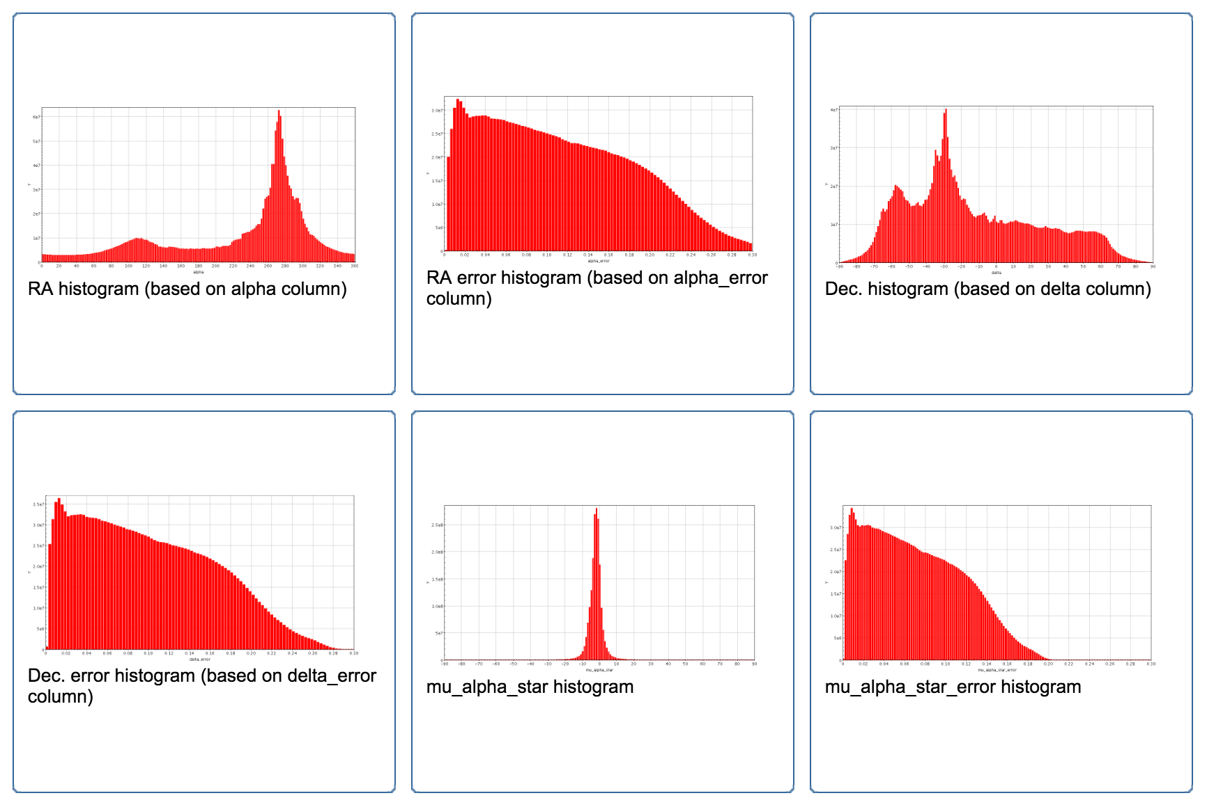
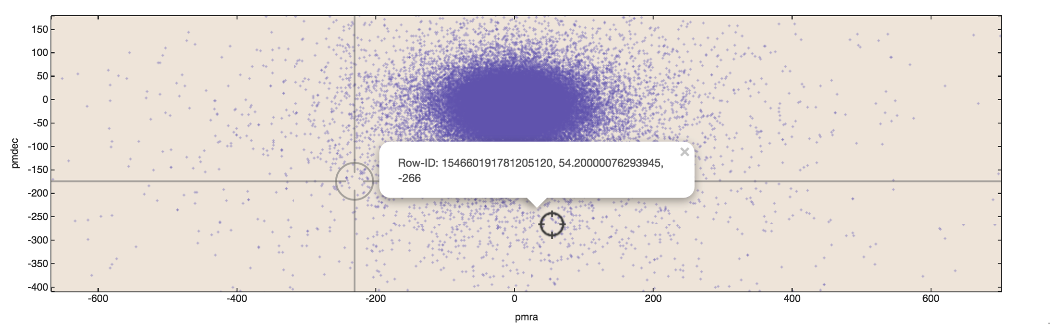
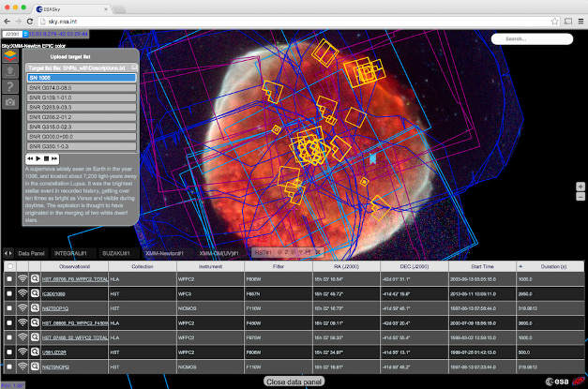
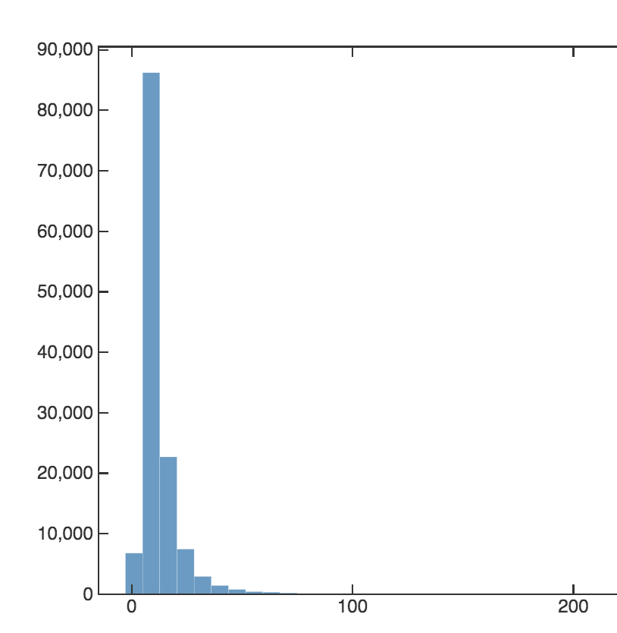
Visualization
Visualization is a need
Statistics provide holistic views. Big data techniques
Validated static stats
On-the-fly visualization (Lisbon University)
ESASky

Slide 14
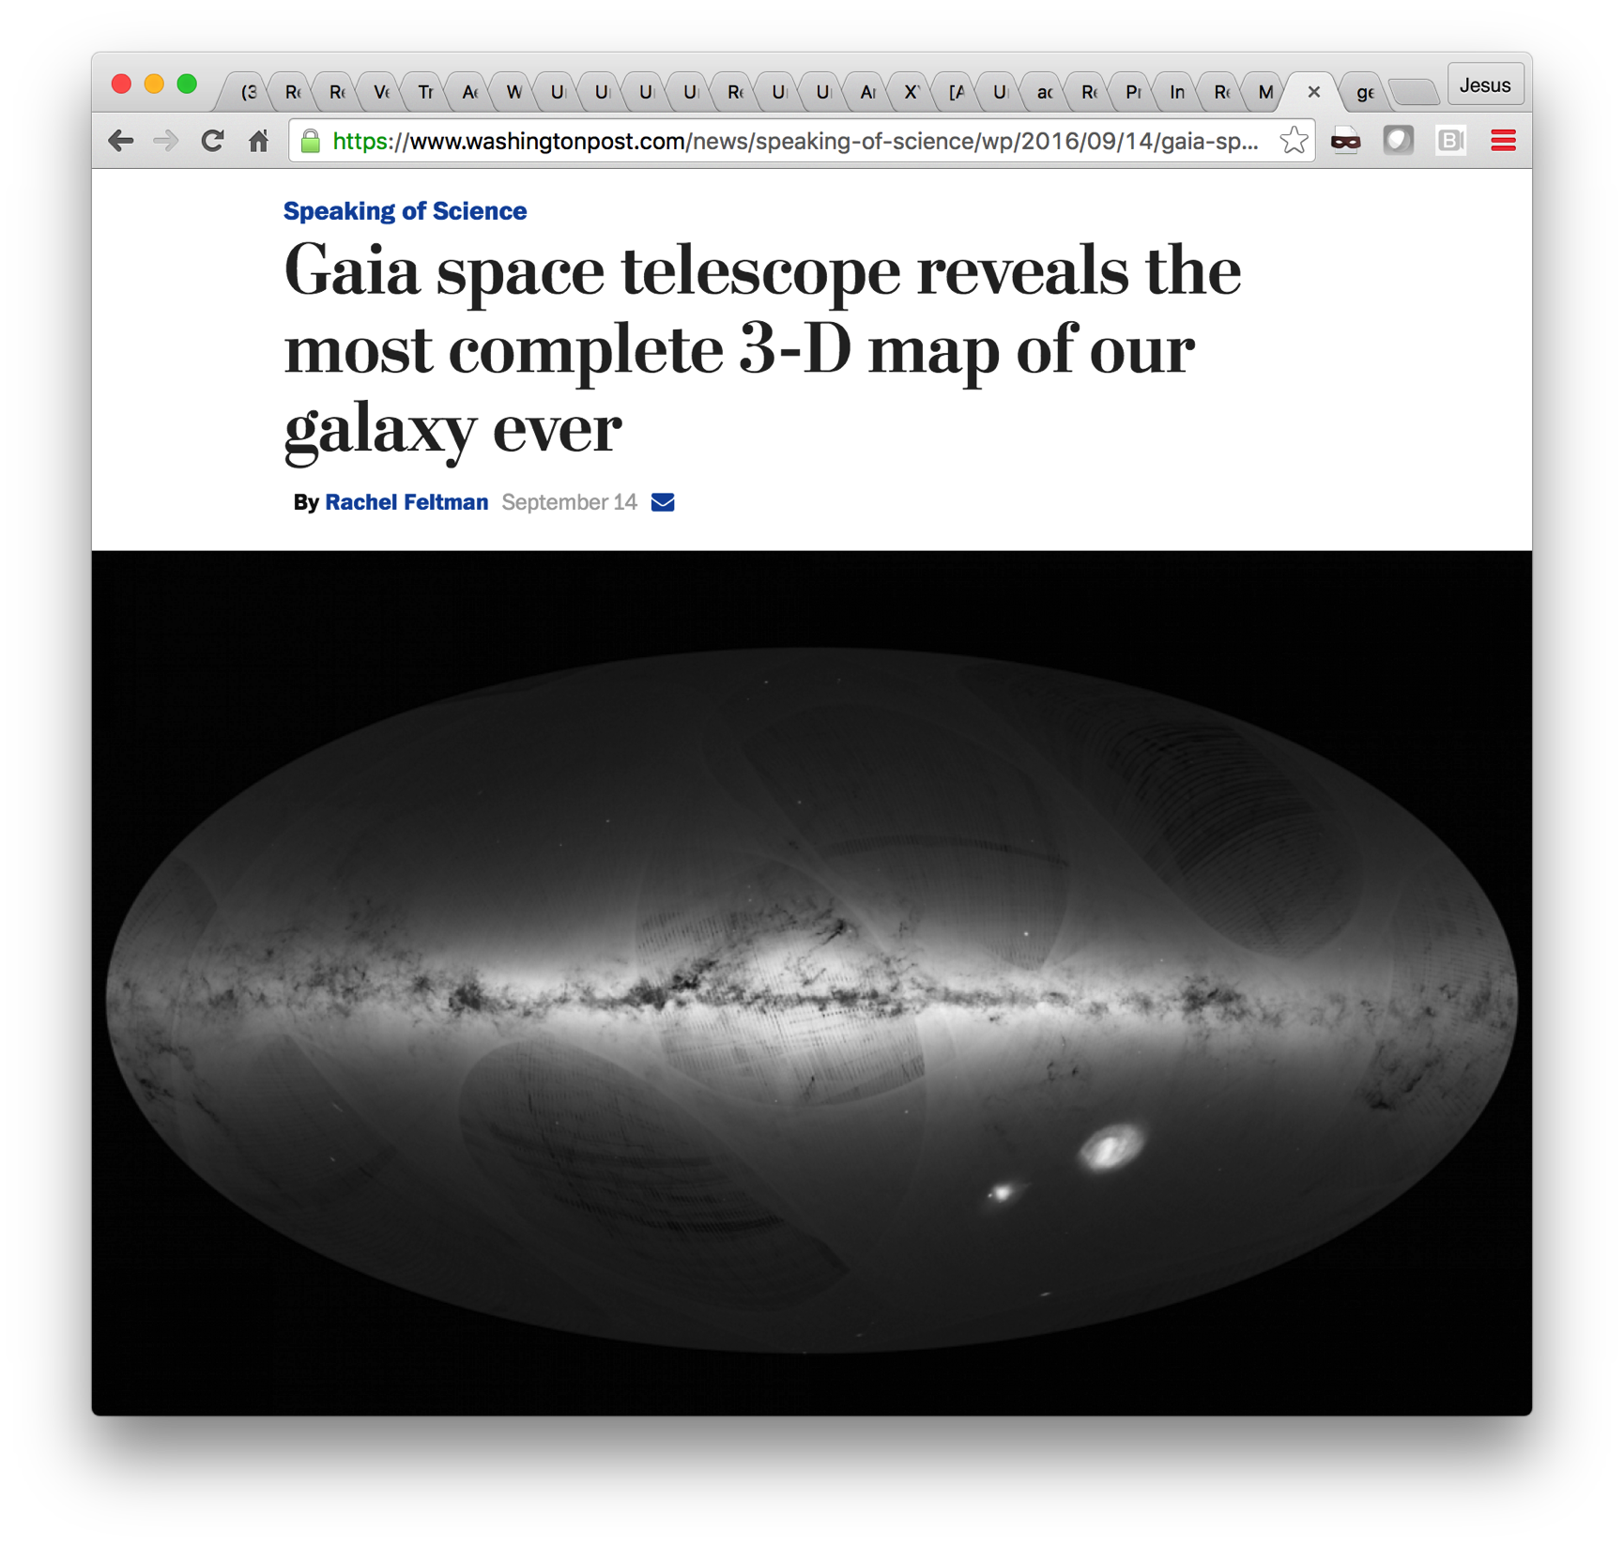
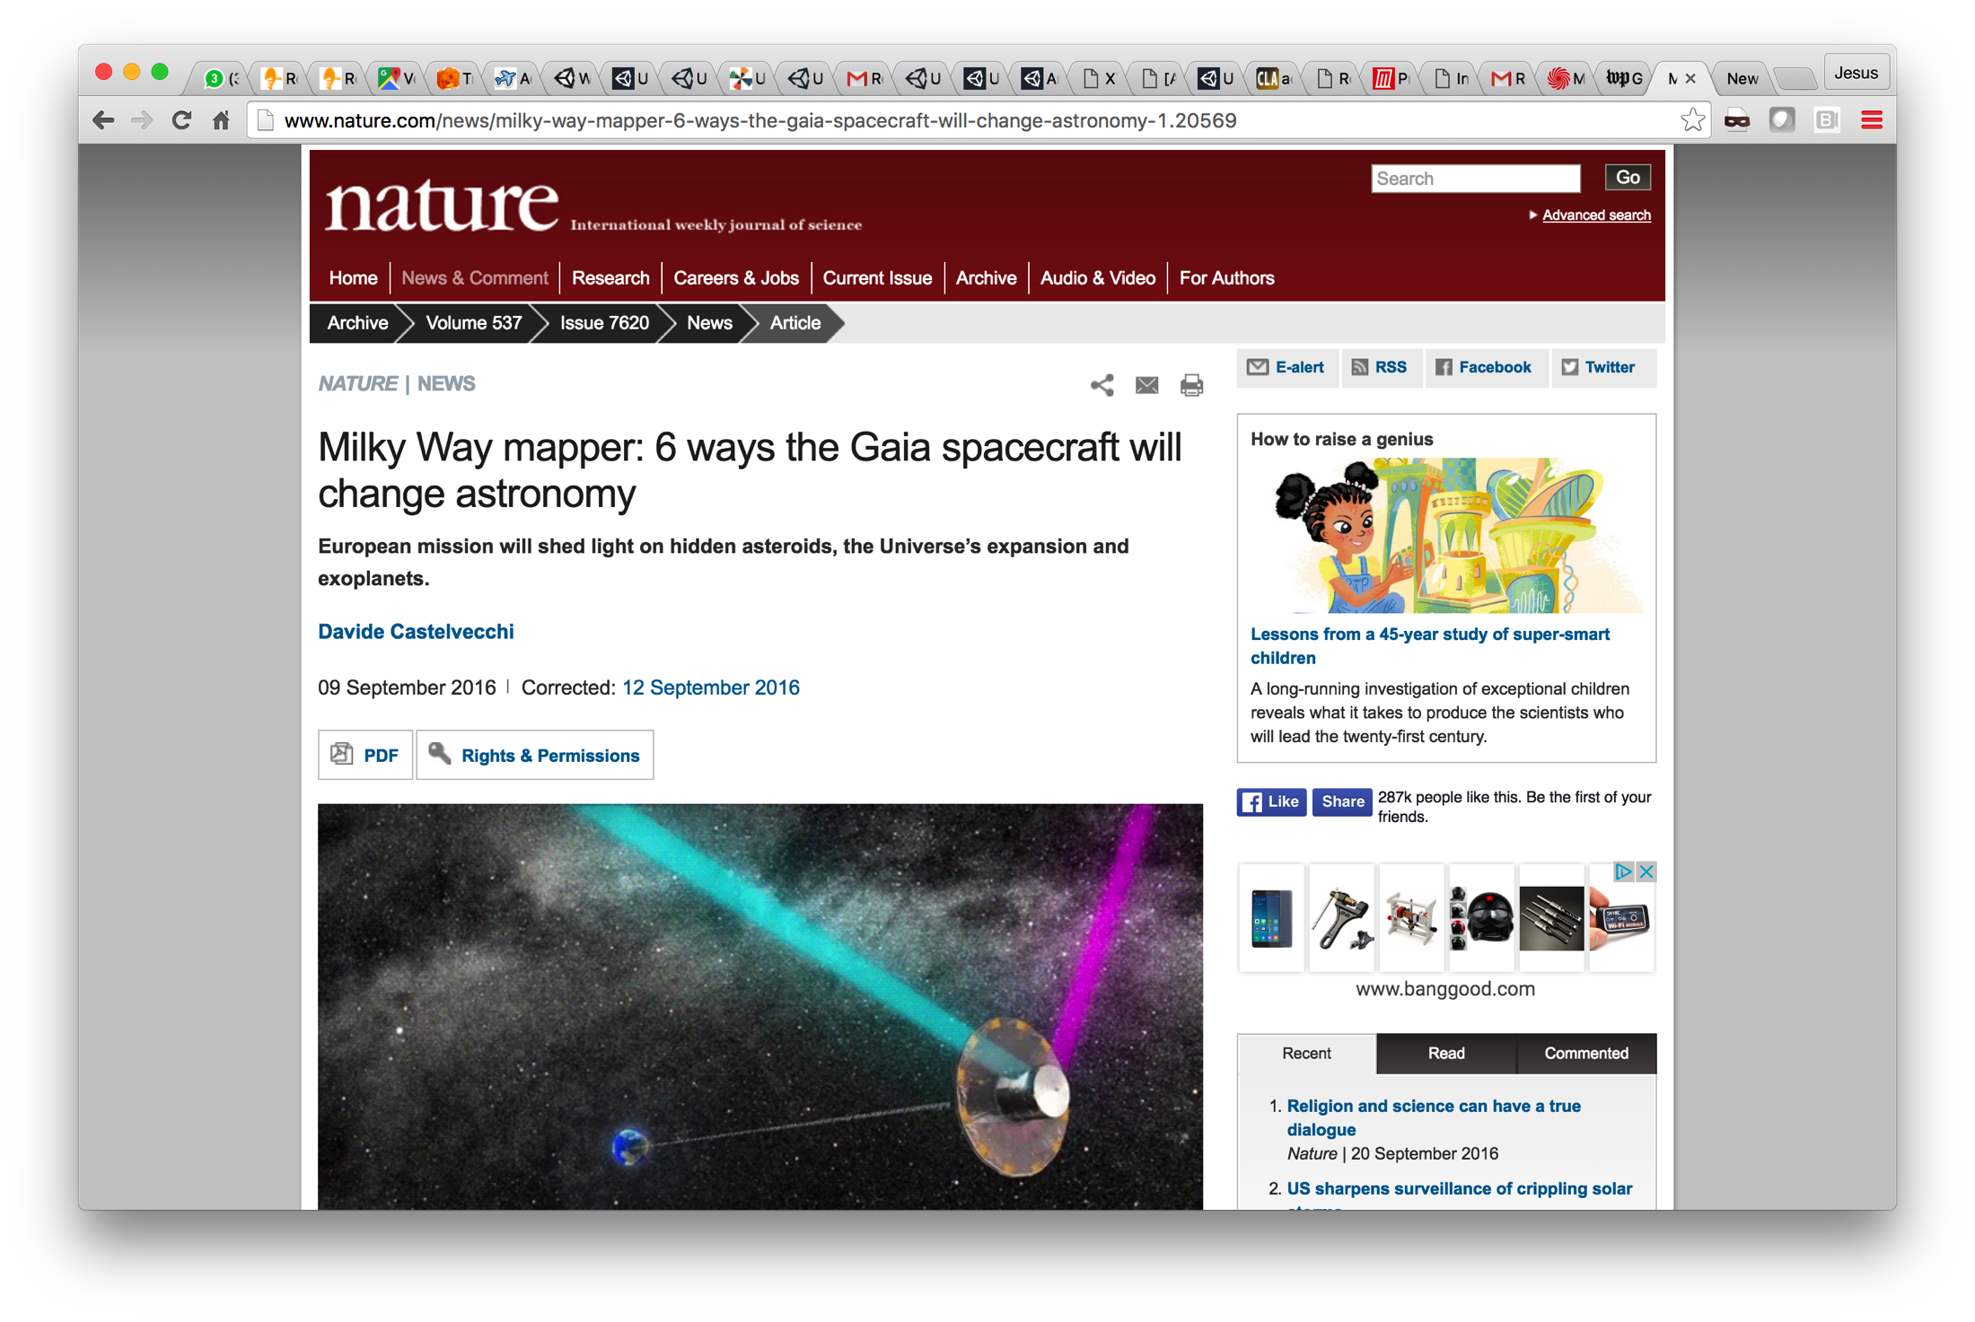
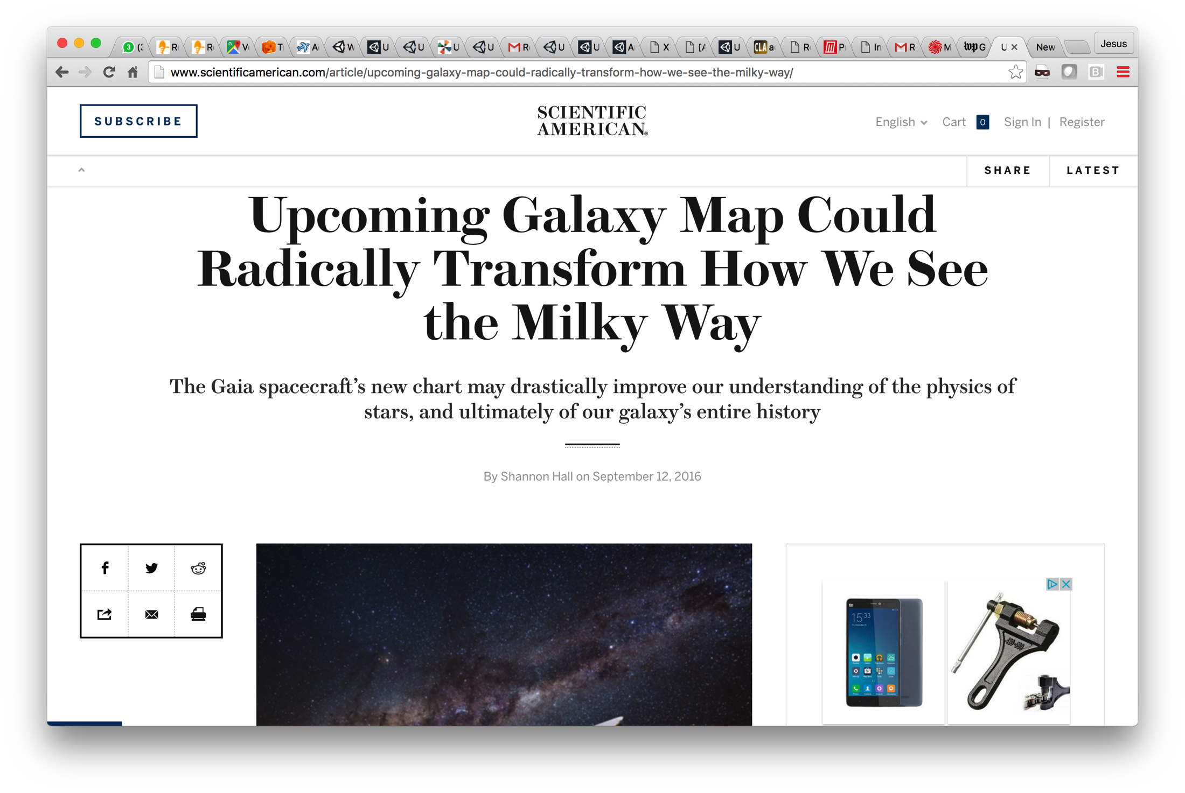
Archive on internet
Gea in internet
Notes:
Archives at ESAC: LPF, planck, herschel, iso, euclid, gaia, hst. Xmm, exosat.
(All archives at ESAC except cheops hipparcos, iue, integral, cos-b (and JWST at minute)

Slide 15
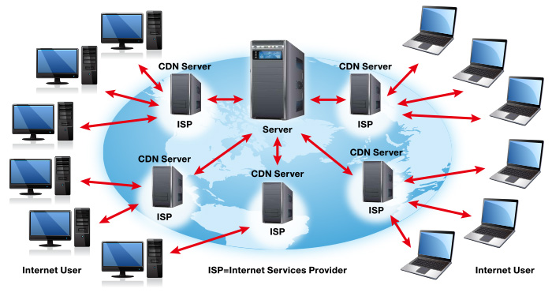
CDN (Content Delivery Network)

Slide 16
Some statistics after 1 week (20 Sept)
TAP Interface
Number of queries
Data retrieved
Synchronous: 429 MB
Asynchronous: 12.4 GB
Active Users: 1153 (by IP)
File download
Total volume downloaded: 73 TB
# download requests: 9 millions
Asynchronous: 95.090
Synchronous: 174.807
See
Juan González
presentation
(for details)

Slide 17
Demo

Slide 18
Conclusions
TAP protocol is a very good candidate to expose a huge catalogue like Gaia
Some changes are needed into the protocol to create an operational archive
Security, login, user schema, etc are requirements from the project
Preservation of data is a nice to have
Cloud computing and TAP synergy is the natural evolution

