Slide 1


Armenian Virtual Observatory (ArVO)
ArVO is a project of the Byurakan Astrophysical Observatory (BAO) aimed at construction of a modern system for data archiving, extraction, acquisition, reduction, use and publication. ArVO is based on the Digitized First Byurakan Survey (DFBS) and is the Armenian contribution to the International Virtual Observatories Alliance (IVOA). One of the ArVO's main tasks is to create and utilize a global Spectroscopic Virtual Observatory, which will combine data from DFBS and other low-dispersion spectroscopic databases, as well as provide the first understanding on the nature of any object up to B=18^{m}.
In frame of the ArVO, BAO collaborates with the Institute of Information Technologies (IIT) of the Armenian National Academy of Sciences to develop software for ArVO corresponding to the IVOA standards. Beside the DFBS, ArVO is being complemented by the Digitized Second Byurakan Survey (SBS) database, the Byurakan photographic archive, and the BAO 2.6m telescope observations, and will be a part of IVOA.
International Virtual Observatory Alliance
Credit: X-ray: NASA/CXC/CfA/R. Tullmann et al.; Optical: NASA/AURA/STScI

Slide 2
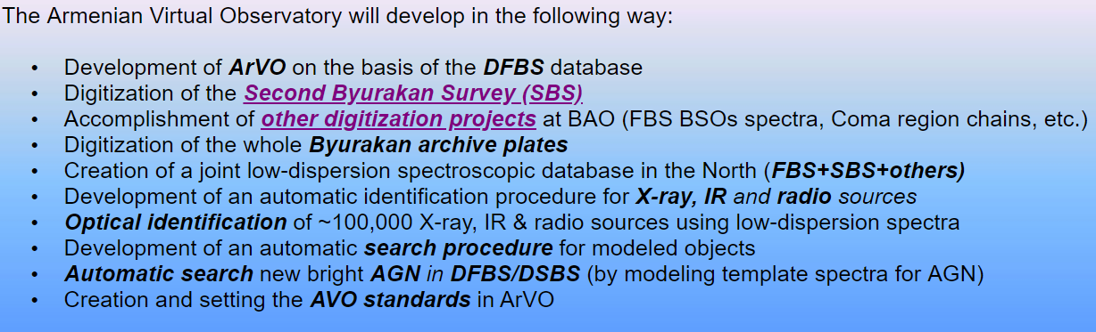
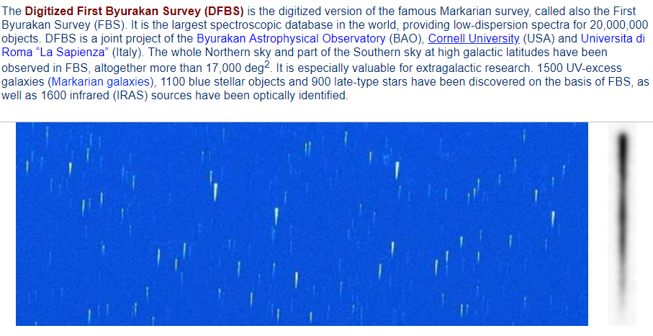
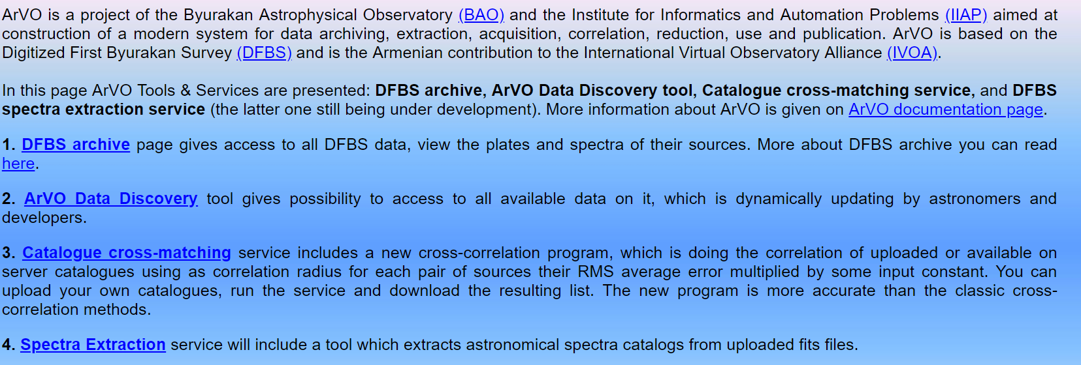
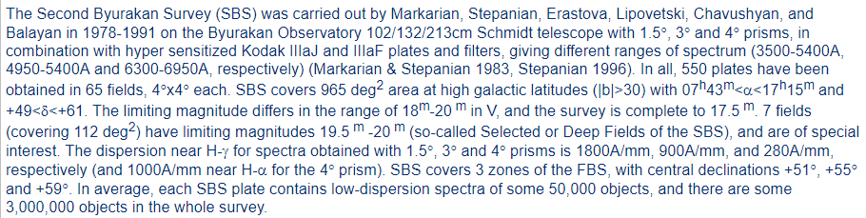
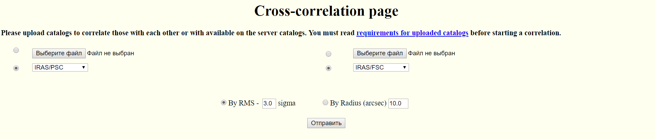
International Virtual Observatory Alliance
Credit: X-ray: NASA/CXC/CfA/R. Tullmann et al.; Optical: NASA/AURA/STScI

